Slide 1
Compile-time reflection, Serialization and ORM
Yu Qi
qicosmos@163.com

Slide 2
Outline
concepts of reflection
implementation of compile-time reflection
application of compile-time reflection
prospect

Slide 3
concepts of reflection
the essence of reflection
benefits of reflection
what can it be used for?

Slide 4
the essence of reflection
reflection
a mechanism that gets internal information of a class by meta data.
get the type of an object, get the fields and methods by meta dada.
metadata
data that provides information about other data.
meatadata describes other data.
self description

Slide 5
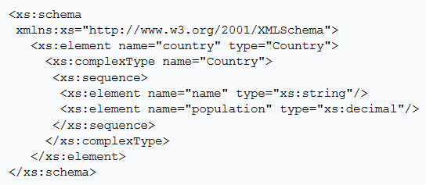
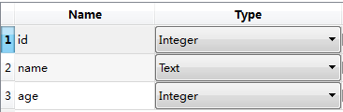
the essence of reflection
classic metadata
name, type, sequence
Notes:
https://zh.wikipedia.org/wiki/XML_Schema

Slide 6
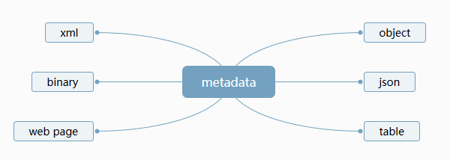
the essence of reflection
reflection
reflection
automatically mapping metadata to any other data format
metadata is the key point

Slide 7
benefits of reflection
simplification
cut the complexity
flexibility
change the behavior without any modification of an exist object
decoupling
decouple visit from the metadata of an object

Slide 8
benefits of reflection
if no reflection
void Serialize(Archive &ar)
{
ar.Serialize("vec", vec);
ar.Serialize("ls", ls);
ar.Serialize("st", st);
ar.Serialize("deq", deq);
ar.Serialize("mp", mp);
ar.Serialize("set", set);
ar.Serialize("un_mp", un_mp);
ar.Serialize("un_set", un_set);
}
duplicate
overelaborate
error prone
should be automatic!

Slide 9
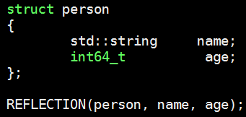


benefits of reflection

Slide 10
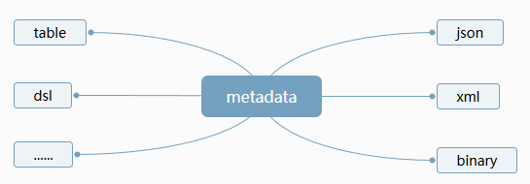
what can it be used for?
reflection
automatically mapping metadata to any other format

Slide 11
what can it be used for?
Serialization
ORM(Object Relational Mapping)

Slide 12
Outline
concepts of reflection
implementation of compile-time reflection
application of compile-time reflection
prospect

Slide 13
implementation of compile time reflection
technology foundation
technical thought
concrete implementation
limitations
proposals of reflection

Slide 14
technology foundation
C++11/14/17 features
variadic templates
std::tuple
auto lambda
std::apply
constexpr if
std::string_view
……
macros

Slide 15
technology foundation(macros)
count variadic arguments number
#define GET_ARG_COUNT(...) GET_ARG_COUNT_INNER(__VA_ARGS__, RSEQ_N())
#define GET_ARG_COUNT_INNER(...) ARG_N(__VA_ARGS__)
#define ARG_N(_1, _2, _3, _4, N, ...) N
#define RSEQ_N() 4, 3, 2, 1, 0
static_assert(GET_ARG_COUNT(a) == 1);
static_assert(GET_ARG_COUNT(a, b) == 2);
static_assert(GET_ARG_COUNT(a, b, c) == 3);
GET_ARG_COUNT(a)
➔ARG_N(a, 4, 3, 2, 1, 0)
ARG_N(a, b, 4, 3, 2, 1, 0)
ARG_N(_1,_2,_3,_4, N, ...)
N ➔1
ARG_N(_1,_2,_3,_4, N, ...)
N ➔2

Slide 16
technology foundation(macros)
#define RSEQ_N() 4,3,2,1,0
#define ARG_N(_1, _2, _3, _4, N, ...) N
#define GET_ARG_COUNT_INNER(...) MARCO_EXPAND(ARG_N(__VA_ARGS__))
#define GET_ARG_COUNT(...) GET_ARG_COUNT_INNER(__VA_ARGS__, RSEQ_N())
#define MARCO_EXPAND(x) x
MARCO_EXPAND for visual studio

Slide 17
technology foundation(macros)
connect string in ,
#define CON_STR_1(element, ...) #element
#define CON_STR_2(element, ...) #element SEPERATOR MARCO_EXPAND(CON_STR_1(__VA_ARGS__))
#define CON_STR_3(element, ...) #element SEPERATOR MARCO_EXPAND(CON_STR_2(__VA_ARGS__))
#define CON_STR_4(element, ...) #element SEPERATOR MARCO_EXPAND(CON_STR_3(__VA_ARGS__))
#define SEPERATOR ,
std::array<const char*, 1> arr1 = { CON_STR_1(a) };
std::array<const char*, 2> arr2 = { CON_STR_2(a, b) };
std::array<const char*, 3> arr3 = { CON_STR_2(a, b, c) };

Slide 18
technology foundation(macros)
make an array
#define MAKE_ARRAY(NAME, ...) \
MAKE_ARRAY_IMPL(NAME, GET_ARG_COUNT(__VA_ARGS__), __VA_ARGS__)
#define MAKE_ARRAY_IMPL(NAME, N, ...) \
constexpr std::array<const char*, N> arr_##NAME = { MACRO_CONCAT(CON_STR, N)(__VA_ARGS__) };
#define MACRO_CONCAT(A, B) A##_##B
MAKE_ARRAY(t, a, b)
➔MAKE_ARRAY_IMPL(t, 2, a, b)
➔{ CON_STR2(a, b)}
➔std::array<const char*, 2> arr_t = { "a", "b" }

Slide 19
technical thought
exist libraries about reflection
magic_get
boost.fusion
boost.hana

Slide 20
technical thought
magic_get
struct foo {
int some_integer;
char c;
};
auto& r1 = boost::pfr::get<0>(f); //accessing field with index 0
auto& r2 = boost::pfr::get<1>(f);
T must be POD
the array will be flatted
Notes:
big limitations

Slide 21
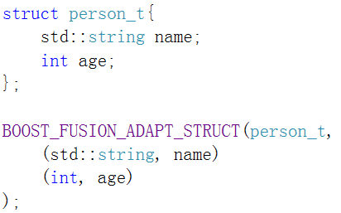
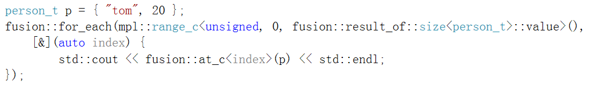
technical thought
boost.fusion
you can't do that

Slide 22
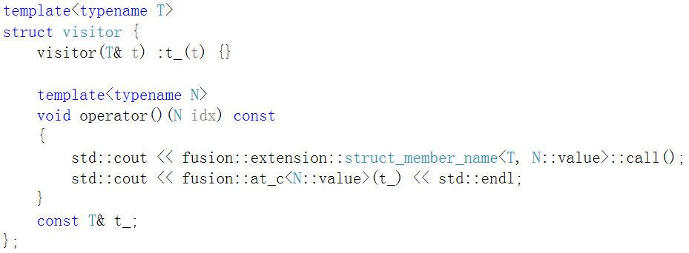

Slide 23
boost.fusion
get value by index
get name by index
for_each fields
basic reflection function

Slide 24
technical thought
boost.hana
struct person {
std::string name;
int age;
};
BOOST_HANA_ADAPT_STRUCT(not_my_namespace::person, name, age);
person john{ "John", 30 };
hana::for_each(john, [](auto pair) {
std::cout << hana::to<char const*>(hana::first(pair)) << ": "<< hana::second(pair) << std::endl;
});

Slide 25
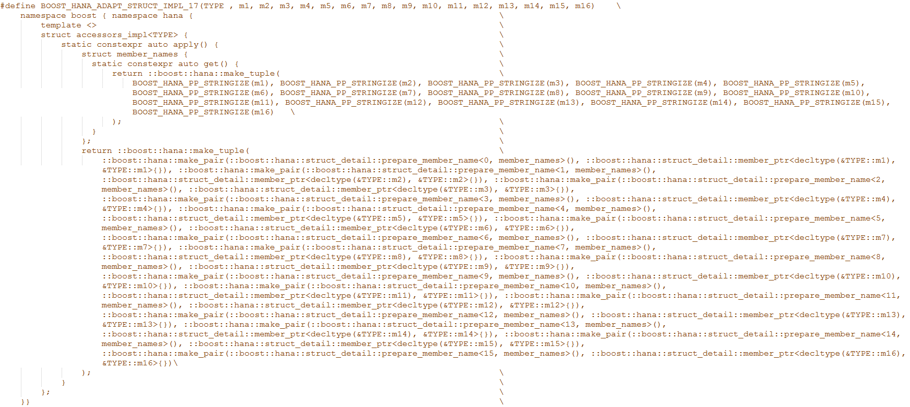

Slide 26
technical thought
metadata defination
operation of metadata
get each field
for_each every field
no limitation about the reflection object

Slide 27
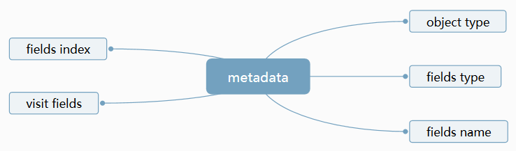
technical thought

Slide 28
technical thought
a simple implementation
template<typename> struct Members {};
//the field information：field type, field value, field index
template<typename T, T mPtr, unsigned Index>
struct MemberBinding
{
constexpr static T value = mPtr;
constexpr static unsigned index = Index;
};
//pack all fields(MemberBinding)
template<typename...> struct Pack {};

Slide 29
struct Aggregate {
int member1;
std::string member2;
};
template<> struct Members<Aggregate> {
using type = Pack<
MemberBinding<decltype(&Aggregate::member1), &Aggregate::member1, 0 >,
MemberBinding<decltype(&Aggregate::member2), &Aggregate::member2, 1 >
>;
constexpr static const char *name = "Aggregate";
static const char *const *names() {
static const char *rv[] = { "member1", "member2" };
return rv;
}
};
object type
fields type
fields value
fields index
fields name

Slide 30
template<typename A, typename MT, MT MPTR, unsigned Ndx, typename... Rest>
void printPack(std::ostream &out, const A &v,
Pack<MemberBinding<MT, MPTR, Ndx>, Rest...> *)
{
using M = Members<A>;
out << ' ' << Ndx << ':' << M::names()[Ndx] << ':' << v.*MPTR;
printPack(out, v, (Pack<Rest...> *)nullptr);
}
all fields information
template<typename A>
void printPack(std::ostream &out, const A &v, Pack<> *) {}
using M = Members<T>;
printPack(ostr, v, (typename M::type *)nullptr);
cppcon2016: Achieving financial data processing performance through compile time introspection

Slide 31
technical thought
the specialized template class saves the object type
save the field information
template<typename T, T mPtr, unsigned Index>
struct MemberBinding;
variadic template class Pack<…> save all fields information
a string array save all the names of fields
visit all fields by recursively foreach pack<…>

Slide 32
struct Aggregate {
int member1;
std::string member2;
};
template<> struct Members<Aggregate> {
using type = Pack<
MemberBinding<decltype(&Aggregate::member1), &Aggregate::member1, 0 >,
MemberBinding<decltype(&Aggregate::member2), &Aggregate::member2, 1 >
>;
constexpr static const char *name = "Aggregate";
static const char *const *names() {
static const char *rv[] = { "member1", "member2" };
return rv;
}
};
define metadata is quite overelaborate
need handwritten, can’t automatic
reduplicate for the other reflection objects
define metadata
Members<Aggregate>, Members<Person>, Members<Other>,……
how to automaticly generate the metadata of an arbitray object?
Notes:
define a specialized template class means define an object’s metadata

Slide 33
how to automatically generate the metadata of an arbitray object?
automatically pack all fields by macros and new features
automatically create a field name array by macros and new features
provide a generic for_each algorithm

Slide 34
#define MAKE_META_DATA(STRUCT_NAME, N, ...) \
constexpr inline std::array<std::string_view, N> arr_##STRUCT_NAME = { MARCO_EXPAND(MACRO_CONCAT(CON_STR, N)(__VA_ARGS__)) };\
MAKE_META_DATA_IMPL(STRUCT_NAME, MAKE_ARG_LIST(N, &STRUCT_NAME::OBJECT, __VA_ARGS__))
automatically pack all fields
automatically create a std::array<std::string_view, N> of fields names

Slide 35
template<typename> struct Members {};
#define MAKE_META_DATA_IMPL(STRUCT_NAME, ...)\
template<>struct Members<STRUCT_NAME>{\
constexpr decltype(auto) static apply_impl(){\
return std::make_tuple(__VA_ARGS__);\
}\
using size_type = std::integral_constant<size_t, GET_ARG_COUNT(__VA_ARGS__)>;\
constexpr static size_t value() { return size_type::value; }\
constexpr static std::string_view name() {\
return std::string_view(#STRUCT_NAME, sizeof(#STRUCT_NAME));\
}\
constexpr static std::array<std::string_view, size_type::value> arr() {\
return arr_##STRUCT_NAME;\
}\
};
using type = void; \
#define MAKE_META_DATA(STRUCT_NAME, N, ...) \
constexpr inline std::array<std::string_view, N> arr_##STRUCT_NAME = { MARCO_EXPAND(MACRO_CONCAT(CON_STR, N)(__VA_ARGS__)) };\
MAKE_META_DATA_IMPL(STRUCT_NAME, MAKE_ARG_LIST(N, &STRUCT_NAME::FIELD, __VA_ARGS__))

Slide 36
#define MAKE_ARRAY(NAME, ...) \
MAKE_ARRAY_IMPL(NAME, GET_ARG_COUNT(__VA_ARGS__), __VA_ARGS__)
#define MAKE_ARRAY_IMPL(NAME, N, ...) \
constexpr std::array<const char*, N> arr_##NAME = { MACRO_CONCAT(CON_STR, N)(__VA_ARGS__) };
#define MACRO_CONCAT(A, B) A##_##B
MAKE_ARRAY(t, a, b)
➔MAKE_ARRAY_IMPL(t, 2, a, b)
➔{ CON_STR2(a, b)}
➔std::array<const char*, 2> arr_t = { "a", "b" }

Slide 37
#define MAKE_META_DATA(STRUCT_NAME, N, ...) \
MAKE_META_DATA_IMPL(STRUCT_NAME, MAKE_ARG_LIST(N, &STRUCT_NAME::OBJECT, __VA_ARGS__))
(
)
&SomeObject::field1, &SomeObject::field2, &SomeObject::field3,....., &SomeObject::fieldN
#define MAKE_META_DATA_IMPL(STRUCT_NAME, ...)\
template<>struct Members<STRUCT_NAME>{\
constexpr decltype(auto) static apply_impl(){\
return std::make_tuple(__VA_ARGS__);\
}\
#define REFLECTION(STRUCT_NAME, ...) \
MAKE_META_DATA(STRUCT_NAME, GET_ARG_COUNT(__VA_ARGS__), __VA_ARGS__)
automatically pack all member variables

Slide 38
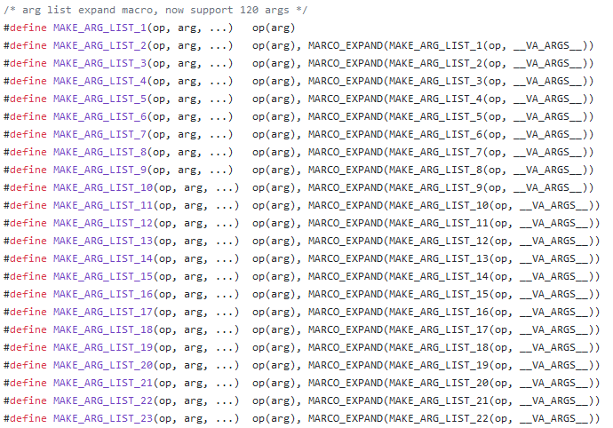

Slide 39
template<typename...> struct Pack {};
template<typename> struct Members {};
template<> struct Members<Person> {
using type = Pack<
MemberBinding<decltype(&Person::name), &Person::name, 0 >,
MemberBinding<decltype(&Person::age), &Person::age, 1 >
>;
static const size_t value() { return 2; }
static const char *name = "Person";
static const char *const *names() {
static const char *rv[] = { "name", "age" };
return rv;
}
};
automatically define metadata
Notes:
compare

Slide 40
template <class T>
constexpr auto tie_as_tuple(T&& val, size_t_<1>) noexcept {
auto&[a] = std::forward<T>(val);
return make_tuple_of_references(a);
}
template <class T>
constexpr auto tie_as_tuple(T&& val, size_t_<2>) noexcept {
auto&[a, b] = std::forward<T>(val);
return make_tuple_of_references(a, b);
}
template <class T>
constexpr auto tie_as_tuple(T&& val, size_t_<12>) noexcept {
auto&[a, b, c, d, e, f, g, h, j, k, l, m] = std::forward<T>(val);
return ::boost::pfr::detail::make_tuple_of_references(a, b, c, d, e, f, g, h, j, k, l, m);
}

Slide 41
operation of metadata
template<typename T>
std::enable_if_t<is_reflection<T>::value, size_t> get_value()
{
using M = Members<std::remove_const_t <std::remove_reference_t<T>>>;
return M::value();
}
template <typename T, typename = void>
struct is_reflection : std::false_type{};
template <typename T>
struct is_reflection<T, void_t<
typename Members<std::remove_const_t <std::remove_reference_t<T>>>::type
>> : std::true_type{
};

Slide 42
template<typename T, size_t I>
constexpr const std::string_view get_name()
{
using M = Members<std::remove_const_t <std::remove_reference_t<T>>>;
static_assert(I<M::value(), "out of range");
return M::arr()[I];
}

Slide 43
//get the field by index
template<size_t I, typename T>
constexpr decltype(auto) get(T&& t)
{
using M = Members<std::remove_const_t <std::remove_reference_t<T>>>;
static_assert(I<M::value(), "out of range");
return std::forward<T>(t).*(std::get<I>(M::apply_impl()));
}

Slide 44
for_each metadata
template<typename T, typename F>
constexpr std::enable_if_t<is_reflection<T>::value> for_each(T&& t, F&& f)
{
using M = Members<std::remove_const_t <std::remove_reference_t<T>>>;
for_each(M::apply_impl(), std::forward<F>(f), std::make_index_sequence<M::value()>{});
}
template <typename... Args, typename F, std::size_t... Idx>
constexpr void for_each(const std::tuple<Args...>& t, F&& f, std::index_sequence<Idx...>)
{
(std::forward<F>(f)(std::get<Idx>(t), std::integral_constant<size_t, Idx>{}), ...);
}
Notes:
c++17 fold expression

Slide 45
template <typename... Args, typename Func, std::size_t... Idx>
void for_each(const std::tuple<Args...>& t, Func&& f, std::index_sequence<Idx...>) {
(void)std::initializer_list<int> { (f(std::get<Idx>(t)), void(), 0)...};
}
template <typename... Args, typename Func, std::size_t... Idx>
void for_each(const std::tuple<Args...>& t, Func&& f, std::index_sequence<Idx...>) {
(f(std::get<Idx>(t)), ...);
}
fold expression

Slide 46
struct Person {
std::string name;
int age;
};
REFLECTION(Person, name, age)
std::cout << get_name<Person, 0>() << std::endl;
std::cout << get_name<Person, 1>() << std::endl;
std::cout << get<0>(p) << std::endl;
std::cout << get<1>(p) << std::endl;
Person p = { "admin", 20 };
for_each(p, [](const auto& item, auto idx) {
std::cout << item << " " << index << " " << decltype(i)::value << std::endl;
});

Slide 47
limitations
can’t reflect member functions
can’t reflect private members

Slide 48
proposals
Reflection
R194r3 by Matúš Chochlík and Axel Naumann
P0670r0 by Chochlík, Naumann and David Sankel
template <Record T> struct get_public_data_members;
template <Record T> struct get_accessible_data_members;
template <Record T> struct get_data_members;
template <Record T> struct get_public_member_functions; template <Record T> struct get_accessible_member_functions; template <Record T> struct get_member_functions;
Notes:
before this we need a practical reflection library

Slide 49
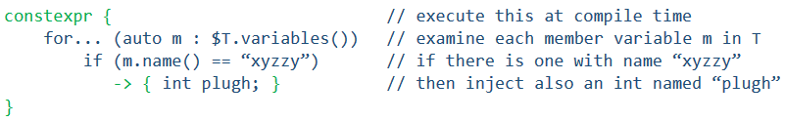
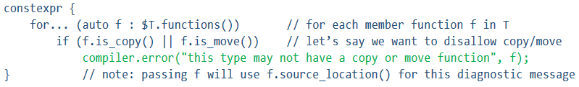
proposals
Metaclass
P0707r1 by Herb Sutter
Based on static reflection, next-level layer of abstraction

Slide 50
Outline
concepts of reflection
implementation of compile-time reflection
application of compile-time reflection
prospect

Slide 51
application of compile-time reflection
Serialization
ORM(Object Relational Mapping)

Slide 52
Serialization engine
reflection

Slide 53
person p = { "admin", 20 };
iguana::string_stream ss;
iguana::json::to_json(ss, p);
iguana::xml::to_xml(ss, p);
person p2;
iguana::json::from_json(ss.str(), p2);
iguana::json::from_xml(ss.str(), p2);

Slide 54
constexpr auto to_json(Stream& s, T &&t) -> std::enable_if_t<is_reflection<T>::value> {
s.put('{');
for_each(std::forward<T>(t), [&t, &s](const auto &v, auto i) {
using M = decltype(iguana_reflect_members(std::forward<T>(t)));
constexpr auto Idx = decltype(i)::value;
constexpr auto Count = M::value();
write_json_key(s, i, t);
s.put(':');
if constexpr (!is_reflection<decltype(v)>::value) {
render_json_value(s, t.*v);
}
else {
to_json(s, t.*v);
}
if (Idx < Count - 1)
s.put(',');
});
s.put('}');
};
for the nested struct

Slide 55
constexpr auto write_json_key = [](auto& s, auto i, auto& t) {
s.put('"');
auto name = get_name<decltype(t), decltype(i)::value>();
s.write(name.data(), name.length() - 1);
s.put('"');
};

Slide 56
template<typename T, typename = std::enable_if_t<is_reflection<T>::value>>
constexpr void do_read(xml_reader_t &rd, T &&t){
for_each(std::forward<T>(t), [&t, &rd](const auto v, auto i){
if constexpr (!is_reflection<decltype(t.*v)>::value){
if (rd.begin_object(get_name<T, Idx>().data()) == object_status::NORMAL){
rd.get_value(t.*v);
rd.end_object(get_name<T, Idx>().data());
}
}
else{
if (rd.begin_object(get_name<T, Idx>().data()) == object_status::NORMAL){
do_read(rd, t.*v);
rd.end_object(get_name<T, Idx>().data());
}
}
});
}
Notes:
metadata can be expanded to serialize any format data by reflection methods

Slide 57
template<typename T>
std::enable_if_t<std::is_integral<T>::value, std::string> to_str(T t)
{
return std::to_string(t);
}
template<typename T>
std::enable_if_t<!std::is_integral<T>::value, std::string> to_str(T t)
{
return t;
}
template<typename T>
auto to_str17(T t)
{
if constexpr(std::is_integral<T>::value)
return std::to_string(t);
else
return t;
}

Slide 58
ORM(Object Relational Mapping)
struct user{
int id;
std::string name;
std::string pwd;
std::string qq;
int sex;
int role;
};
REFLECTION(user, id, name, pwd, qq, sex, role);
const char* get_all1 = "select * from user;";
std::vector<user> users = db.query<user>(get_all);
const char* get_all2 = "select user.*, article.title, contact.author_id from user,article,contact;";
std::vector<std::tuple<user, std::string, int>> parts = db.query<user, std::string, int>(get_all1);

Slide 59
std::vector<T> v;
while (true){
result = sqlite3_step(stmt_);
T t;
for_each(t, [this](auto& item, auto I){
constexpr auto index = decltype(I)::value;
if (SQLITE_NULL == sqlite3_column_type(stmt_, index)){
return;
}
sqlite::assign(stmt_, item);
});
v.push_back(std::move(t));
}

Slide 60
template<typename T>
std::string make_insert_sql(){
std::string str_atr = "insert into ";
std::string str = "values(";
using M = Members<std::remove_const_t <std::remove_reference_t<T>>>;
str_atr += M::name();
str_atr += +"(";
const int size = M::value();
for (size_t i = 0; i < size; i++){
str_atr += get_name<T>(i);
str += "?";
...
}
return str_atr + str;
}
db.make_insert_sql<user>();
//insert into user(id, name,pwd,qq,sex,role) values(?,?,?,?,?,?);

Slide 61
Outline
concepts of reflection
implementation of compile-time reflection
application of compile-time reflection
prospect

Slide 62
prospect
DSL(domain-specific language)
data binding
protocols adaptor

Slide 63
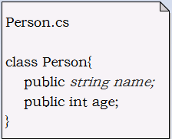
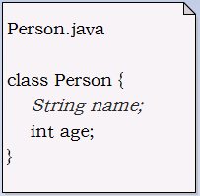
DSL
struct Person {
std::string name;
int age;
};
REFLECTION(Person, name, age)

Slide 64
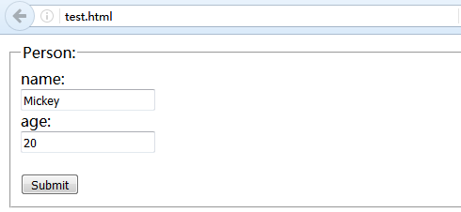
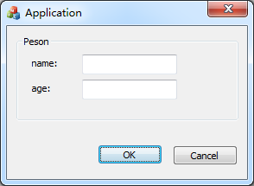
data binding
struct Person {
std::string name;
int age;
};
REFLECTION(Person, name, age)

Slide 65

protocols adaptor
xml
metadata
msgpack
json
binary

