Slide 1
从现代C++元编程到ORM
祁 宇
qicosmos@163.com
purecpp.org

Slide 2
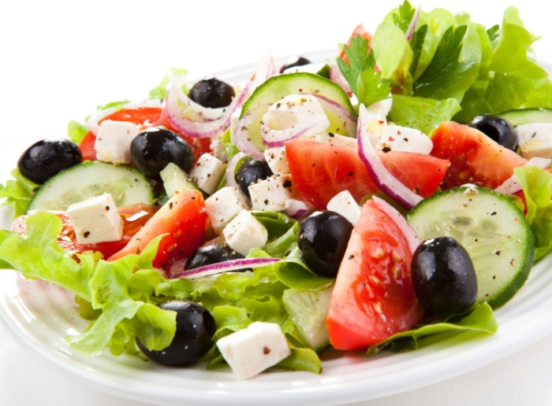

Slide 3
新特性（C++11/14/17）
元编程
元编程的一些用途
元编程实现ORM

Slide 4

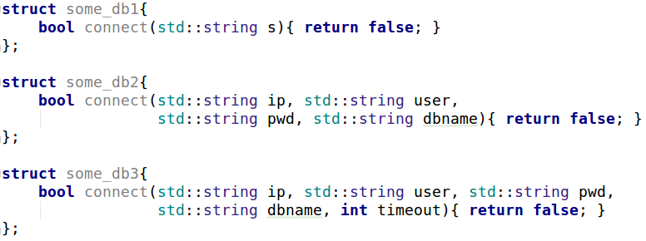
Variadic Template
适配不同的接口

Slide 5
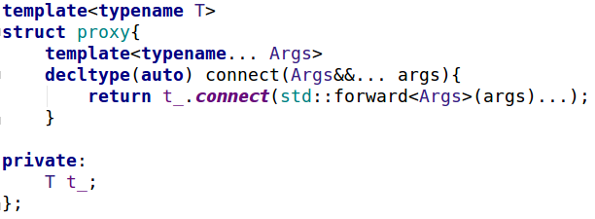
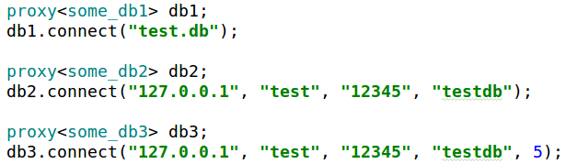
Variadic Template

Slide 6
Structured Binding
std::map<int, int> mp = { {1, 2}, {3, 4} };
for(auto&& [k, v] : mp)
std::cout<<k<<" "<<v<<'\n';
std::tuple<int, double> tp(1, 2.5);
auto [a, b] = tp;

Slide 7
Variadic Template + Structured Binding
分割一个定长的variadic template
template<typename... Args>
auto split_3args(Args&&... args){
auto tp = std::make_tuple(std::forward<Args>(args)...);
return std::make_tuple(std::get<0>(tp), std::get<1>(tp), std::get<2>(tp));
}
auto t = split_3args(1, 2.5, "test", '1');
//tuple(1, 2.5, "test")

Slide 8
Variadic Template + Structured Binding
template<typename... Args>
auto split_3args(Args&&... args){
auto tp = std::make_tuple(std::forward<Args>(args)...);
auto [a, b, c, d] = tp;
return std::make_tuple(a, b, c);
}
auto split_3args(auto a, auto b, auto c, auto d){
return std::make_tuple(a, b, c);
}

Slide 9
Constexpr If
template<typename T> std::enable_if_t<std::is_integral<T>::value, std::string> to_str(T t) { return std::to_string(t); } template<typename T> std::enable_if_t<!std::is_integral<T>::value, std::string> to_str(T t) { return t; }

Slide 10
Constexpr If
消除enable_if
让编译期选择变得简单
更紧密、清晰的上下文
template<typename T> auto to_str17(T t) { if constexpr(std::is_integral<T>::value) return std::to_string(t); else return t; }

Slide 11
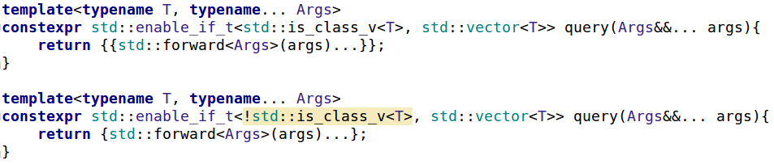
Enable_if
用constexpr if消除enable_if
提供参数相同，返回类型不同的同名接口

Slide 12
Constexpr If + Variadic Template
扩展接口：
接口不变
根据参数类型的不同展现不同的行为
extend(); //no extention
extend(0); //do int branch
extend(2.5); //do double branch

Slide 13
Constexpr If + Variadic Template
template<typename... Args>
auto extend(Args&&... args){
if constexpr(sizeof...(Args)==0){
std::cout<<"no extention"<<std::endl;
}
else if constexpr(sizeof...(Args)==1){
if constexpr(std::is_same_v<int, Args...>){
std::cout<<"do int branch"<<std::endl;
}
else if constexpr(std::is_same_v<double, Args...>){
std::cout<<"do double branch"<<std::endl;
}
}
}

Slide 14
Fold Expression
简化variadic template的使用
template<typename T>
auto add(T t){
return t;
}
template<typename Arg, typename... Args>
auto add(Arg arg, Args... args){
return arg+add(args...);
}
add(1,2,3); //6
template<typename... Args> auto add(Args... args) { return (args + ...); }
template<typename... Args> auto sub (Args... args) { return (args - ... - 1); }

Slide 15
Fold Expression
//c++11
template<typename... Args>
void print(Args... Args){
std::initializer_list<int>{(std::cout << args<<std::endl, 0)...};
}
//c++17 unary fold
template<typename... Args>
void print(Args... args) {
((std::cout<<args<<std::endl), ...);
}
//c++17 binary fold
template<typename ...Args> void print(Args&&... args) {
(std::cout << ... << args) << '\n'; }

Slide 16
连接任意个字符串
template<typename... Args>
inline void append(std::string& s, Args&&... args) {
((s+=std::forward<Args>(args), s += ", "),...);
}
std::string s="";
append(s, "a", "b", "c"); //a, b, c

Slide 17
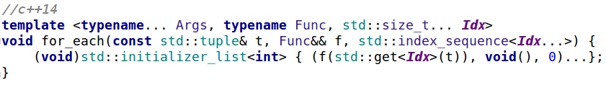
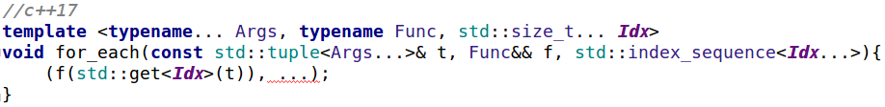
Fold Expression
遍历tuple/variadic template

Slide 18
Static_assert
编译期检查，在编译期就抓住错误
fun_for_1024<0,1,2,4>(); //ok
fun_for_1024<4,2,1,0>(); //ok
fun_for_1024<0,1,1,4>(); //static assertion failed: hi guy, just for 1024
fun_for_1024<1,0,2,5>(); //static assertion failed: hi guy, just for 1024
fun_for_1024<1,0,2>(); //static assertion failed: hi guy, just 4 numbers

Slide 19
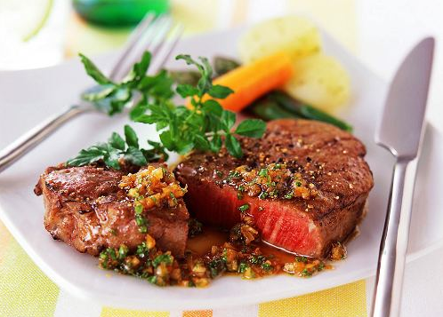

Slide 20

Future C++
Type-and resource-safe
Significantly simpler and clearer code
As fast or faster than anything else
Good at using “modern hardware”
Significantly faster compilation catching many more errors

Slide 21
ORM
统一好用的接口
可扩展的接口
自动生成sql脚本
自动化地实体映射

Slide 22
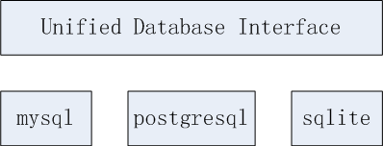
ORM
屏蔽不同数据库的差异

Slide 23



Slide 24


Slide 25
AOP
Logging
Validation
Thread Strategy
Caching
Exception Handling
… and a lot more

Slide 26
Newer is Better!

