Slide 1
从现代C++元编程到ORM
祁 宇
qicosmos@163.com
purecpp.org

Slide 2
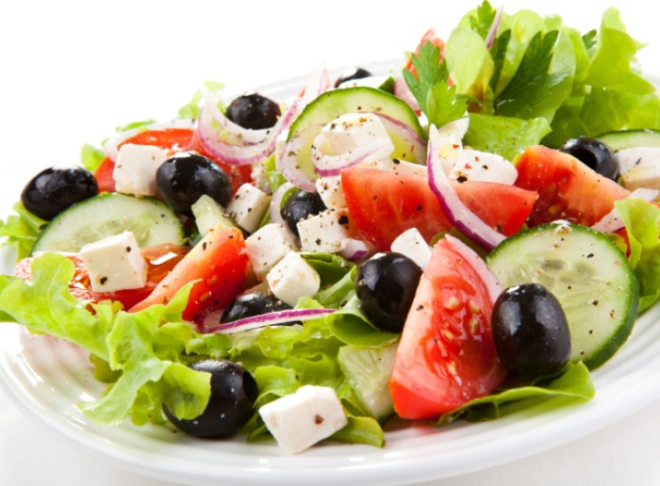

Slide 3
Variadic Template

Slide 4
Constexpr If

Slide 5
Enable_if

Slide 6
Structured Binding

Slide 7
Fold Expression

Slide 8
Static_assert

Slide 9
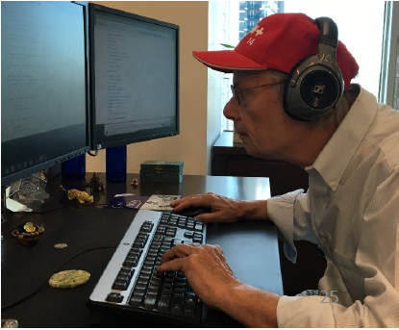
Future C++
Type-and resource-safe
Significantly simpler and clearer code
As fast or faster than anything else
Good at using “modern hardware”
Significantly faster compilation catching many more errors

Slide 10
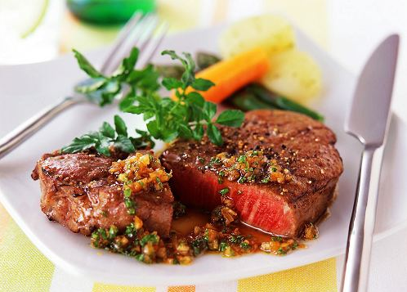

Slide 11
统一语义的接口
可扩展的接口
灵活易用的接口
类型映射
编译期反射
自动生成sql脚本
自动化地实体映射

Slide 12
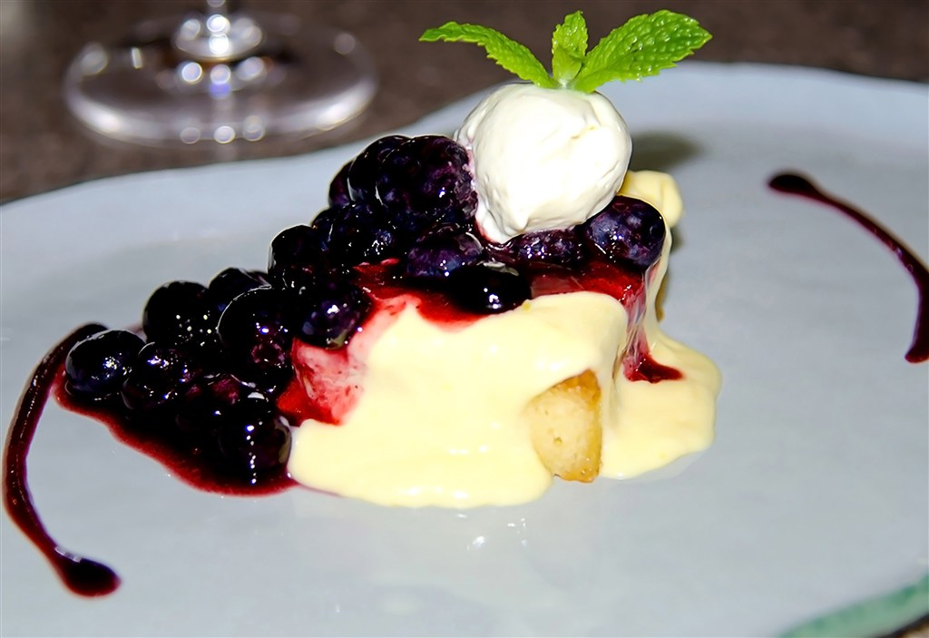

Slide 13
AOP
Logging
Validate
Thread Strategy
Caching
Exception handling
… and lot more

