Slide 1
Feather: A Modern C++ Web Development Framework
Yu Qi
qicosmos@163.com

Slide 2
Outline
Basic Concepts of Web Framework
What is Feather?
Components
How to Rapidly Develop Web Applications?

Slide 3
Basic concepts
Web framework
Handle http request
Access database
ORM(Object-relational
mapping)
Http server
Html template engine
Render html

Slide 4
Basic concepts
http request
ORM
controller
model
http response
view

Slide 5
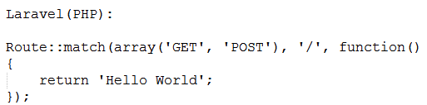
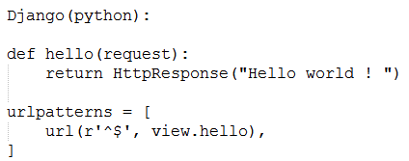
Some web frameworks

Slide 6
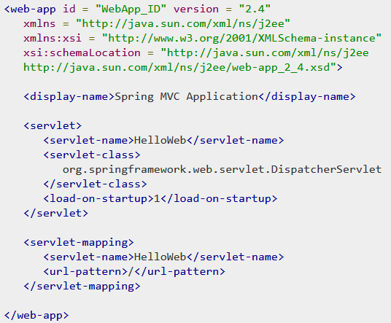
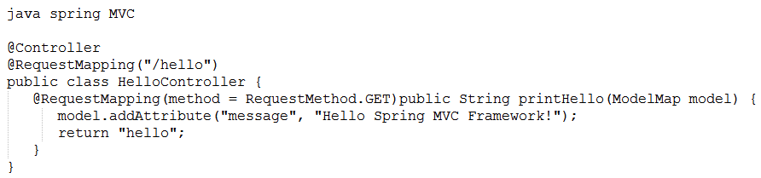
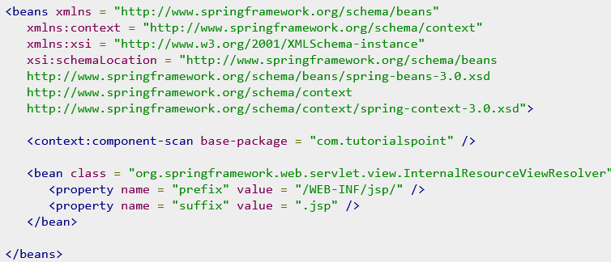
Some web frameworks

Slide 7
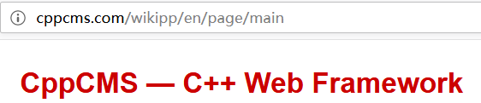
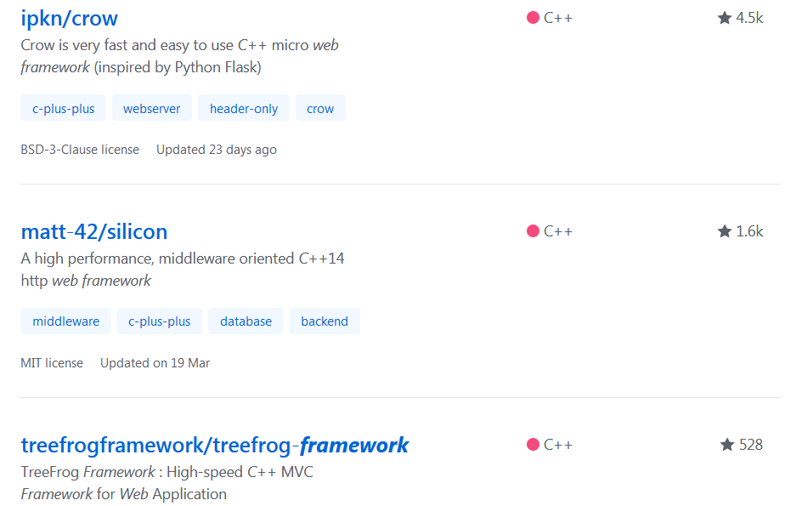
Some popular c++ web frameworks
4 popular c++ web
frameworks

Slide 8
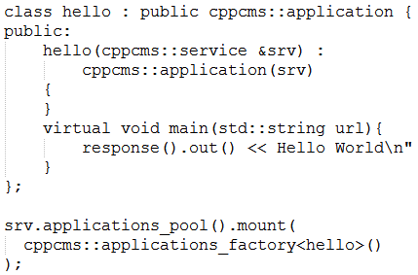
cppcms
You have to know many details of the framework
Need a special compiler to build
html templates
Cppcms is not easy to use, not modern c++

Slide 9
Tree-frog
based on qt, too heavy
Crow
Just a http server, not a real web framework

Slide 10
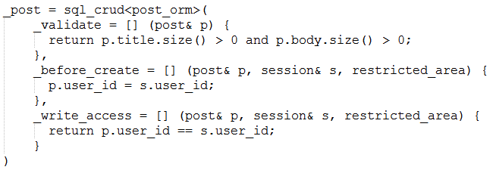
silicon
A little bit complicated
Lacks of html template engine

Slide 11


Slide 12
We need a better c++ web framework
Good infrastructure
http server, ORM, html template engine, AOP,…….
Easy to use
Focus on business only, low learning cost
High performance, cross platform

Slide 13
We need a better c++ web framework
Feather: a rapidly application framework of web development
you can use feather to develop a web application rapidly

Slide 14
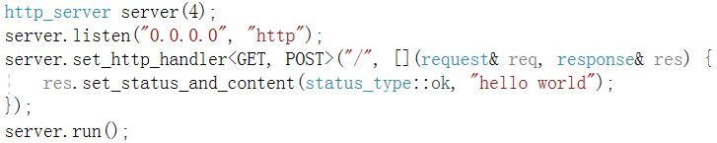
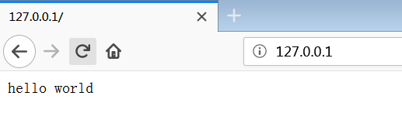
What is feather?
A web application with 5 lines code

Slide 15
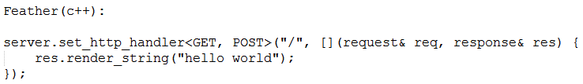
Very simple, no need to know many details about the framework
Just focus on business, as simple as possible
Become the master of the framework not the slave!

Slide 16
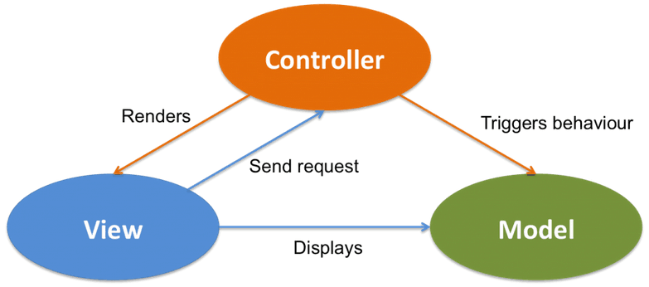
What is feather?

Slide 17
What is feather?
This website was developed in feather
http://purecpp.org/
https://github.com/qicosmos/feather

Slide 18
Development efficiency
How many business functions of http://purecpp.org ?
add, edit, remove, query posts;
add, edit, remove, query users;
member login/quit, member registration
upload/download files
search posts/classify posts
…….
More than 15 functions
All the core business code is about 500 lines
30 lines code per business function

Slide 19
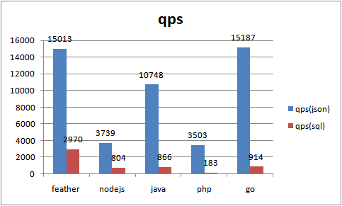
Performance
Higher is better

Slide 20
Why we need a c++ web framework feather?
High development efficiency
High performance

Slide 21


Slide 22
Components
Feather
Handle http request
Access database
cinatra
ormpp
render
Render html

Slide 23
Cinatra
Cinatra is a http server based on asio developed in c++17
Http1.1/https, websocket
Functional high level easy to use interface
Header-only
Support AOP(Aspect Oriented Programming)
Support upload/download files, session/cookie

Slide 24
Differences between cinatra and beast
cinatra is a application library, focus on business, lead to very few code to finish a web application
cinatra do much work for users
beast is a fundamental library, provide low level interface
beast users have to write much code to finish a business function
The goal is different

Slide 25
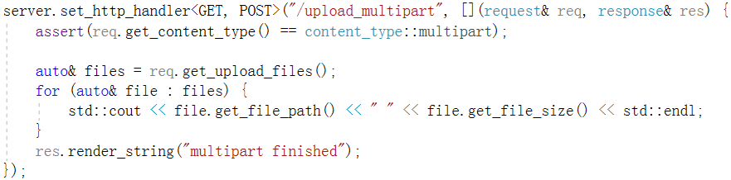
http upload/download
Beast lead to more than 100 lines code
https://codereview.stackexchange.com/questions/148596/http-downloader-using-beast
Cinatra just need less than 6 lines code
http download in cinatra:
http://127.0.0.1/assets/show.jpg

Slide 26
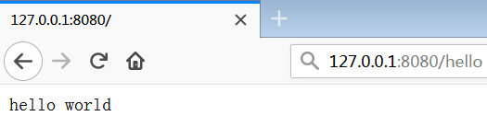
http server
http request
http://127.0.0.1/hello
Parse http
http method: GET
URL: /hello
Router
find the http handler
Function
do business

Slide 27
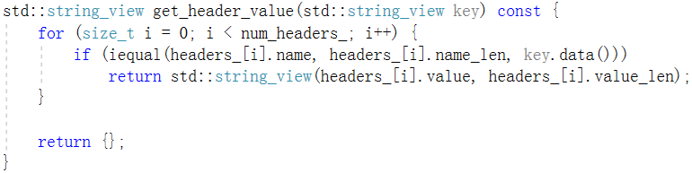
http parser
Parse http request: method, url,version,headers,……
std::string_view is very suitable for parsing http protocol

Slide 28



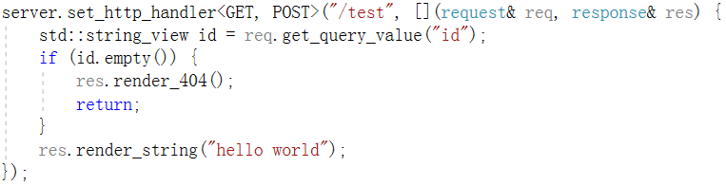
http router
route
route

Slide 29
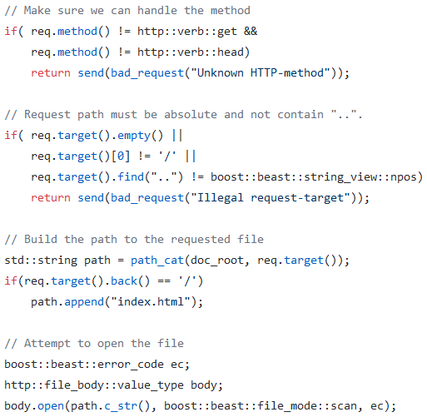
should avoid long long code
should focus on what we want

Slide 30
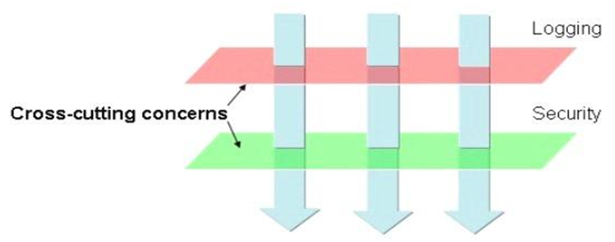
AOP(Aspect Oriented Programming)
Core business
Non-core business
aspects

Slide 31

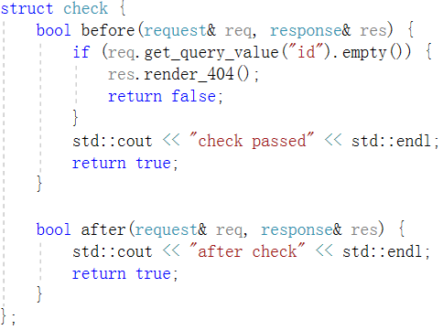
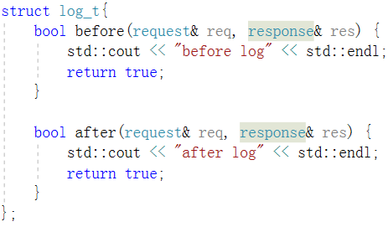
AOP

Slide 32

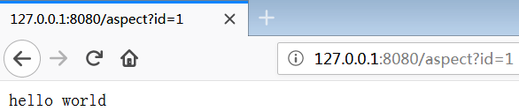
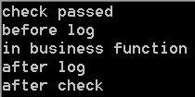
AOP
Before entry
After entry
request
Core business function
response
check
aspect
log
aspect
log
aspect
check
aspect

Slide 33
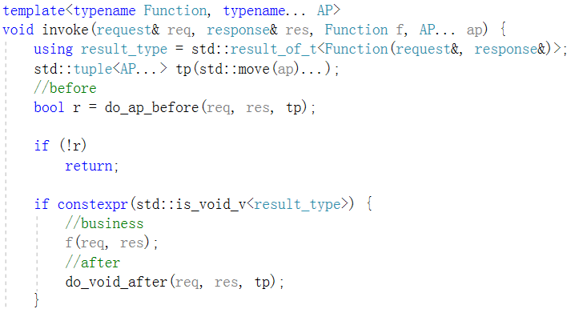
AOP
Execute before function in all aspects
Execute core business function
Execute after function in all aspects

Slide 34
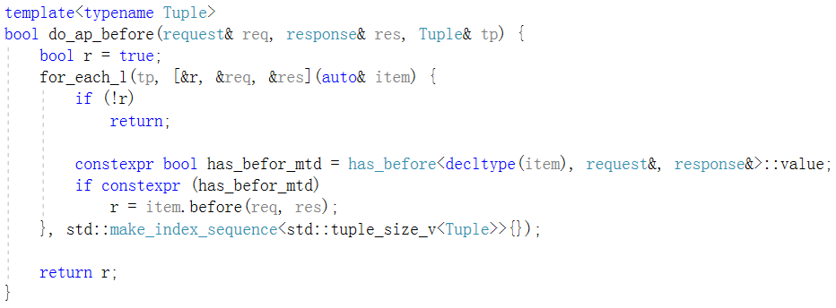
AOP

Slide 35
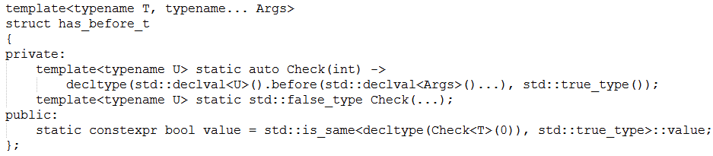
AOP

Slide 36
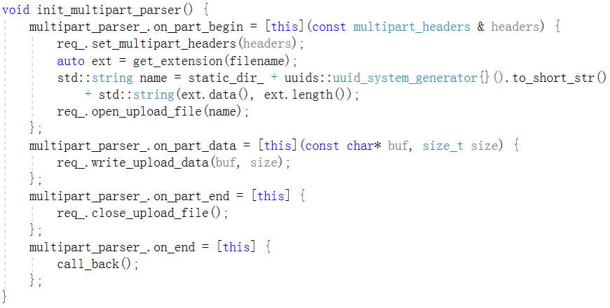
http upload

Slide 37
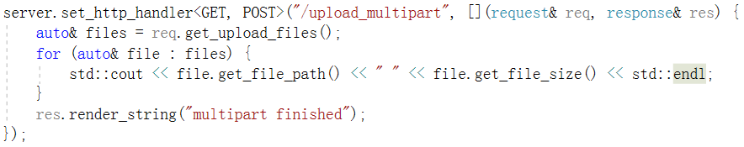
Hide complex details, expose simple user interfaces

Slide 38
cinatra
std::string_view helps to parse http protocol efficiently
The http router and AOP make the user focus on core business function
The framework does a lot of work and then provides simple interface for the user

Slide 39
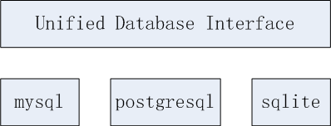
ormpp
ormpp: an easy to use ORM library based on compile-time reflection developed in c++17
You can use ormpp to operate different kinds of databases
https://github.com/qicosmos/ormpp

Slide 40
ormpp
Unified and easy to use interface
Extensible interface
Automatically generate sql
Automatically mapping table data to object

Slide 41
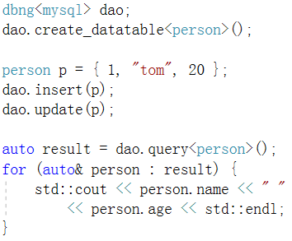
struct person
{
int id;
std::string name;
int age;
};
REFLECTION(person, id, name, age)
How to change the database?
dbng<postgresql> dao;
dbng<mysql> dao;
Ormpp hides databases differences
Accessing different databases use the same code

Slide 42


ormpp
Connect database
mysql
postgresql
sqlite

Slide 43
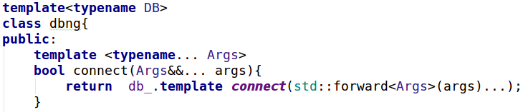
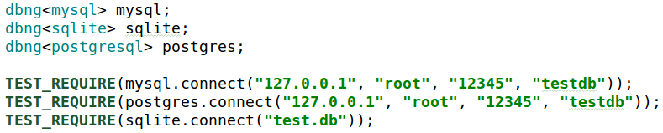
ormpp
Unified interface with variadic templates
Policy based design make it easy to change databse

Slide 44
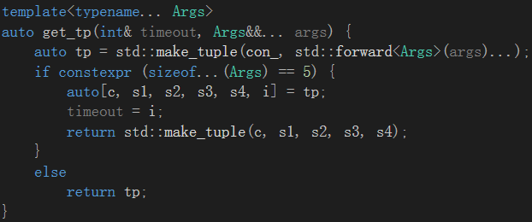
ormpp
implement static polymorphism with constexpr if and variadic templates

Slide 45
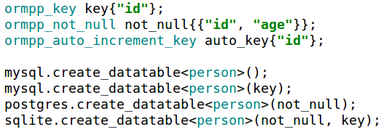
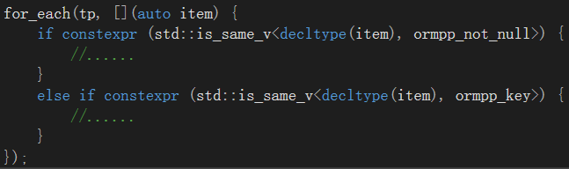
ormpp
Expand interface with constexpr if

Slide 46
ormpp-- Automatically generate sql
mysql.create_datatable<person>();
" CREATE TABLE person ( id INT, name TEXT, age INT) "
struct person {
int id;
std::string name;
int age;
};
REFLECTION(person, id, name, age)
<<Compile-time Reflection, Serialization and ORM Examples>>
https://github.com/CppCon/CppCon2017
https://www.youtube.com/watch?v=WlhoWjrR41A

Slide 47
generate sql
generate sql by compile-time reflection
Get the table name
Get the fields name of a table
Get the fields type
constexpr auto table_name = iguana::get_name<T>(); → "person"
constexpr auto arr = iguana::get_array<T>(); → {"id" , "name" , "age" }
How to get the fields type name? →{"INTEGER" , "TEXT”, "INTEGER" }

Slide 48
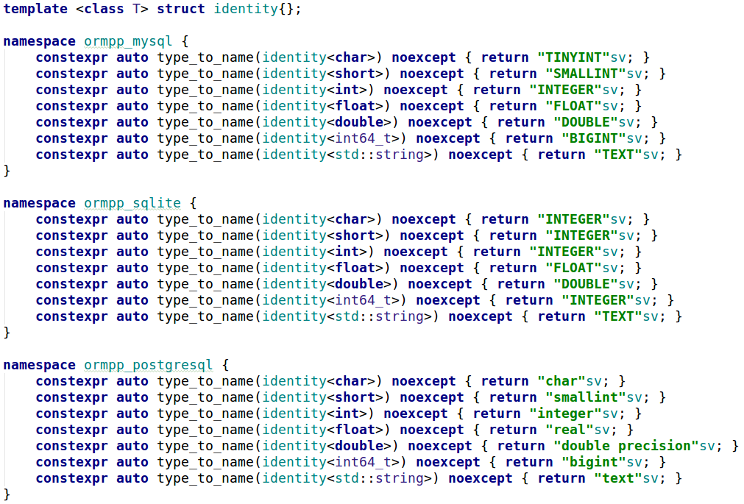
Type mapping

Slide 49
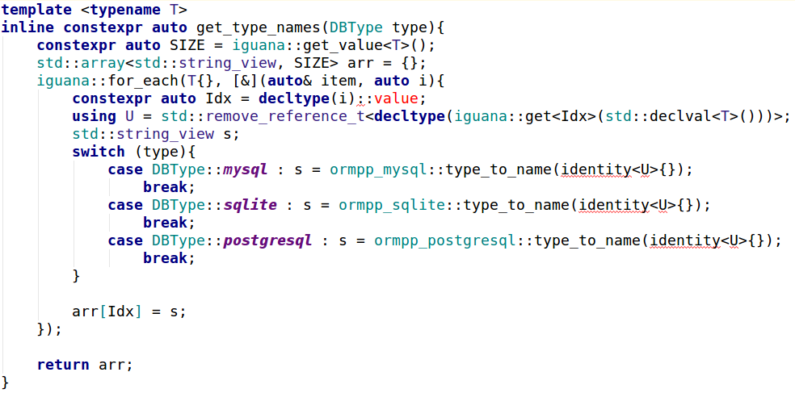
Get mapped type name

Slide 50

generate sql automatically
struct person {
int id;
std::string name;
int age;
};
REFLECTION(person, id, name, age)
generate sql
" CREATE TABLE person ( id INT, name TEXT, age INT) "
use an object to do everything what you want

Slide 51
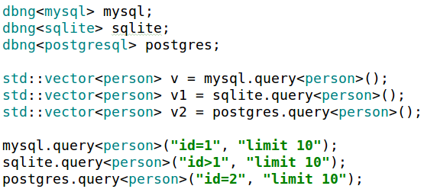

entity mapping

Slide 52
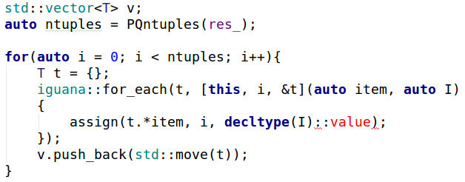
entity mapping
Data table to object

Slide 53
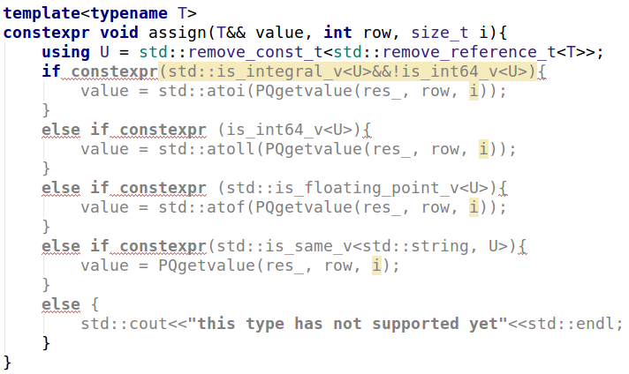
entity mapping

Slide 54
ormpp
Unified interface with variadic temlates and constexpr if
Expand interface with constexpr if
Generate sql with compile-time reflection
Mapping entity with compile-time reflection

Slide 55
Render
Html template engine
Fill html pages with dynamic data
Control UI display
Reuse html code

Slide 56
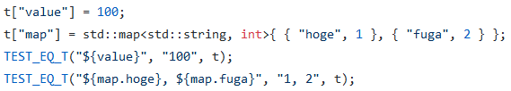
Render
https://github.com/qicosmos/render
https://github.com/melpon/ginger

Slide 57
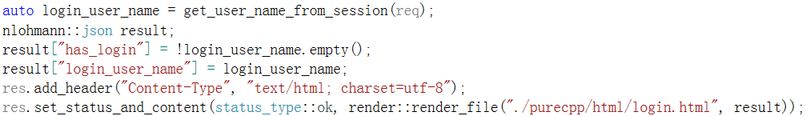
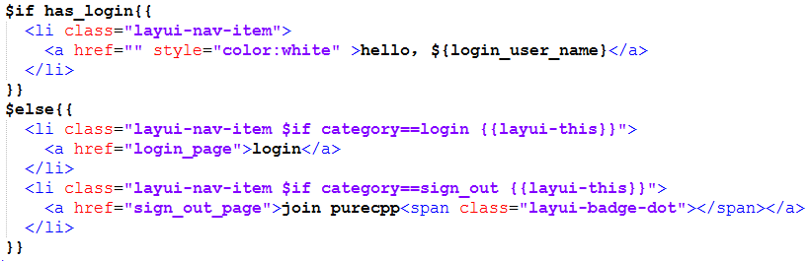
Render
Fill html pages with dynamic data
fill

Slide 58
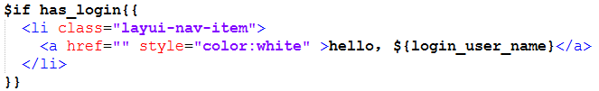
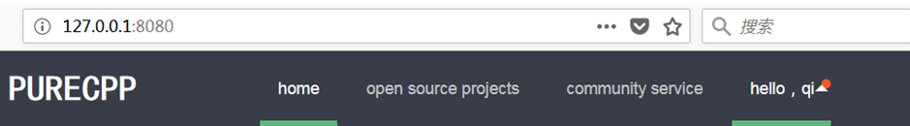
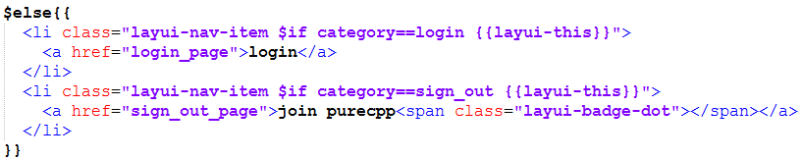
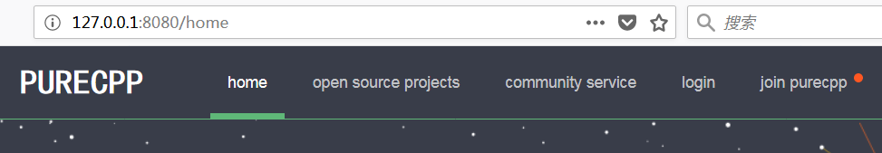
Control UI display

Slide 59
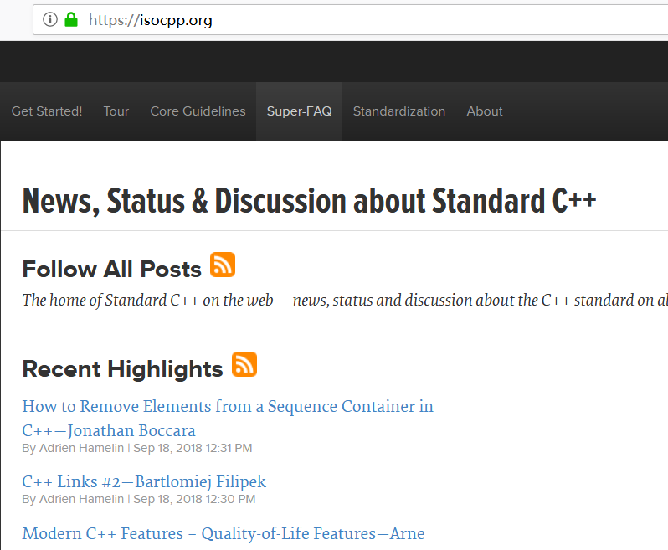
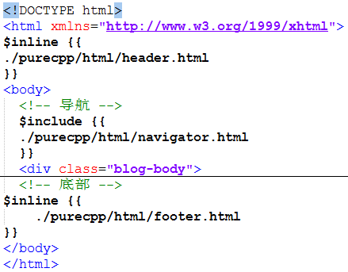
render
Reuse html code

Slide 60



Slide 61


Slide 62

Example—login

Slide 63

Login html code

Slide 64


Controller function
render login html page
route
controller function

Slide 65
Example—login

Slide 66


Separate non-core business

Slide 67

Simple and direct core business code

Slide 68
How to rapidly develop
Focus on business function
Separate core business and non-core business
Utilize the framework to help you to solve trivial details
Use cinatra to solve http details, just need focus on the parsed results
Use ormpp to solve the database details, just need focus on objects mapped from the database
Use render to solve html details, just need focus on how to fill the html templates

Slide 69
FAQ

Slide 70
Thank you

