Slide 1
Feather: A Modern C++ Web Development Framework
Yu Qi
qicosmos@163.com

Slide 2
Outline
Basic Concepts of Web Framework
What is Feather?
Components
How to Rapidly Develop Web?

Slide 3
Basic concepts
http request
ORM
http response
MVC

Slide 4
Basic concepts
Http server
ORM(Object-relational mapping)
Html render
Serialization, AOP……

Slide 5
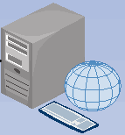
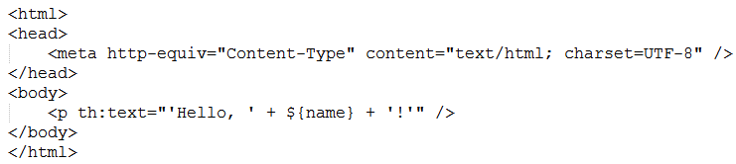
Html template
Web server
Index.html

Slide 6
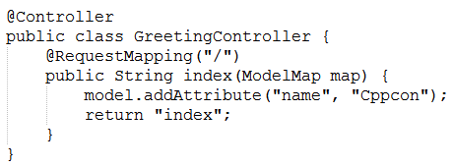
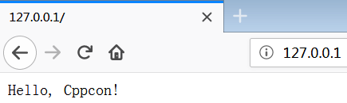
Render html
response
Html template
Render html template

Slide 7
Some c++ web frameworks
Cppcms
treefrog-framework
Crow
Silicon

Slide 8
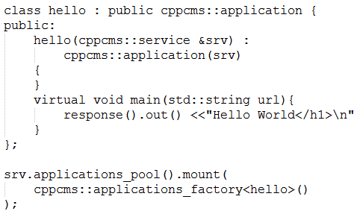
cppcms
Need a special compiler to build
html template
Cppcms is not easy to use, not modern c++

Slide 9
Tree-frog
based on qt, too heavily, not modern c++
Crow
Just a http server, not a real web framework

Slide 10
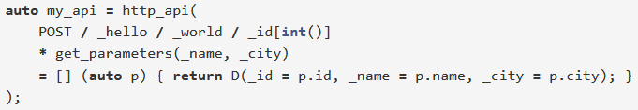
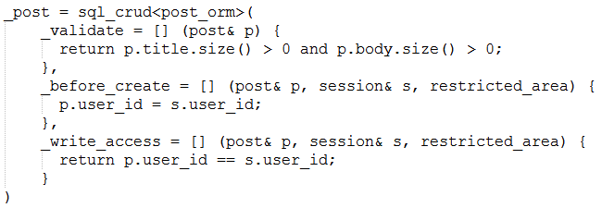
silicon

Slide 11
silicon
The user interface is not friendly
Complicated, not flexible
Don’t separate non-core business
Lack of html templates component

Slide 12


Slide 13
We need a better c++ web framework
Good infrastructure
http server, ORM, html render, AOP,…….
Easy to use
Focus on business only, low learning cost
High performance, cross platform

Slide 14
We need a better c++ web framework
Feather: a rapidly application framework of web development
you can use modern c++ to develop a web application rapidly

Slide 15
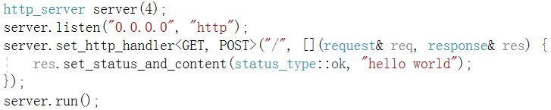
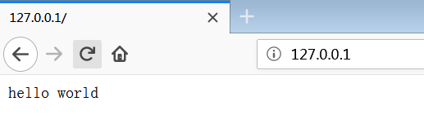
What is feather?
A web application with 5 lines code

Slide 16
What is feather?
This website was developed in feather
http://purecpp.org/
https://github.com/qicosmos/feather

Slide 17
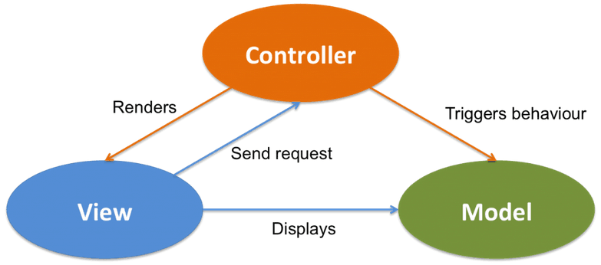
What is feather?

Slide 18
Components of feather
Cinatra: an easy to use http library(http/https, web socket, AOP)
Ormpp: a flexible ORM library, support multiple databases(compile-time reflection)
Render: a powerful html template engine
Iguana: a fast serialization library

Slide 19
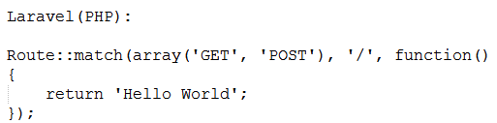
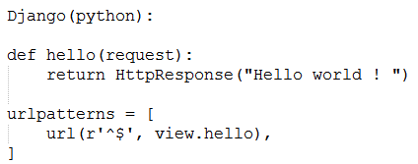
Comparison with other frameworks

Slide 20
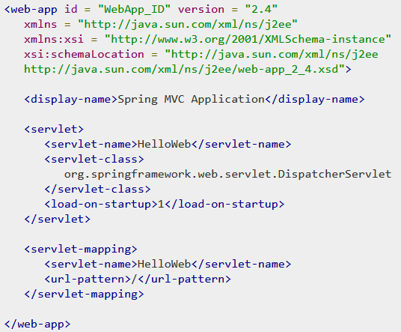
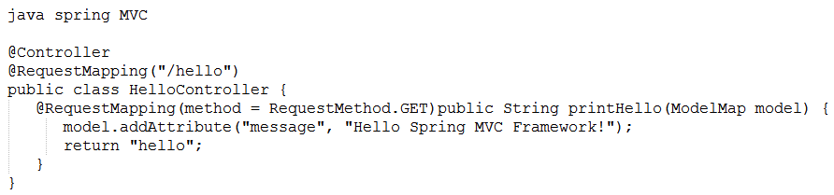
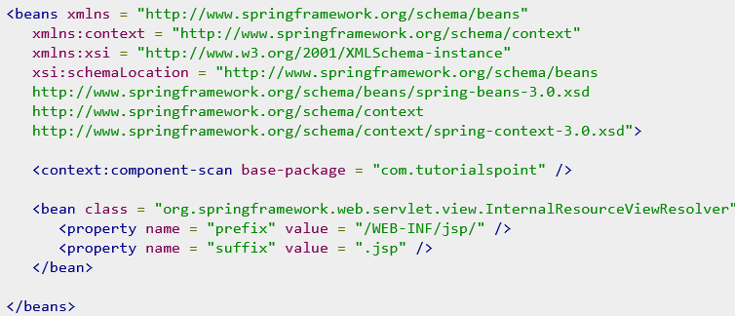

Slide 21
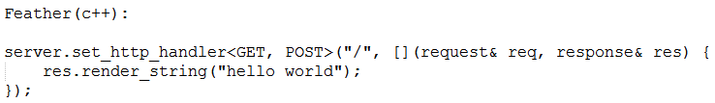
Very simple, no need to know many details about the framework
Just focus on business, can develop a web application rapidly
Become the master of the framework not the slave!

Slide 22
Development efficiency
How many business functions of http://purecpp.org ?
add, edit, remove, query posts;
add, edit, remove, query users;
member login/quit, member registration
upload/download files
search posts/classify posts
…….
More than 15 functions
All the business code is just 500 lines
30 lines code per business function

Slide 23
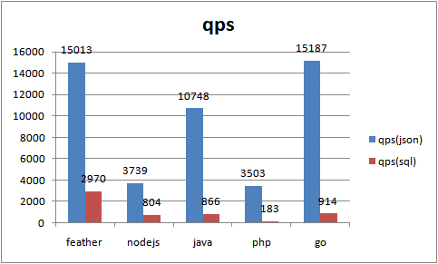
Performance

Slide 24
Why we need feather?
High development efficiency
High performance

Slide 25


Slide 26
Components
cinatra(Comparison)
ormpp(Comparison)
render
iguana/json

Slide 27


Slide 28
How to rapidly develop
Few code
Friendly, ease interface
Automatically done
……

