Slide 1
Feather: A Modern C++ Web Development Framework
Yu Qi
qicosmos@163.com

Slide 2
Outline
Basic Concepts of Web Framework
What is Feather?
Components
How to Rapidly Develop Web?

Slide 3
Basic concepts
http request
ORM
http response
MVC

Slide 4
Basic concepts
Http server
ORM(Object-relational mapping)
Html render
Serialization, AOP……

Slide 5
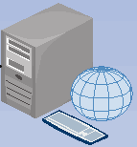
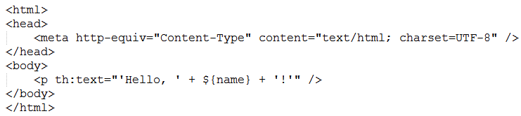
Html template
Web server
Index.html

Slide 6
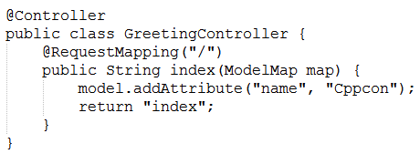
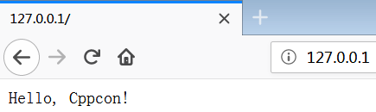
Render html
response
Html template
Render html template

Slide 7
Some c++ web frameworks
Cppcms
treefrog-framework
Crow
Silicon

Slide 8
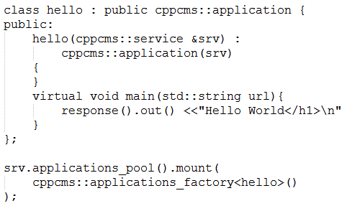
cppcms
Need a special compiler to build
html template
Cppcms is not easy to use, not modern c++

Slide 9
Tree-frog
based on qt, too heavily, not modern c++
Crow
Just a http server, not a real web framework

Slide 10
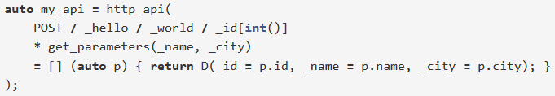
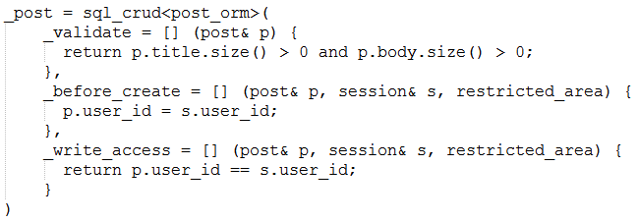
silicon

Slide 11
silicon
The user interface is not friendly
Complicated, not flexible
Don’t separate non-core business
Lack of html templates component

Slide 12


Slide 13
We need a better c++ web framework
Good infrastructure
http server, ORM, html render, AOP,…….
Easy to use
Focus on business only, low learning cost
High performance, cross platform

Slide 14
We need a better c++ web framework
Feather: a rapidly application framework of web development
you can use modern c++ to develop a web application rapidly

Slide 15
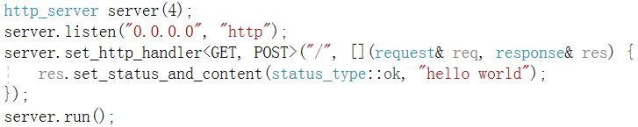
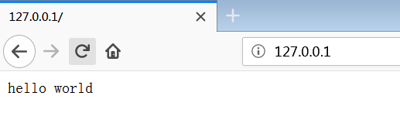
What is feather?
A web application with 5 lines code

Slide 16
What is feather?
This website was developed in feather
http://purecpp.org/
https://github.com/qicosmos/feather

Slide 17
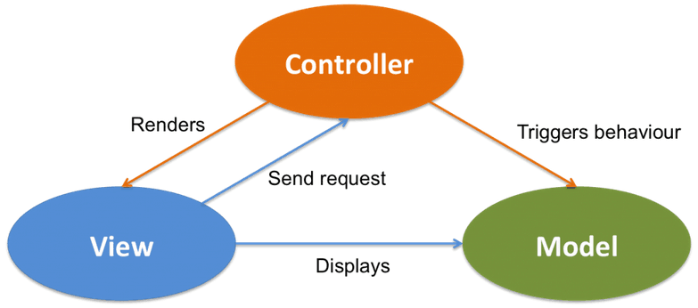
What is feather?

Slide 18
Components of feather
Cinatra: an easy to use http library(http/https, web socket, AOP)
Ormpp: a flexible ORM library, support multiple databases(compile-time reflection)
Render: a powerful html template engine
Iguana: a fast serialization library

Slide 19
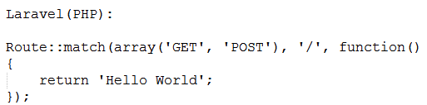
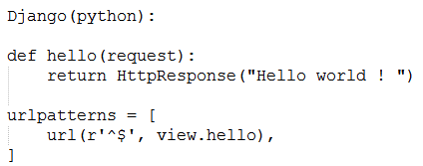
Comparison with other frameworks

Slide 20
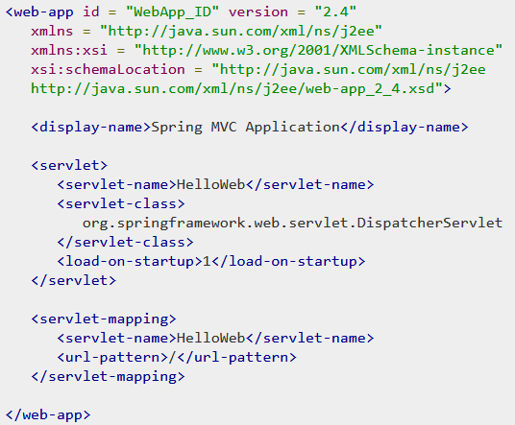
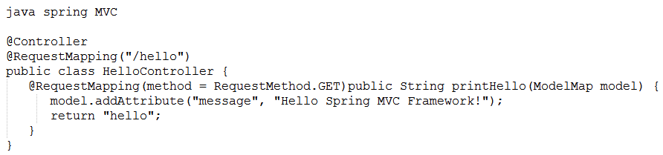
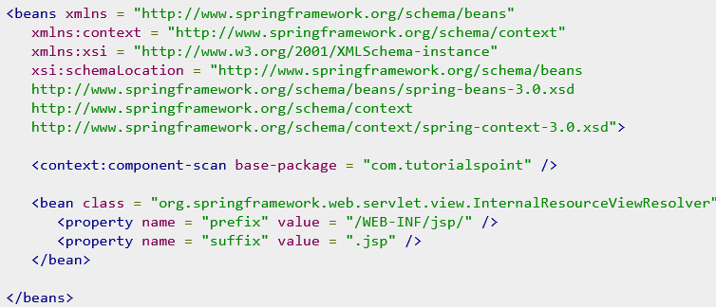

Slide 21
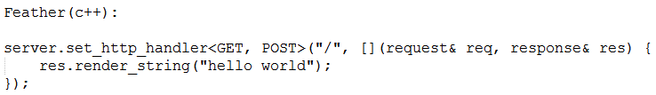
Very simple, no need to know many details about the framework
Just focus on business, can develop a web application rapidly
Become the master of the framework not the slave!

Slide 22
Development efficiency
How many business functions of http://purecpp.org ?
add, edit, remove, query posts;
add, edit, remove, query users;
member login/quit, member registration
upload/download files
search posts/classify posts
…….
More than 15 functions
All the business code is just 500 lines
30 lines code per business function

Slide 23
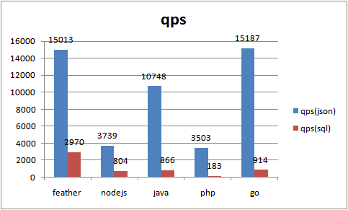
Performance

Slide 24
Why we need feather?
High development efficiency
High performance

Slide 25


Slide 26
Components
cinatra
ormpp(Comparison)
render
iguana/json

Slide 27
Cinatra
Cinatra is a http server based on asio developed in c++17
Http1.1/https, websocket
Functional high level easy to use interface
Header-only
Support AOP(Aspect Oriented Programming)
Support file upload/download, session/cookie

Slide 28
Differences between cinatra and beast
Cinatra is a application library, focus on business, lead to very few code to finish a web application
Framework do much work for user
Beast is a basic library, provide low level interface
Beast users have to write much code to finish a business function
The goal is different

Slide 29
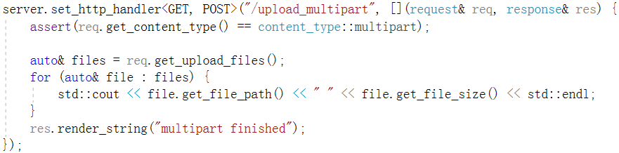
http upload/download
Beast lead to more than 100 lines code
https://codereview.stackexchange.com/questions/148596/http-downloader-using-beast
Cinatra just need less than 6 lines code
http download in cinatra:
http://127.0.0.1/assets/show.jpg

Slide 30
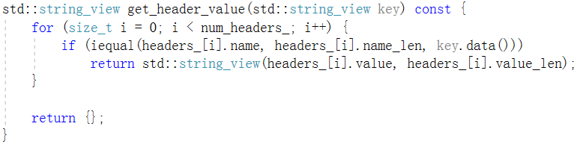
http parser
std::string_view is very good to parse http protocol

Slide 31



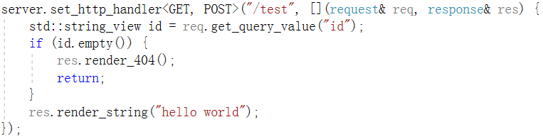
http router
route
route

Slide 32
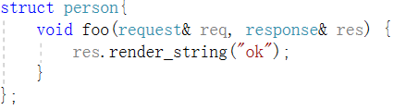

http router
Similar with std::bind, but no need placeholders here, more easy to use
C++Now 2017: https://www.youtube.com/watch?v=vh1BhlqF-fs

Slide 33
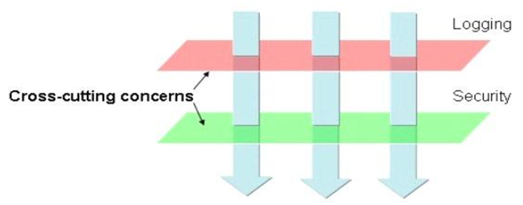
AOP
Core business
Non-core business
aspects

Slide 34

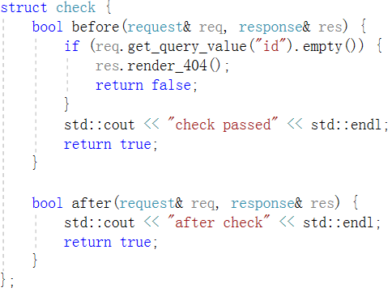
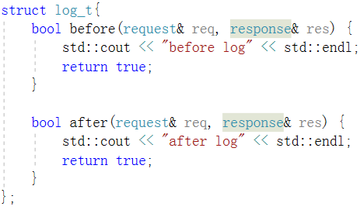
AOP

Slide 35

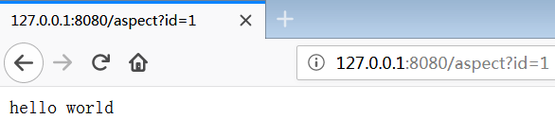
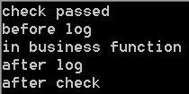
AOP
Before entry
After entry
request
Core business function
response
check
aspect
log
aspect
log
aspect
check
aspect

Slide 36
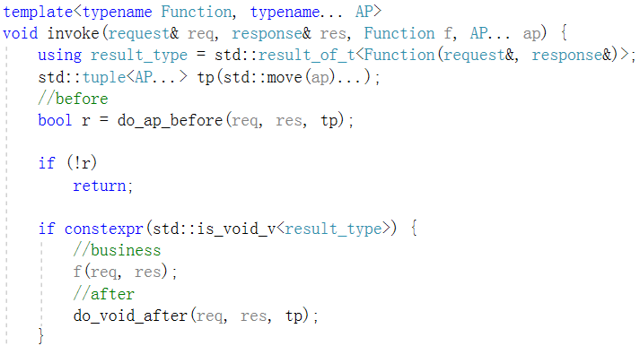
AOP
Execute before function in all aspects
Execute core business function
Execute after function in all aspects

Slide 37
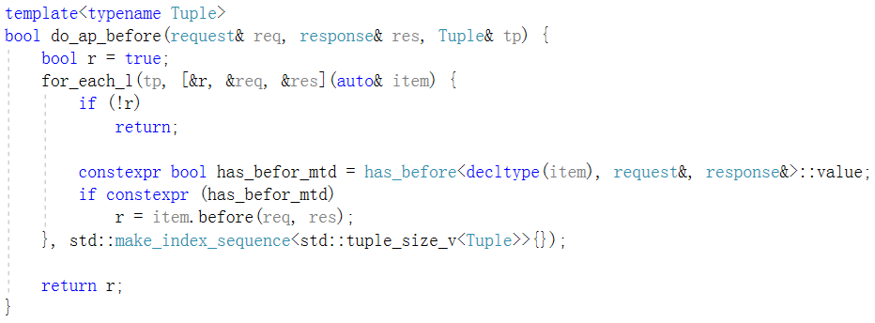
AOP

Slide 38
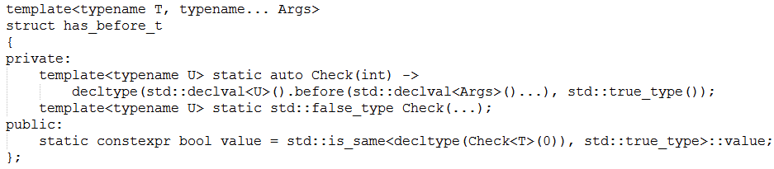
AOP

Slide 39
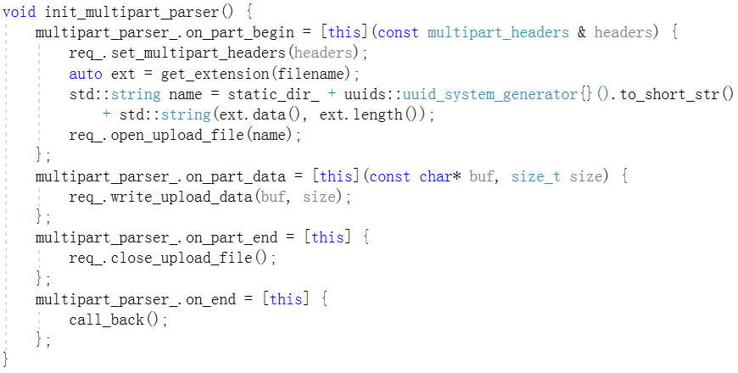
auto http upload

Slide 40
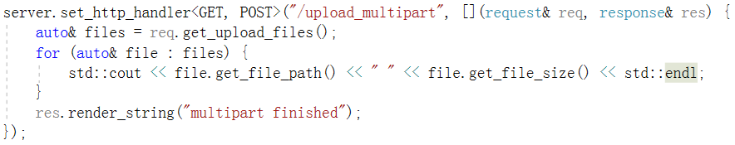
Hide complex details, expose simple user interface

Slide 41
cinatra
std::string_view help to parse http protocol efficiently
The http router and AOP make the user focus on core business function
The framework does a lot of work and then provides simple interface for the user

Slide 42
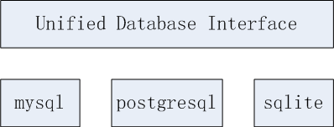
ormpp
ormpp: an easy to use ORM library based on compile-time reflection developed in c++17
You can use ormpp to operate different kind of databases
https://github.com/qicosmos/ormpp

Slide 43
ormpp
Unified and easy to use interface
Extensible interface
Automatically generate sql
Automatically mapping entity to object

Slide 44


ormpp
Connect database
mysql
postgresql
sqlite

Slide 45
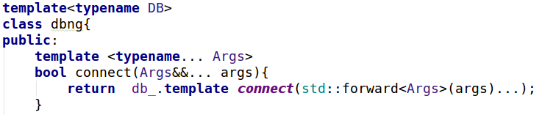
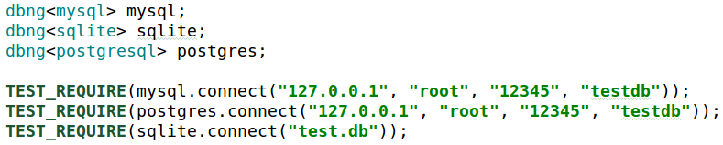
ormpp
Unified interface with variadic templates
Policy based design make it easy to change databse

Slide 46
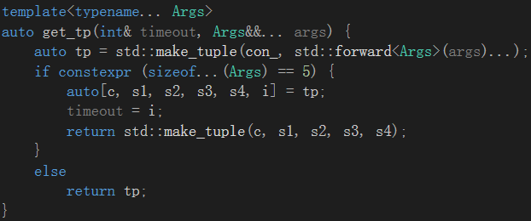
ormpp
implement static polymorphism with constexpr if and variadic templates

Slide 47
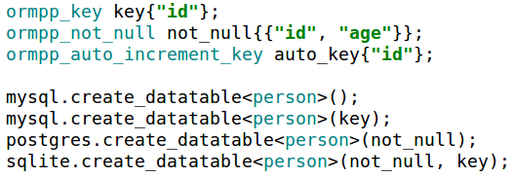
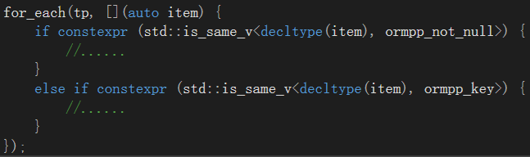
ormpp
Expand interface with constexpr if

Slide 48
ormpp
Automatically generate sql by compile-time reflection
" CREATE TABLE person ( id INT, name TEXT, age INT) "
struct person {
int id;
std::string name;
int age;
};
REFLECTION(person, id, name, age)
<<Compile-time Reflection, Serialization and ORM Examples>>
https://github.com/CppCon/CppCon2017
https://www.youtube.com/watch?v=WlhoWjrR41A

Slide 49
generate sql
generate sql by compile-time reflection
Get the table name
Get the fields name of a table
Get the fields type
constexpr auto table_name = iguana::get_name<T>(); → "person"
constexpr auto arr = iguana::get_array<T>(); → {"id" , "name" , "age" }
How to get the fields type name? →{"INTEGER" , "TEXT”, "INTEGER" }

Slide 50
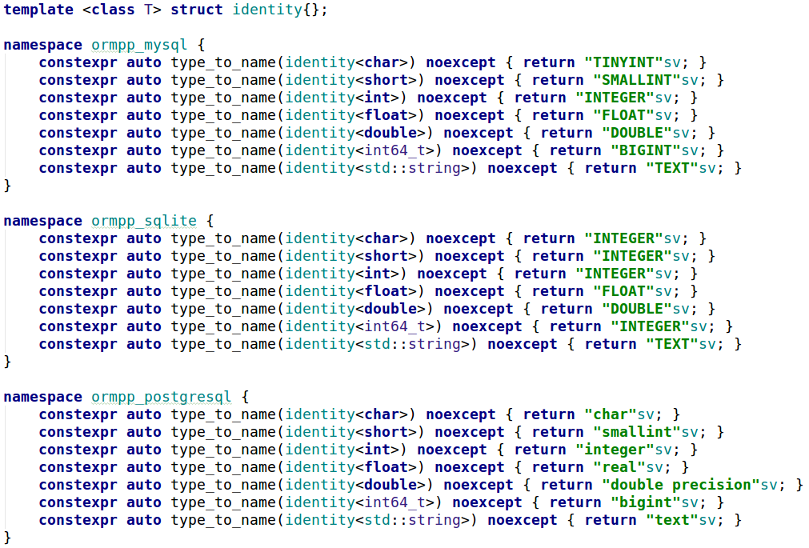
Type mapping

Slide 51
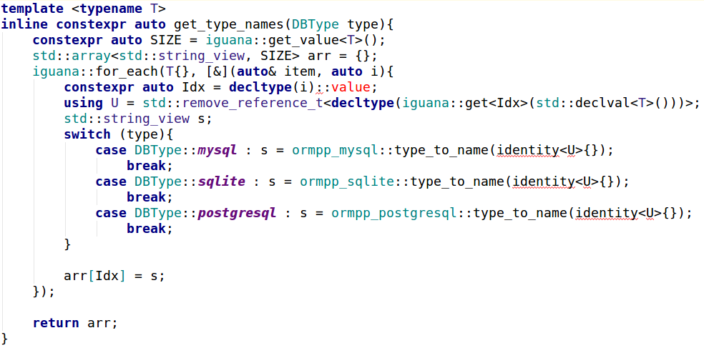
Get mapped type name

Slide 52

generate sql automatically
struct person {
int id;
std::string name;
int age;
};
REFLECTION(person, id, name, age)
generate sql
" CREATE TABLE person ( id INT, name TEXT, age INT) "
Just need an object type to generate a sql statement automatically

Slide 53
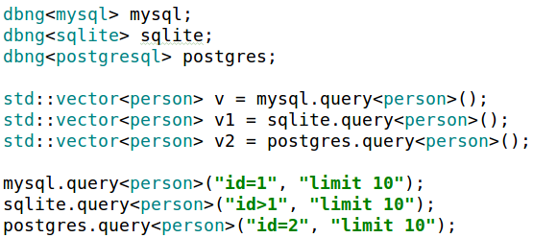

entity mapping

Slide 54
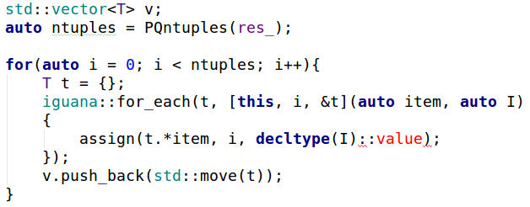
entity mapping
Data table to object

Slide 55
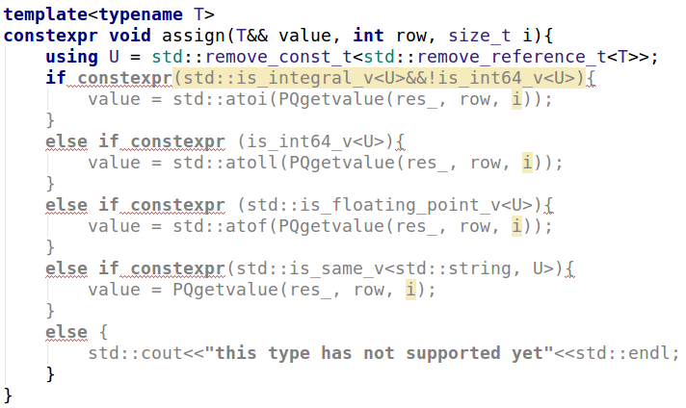
entity mapping

Slide 56
ormpp
Unified interface with variadic temlates and constexpr if
Expand interface with constexpr if
Generate sql with compile-time reflection
Mapping entity with compile-time reflection

Slide 57
Render
Html template engine
Dynamic filling html
Control UI display
Html reuse

Slide 58
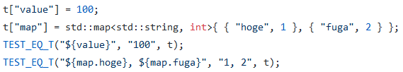
Render
https://github.com/qicosmos/render
https://github.com/melpon/ginger

Slide 59
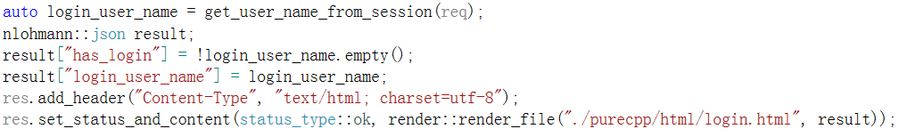
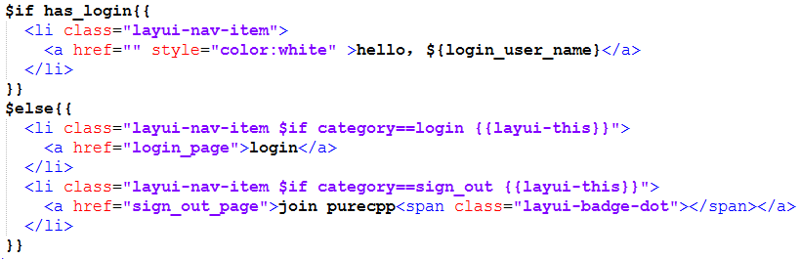
Render

Slide 60
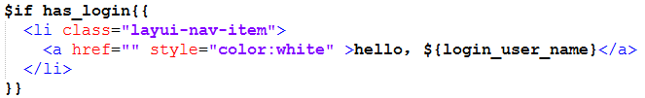
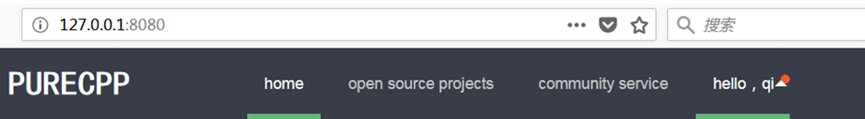
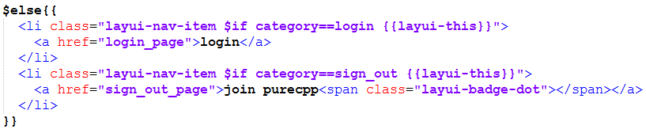
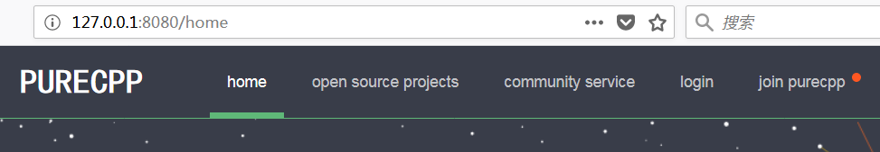

Slide 61
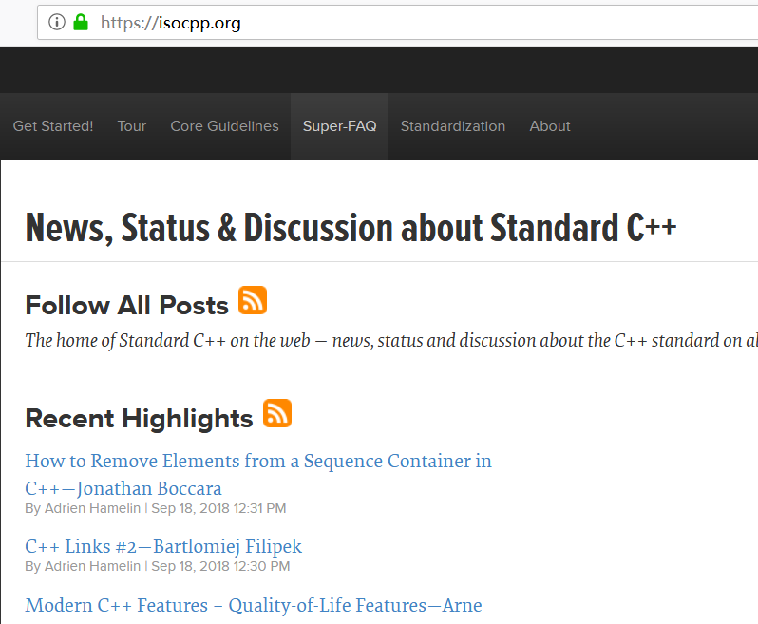

render
Reuse html code

Slide 62



Slide 63


Slide 64
How to rapidly develop
Focus on business function
Separate core business and non-core business
Utilize the framework to help you to solve trivial details
Use cinatra to solve http details, just need focus on the parsed results
Use ormpp to solve the database details, just need focus on objects mapped from the database
Use render to solve html details, just need focus on how to fill the template

Slide 65

Login html page

Slide 66


Example—login

Slide 67


Slide 68


Separate non-core business

Slide 69

Simple and direct core business code

Slide 70
How to rapidly develop
Focus on business function
Separate core business and non-core business
Utilize the framework to help you to solve trivial details
Use cinatra to solve http details, just need focus on the parsed results
Use ormpp to solve the database details, just need focus on objects mapped from the database
Use render to solve html details, just need focus on how to fill the template

Slide 71
FAQ

Slide 72
Thank you

