Slide 1
Feather: A Modern C++ Web Development Framework
Yu Qi
qicosmos@163.com

Slide 2
Outline
What is Feather?
the Framework of Feather
Components
How to Rapidly Develop Web?

Slide 3
What is feather?
Introduction
Example
Why we need it?(Application framework)
the Goal of Feather

Slide 4
What is feather?
A rapidly application framework of web development
you can use modern c++ to develop a web application rapidly

Slide 5
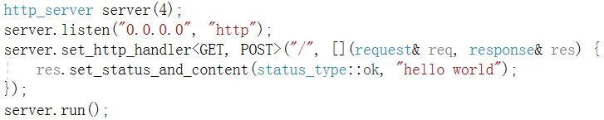
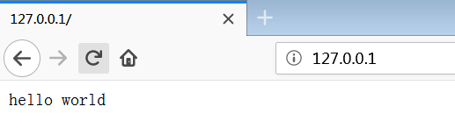
What is feather?
5 lines code web application

Slide 6
Easy to use
High performance
Focus on business only
Lightweight, low learning costs
Cross platform, header only

Slide 7
Example
This website was developed in feather
http://purecpp.org/
https://github.com/qicosmos/feather

Slide 8
Example
How many business functions?
add, edit, remove, query posts;
add, edit, remove, query users;
member login/quit, member registration
upload/download files
search posts/classify posts
…….
All the business code is just 500 lines

Slide 9
Why we need it?
You can develop an App rapidly in feather
Naive high performance comparing with other language web framework
Lack of such a modern c++ web application framework

Slide 10
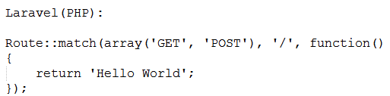
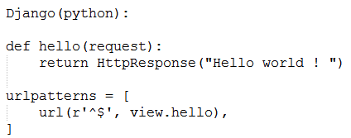
Comparison with other frameworks

Slide 11
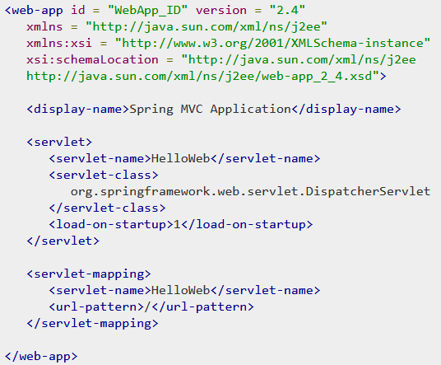
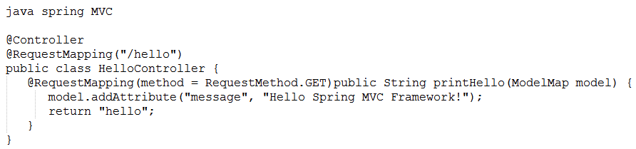
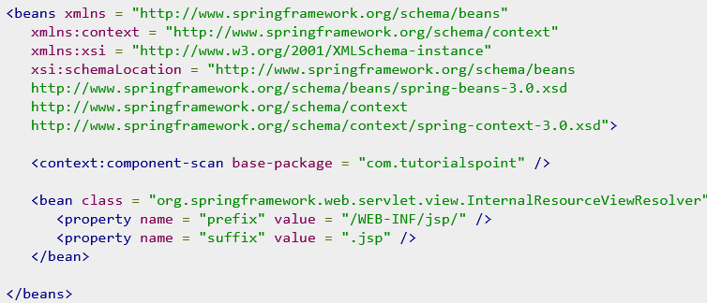

Slide 12
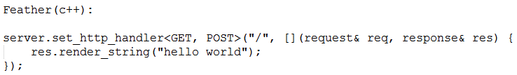
Very simple, no need to know many details about the framework
Become the master of the framework not the slave!

Slide 13
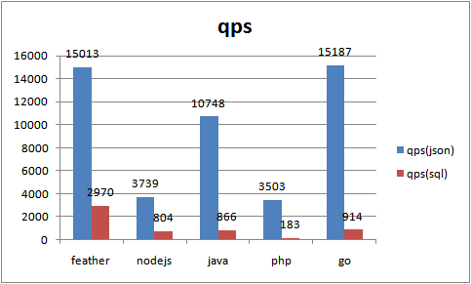
Performance

Slide 14
Some c++ web frameworks
Cppcms: not modern c++, not easy to use
treefrog-framework: based on qt, too heavily, not modern c++
Silicon: not so easy to use
Crow: lack of some important components, it’s not a really web framework

Slide 15
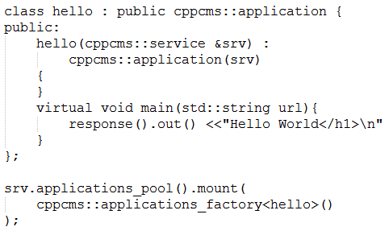
cppcms
You need a special compiler to build
html template
Cppcms is not easy to use, not modern c++

Slide 16
Tree-frog
Tree-frog
based on qt, too heavily, not modern c++
Crow
Just a http server, not a real web framework

Slide 17
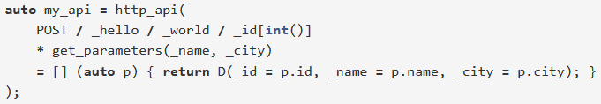
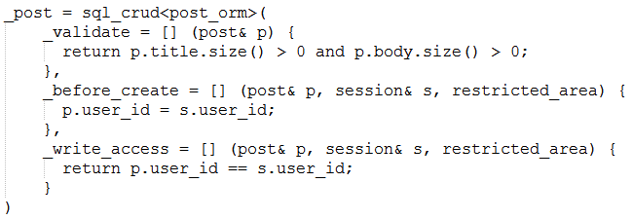
silicon

Slide 18
silicon
Silicon contains http component and ORM component
The user interface is not friendly
Complicated, not flexible
Lack of html templates component

Slide 19
the Framework of Feather
Basic concepts of web
Classic web framework
The framework of feather
Comparison()

Slide 20
Components
An easy to use http library(http/https, web socket, AOP)
A flexible ORM library, support multiple databases(compile-time reflection)
A powerful html template engine
A fast serialization library

Slide 21
Components
cinatra(Comparison)
ormpp(Comparison)
render
iguana/json

Slide 22
How to rapidly develop
Few code
Friendly, ease interface
Automatically done
……

