Slide 1
Feather: A Modern C++ Web Development Framework
Yu Qi
qicosmos@163.com

Slide 2
Outline
Basic Concepts of Web Framework
What is Feather?
Components
How to Rapidly Develop Web?

Slide 3
Basic concepts
Web framework
Handle http request
Access database
ORM(Object-relational
mapping)
Http server
Html template engine
Render html

Slide 4
We need a better c++ web framework
Feather: a rapidly application framework of web development
you can use feather to develop a web application rapidly

Slide 5
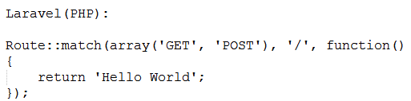
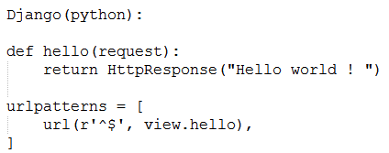
Some web frameworks

Slide 6
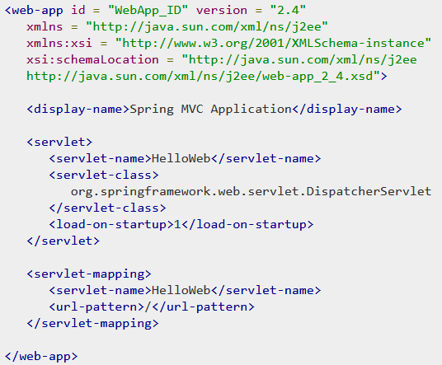
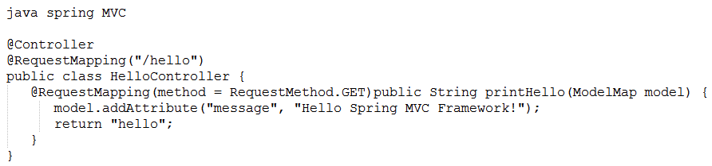
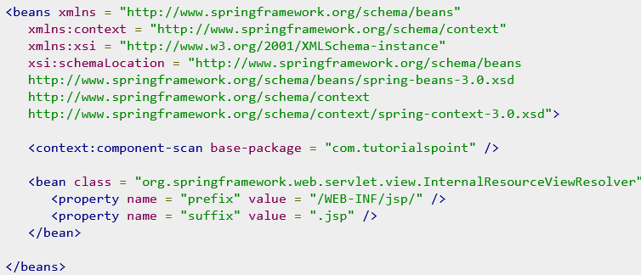
Some web frameworks

Slide 7
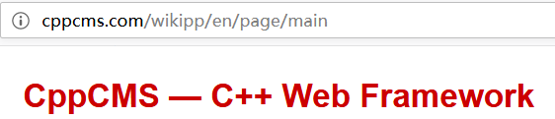
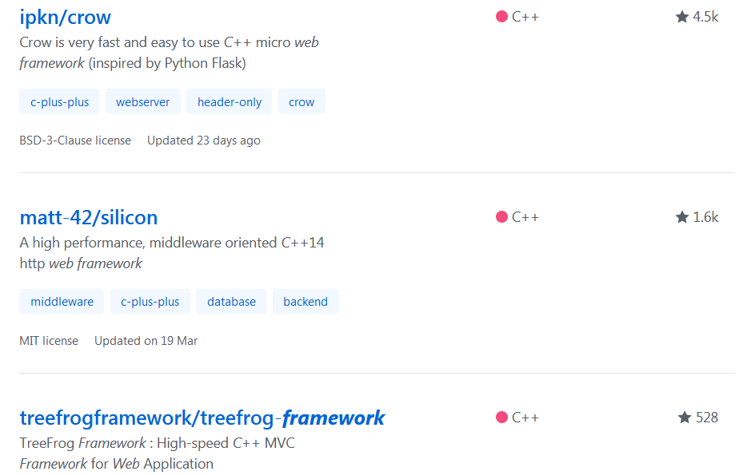
Some popular c++ web frameworks
4 popular c++ web
frameworks

Slide 8
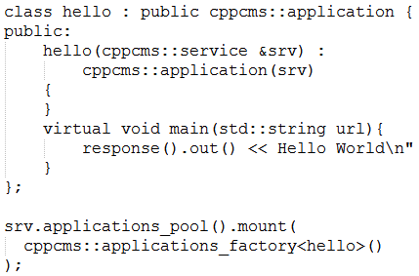
cppcms
You have to know many details of the framework
Need a special compiler to build
html template
Cppcms is not easy to use, not modern c++

Slide 9
Tree-frog
based on qt, too heavy, not modern c++
Crow
Just a http server, not a real web framework

Slide 10
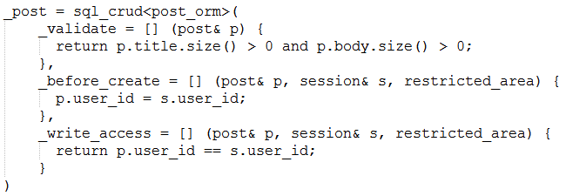
silicon
A little complicated, not very easy to use
Lacks of html template engine

Slide 11


Slide 12
We need a better c++ web framework
Good infrastructure
http server, ORM, html template engine, AOP,…….
Easy to use
Focus on business only, low learning cost
High performance, cross platform

Slide 13
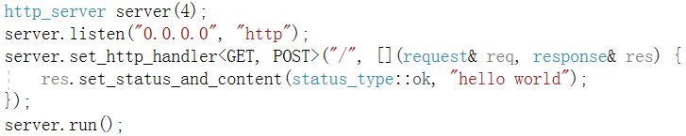
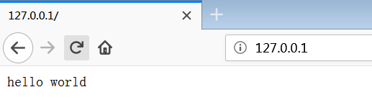
What is feather?
A web application with 5 lines code

Slide 14
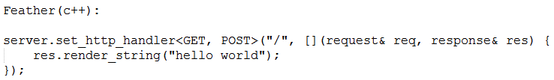
Very simple, no need to know many details about the framework
Just focus on business, can develop a web application rapidly
Become the master of the framework not the slave!

Slide 15
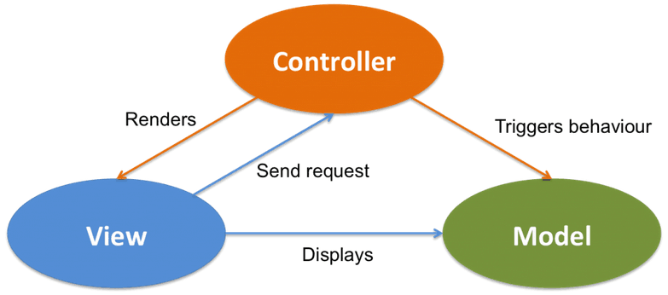
What is feather?

Slide 16
What is feather?
This website was developed in feather
http://purecpp.org/
https://github.com/qicosmos/feather

Slide 17
Development efficiency
How many business functions of http://purecpp.org ?
add, edit, remove, query posts;
add, edit, remove, query users;
member login/quit, member registration
upload/download files
search posts/classify posts
…….
More than 15 functions
All the core business code is just 500 lines
30 lines code per business function

Slide 18
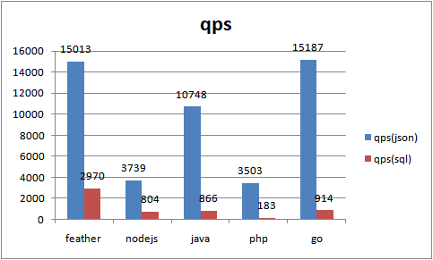
Performance

Slide 19
Why we need a c++ web framework feather?
High development efficiency
High performance

Slide 20


Slide 21
Components
Feather
Handle http request
Access database
cinatra
ormpp
render
Render html

Slide 22
Cinatra
Cinatra is a http server based on asio developed in c++17
Http1.1/https, websocket
Functional high level easy to use interface
Header-only
Support AOP(Aspect Oriented Programming)
Support file upload/download, session/cookie

Slide 23
Differences between cinatra and beast
Cinatra is a application library, focus on business, lead to very few code to finish a web application
Framework do much work for user
Beast is a basic library, provide low level interface
Beast users have to write much code to finish a business function
The goal is different

Slide 24
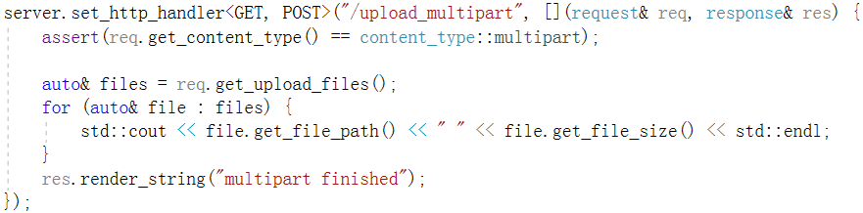
http upload/download
Beast lead to more than 100 lines code
https://codereview.stackexchange.com/questions/148596/http-downloader-using-beast
Cinatra just need less than 6 lines code
http download in cinatra:
http://127.0.0.1/assets/show.jpg

Slide 25
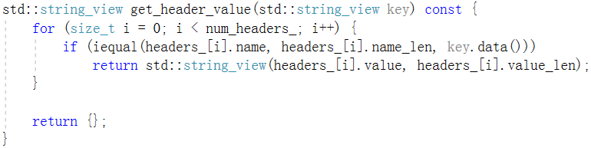
http parser
std::string_view is very good to parse http protocol

Slide 26



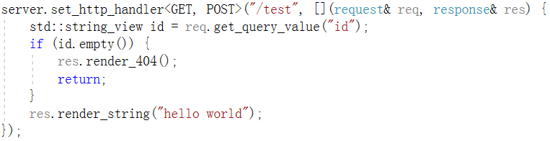
http router
route
route

Slide 27
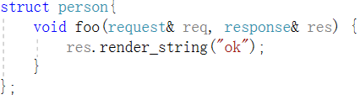

http router
Similar with std::bind, but no need placeholders here, more easy to use
C++Now 2017: https://www.youtube.com/watch?v=vh1BhlqF-fs

Slide 28
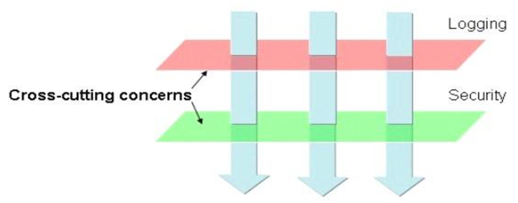
AOP
Core business
Non-core business
aspects

Slide 29

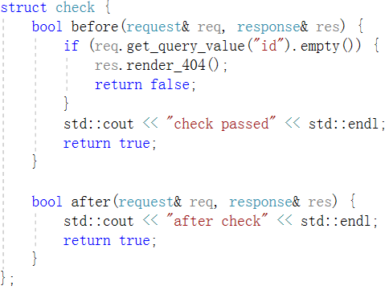
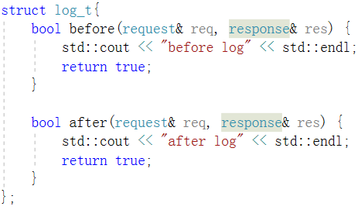
AOP

Slide 30

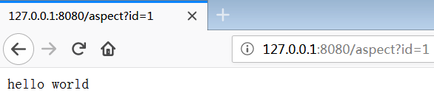
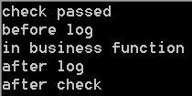
AOP
Before entry
After entry
request
Core business function
response
check
aspect
log
aspect
log
aspect
check
aspect

Slide 31
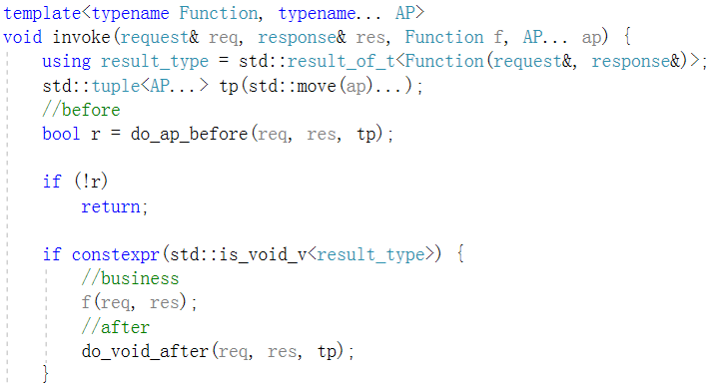
AOP
Execute before function in all aspects
Execute core business function
Execute after function in all aspects

Slide 32
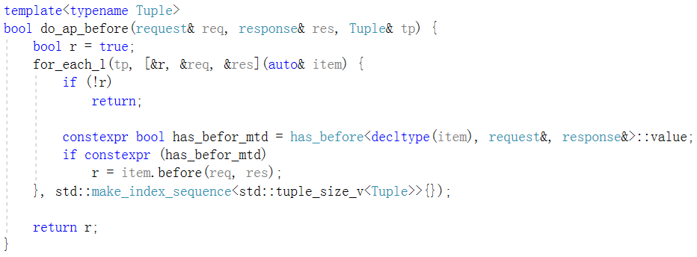
AOP

Slide 33
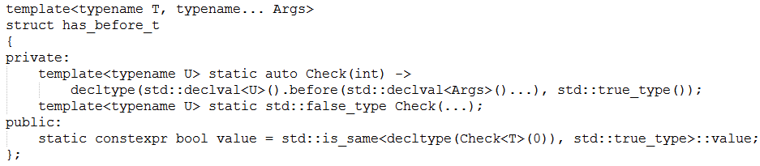
AOP

Slide 34
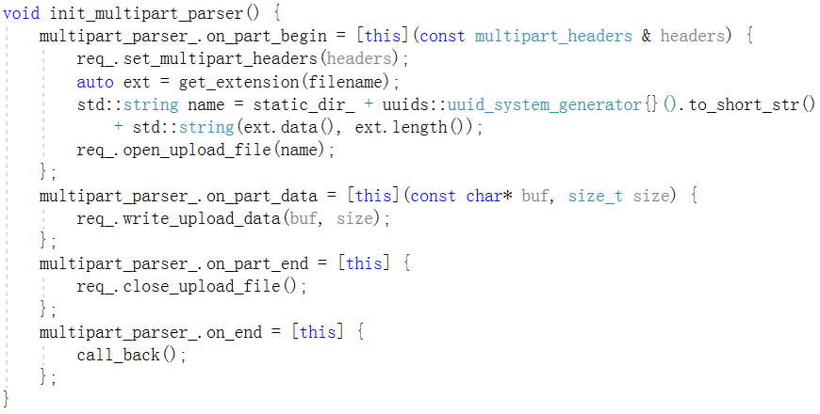
auto http upload

Slide 35
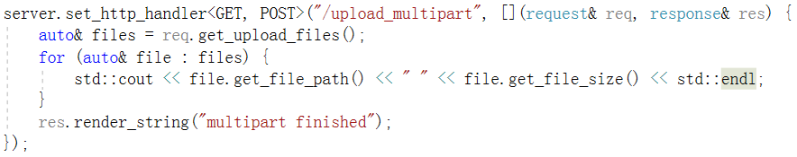
Hide complex details, expose simple user interface

Slide 36
cinatra
std::string_view help to parse http protocol efficiently
The http router and AOP make the user focus on core business function
The framework does a lot of work and then provides simple interface for the user

Slide 37
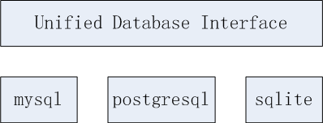
ormpp
ormpp: an easy to use ORM library based on compile-time reflection developed in c++17
You can use ormpp to operate different kind of databases
https://github.com/qicosmos/ormpp

Slide 38
ormpp
Unified and easy to use interface
Extensible interface
Automatically generate sql
Automatically mapping entity to object

Slide 39


ormpp
Connect database
mysql
postgresql
sqlite

Slide 40
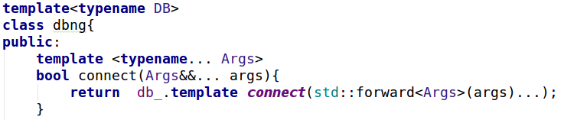
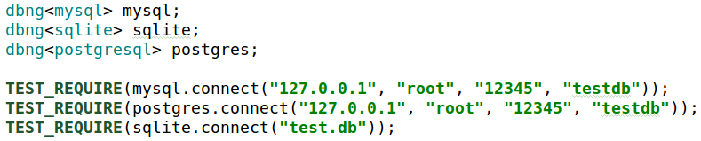
ormpp
Unified interface with variadic templates
Policy based design make it easy to change databse

Slide 41
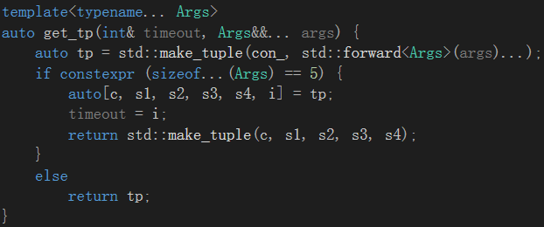
ormpp
implement static polymorphism with constexpr if and variadic templates

Slide 42
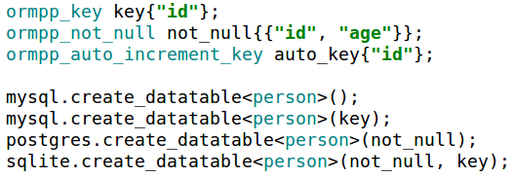
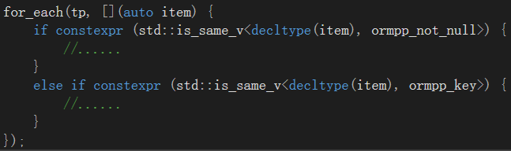
ormpp
Expand interface with constexpr if

Slide 43
ormpp
Automatically generate sql by compile-time reflection
" CREATE TABLE person ( id INT, name TEXT, age INT) "
struct person {
int id;
std::string name;
int age;
};
REFLECTION(person, id, name, age)
<<Compile-time Reflection, Serialization and ORM Examples>>
https://github.com/CppCon/CppCon2017
https://www.youtube.com/watch?v=WlhoWjrR41A

Slide 44
generate sql
generate sql by compile-time reflection
Get the table name
Get the fields name of a table
Get the fields type
constexpr auto table_name = iguana::get_name<T>(); → "person"
constexpr auto arr = iguana::get_array<T>(); → {"id" , "name" , "age" }
How to get the fields type name? →{"INTEGER" , "TEXT”, "INTEGER" }

Slide 45
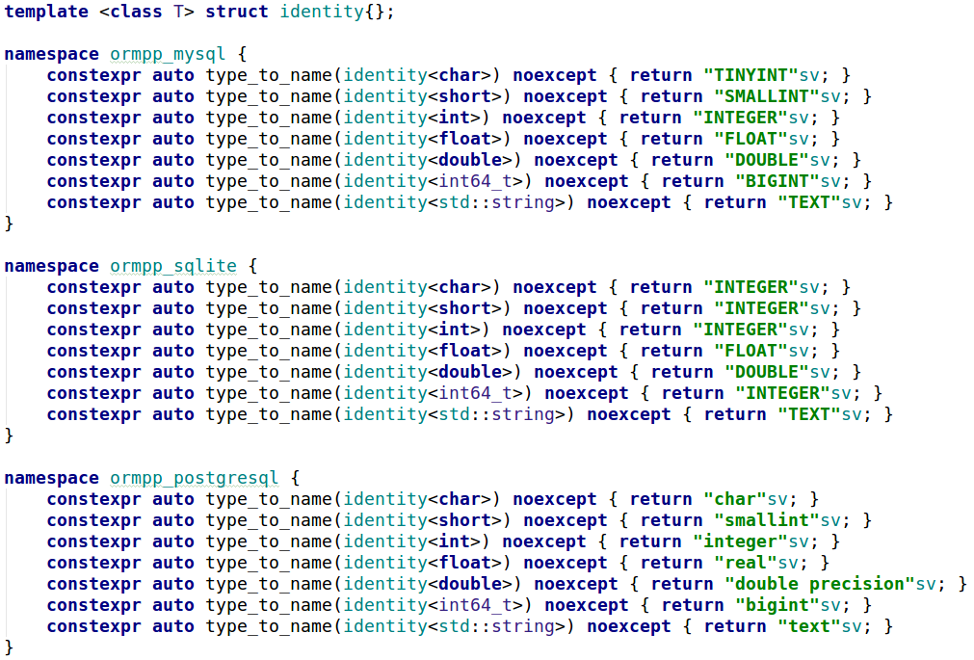
Type mapping

Slide 46
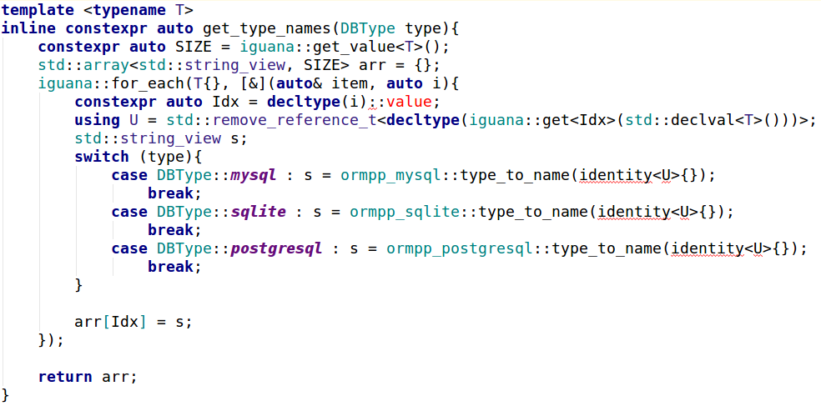
Get mapped type name

Slide 47

generate sql automatically
struct person {
int id;
std::string name;
int age;
};
REFLECTION(person, id, name, age)
generate sql
" CREATE TABLE person ( id INT, name TEXT, age INT) "
Just need an object type to generate a sql statement automatically

Slide 48
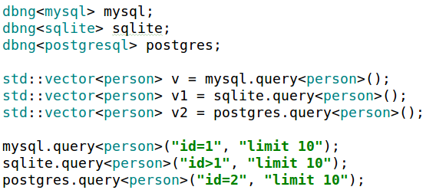

entity mapping

Slide 49
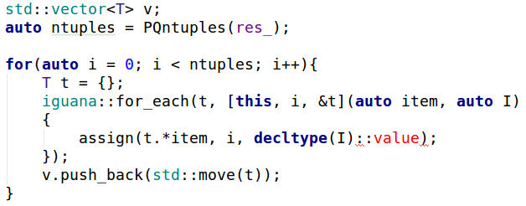
entity mapping
Data table to object

Slide 50
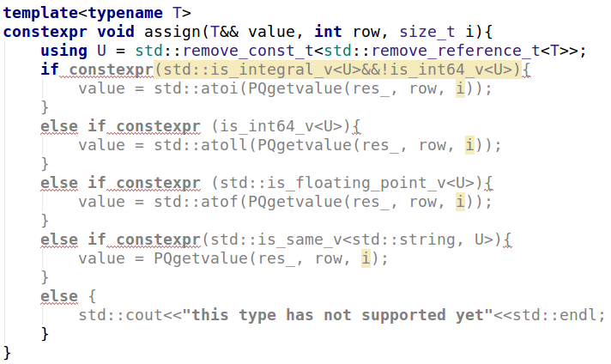
entity mapping

Slide 51
ormpp
Unified interface with variadic temlates and constexpr if
Expand interface with constexpr if
Generate sql with compile-time reflection
Mapping entity with compile-time reflection

Slide 52
Render
Html template engine
Dynamic filling html
Control UI display
Html reuse

Slide 53
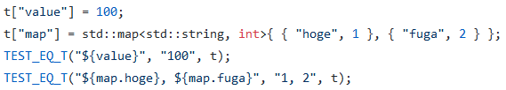
Render
https://github.com/qicosmos/render
https://github.com/melpon/ginger

Slide 54
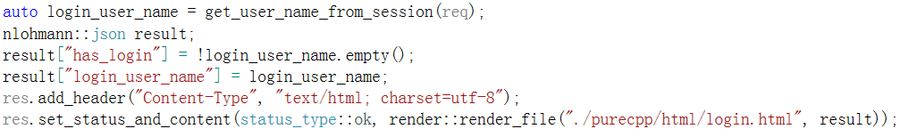
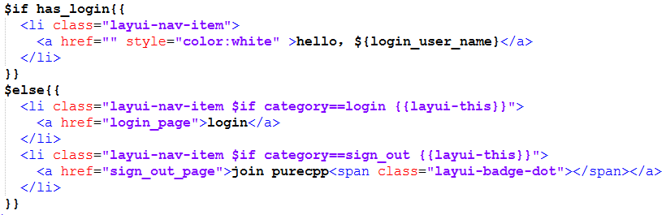
Render

Slide 55
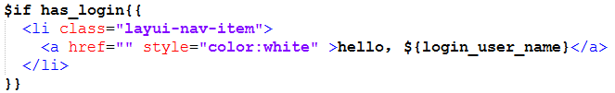
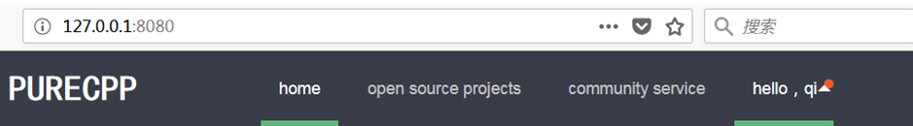
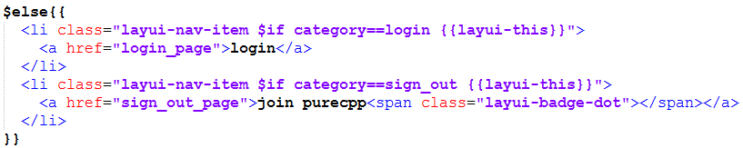
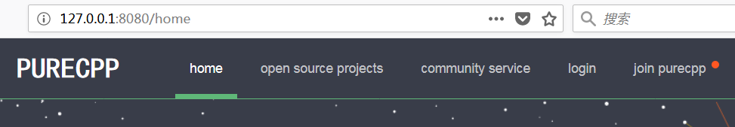

Slide 56
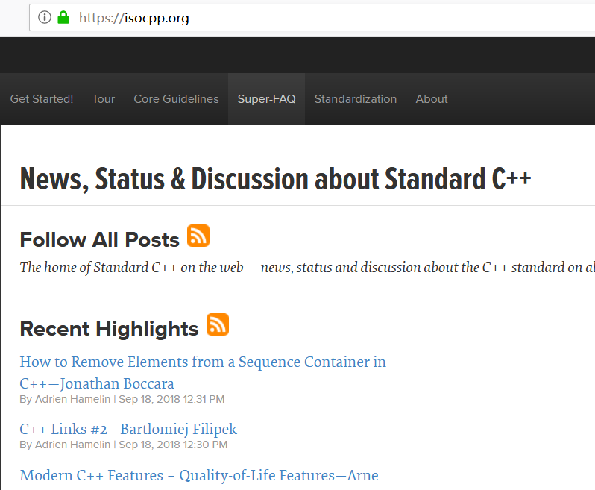
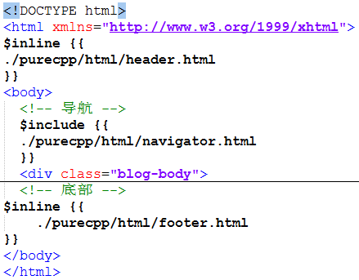
render
Reuse html code

Slide 57
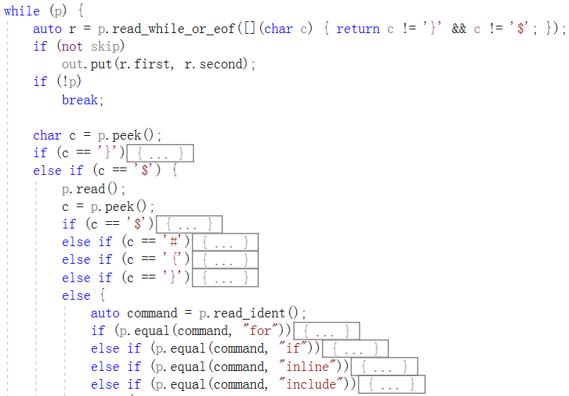
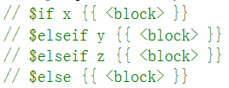

Slide 58


Slide 59
How to rapidly develop
Focus on business function
Separate core business and non-core business
Utilize the framework to help you to solve trivial details
Use cinatra to solve http details, just need focus on the parsed results
Use ormpp to solve the database details, just need focus on objects mapped from the database
Use render to solve html details, just need focus on how to fill the template

Slide 60

Login html page

Slide 61


Example—login

Slide 62


Slide 63


Separate non-core business

Slide 64

Simple and direct core business code

Slide 65
How to rapidly develop
Focus on business function
Separate core business and non-core business
Utilize the framework to help you to solve trivial details
Use cinatra to solve http details, just need focus on the parsed results
Use ormpp to solve the database details, just need focus on objects mapped from the database
Use render to solve html details, just need focus on how to fill the template

Slide 66
FAQ

Slide 67
Thank you

