Slide 1
Popular Types of Charts
in Python

Slide 2
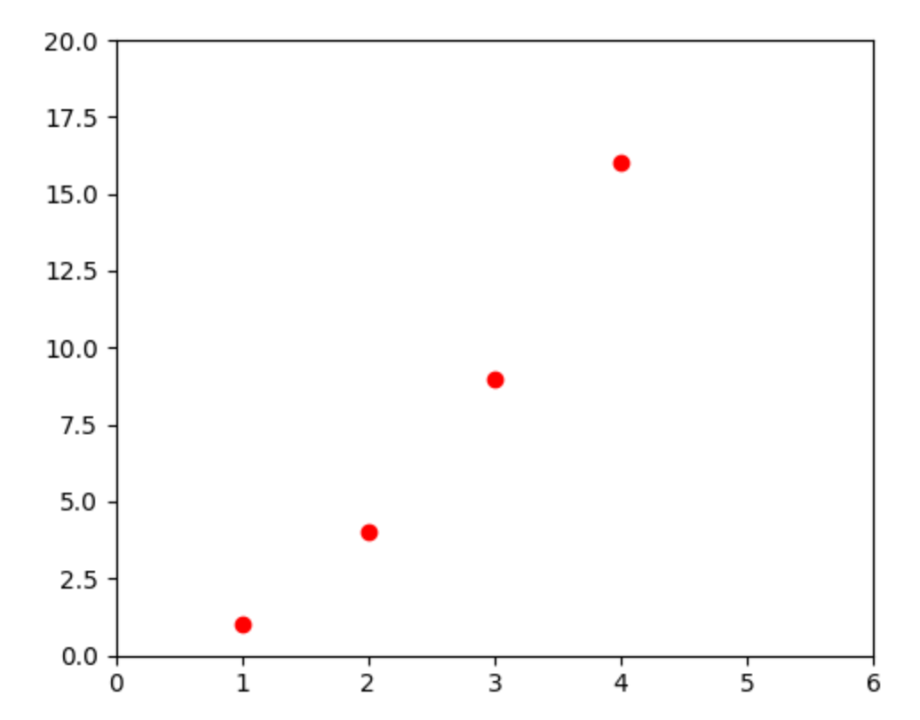
Scattergram
(matplotlib.org)

Slide 3
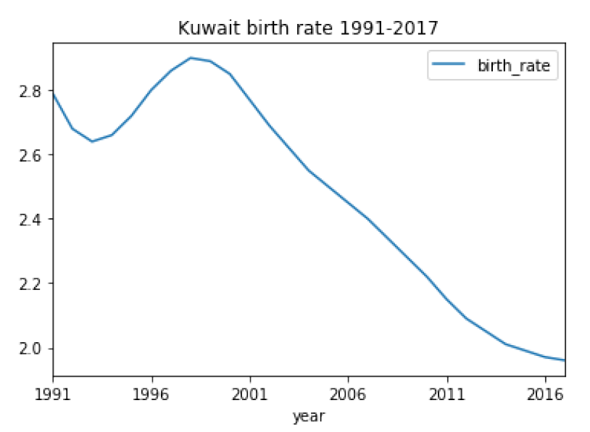
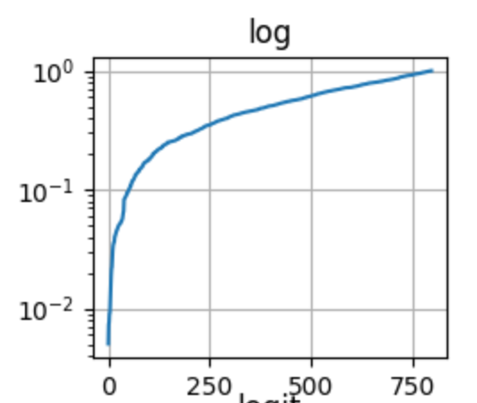
Line Chart
(matplotlib.org)

Slide 4
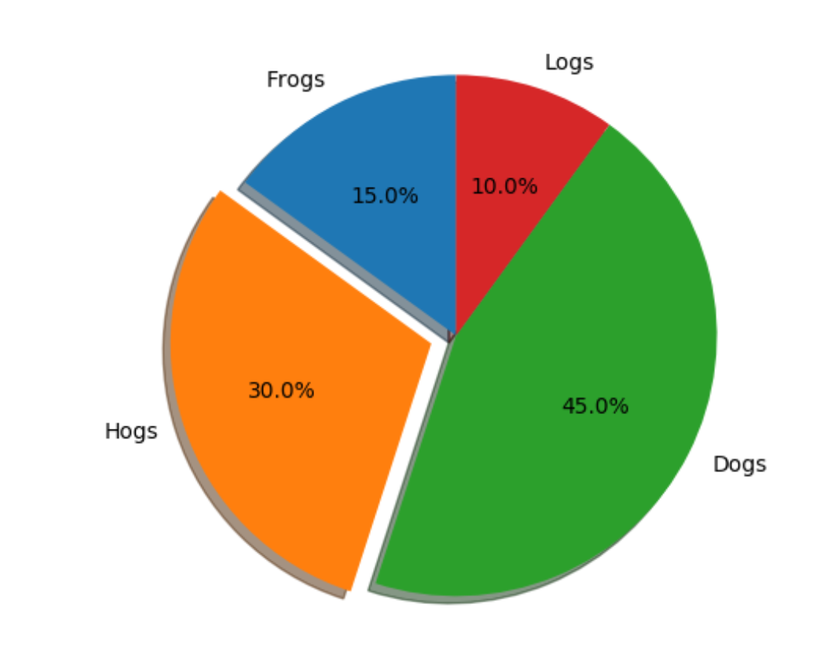
Pie Chart
(matplotlib.org)

Slide 5
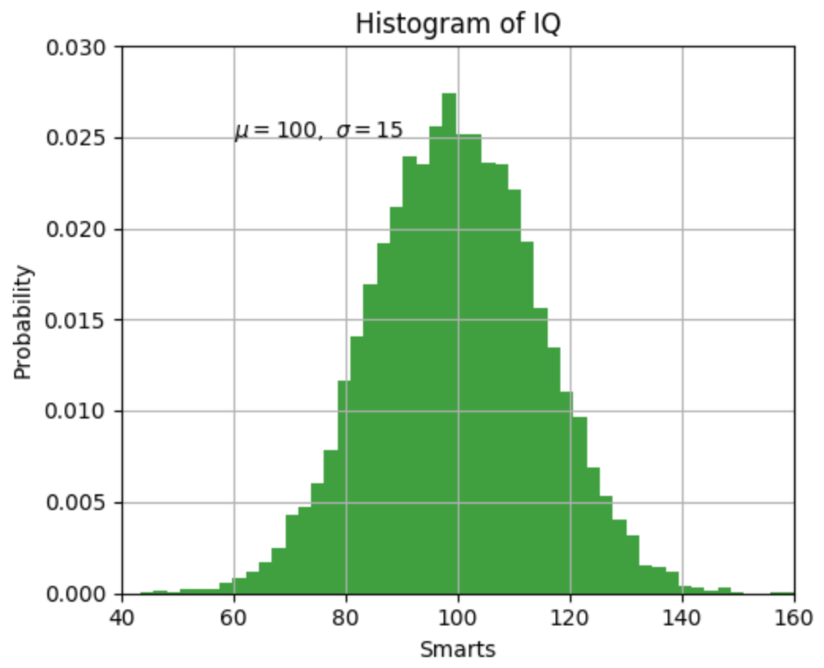
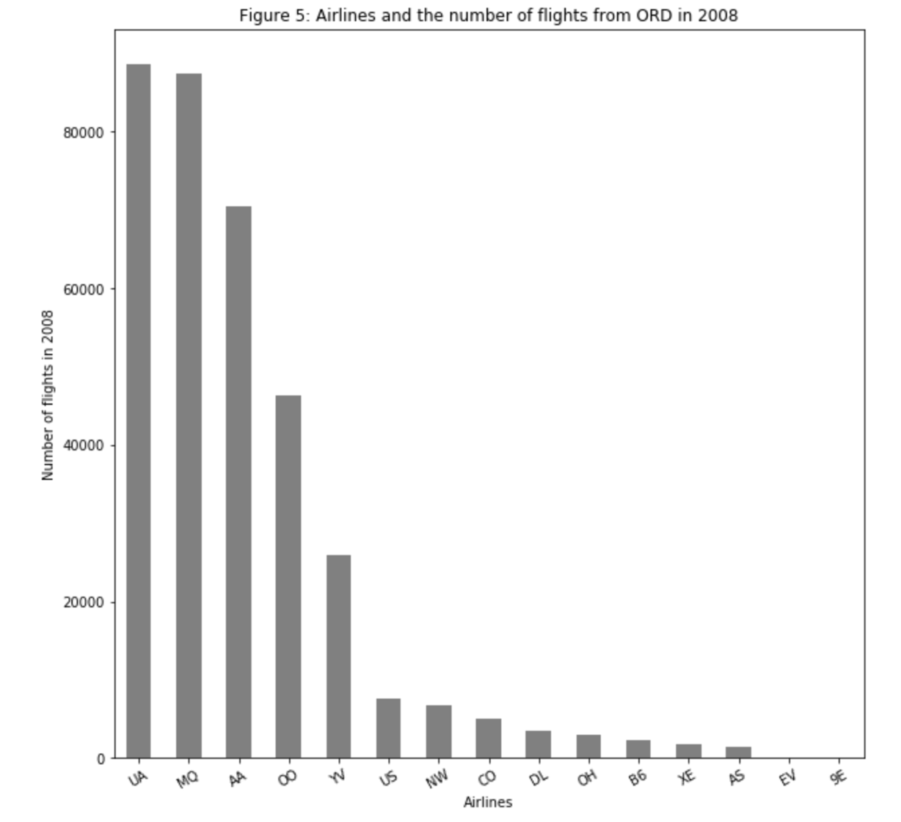
Histogram Bar Chart
(matplotlib.org)

Slide 6
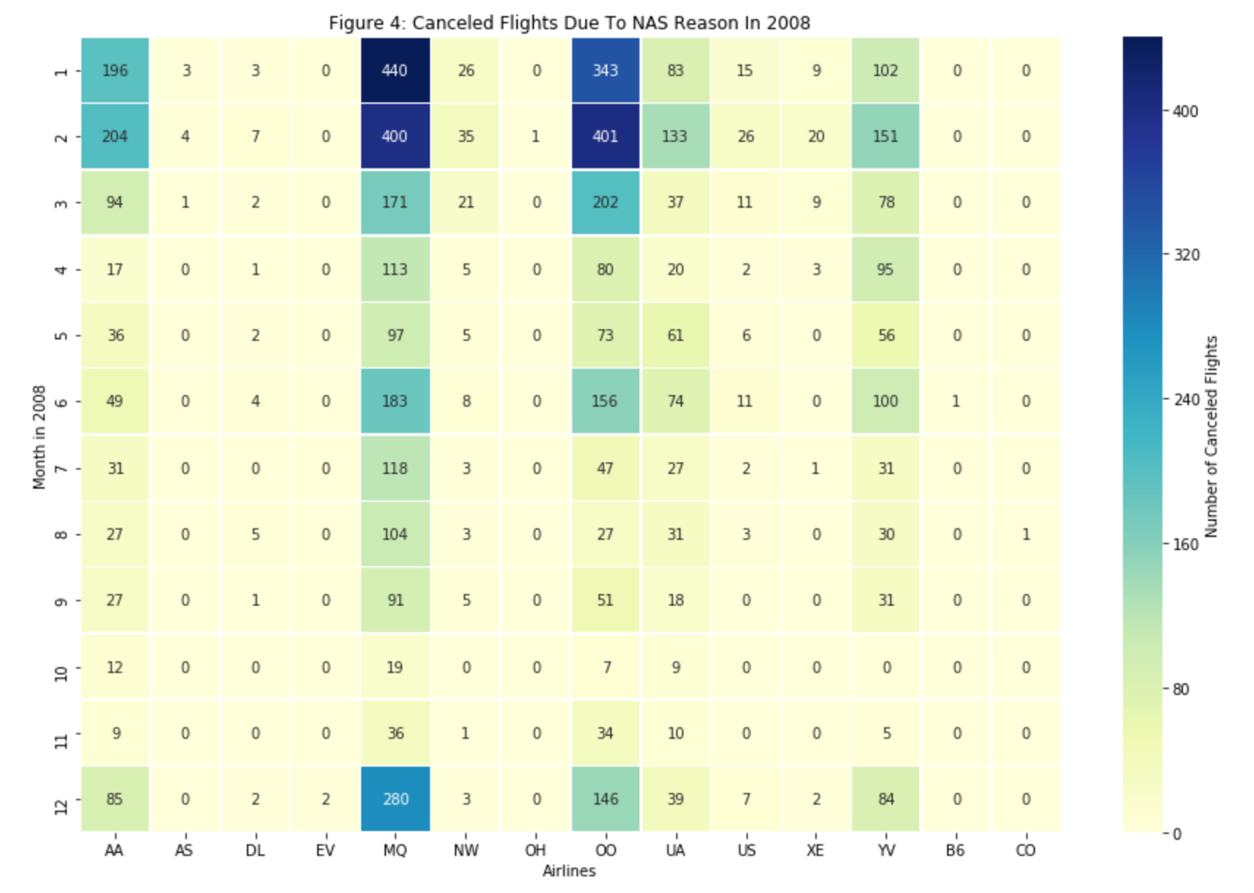
Heatmap

