Slide 1
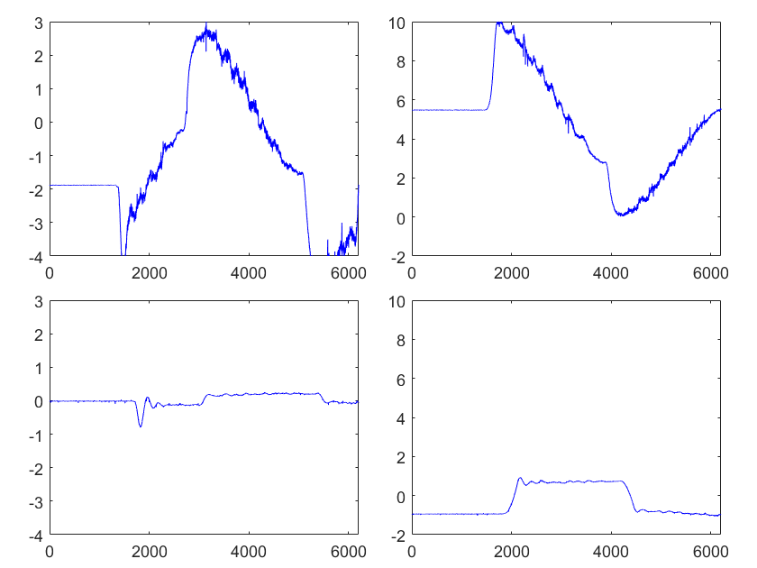
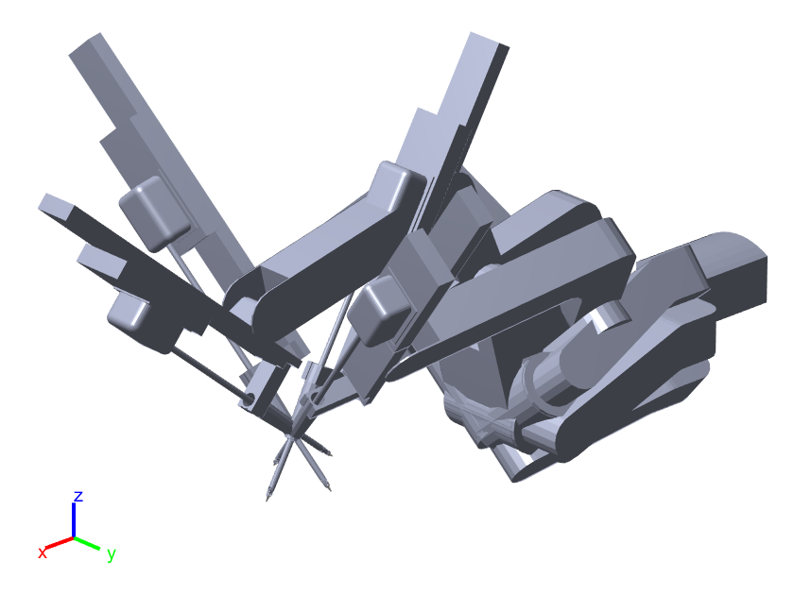
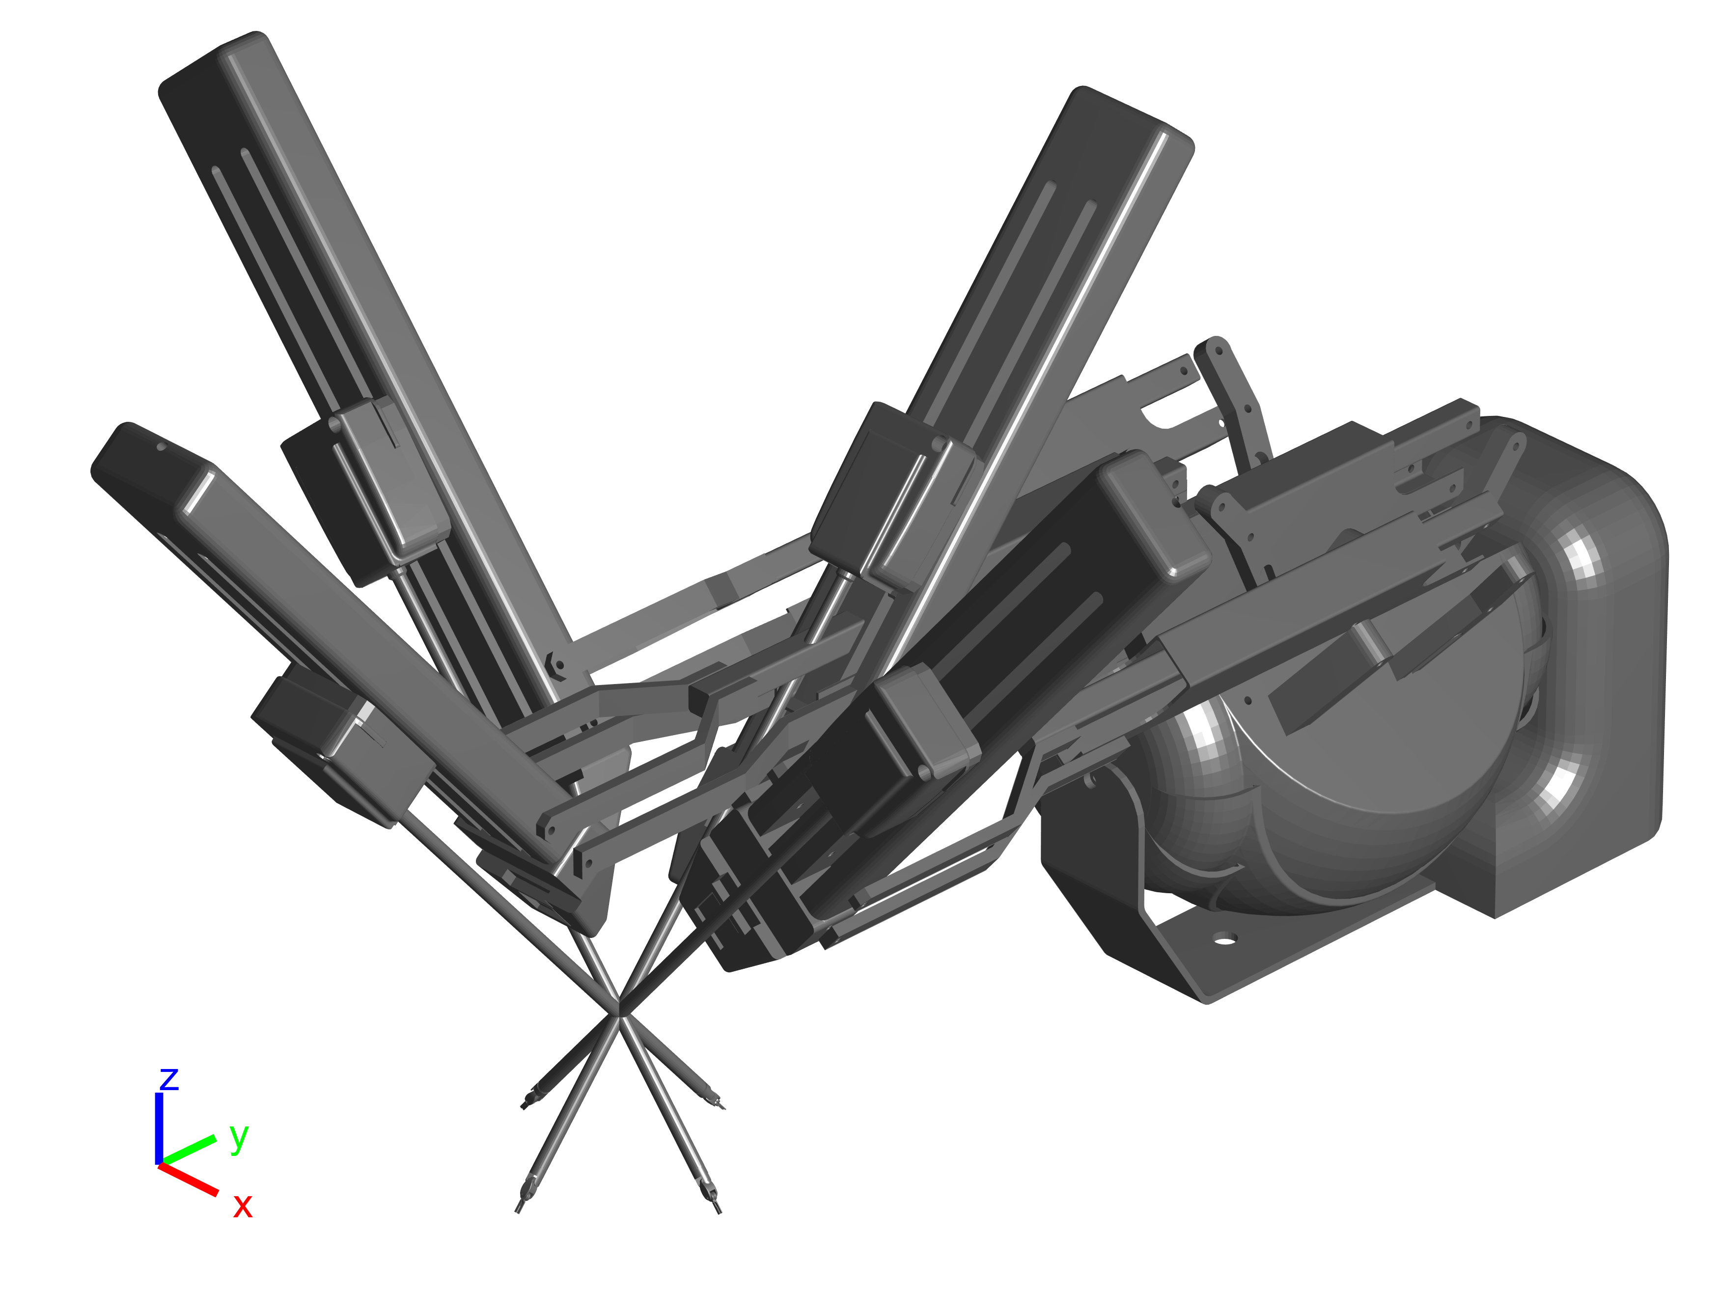

Slide 2
Command Joint Position
PID Controller
Command Joint Torque
Robot
Feedback Joint Position

