Slide 2
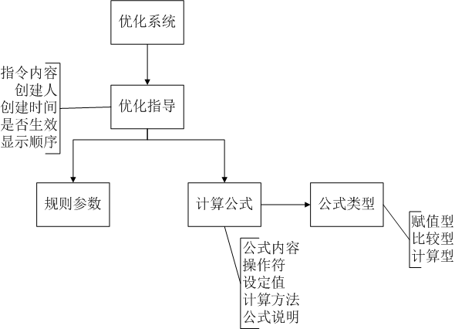
1
n
n
1
n
1
1

