Slide 1
System Programming
410921313 陳京生 410921365 陳祁鎔

Slide 2
INDEX
(1) problem description
(2) The way of writing the program
(3) program listing
(4) result screenshots
(5) discussion

Slide 3
Problem description
Assignment description
Write a simple SIC simulator that reads a standard SIC object program into memory.
Goal
(1) Get familiar with C programming language.
(2) Learn to use the I/O facilities and library functions provided by standard C.
(3) Get experience with the system-level programming.
(4) Get experience with separate compilation, make utility, and C debugger.

Slide 4
The way of writing the program
load: implement this algorithm with the functions provided by the professor.

Slide 5
Cont’d
show:
Output a file with the content loaded in the memory.
unload:
Initialize every variable that is used to load and show.
exit:
Break the while loop in main function to exit the program.
run:
Use the provided function to get OP code, check which one it is and then implement it.

Slide 6
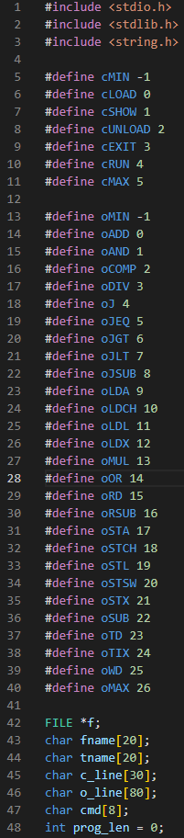
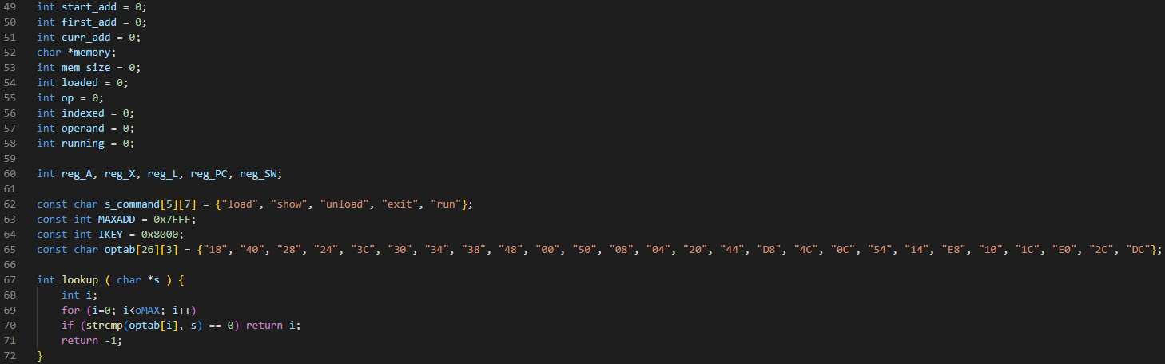
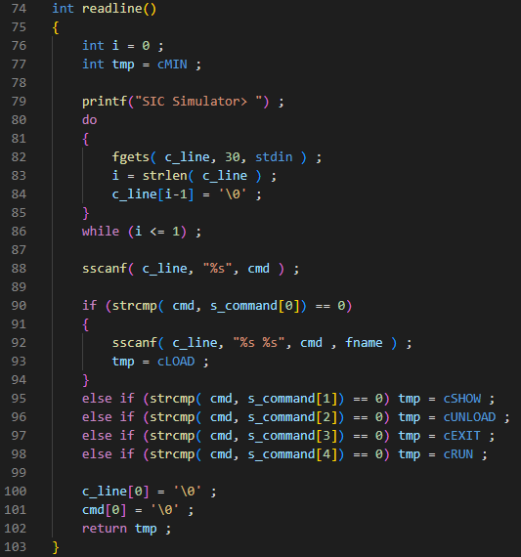
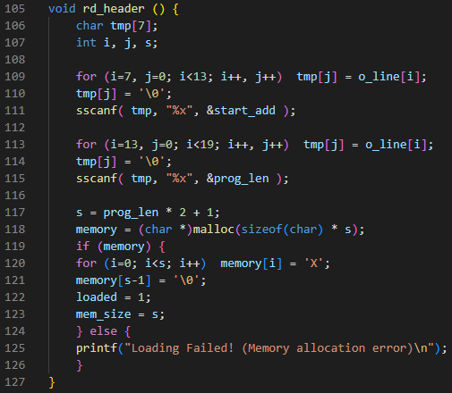
Program listing

Slide 7
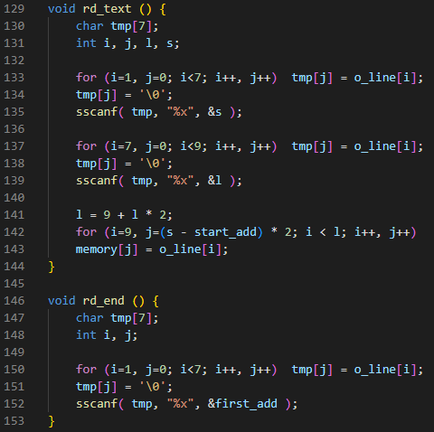
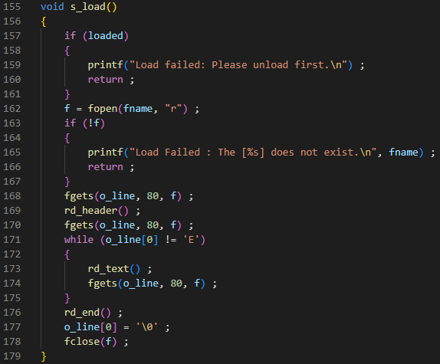

Slide 8
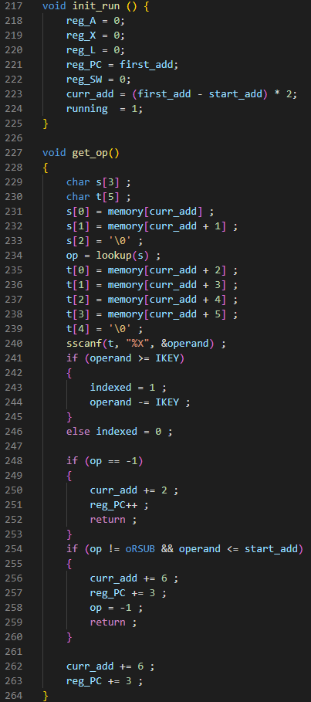
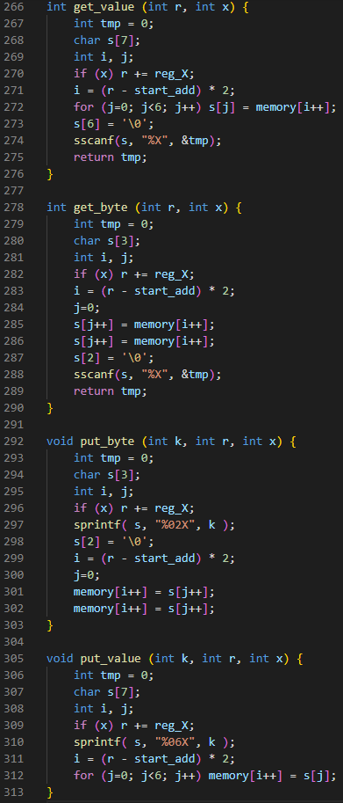
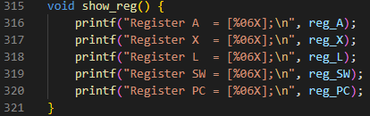
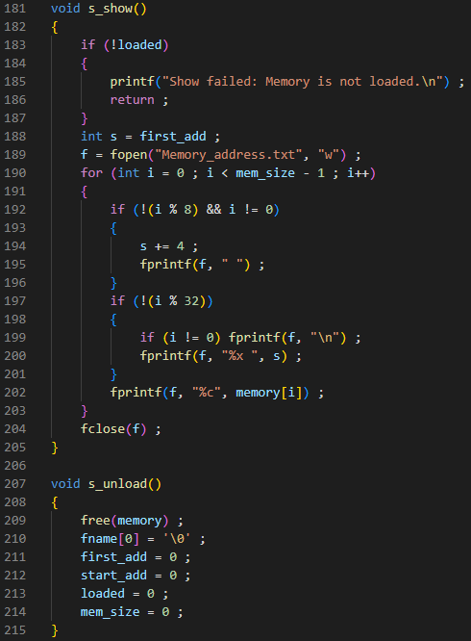
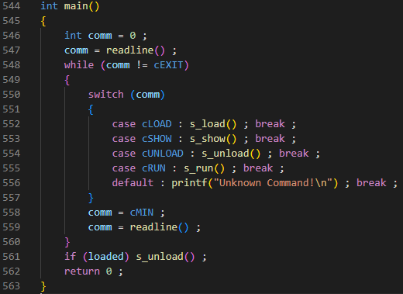

Slide 9
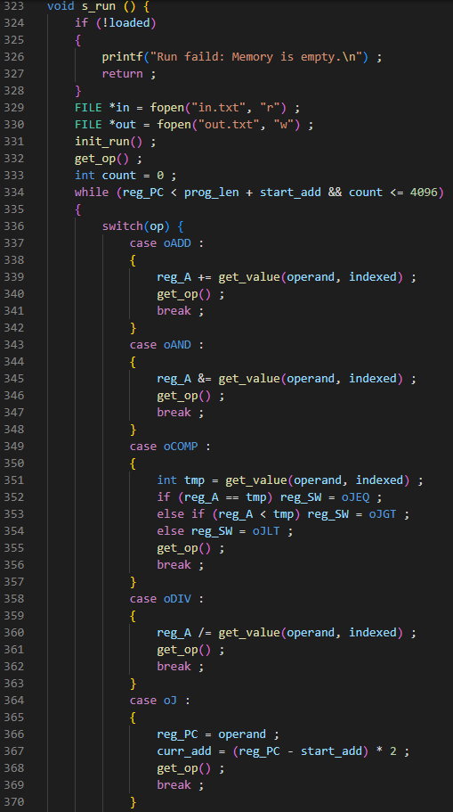
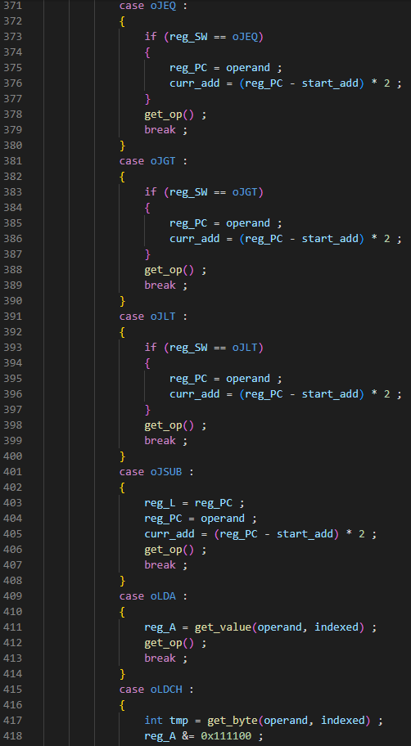
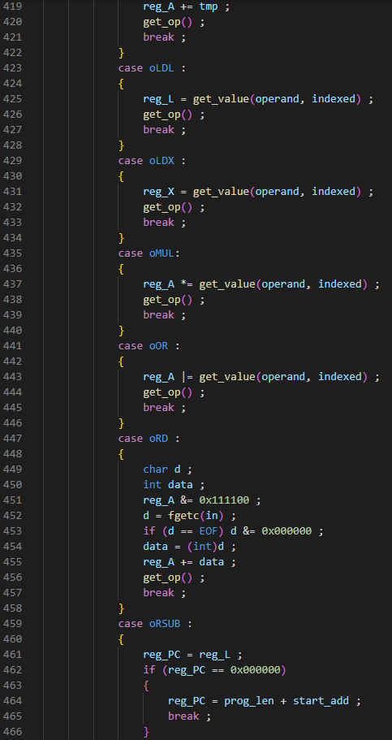

Slide 10
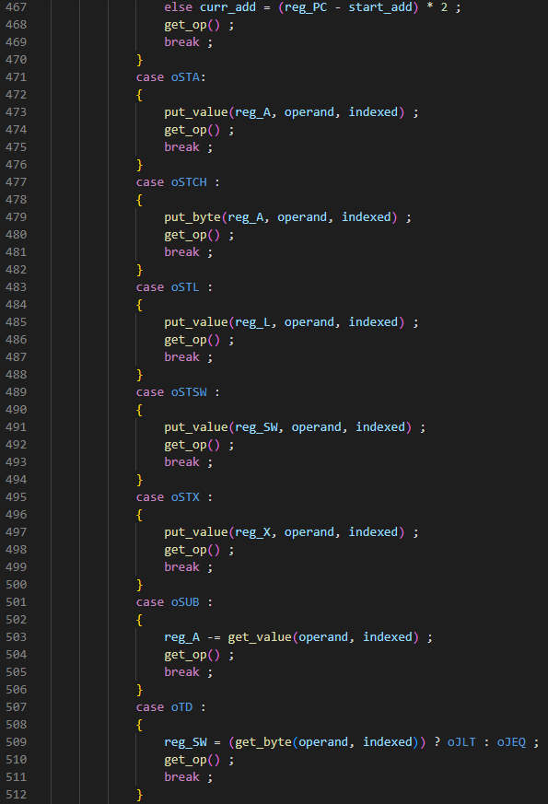
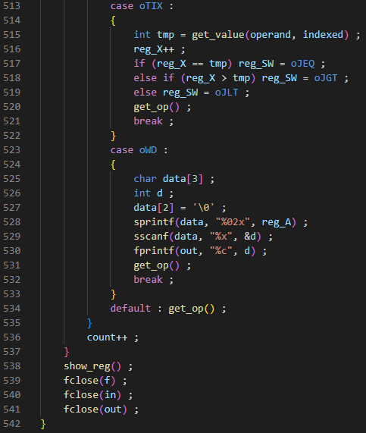

Slide 11
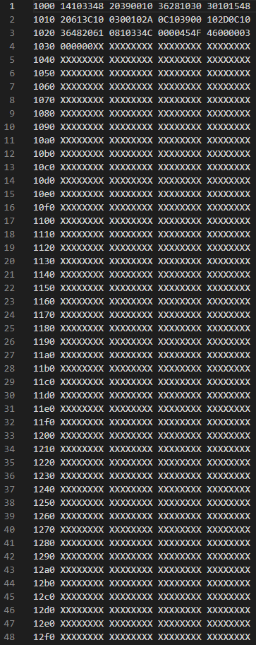
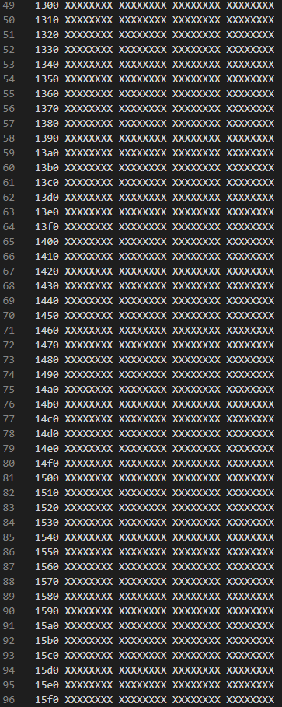
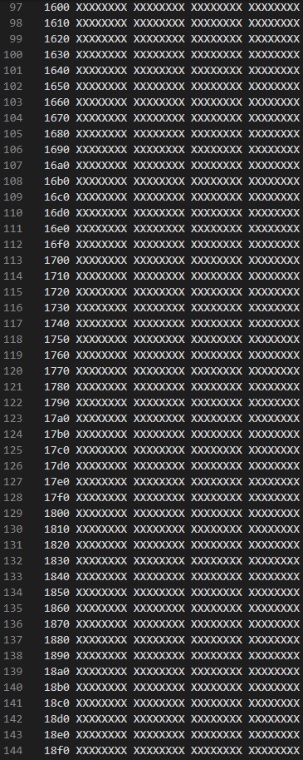
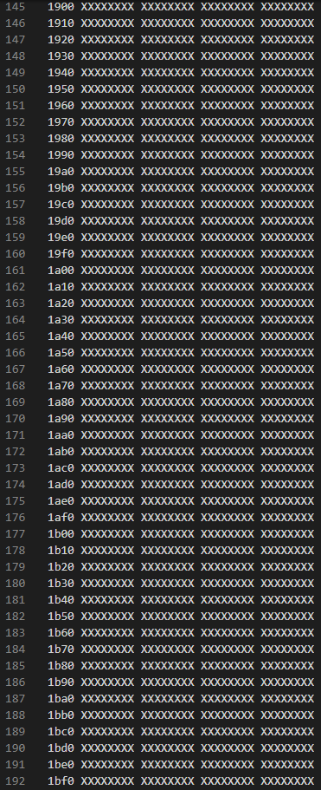
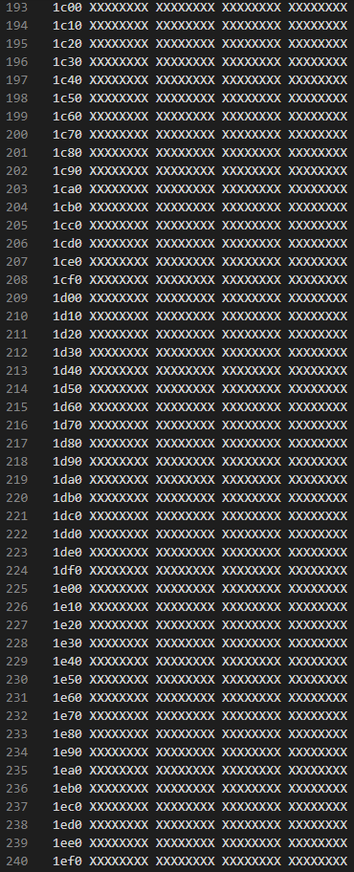
Results screenshots: test1.obj

Slide 12
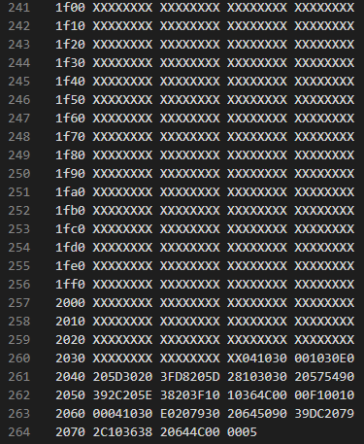
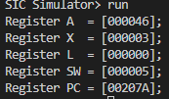



Slide 13

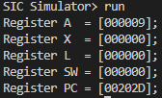
Results screenshots: test2.obj

Slide 14
Discussion
I am happy that we can learn how to implement a loader through this assignment. It is simple to complete since some functions are already provided. However, it is not quite easy to finish all functions because you need to realize how the loader works. It is my pleasure that I can learn more about system-programming and C language. I would suggest others to come to this class.

