Slide 1
a
ND
PD
Establishment
probability
FD
RFD

Slide 2
b
ND
PD
Dominance
probability
FD
RFD

Slide 3
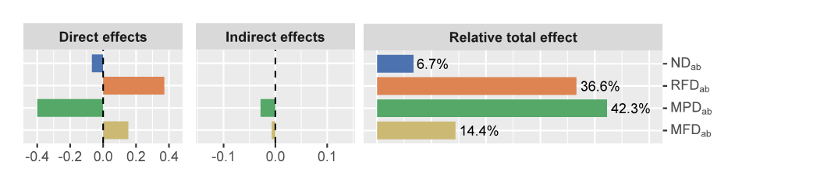
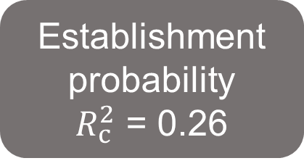
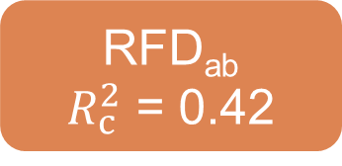
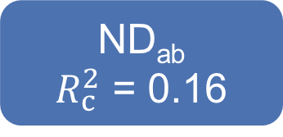
-0.35
ND_{ab}
$R_{c}^{2}$ = 0.16
-0.03
MPD_{ab}
0.14
Establishment
probability
$R_{c}^{2}$ = 0.26
-0.03
0.08
0.20
MFD_{ab}
RFD_{ab}
$R_{c}^{2}$ = 0.42
-0.07
-0.22
Fisher’s C = 0.691, P = 0.708, AIC = 48019.836

Slide 4
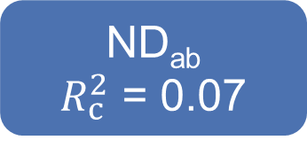
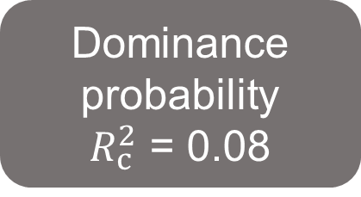
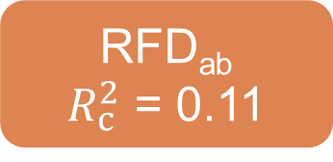
-0.09
ND_{ab}
$R_{c}^{2}$ = 0.07
-0.01
MPD_{ab}
0.09
Dominance
probability
$R_{c}^{2}$ = 0.08
0.02
0.30
MFD_{ab}
0.07
0.06
RFD_{ab}
$R_{c}^{2}$ = 0.11
-0.05
Fisher’s C = 1.883, P = 0.39, AIC = 10734.053

Slide 5
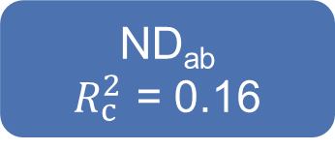
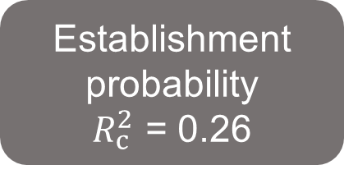
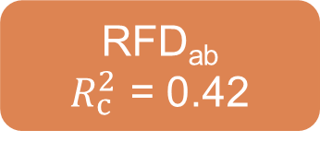
-0.35
ND_{ab}
$R_{c}^{2}$ = 0.16
-0.03
MPD_{ab}
0.14
Establishment
probability
$R_{c}^{2}$ = 0.26
-0.03
0.08
MFD_{ab}
0.20
-0.07
RFD_{ab}
$R_{c}^{2}$ = 0.42
-0.22
Fisher’s C = 0.691, P = 0.708, AIC = 48019.836

Slide 6

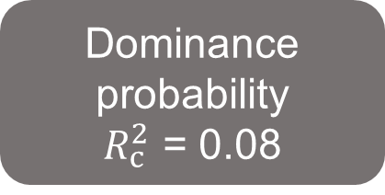
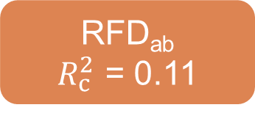
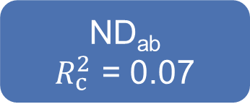
-0.09
ND_{ab}
$R_{c}^{2}$ = 0.07
-0.01
MPD_{ab}
0.09
Dominance
probability
$R_{c}^{2}$ = 0.08
0.02
0.30
Dominance
probability
$R_{c}^{2}$ = 0.08
MFD_{ab}
0.07
0.06
RFD_{ab}
$R_{c}^{2}$ = 0.11
-0.05
Fisher’s C = 0.691, P = 0.708, AIC = 48019.836

