Slide 1
Phylogenetic difference (PD)
Niche difference (ND)
Establishment or dominance
probability
MFD_{ab}
Functional difference (FD)
Relative fitness difference (RFD)

Slide 2
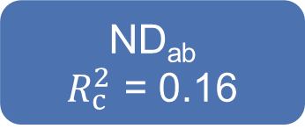
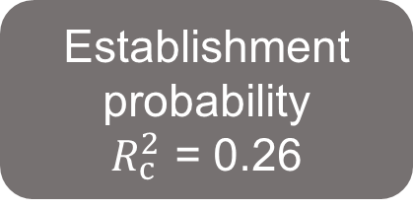
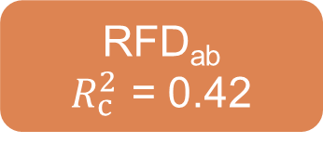
-0.35
ND_{ab}
$R_{c}^{2}$ = 0.16
MPD_{ab}
-0.03
0.14
Establishment
probability
$R_{c}^{2}$ = 0.26
-0.06
-0.03
0.08
0.20
MFD_{ab}
-0.07
RFD_{ab}
$R_{c}^{2}$ = 0.42
-0.22
Fisher’s C = 0.691, P = 0.708, AIC = 48019.836

Slide 3

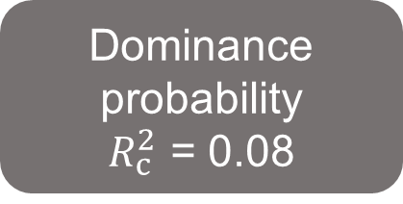
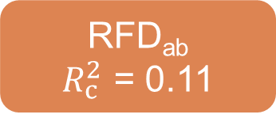
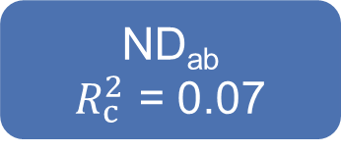
-0.09
ND_{ab}
$R_{c}^{2}$ = 0.07
MPD_{ab}
-0.01
0.13
Dominance
probability
$R_{c}^{2}$ = 0.08
0.15
0.30
0.02
Dominance
probability
$R_{c}^{2}$ = 0.08
0.14
MFD_{ab}
0.06
RFD_{ab}
$R_{c}^{2}$ = 0.11
-0.05
Fisher’s C = 1.883, P = 0.390, AIC = 10734.053

Slide 4



-0.35
$R_{c}^{2}$ = 0.16
Phylogenetic difference (MPD_{ab})
-0.03
Niche difference (ND_{ab})
0.14
Establishment
probability
-0.06
-0.03
0.08
0.20
MFD_{ab}
$R_{c}^{2}$ = 0.26
Functional difference (MFD_{ab})
-0.07
Relative fitness difference (RFD_{ab})
$R_{c}^{2}$ = 0.42
-0.22
Fisher’s C = 0.691, P = 0.708, AIC = 48019.836

Slide 5



-0.09
$R_{c}^{2}$ = 0.07
Phylogenetic difference (MPD_{ab})
-0.01
Niche difference
(ND_{ab})
0.13
Dominance
probability
0.02
0.15
0.30
0.14
MFD_{ab}
$R_{c}^{2}$ = 0.08
Functional difference (MFD_{ab})
0.06
Relative fitness difference (RFD_{ab})
$R_{c}^{2}$ = 0.11
-0.05
Fisher’s C = 1.883, P = 0.390, AIC = 10734.053

