Slide 1
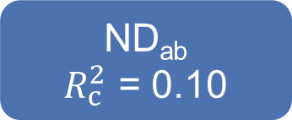
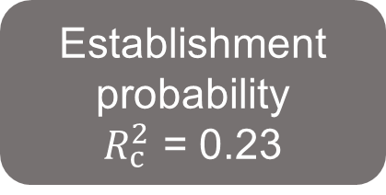
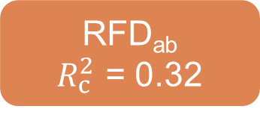
-0.34
ND_{ab}
$R_{c}^{2}$ = 0.10
-0.04
MPD_{ab}
0.09
Establishment
probability
$R_{c}^{2}$ = 0.23
-0.03
0.12
MFD_{ab}
0.20
-0.09
RFD_{ab}
$R_{c}^{2}$ = 0.32
-0.19
Fisher’s C = 1.011, P = 0.603, AIC = 42407.119

Slide 2

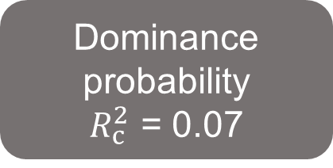
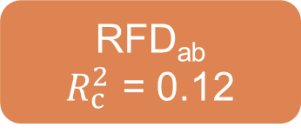

-0.06
ND_{ab}
$R_{c}^{2}$ = 0.74
-0.04
MPD_{ab}
0.04
Dominance
probability
$R_{c}^{2}$ = 0.07
-0.03
0.29
Dominance
probability
$R_{c}^{2}$ = 0.08
MFD_{ab}
0.17
0.03
RFD_{ab}
$R_{c}^{2}$ = 0.12
-0.01
Fisher’s C = 4.749, P = 0.093, AIC = 10885.128

Slide 3



-0.34
$R_{c}^{2}$ = 0.10
Phylogenetic difference (MPD_{ab})
-0.04
Niche difference (ND_{ab})
0.09
Establishment
probability
-0.09
-0.03
0.12
0.20
MFD_{ab}
$R_{c}^{2}$ = 0.23
Functional difference (MFD_{ab})
-0.09
Relative fitness difference (RFD_{ab})
$R_{c}^{2}$ = 0.32
-0.19
Fisher’s C = 1.011, P = 0.603, AIC = 42407.119

Slide 4



-0.06
$R_{c}^{2}$ = 0.74
Phylogenetic difference (MPD_{ab})
-0.04
Niche difference
(ND_{ab})
0.04
-0.03
Dominance
probability
0.15
0.29
0.17
MFD_{ab}
$R_{c}^{2}$ = 0.07
Functional difference (MFD_{ab})
0.03
Relative fitness difference (RFD_{ab})
$R_{c}^{2}$ = 0.12
-0.01
Fisher’s C = 4.749, P = 0.093, AIC = 10885.128

