Slide 1
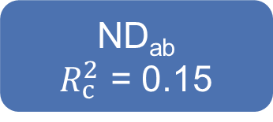
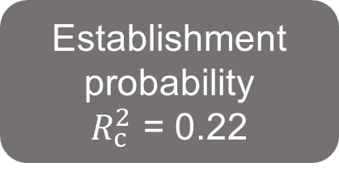
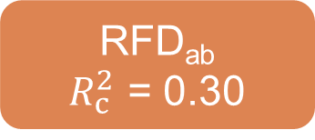
-0.33
ND_{ab}
$R_{c}^{2}$ = 0.15
-0.03
MPD_{ab}
0.07
Establishment
probability
$R_{c}^{2}$ = 0.22
-0.04
0.19
MFD_{ab}
0.22
-0.13
RFD_{ab}
$R_{c}^{2}$ = 0.30
-0.19
Fisher’s C = 0.842, P = 0.656, AIC = 34911.344

Slide 2

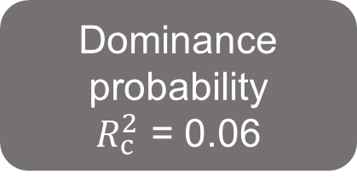
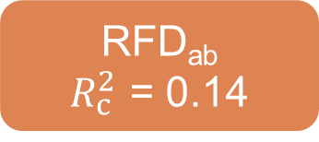
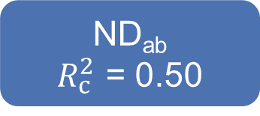
-0.05
ND_{ab}
$R_{c}^{2}$ = 0.50
-0.01
MPD_{ab}
0.03
Dominance
probability
$R_{c}^{2}$ = 0.06
-0.01
0.37
Dominance
probability
$R_{c}^{2}$ = 0.08
MFD_{ab}
0.15
0.01
RFD_{ab}
$R_{c}^{2}$ = 0.14
-0.03
Fisher’s C = 1.323, P = 0.520, AIC = 10731.800

Slide 3



-0.33
$R_{c}^{2}$ = 0.15
Phylogenetic difference (MPD_{ab})
-0.03
Niche difference (ND_{ab})
0.07
Establishment
probability
-0.15
-0.04
0.19
0.22
MFD_{ab}
$R_{c}^{2}$ = 0.22
Functional difference (MFD_{ab})
-0.13
Relative fitness difference (RFD_{ab})
$R_{c}^{2}$ = 0.30
-0.19
Fisher’s C = 0.842, P = 0.656, AIC = 34911.344

Slide 4



-0.05
$R_{c}^{2}$ = 0.50
Phylogenetic difference (MPD_{ab})
-0.01
Niche difference
(ND_{ab})
0.03
-0.01
Dominance
probability
0.09
0.37
0.15
MFD_{ab}
$R_{c}^{2}$ = 0.06
Functional difference (MFD_{ab})
0.01
Relative fitness difference (RFD_{ab})
$R_{c}^{2}$ = 0.14
-0.03
Fisher’s C = 1.323, P = 0.520, AIC = 10731.800

