Slide 1
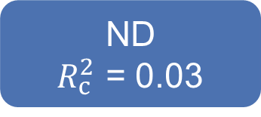
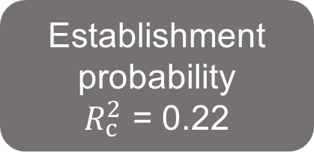
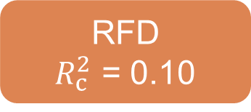
-0.36
ND
$R_{c}^{2}$ = 0.03
-0.02
MPD
0.09
Establishment
probability
$R_{c}^{2}$ = 0.22
0.04
0.18
MFD
0.20
0.02
RFD
$R_{c}^{2}$ = 0.10
-0.08
Fisher’s C = 0.113, P = 0.945, AIC = 50886.191

Slide 2

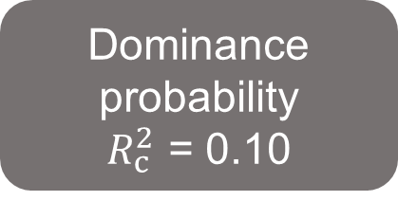
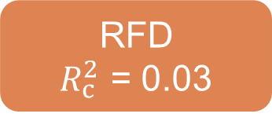

-0.02
ND
$R_{c}^{2}$ = 0.03
-0.0001
MPD
0.14
Dominance
probability
$R_{c}^{2}$ = 0.10
0.08
0.49
Dominance
probability
$R_{c}^{2}$ = 0.08
MFD
0.15
0.18
RFD
$R_{c}^{2}$ = 0.03
-0.06
Fisher’s C = 1.666, P = 0.435, AIC = 11023.246

Slide 3



-0.36
$R_{c}^{2}$ = 0.03
Phylogenetic difference (MPD)
-0.02
Niche difference (ND)
0.09
Establishment
probability
0.04
-0.10
0.18
0.20
MFD_{ab}
$R_{c}^{2}$ = 0.22
Functional difference (MFD)
0.02
Relative fitness difference (RFD)
$R_{c}^{2}$ = 0.10
-0.08
Fisher’s C = 0.113, P = 0.945, AIC = 50886.191

Slide 4



-0.02
$R_{c}^{2}$ = 0.03
Phylogenetic difference (MPD)
< -0.01
Niche difference
(ND)
0.14
0.08
Dominance
probability
0.03
0.49
0.15
MFD_{ab}
$R_{c}^{2}$ = 0.10
Functional difference (MFD)
0.18
Relative fitness difference (RFD)
$R_{c}^{2}$ = 0.03
-0.06
Fisher’s C = 1.666, P = 0.435, AIC = 11023.246

