Slide 1
Phylogenetic difference (PD)
Niche difference (ND)
Establishment or dominance
probability
MFD_{ab}
Functional difference (FD)
Relative fitness difference (RFD)

Slide 2







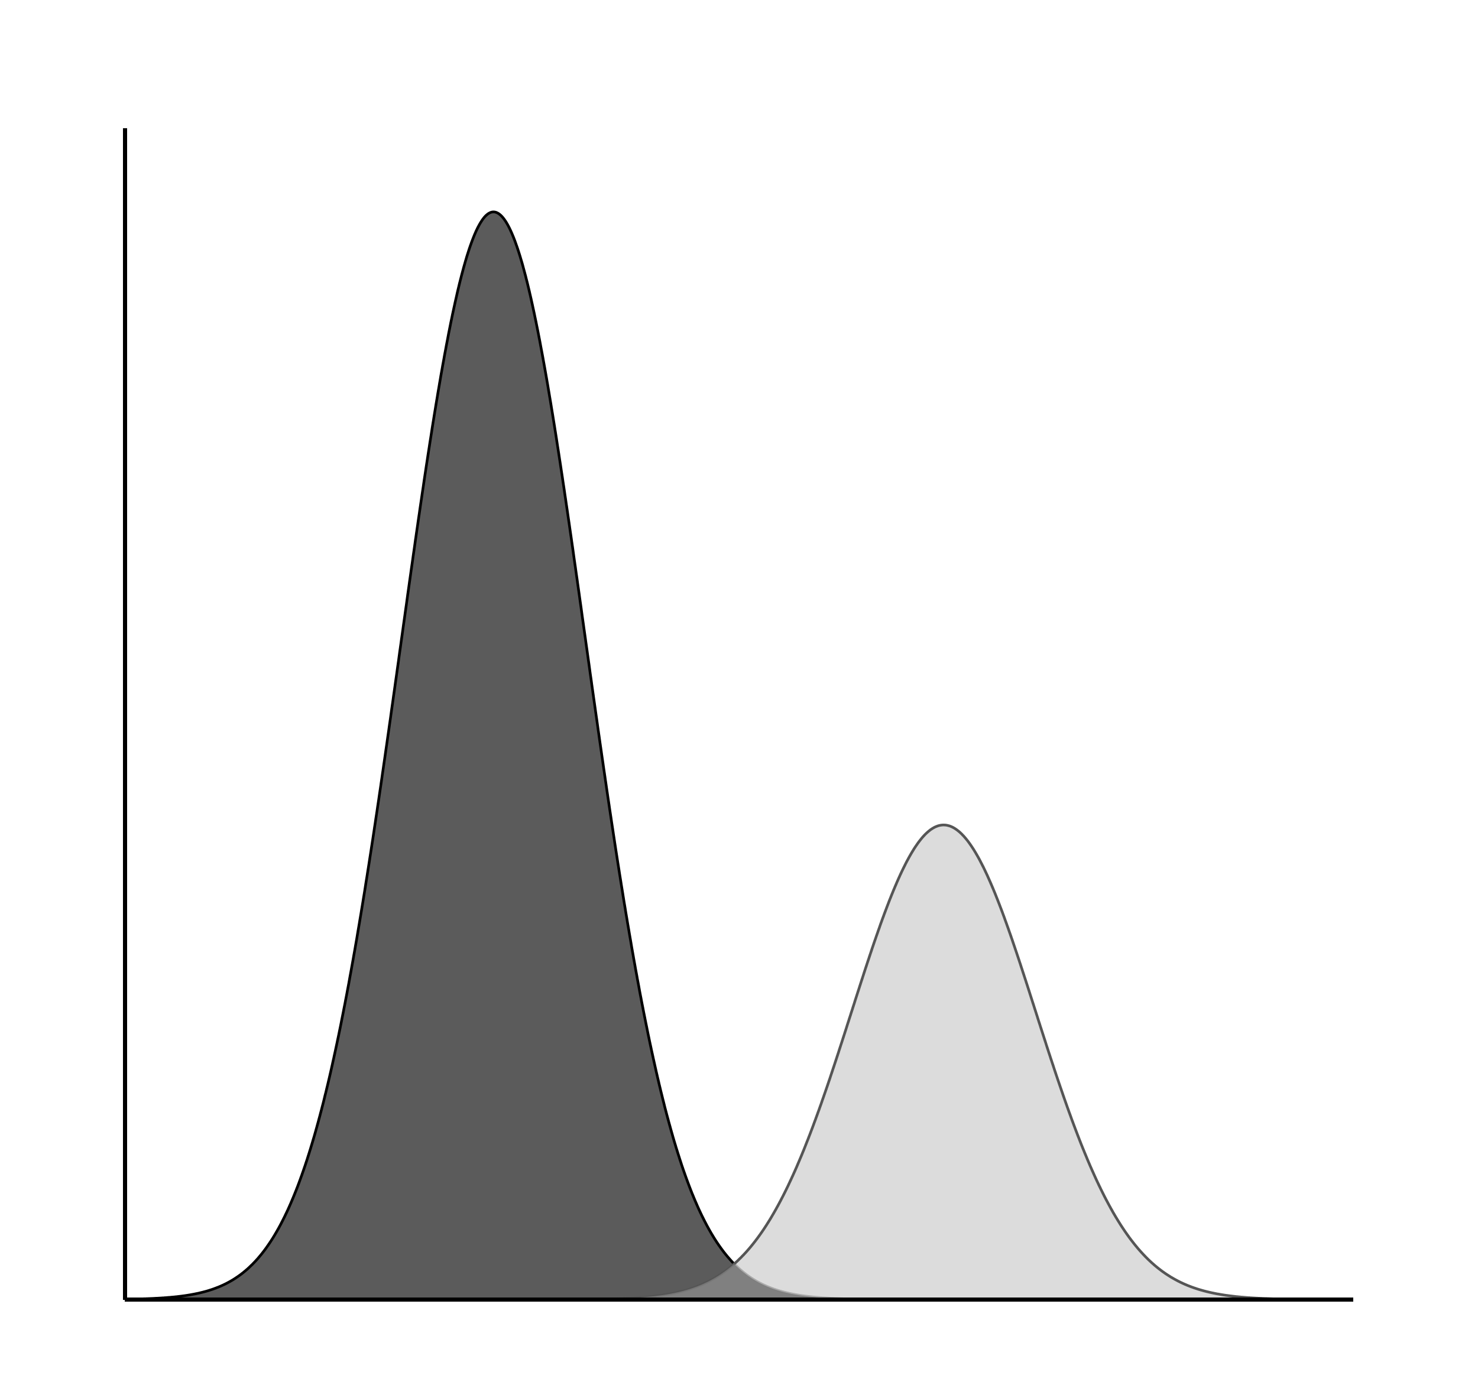
Phylogenetic difference
(PD)
Functional difference
(FD)
Niche difference
(ND)
Relative fitness difference
(RFD)
Exotics
Natives
Establishment or dominance
probability

Slide 3

Phylogenetic difference
(PD)
Functional difference
(FD)
Niche difference
(ND)
Relative fitness difference
(RFD)
Exotics
Natives
Establishment or dominance
probability

Slide 4



-0.35
$R_{c}^{2}$ = 0.16
Phylogenetic difference (MPD_{ab})
-0.03
Niche difference (ND_{ab})
0.14
Establishment
probability
-0.06
-0.03
0.08
0.20
MFD_{ab}
$R_{c}^{2}$ = 0.26
Functional difference (MFD_{ab})
-0.07
Relative fitness difference (RFD_{ab})
$R_{c}^{2}$ = 0.42
-0.22
Fisher’s C = 0.691, P = 0.708, AIC = 48019.836

Slide 5



-0.09
$R_{c}^{2}$ = 0.07
Phylogenetic difference (MPD_{ab})
-0.01
Niche difference
(ND_{ab})
0.13
Dominance
probability
0.02
0.15
0.30
0.14
MFD_{ab}
$R_{c}^{2}$ = 0.08
Functional difference (MFD_{ab})
0.06
Relative fitness difference (RFD_{ab})
$R_{c}^{2}$ = 0.11
-0.05
Fisher’s C = 1.883, P = 0.390, AIC = 10734.053

Slide 6
-0.09
$R_{c}^{2}$ = 0.07
Phylogenetic difference (MPD_{ab})
-0.01
Niche difference
(ND_{ab})
0.13
Dominance
probability
0.02
0.15
0.30
0.14
MFD_{ab}
$R_{c}^{2}$ = 0.08
Functional difference (MFD_{ab})
0.06
Relative fitness difference (RFD_{ab})
$R_{c}^{2}$ = 0.11
-0.05
Fisher’s C = 1.883, P = 0.390, AIC = 10734.053

Slide 7
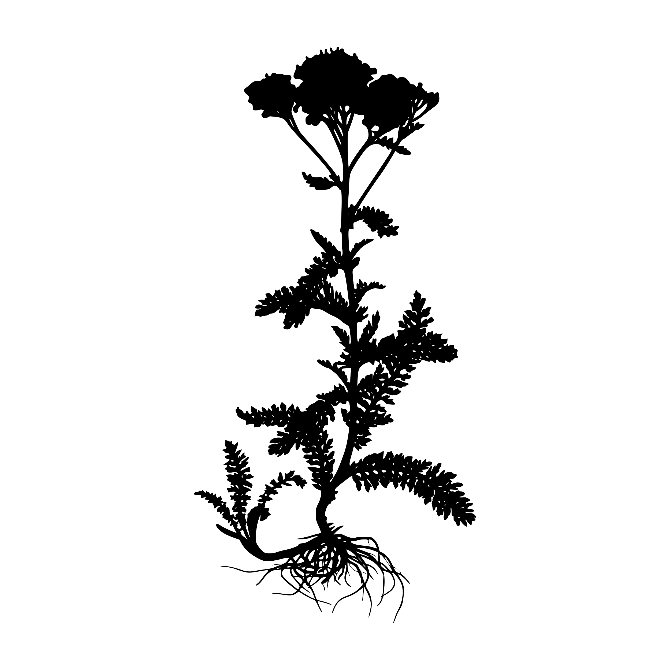
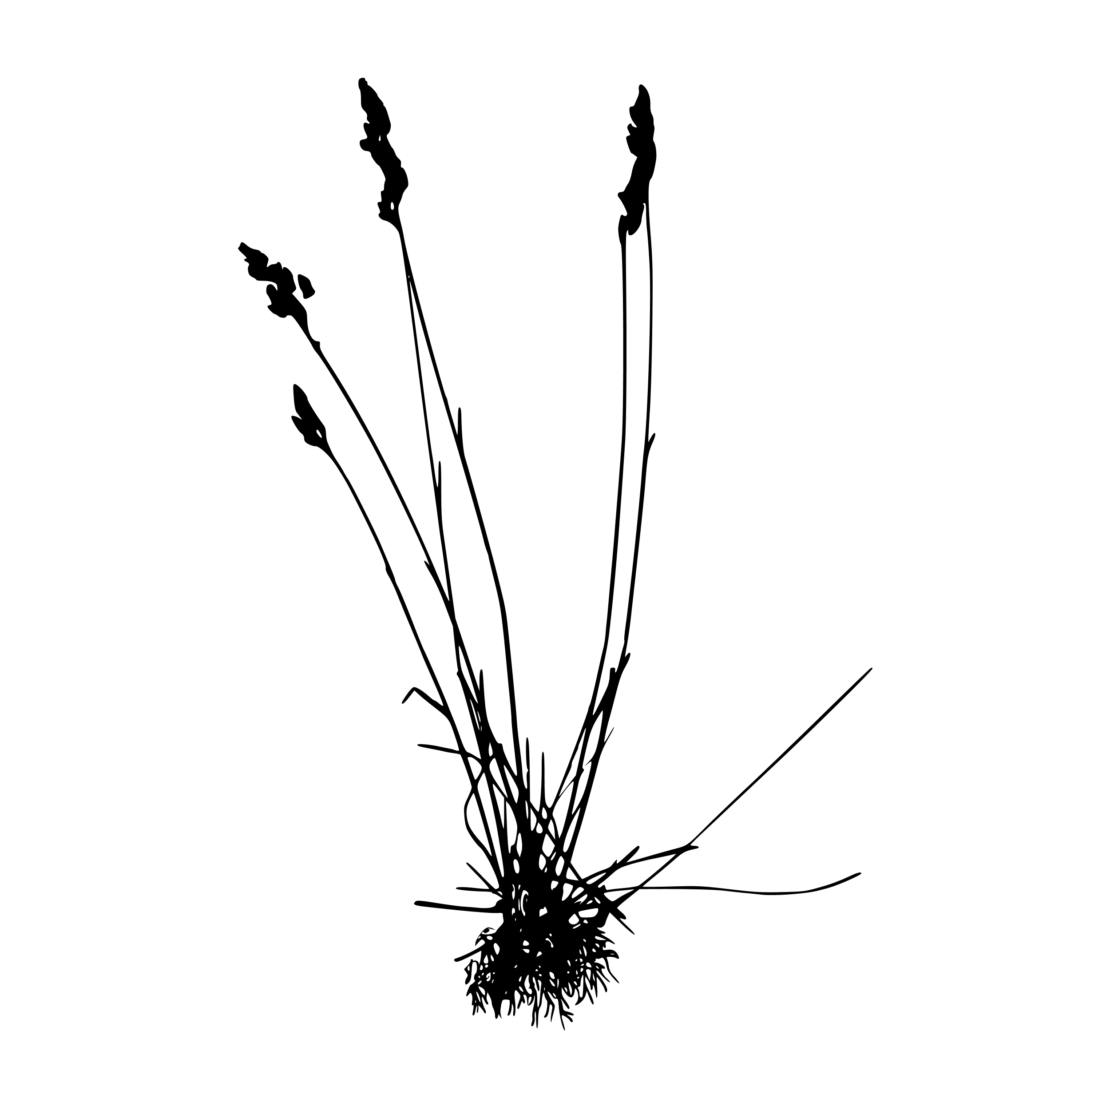





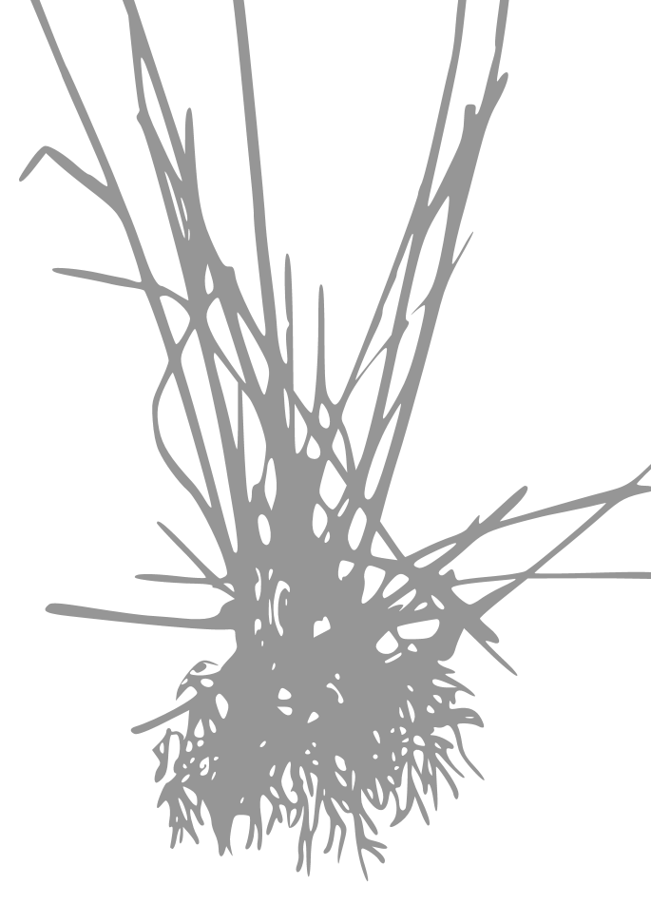
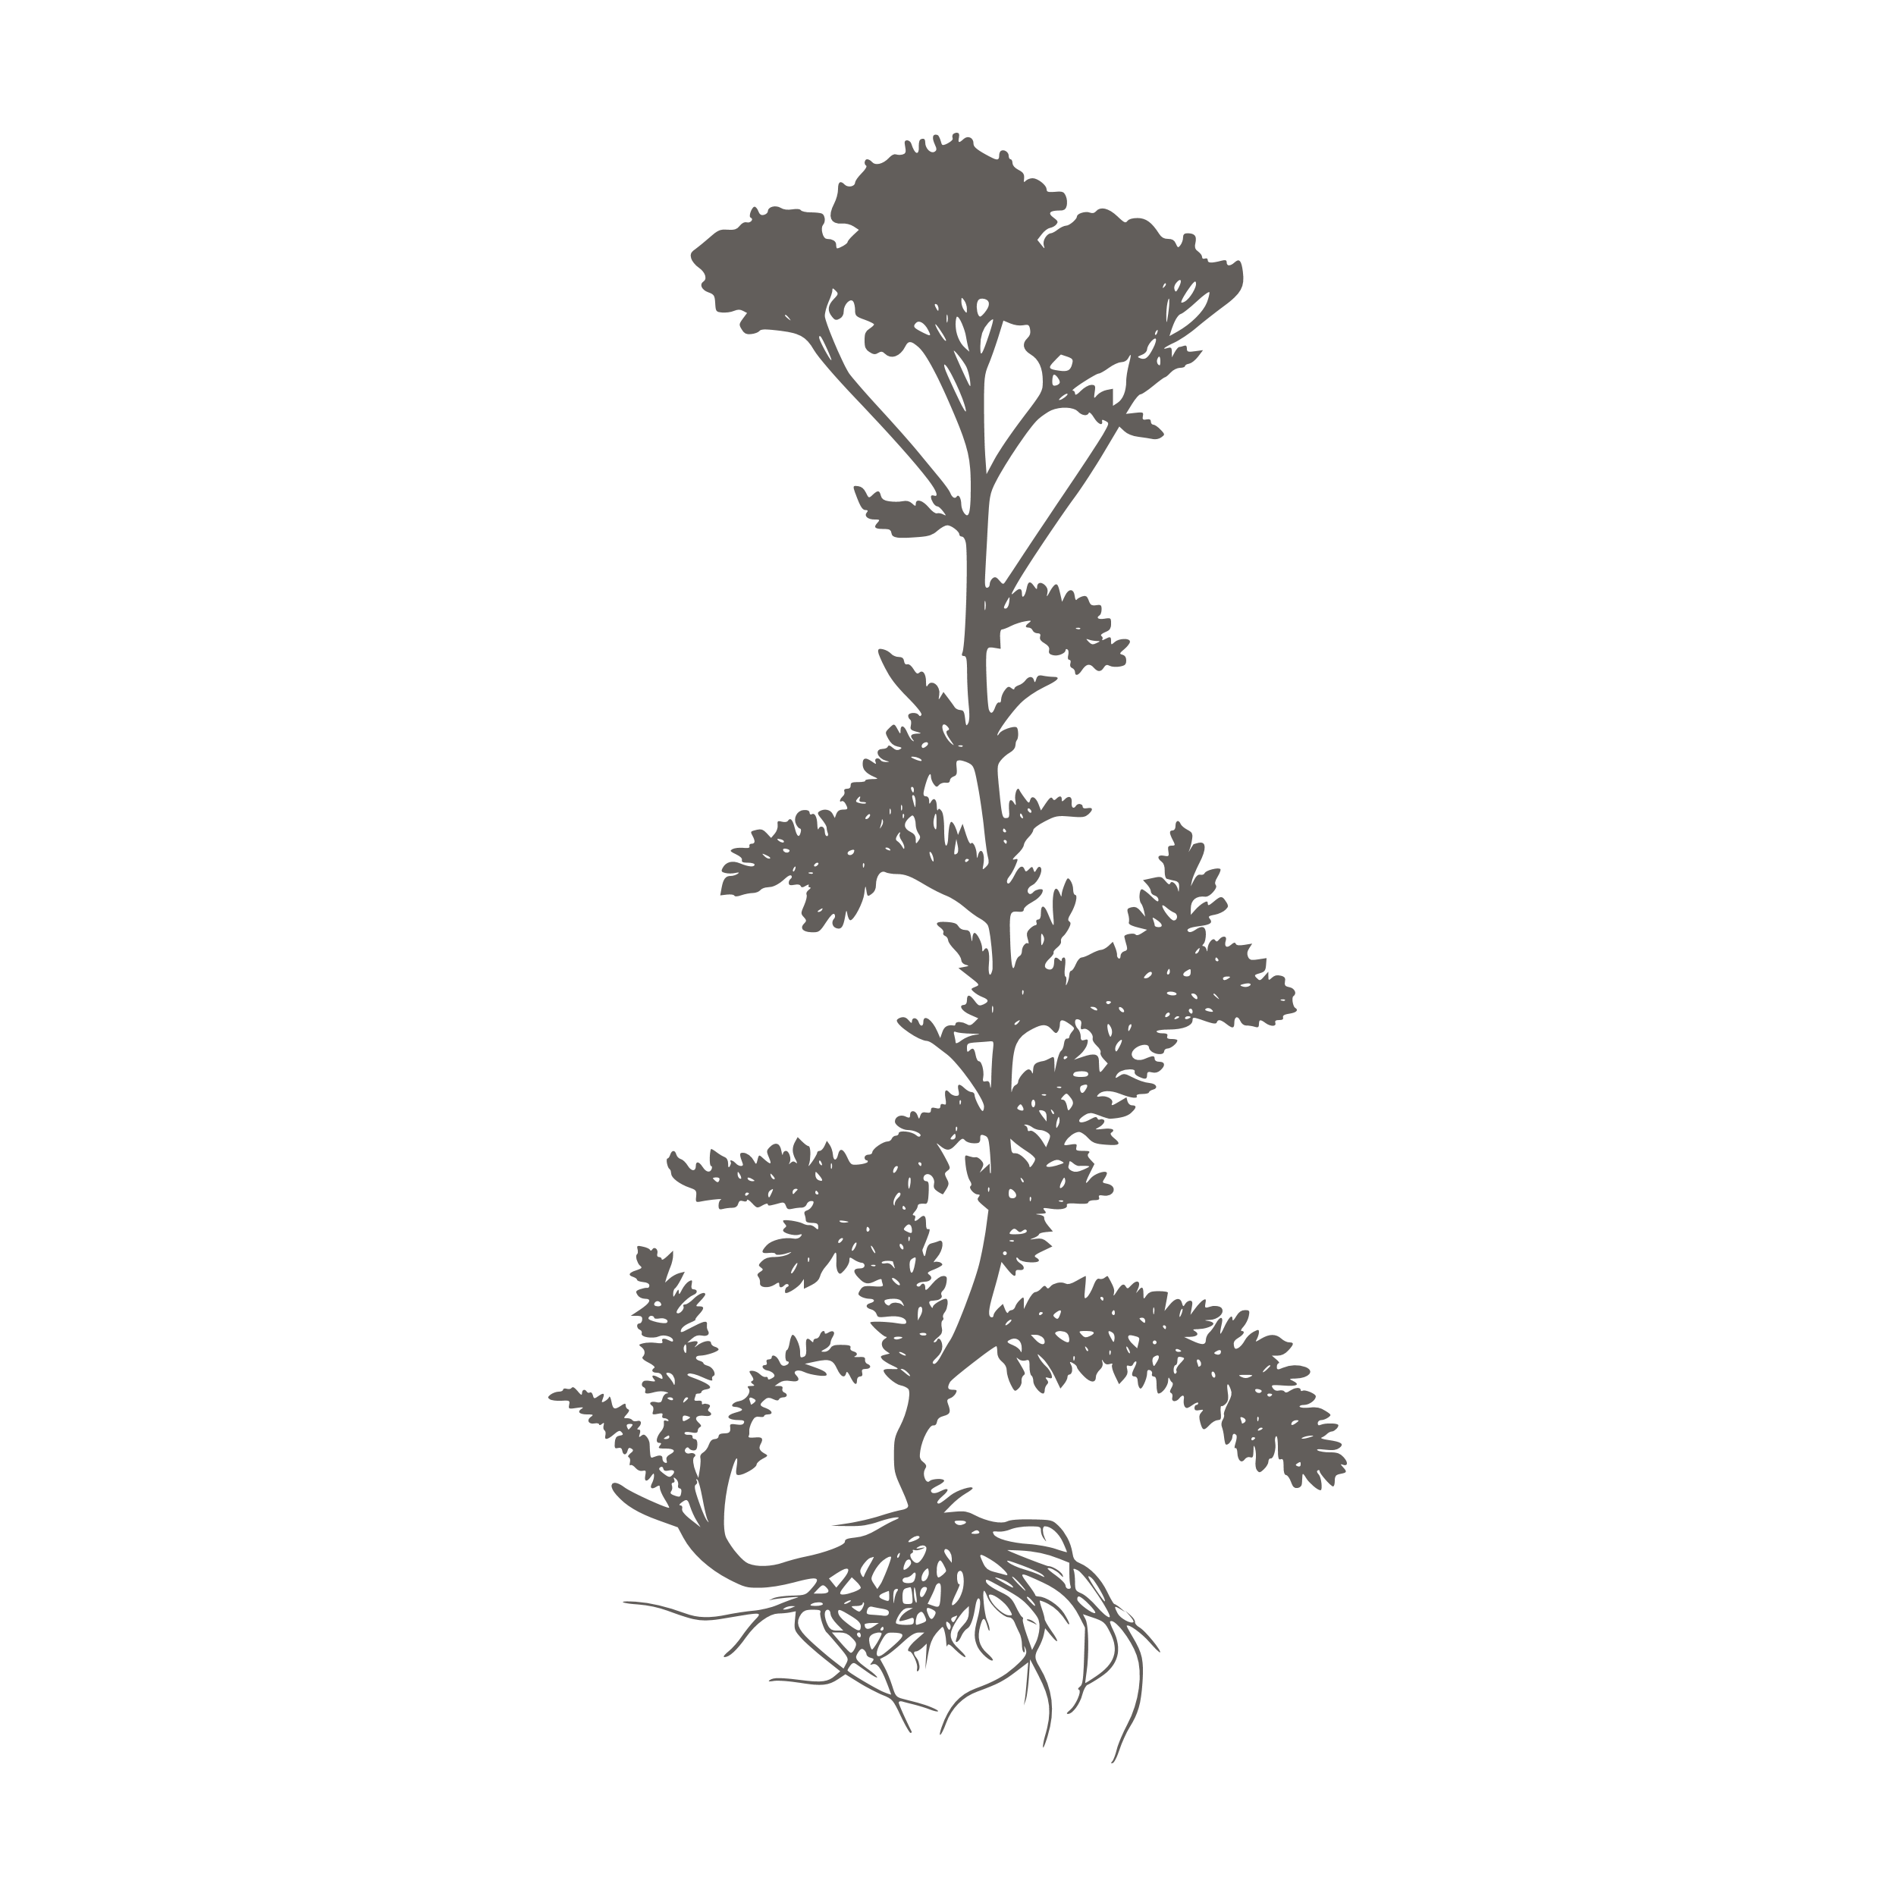
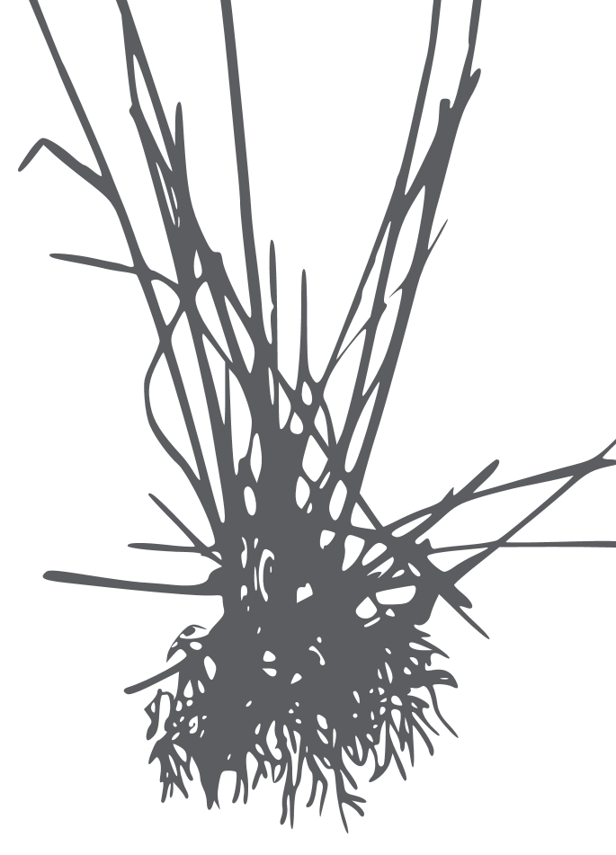
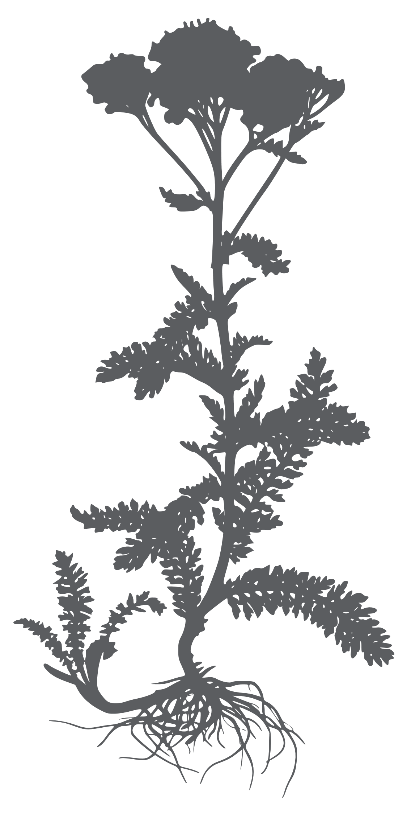

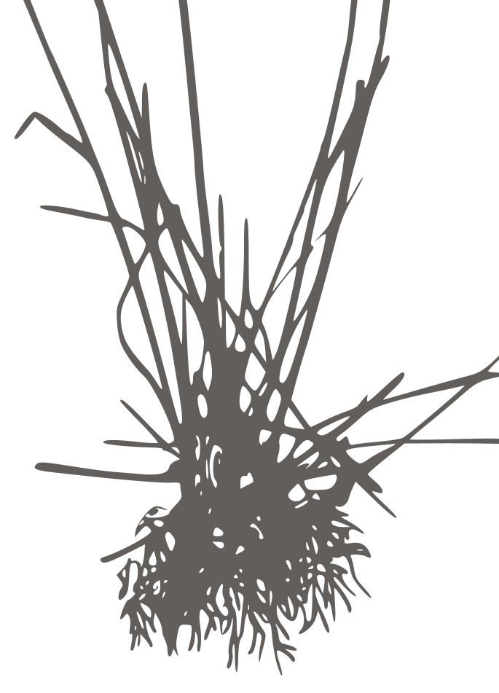


-0.35
$R_{c}^{2}$ = 0.16
Phylogenetic difference (MPD_{ab})
Niche difference (ND_{ab})
-0.03
0.14
Establishment
probability
-0.06
-0.03
0.08
0.20
Functional difference (MFD_{ab})
Relative fitness difference (RFD_{ab})
MFD_{ab}
$R_{c}^{2}$ = 0.26
-0.07
$R_{c}^{2}$ = 0.42
-0.22
Fisher’s C = 0.691, P = 0.708, AIC = 48019.836

Slide 8


-0.35
$R_{c}^{2}$ = 0.16
Phylogenetic difference (MPD_{ab})
Niche difference (ND_{ab})
-0.03
0.14
Establishment
probability
-0.06
-0.03
0.08
0.20
Functional difference (MFD_{ab})
Relative fitness difference (RFD_{ab})
MFD_{ab}
$R_{c}^{2}$ = 0.26
-0.07
$R_{c}^{2}$ = 0.42
-0.22
Fisher’s C = 0.691, P = 0.708, AIC = 48019.836

Slide 9



-0.35
$R_{c}^{2}$ = 0.16
Phylogenetic difference (MPD_{ab})
Niche difference (ND_{ab})
-0.03
0.14
Establishment
probability
-0.06
-0.03
0.08
0.20
Functional difference (MFD_{ab})
Relative fitness difference (RFD_{ab})
-0.07
$R_{c}^{2}$ = 0.26
$R_{c}^{2}$ = 0.42
-0.22
Fisher’s C = 0.691, P = 0.708, AIC = 48019.836

Slide 10




-0.09
$R_{c}^{2}$ = 0.07
Phylogenetic difference (MPD_{ab})
Niche difference (ND_{ab})
-0.01
0.13
Dominance
probability
0.15
0.02
0.30
Functional difference (MFD_{ab})
0.14
MFD_{ab}
Relative fitness difference (RFD_{ab})
$R_{c}^{2}$ = 0.08
0.06
$R_{c}^{2}$ = 0.11
-0.05
Fisher’s C = 1.883, P = 0.390, AIC = 10734.053

Slide 11






-0.06
0.15
Phylogenetic difference (MPD_{ab})
Functional difference (MFD_{ab})
Phylogenetic difference (MPD_{ab})
Functional difference (MFD_{ab})
-0.03
-0.03
-0.07
-0.01
0.02
0.06
0.08
0.30
Niche difference (ND_{ab})
Relative fitness difference
(RFD_{ab})
Niche difference (ND_{ab})
Relative fitness difference
(RFD_{ab})
$R_{c}^{2}$ = 0.16
$R_{c}^{2}$ = 0.42
$R_{c}^{2}$ = 0.07
$R_{c}^{2}$ = 0.11
0.14
0.20
0.13
0.14
-0.35
-0.22
-0.09
-0.05
Establishment
probability
Dominance
probability
$R_{c}^{2}$ = 0.26
$R_{c}^{2}$ = 0.08
Fisher’s C = 0.691, P = 0.708
Fisher’s C = 1.883, P = 0.390
2.5-3.5-4.5-6

Slide 12


-0.06
0.15
Phylogenetic difference (MPD_{ab})
Functional difference (MFD_{ab})
Phylogenetic difference (MPD_{ab})
Functional difference (MFD_{ab})
-0.03
-0.03
-0.07
-0.01
0.06
0.02
0.08
0.30
Niche difference (ND_{ab})
Relative fitness difference
(RFD_{ab})
Niche difference (ND_{ab})
Relative fitness difference
(RFD_{ab})
$R_{c}^{2}$ = 0.16
$R_{c}^{2}$ = 0.42
$R_{c}^{2}$ = 0.07
$R_{c}^{2}$ = 0.11
0.14
0.20
0.13
0.14
-0.35
-0.22
-0.09
-0.05
Establishment
probability
Dominance
probability
$R_{c}^{2}$ = 0.26
$R_{c}^{2}$ = 0.08
Fisher’s C = 0.691, P = 0.708
Fisher’s C = 1.883, P = 0.390
2.5-3.5-4.5-6

