Slide 1
a
b
c
d
Low species distinctiveness
+
0
-
Species distinctiveness
Medium species distinctiveness
High species distinctiveness
e
f
g
-
-
+
-
Low regional distinctiveness
Regional distinctiveness
Medium regional distinctiveness
High regional distinctiveness
Notes:
比本地群落的进化历史更独特还是更不独特的物种可以成功归化？

Slide 2
a
Increasing species evol. distinc.
b
c
d
+
0
-
Species distinctiveness
Increasing regional evol. distinc.
High
Species distinctiveness
e
f
g
Medium
-
-
+
-
Low
Regional distinctiveness
Low
Medium
High
Regional distinctiveness
Notes:
比本地群落的进化历史更独特还是更不独特的物种可以成功归化？

Slide 3
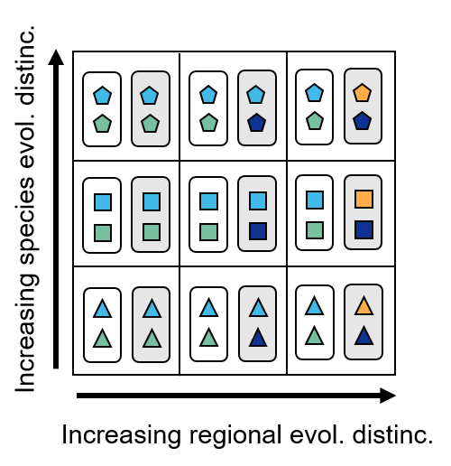
a
b
c
d
-
+
-
e
f
g
h
-
-
-
+
-
-
Species evol. distinc.
Regional evol. distinc.
Notes:
Impacts of species naturalization on phylogenetic turnover:
Species a introduced from region 1 to region 2;
Species a and b introduced from region 3 to region 1 and 2 respectively.

Slide 4
a
b
c
d
-
+
-
e
f
g
h
-
-
-
+
-
-
Species evol. distinc.
Regional evol. distinc.
Notes:
Impacts of species naturalization on phylogenetic turnover:
Species a introduced from region 1 to region 2;
Species a and b introduced from region 3 to region 1 and 2 respectively.

Slide 5
a
b
c
d
-
+
-
e
f
g
h
-
-
-
+
-
-
Species evol. distinc.
Regional evol. distinc.
Notes:
Impacts of species naturalization on phylogenetic turnover:
Species a introduced from region 1 to region 2;
Species a and b introduced from region 3 to region 1 and 2 respectively.
系统发育树和群落需要分开表示，形状和颜色需要表征其绝对的独特性和相对关系
物种太多了，可以少一些物种

Slide 6
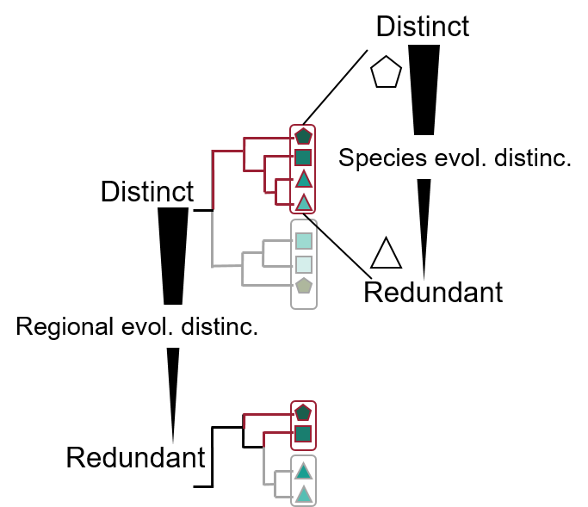
a
c
c
d
-
+
-
b
d
f
g
h
-
-
-
+
-
-
Species evol. distinc.
Regional evol. distinc.
Notes:
Impacts of species naturalization on phylogenetic turnover:
Species a introduced from region 1 to region 2;
Species a and b introduced from region 3 to region 1 and 2 respectively.
系统发育树和群落需要分开表示，形状和颜色需要表征其绝对的独特性和相对关系
物种太多了，可以少一些物种

Slide 7
a
b
Distinct
Species evol. distinc.
Distinct
Redundant
Regional evol. distinc.
Redundant
c
d
e
f
-
-
+
-
+
-
-
-
-
Species evol. distinc.
Regional evol. distinc.
Notes:
Impacts of species naturalization on phylogenetic turnover:
Species a introduced from region 1 to region 2;
Species a and b introduced from region 3 to region 1 and 2 respectively.
系统发育树和群落需要分开表示，形状和颜色需要表征其绝对的独特性和相对关系
物种太多了，可以少一些物种
e图需要强调只有两种情况

Slide 8
a
b
Distinct
Distinct
Regional evol. distinc.
Species evol. distinc.
Redundant
Redundant
c
d
e
f
③
⑤
-
-
+
+
-
①
①
②
-
②
-
+/-
+/-
④
Species evol. distinc.
Regional evol. distinc.
Notes:
Impacts of species naturalization on phylogenetic turnover:
Species a introduced from region 1 to region 2;
Species a and b introduced from region 3 to region 1 and 2 respectively.
系统发育树和群落需要分开表示，形状和颜色需要表征其绝对的独特性和相对关系
物种太多了，可以少一些物种
e图需要强调只有两种情况

Slide 9
a
b
Distinct
Distinct
Regional evol. distinc.
Species evol. distinc.
Redundant
Redundant
c
d
e
f
③
⑤
-
-
+
-
①
+
①
②
-
②
-
+
+
④
Species evol. distinc.
Regional evol. distinc.
Notes:
Impacts of species naturalization on phylogenetic turnover:
Species a introduced from region 1 to region 2;
Species a and b introduced from region 3 to region 1 and 2 respectively.
系统发育树和群落需要分开表示，形状和颜色需要表征其绝对的独特性和相对关系
物种太多了，可以少一些物种
e图需要强调只有两种情况

Slide 10
a
b
Distinct
Distinct
Regional evol. distinc.
Species evol. distinc.
Redundant
Redundant
Gain mean species ED
Focal region
Pathway 1
Naturalizing nonnative species that are evolutionary distinct than mean species ED in focal region
Lose mean species ED
Focal region
Pathway 2
Naturalizing nonnative species that are evolutionary redundant than mean species ED in focal region
Notes:
Impacts of species naturalization on phylogenetic turnover:
Species a introduced from region 1 to region 2;
Species a and b introduced from region 3 to region 1 and 2 respectively.
系统发育树和群落需要分开表示，形状和颜色需要表征其绝对的独特性和相对关系
物种太多了，可以少一些物种
e图需要强调只有两种情况

Slide 11
d
e
f
③
⑤
-
-
+
-
①
②
-
+
+
④
Regional evol. distinc.
Gain regional ED
Gain regional ED
Region A
Region B
Pathway 3
Naturalizing distant-related species that are nonnative to region A and B
Region A
Region B
Pathway 4
Naturalizing species that are nonnative to region A
Notes:
Impacts of species naturalization on phylogenetic turnover:
Species a introduced from region 1 to region 2;
Species a and b introduced from region 3 to region 1 and 2 respectively.
系统发育树和群落需要分开表示，形状和颜色需要表征其绝对的独特性和相对关系
物种太多了，可以少一些物种
e图需要强调只有两种情况

Slide 12
Gain regional ED
Lose regional ED
Region A
Region B
Pathway 3
Naturalizing close-related species that are nonnative to region A and B
Region A
Region B
Pathway 4
Naturalizing species that are native in region A to B
Notes:
Impacts of species naturalization on phylogenetic turnover:
Species a introduced from region 1 to region 2;
Species a and b introduced from region 3 to region 1 and 2 respectively.
系统发育树和群落需要分开表示，形状和颜色需要表征其绝对的独特性和相对关系
物种太多了，可以少一些物种
e图需要强调只有两种情况

Slide 13
Gain mean species evolutionary distinctiveness (ED)
Region A
Pathway 1
Distinct
Naturalizing nonnative species whose ED are higher than mean species ED in region A
Lose mean species ED
Species ED
Region A
Pathway 2
Naturalizing nonnative species whose ED are lower than mean species ED in region A
Redundant
Gain regional ED
Region A
Region B
Pathway 3
Naturalizing distant-related species that are nonnative to region A and B
Region A
Region B
Distinct
Pathway 4
Naturalizing nonnative species that are distantly related to region B to region A
Lose regional ED
Regional ED
Region A
Region B
Pathway 5
Naturalizing close-related species that are nonnative to region A and B
Region A
Region B
Redundant
Pathway 6
Naturalizing species that are native in region A to region B
Region A
Region B
Pathway 7
Naturalizing nonnative species that are closely related to region B to region A
Species native to region A or B
Species nonnative to both regions
Notes:
Impacts of species naturalization on phylogenetic turnover:
Species a introduced from region 1 to region 2;
Species a and b introduced from region 3 to region 1 and 2 respectively.
系统发育树和群落需要分开表示，形状和颜色需要表征其绝对的独特性和相对关系
物种太多了，可以少一些物种
e图需要强调只有两种情况

Slide 14
Gain regional ED
Region A
Region B
Pathway 1
Naturalizing distant-related species that are nonnative to region A and B
Region A
Region B
Distinct
Pathway 2
Naturalizing nonnative species that are distantly related to region B to region A
Lose regional ED
Region A
Region B
Regional ED
Pathway 3
Naturalizing close-related species that are nonnative to region A and B
Region A
Region B
Redundant
Pathway 4
Naturalizing species that are native in region A to region B
Region A
Region B
Pathway 5
Naturalizing nonnative species that are closely related to region B to region A
Species native to region A or B
Species nonnative to both regions
Notes:
Impacts of species naturalization on phylogenetic turnover:
Species a introduced from region 1 to region 2;
Species a and b introduced from region 3 to region 1 and 2 respectively.
系统发育树和群落需要分开表示，形状和颜色需要表征其绝对的独特性和相对关系
物种太多了，可以少一些物种
e图需要强调只有两种情况

Slide 15
Gain PU
Region A
Region B
Pathway 1
Naturalizing distant-related species that are nonnative to region A and B
Region A
Region B
Distinct
Pathway 2
Naturalizing nonnative species that are distantly related to region B to region A
Lose PU
Region A
Region B
Phylogenetic uniqueness (PU)
Pathway 3
Naturalizing close-related species that are nonnative to region A and B
Region A
Region B
Redundant
Pathway 4
Naturalizing species that are native in region A to region B
Region A
Region B
Pathway 5
Naturalizing nonnative species that are closely related to region B to region A
Species native to region A or B
Species nonnative to both regions
Notes:
Impacts of species naturalization on phylogenetic turnover:
Species a introduced from region 1 to region 2;
Species a and b introduced from region 3 to region 1 and 2 respectively.
系统发育树和群落需要分开表示，形状和颜色需要表征其绝对的独特性和相对关系
物种太多了，可以少一些物种
e图需要强调只有两种情况

Slide 16
Phylo. dis. from R1
 | R1 | R2 | R3 | R4 | R5
R1 |  | 0.4 | 0.2 | 0.6 | 0.9
R1
R4
R1
R3
Average
R2
R5
Phylo. Uniquess of R1
Lose PU
R1
R1
R1
Pathway 1
Naturalizing species that are native in focal region (R1) to remaining regions
R1
R1
R1
Pathway 2
Naturalizing common species originating from common regions to R1
R1
Pathway 3
R1
R1
Naturalizing close relatives of R1 native to other regions to other remaining ones
Gain PU
R1
Pathway 4
R1
R1
Naturalizing endemic species originating from unique regions to R1
R1
Pathway 5
R1
R1
Naturalizing distant relatives of R1 native to other regions to other remaining ones
Notes:
Impacts of species naturalization on phylogenetic turnover:
Species a introduced from region 1 to region 2;
Species a and b introduced from region 3 to region 1 and 2 respectively.
系统发育树和群落需要分开表示，形状和颜色需要表征其绝对的独特性和相对关系
物种太多了，可以少一些物种
e图需要强调只有两种情况

