Slide 1
Advanced Programming Concepts with C++ CSI2372 – Fall 2019
Jochen Lang &
Mohamed Taleb
EECS
Notes:
1

Slide 2
C++
Object-oriented programming language
Data abstraction (class concepts)
Operator overloading
C/C++ (and Objective C) together are (still) the de-facto standard (except for web centric applications)
Combines a high-level language with low-level features
C++ is a superset of C
C is a functional programming language
Goals:
Augment C with the notion of classes and inheritance
Keep the same performance as C
Keep same applicability as C
Notes:
2

Slide 3
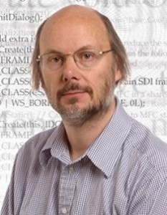
Brief History of C/C++
1967-1980 | Development of Unix by Ken Thompson, Denis Ritchie and others at Bell Labs
1969-1973 | C by Denis Ritchie, Bell Labs Based on B written by Ken Thompson, most of Unix written in C
1984 | C++ by Bjarne Stroustroup, Bell Labs Object oriented programming constructs were added to C
1998 | C++ Standard ISO/IEC 14882 and revised in 2003 as ISO/IEC 14882:2003
2011 | C++ Standard C++11 “C++0x”, ISO/IEC 14882:2011
2014 | C++ Standard ISO/IEC 14882:2014
2017 | C++ Standard ISO/IEC 14882:2017
2020 | Next scheduled release
Bjarne Strousroup

Slide 4
C++
C++ has been derived from the well-known programming language C.
The name C++ is related to the expression C++, which we can write in a C program to increment a variable C.
C++ is a much younger language than C, its use is already widespread, and its popularity will no doubt increase considerably as a result of the excellent quality of popular compilers such as Turbo C++ from Borland.
One of the attractive aspects of C++ is that it offers good facilities from Object-Oriented Programming (OOP), but, as a hybrid language, it also permits the traditional programming style, so that programmers can shift to OOP id and when they feel the need to do so.
Notes:
4

Slide 5
C++
In this regard, C++ differs from some ‘purely’ OO languages, such as: Smalltalk, Eiffel and Java.
Viewed from the angle of many C programmers, C++ is simply ‘a better C’.
Besides the important: class concept, essential to OOP, there are many other points in C++ that are not available to C programmers. To mention just a few, related to functions: function overloading, inline functions, default arguments, type-safe linkage, and the very simple requirement that functions be declared before they are used.
In C, the old practice of using undeclared functions is still allowed in order to keep many existing C programs valid; in C++ it is not.
Notes:
5

Slide 6
C++
Strengths
Low-level systems programming
High-level systems programming
Generic programming
Embedded code
High performance programming
Numeric/scientific computation
Games programming
General application programming
Weaknesses
Legacy of C
Insecurities
Complexity
No standard GUI library
Notes:
6

Slide 7
Programming Languages Popularity
Aug 2016 | Aug 2015 | Prog. Language | Ratings | Change
1 | 1 | Java | 19.010% | -0.26%
2 | 2 | C | 11.303% | -3.43%
3 | 3 | C++ | 5.800% | -1.94%
4 | 4 | C# | 4.907% | +0.07%
5 | 5 | Python | 4.404% | +0.34%
6 | 7 | PHP | 3.173% | +0.44%
7 | 9 | JavaScript | 2.705% | +0.54%
8 | 8 | Visual Basic .NET | 2.518% | -0.19%
9 | 10 | Perl | 2.511% | +0.39%
10 | 12 | Assembly language | 2.364% | +0.60%
11 | 14 | Delphi/Object Pascal | 2.278% | +0.87%
12 | 13 | Ruby | 2.278% | +0.86%
13 | 11 | Visual Basic | 2.046% | +0.26%
14 | 17 | Swift | 1.983% | +0.80%
15 | 6 | Objective-C | 1.884% | -1.31%
16 | 37 | Groovy | 1.637% | +1.27%
17 | 20 | R | 1.605% | +0.60%
18 | 15 | MATLAB | 1.538% | +0.31%
19 | 19 | SQL | 1.349% | +0.21%
20 | 95 | Go | 1.270% | +1.19%
Source:
http://www.tiobe.com
Note:
Other sources, other statistics.
Programming language popularity
Notes:
7

Slide 8
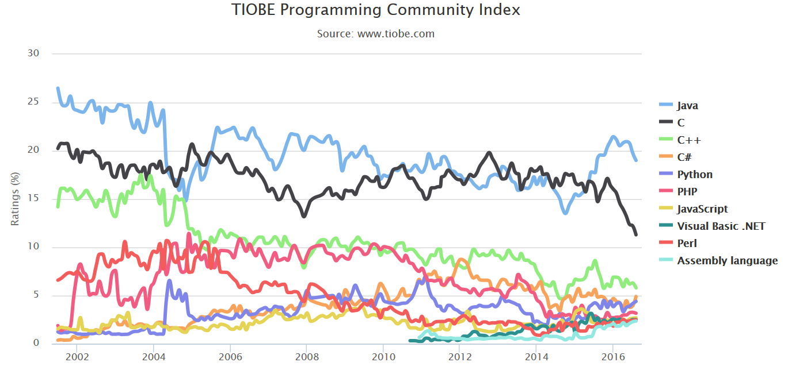
Programming Languages Popularity
Note: Other sources, other statistics.
Notes:
8

Slide 9
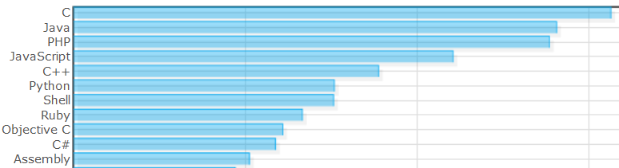
Popularity of Programming Languages
Normalized comparison of languages as published by langpop.com [accessed Aug. 29, 2014]. Based on web searches on language discussions, available code etc.
0.2
0.4
0.6

Slide 10
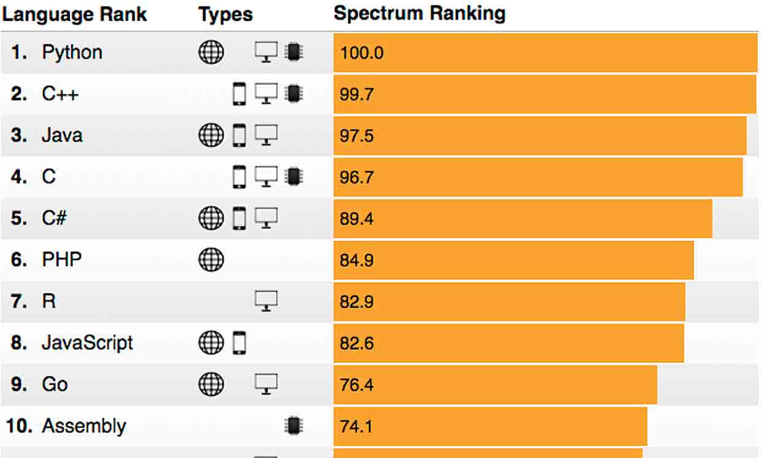
Popularity of Programming Languages
“The 2018 Top Programming Languages” IEEE Spectrum ranking [accessed Sep. 1, 2018]. Based on web searches, specific web pages, IEEE digital library etc.

Slide 11
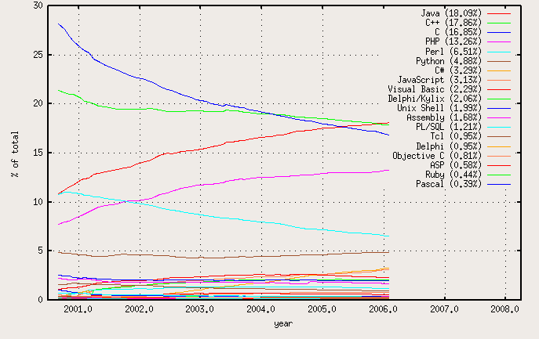
Use of Programming Languages at the Beginning of the Century
François Labelle, Programming Language Usage Graph
https://wismuth.com/lang/languages.html
Statistics based on open source projects at SourceForge
Notes:
11

Slide 12
Is C++ in decline?
Bjarne Stroustrup:
“No, I don't think so. C++ use appears to be declining in some areas and to be on an upswing in others. If I had to guess, I'd suspect a net decrease sometime during 2002-2004 and a net increase in 2005-2007 and again in 2010-2011, but I doubt anyone really knows. Most of the popular measures basically measures noise and ought to report their findings in decibel rather than "popularity." A professional survey in 2015 estimated the number of C++ programmers to be 4.4 million.”
See the Tiobe index at https://www.tiobe.com/tiobe-index/ – a very popular measure
"There are more useful systems developed in languages deemed awful than in languages praised for being beautiful--many more“
Bjarne Stroustrup's FAQ: Did you really say that?. Retrieved on 2017-09-03.

Slide 13
Benefits of Learning C++
Low-level control over many features including memory management, and, the breadth of C++
Improves understanding of software design
Helps to make informed choices about design
Bjarne Stroustrup: "To use C++ well, you have to understand design and programming technique" Bjarne Stroustrup's FAQ: Did you really say that?. Retrieved on 2017-09-03.
Wide use and popularity of C/C++
Increases employment prospects
Helps to communicate with expert developers
Helps to evaluate and adapt projects by others

Slide 14
A First Look at C/C++
Namespaces allow to group entities like classes, objects and functions under a name. This way the global scope can be divided in "sub-scopes", each one with its own name.
Java syntax is based on C
Execution of C/C++ starts with main
System functions are not grouped in a class
C++ has the concept of a namespace
Example
Hello World in Java and C
- Namespaces defined:
* Collection of name definitions
- For now: interested in namespace "std"
* Has all standard library definitions we need
- Examples:
#include <iostream>
using namespace std;
* Includes entire standard library of name definitions
- #include <iostream>
using std::cin;
using std::cout;
* Can specify just the objects we want
- Used to resolve name clashes
- Programs use many classes, functions
* Commonly have same names
* Namespaces deal with this
* Can be "on" or "off"
** If names might conflict à turn off
Notes:
14

Slide 15
Example #1 : namespace
// namespaces
#include <iostream>
using namespace std;
namespace NS1
{
int x = 5;
}
namespace NS2
{
double x = 3.1416;
}
int main () {
cout << NS1::x << endl;
cout << NS2::x << endl;
return 0;
}
5
3.1416

Slide 16
Example #2 : namespace
// namespaces
#include <iostream>
using namespace std;
namespace NS1
{
int x = 5;
int y = 10;
}
namespace NS2
{
double x = 3.1416;
double y = 2.7183;
}
int main () {
using NS1::x;
using NS2::y;
cout << x << endl;
cout << y << endl;
cout << NS1::y << endl;
cout << NS2::x << endl;
return 0;
}
5
2.7183
10
3.1416

Slide 17
Example #3 : namespace
// Using
#include <iostream>
using namespace std;
namespace NS1
{
int x = 5;
int y = 10;
}
namespace NS2
{
double x = 3.1416;
double y = 2.7183;
}
int main () {
using namespace NS1::x;
cout << x << endl;
cout << y << endl;
cout << NS2::x << endl;
cout << NS2::y << endl;
return 0;
}
5
10
3.1416
2.7183

Slide 18
Example #4 : namespace
// Using namespace
#include <iostream>
using namespace std;
namespace NS1
{
int x = 5;
}
namespace NS2
{
double x = 3.1416;
}
int main () {
{
using namespace NS1;
cout << x << endl;
}
{
using namespace NS2;
cout << x << endl;
}
return 0;
}
5
3.1416

Slide 19
Hello World
/* Hello World in Java */
public class HelloWorld {
static public void main( String args[] ) {
System.out.println( "Hello World!");
return;
}
}
#include <iostream>
/* Hello World in C++ */
int main() {
std::cout << "Hello World!" << std::endl;
return 0;
}
Notes:
19

Slide 20
Standard Input and Output
Output stream cout
Object-oriented printing to console
Built-in types can be printed using the left-shift operator
Similar than System.out.print in Java but more flexible (stream modifiers; more later)
Input stream cin
Object-oriented input from console
Built-in types can be converted and assigned with the right-shift operator
std::cout << myVar;
std::cin >> myVar;

Slide 21
Using Definitions of the Standard Namespace
iostream library necessary for console input and output.
Declarations are in the namespace std (standard).
Using a single declaration:
just once
in the whole scope
Using all the declaration within a namespace in a scope (avoid!)
std::cout
using std::cout;
using namespace std;
Notes:
21

Slide 22
Main Function
C/C++ program entry point main which is of type
All source files in a project are allowed to define only one main function.
Note: Visual Studio defines additionally program entry points (other “main” functions). Standard compliant C++ code will only use the above.
int main( void );
int main( int argc, char *argv[] );
Notes:
22

Slide 23
Java and C++
Java
Compiled to byte code
Executed by virtual machine
Object-oriented
Platform-independent byte code
C++
Preprocessor
Compiled to object code
Linked to binary executable
Object-oriented, generic and functional features
Object code and executable are platform-specific
Notes:
23

Slide 24
C++ Fundamentals
Fundamental and complex data types including classes and strings
Operators for fundamental types
Control and decision statements
Notes:
24

Slide 25
Variable and Function Names
identifier :
underscore
letter
identifier following-character
following-character :
letter
underscore
digit
letter : one of
A B … Z a b … z
digit : one of
0 1 2 … 9
underscore : _
Exactly like in Java
Case sensitive!
Examples:
i5
__do_not_use__
butUseThis
myFavoriteVariable
Notes:
25

Slide 26
Declarations
Declarations introduce names into a program. Declarations may occur in different places in a program.
What to declare?
variables
functions
classes, structures and union components
types
type tags
enumeration constants
namespace
statement labels
preprocessor macros
Notes:
26

Slide 27
Definition vs. Declaration
Java and C++ provide definitions in one file and use it in many files
Java
Name is imported into another file.
C++ (Each file is compiled separately – if not #include’d)
Linker ensures that name (according to scoping rules) refers to the same entity everywhere.
Definition allocates a variable.
Declaration introduces only the name.

Slide 28
Fundamental Data Types
Three categories integral, floating and void.
integral
bool, char, short, int, long, long long (in C++11)
intN_t with N = 8,16,32 or 64 (only C99);
MSVC: _intN with N = 8,16,32 or 64
floating
float, double, long double
void
… close to Java
BUT size may vary with C++ compiler/OS
Standard defines minimum sizes
Notes:
28

Slide 29
Type Modifiers and Size
Modifiers
unsigned, signed, short, long
Sizes in MSVC++
1 byte
bool, char, unsigned char, signed char
2 bytes
short, unsigned short
4 bytes
int, unsigned int, long, unsigned long, float
8 bytes
double, long long
18 bytes
long double
Notes:
29

Slide 30
Derived Data Types
Directly derived data types
Arrays, functions, pointers, object references, constants
Composed derivative types
classes, structures, unions, scoped enumerations
To be defined later !
class myClass
{
…
};
Notes:
30

Slide 31
Automatic Typing with auto
Most often initialization can be done better (less error prone) by using auto types.
Aside: Arithmetic literals
auto iVal=65;
auto oiVal=iVal;
auto fVal=3.0f;
auto ofVal=fVal;
1 is an int
1U is an unsigned int
1L is a long
1LL is a long long
1.0f is a float
1.0 is a double
'\1' is a char.

Slide 32
Compilers and IDEs
Apple Xcode C++
Bloodshed Dev-C++
Code::Blocks
Cygwin
Eclipse for C++
MINGW - "Minimalist GNU for Windows"
GNU CC
The LLVM Compiler Infrastructure
Microsoft Visual C++ 2010
Sun Studio NetBeans
Notes:
32

Slide 33
Libraries
General
Boost
MFC: Microsoft Foundation classes
STL: Standard Template Library
GUI
MFC GUI
Qt
SFML
WxWidgets
Notes:
33

Slide 34
Next week:
Java in C++
Basic Object-oriented C++
Strongly-typed Enumerations
Operators, Ch. 4.1-4.9
Selection and Iteration Statements, Ch. 1.4, 5.3-5.5
Static casts, Ch. 4.11.3-5.12.6
Overview of std::string
Introduction to std::array and std::vector
Notes:
34

