Slide 1
Advanced Programming Concepts with C++ CSI2372 – Fall 2019
Jochen Lang &
Mohamed Taleb
EECS
Notes:
1

Slide 2
Sequential Containers and Iterators
No reinventing the wheel
STL
Review: Java Collections Framework
Sequential containers, Ch. 9.1- 9.4
vector string deque
C++11 array forward_list
Iterators, Ch. 3.4, 9.2.1

Slide 3
Java Collections Framework
Aside: Collection is another word for container
Java Collections Framework is an object-oriented framework with generic types
Implements most basic data structures
Including:
linked lists, growable arrays, trees, maps and dictionaries, sets
Why use collections?
available (no implementation required)
reliability and standardization
efficient general purpose implementations

Slide 4
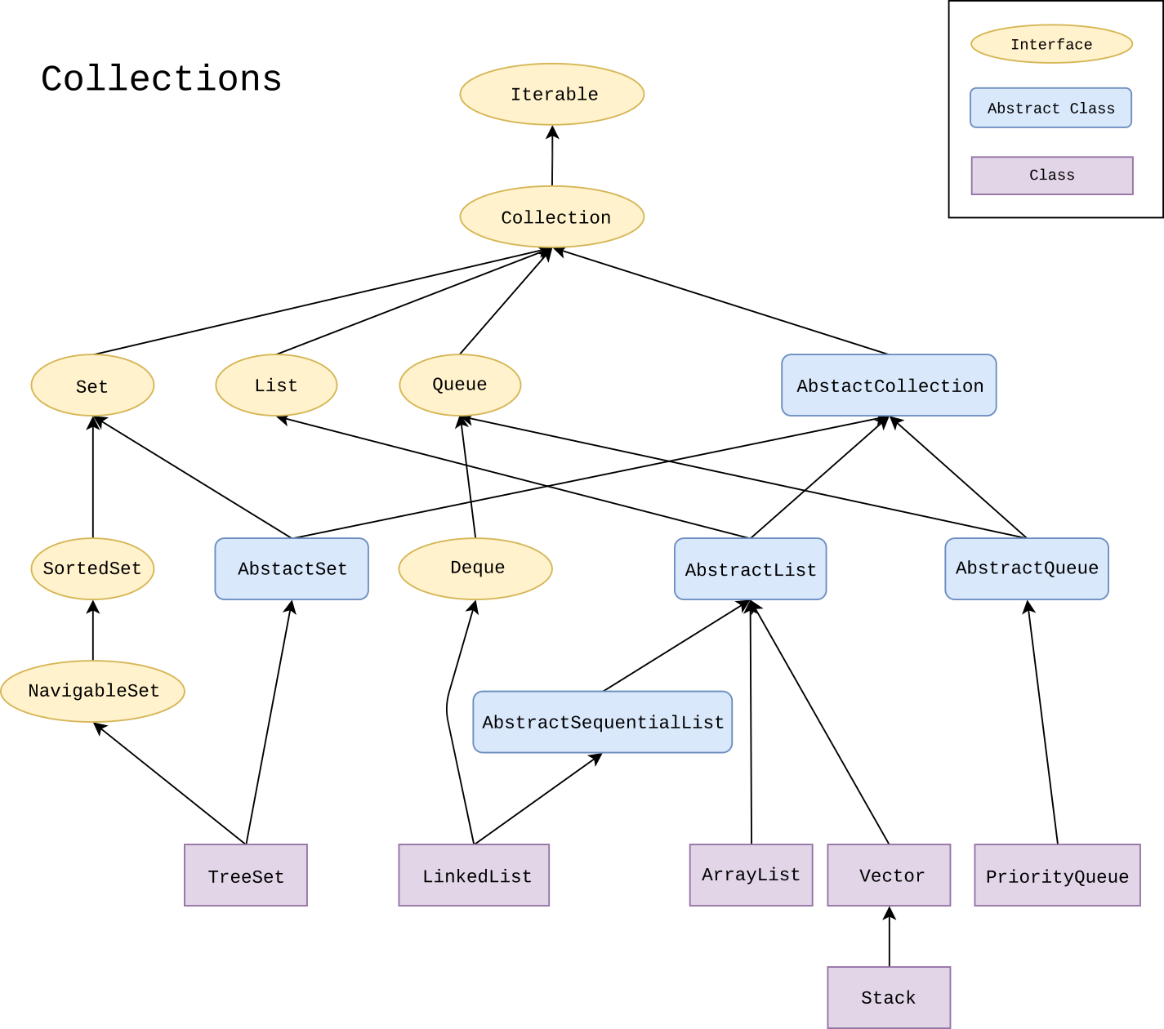
Jave Collections
By Ramlmn - Own work, CC BY-SA 4.0, https://commons.wikimedia.org/w/index.php?curid=64043967

Slide 5
Components of the Framework
Top-Level Interfaces
Collection and its children Set, List, Queue, Deque plus related interfaces targeted at concurrency
Map
Implementations
List implementations: ArrayList, LinkedList and about 6 more.
Set implementations: HashSet, TreeSet and about 4 more.
Queue implementations: LinkedList, PriorityQueue and about 10 more.
Map implementations: HashMap, TreeMap, HashTable and about 6 more.

Slide 6
Relationships between Abstract Data Type
Interfaces | Implementations
 | Hash Table | Resizable Array | Balanced Tree | Linked List | Old
Set | HashSet |  | TreeSet
List |  | ArrayList |  | LinkedList | Vector, Stack
Deque |  | ArrayDeque |  | LinkedList
Map | HashMap |  | TreeMap |  | HashTables

Slide 7
Iterators and Algorithms for Collections
Iterators
Iterable interface allows one to obtain an iterator for the container
Iterator itself is an interface and is implemented by the container classes
Algorithms
In Java, we have polymorphic algorithms (sort of)
sort algorithms are implemented in separate class Sort and can be used with containers
sort, shuffle, reverse, fill, copy, swap, addAll, binarySearch, frequency, disjoint, min, max are part of the Collection interface

Slide 8
Abstract Data Types in C++
Standard Template Library
Implements standard abstract data types
More generic than object-oriented
Containers and Adaptors
similar to Java collections and interfaces
Generic algorithms
similar in scope to algorithms in Collection but not part of any class
Containers
Iterators
Algorithms

Slide 9
Standard Template Library (STL)
STL is more than abstract data types
STL Content Overview
containers including strings, i.e., abstract data types
generic algorithms
memory management support
runtime environment support
streams
exceptions

Slide 10
Containers
Containers store elements of the same type
Sequential Containers
Associative Containers
Derived Containers
Arrays
Lists
Defined in terms of other Containers
Maps

Slide 11
Sequential Containers
Textbook, Chapter 9
Store one element after another in sequence
Order of elements does not depend on element (no key)
Sequential STL Containers
vector list deque
Defined in headers <vector> <list> <deque>
C++11: forward_list array
Defined in headers <forward_list> <array>

Slide 12
Review: Why a vector (growable array)?
Limitations of built-in arrays
Arrays are fixed size
Arrays can not be operated on as a whole
Vectors (growable array)
ArrayList or Vector (deprecated) in Java
Adjust their size based on the number of element stored in the vector
Vectors can be copied, assigned and compared
Offer same random (constant time) access than arrays

Slide 13
Constructing a Container
Default
empty container
Copy
copies the elements
Copying a portion of another container
Constructing elements in the container
C++11: list initialization
A
A
B
1 | 2 | … | 99
1 | 2 | … | 99
A
B
4 | 5 | … | 49
1 | 2 | … | 99
A
1 | 1 | … | 1 | 1

Slide 14
Review: Constructing a vector
#include <vector>
using std::vector;
// Default construction
vector<int> iVecA;
// Construction by constructing 100 elements all = 1
vector<int>::size_type size = 100;
vector<int> iVecB( size, 1 );
// copy construction
vector<int> iVecC( iVecB );
// construction by copying the first 5 elements
vector<int>::iterator iter = iVecB.begin();
vector<int> iVecD( iter, iter + 5 );
// list initialization
vector<int> iVecE{1,2,3,4,5};

Slide 15
Containers hold copies
Minimum requirements
Container will use assignment operator
Container stores copies of elements
Only types with a copy constructor
Or types with a move constructor (since C++11)
Additional requirements for some operations
E.g., container must be able to default construct elements if vector<T>(size_type) is used
Only types with a default constructor

Slide 16
Accessing elements in a Container: Iterators
Iterators encapsulate the principle of visiting elements in turn
Pointers are iterators for built-in arrays
Common Operations with Iterators
Dereference *iter
Access to methods and attributes of element iter->foo()
Increment and decrement iter++ ++iter iter--
--iter
Comparison; equals and not equals == !=
C++11: iter=prev(iter) iter=next(iter) begin(container) end(container)

Slide 17
Iterator Range
Sequential containers provide an iterator to the beginning and the end
The end iterator points just passed the last element
Many methods work with a range, e.g., construction
1 | 1 | … | 1 | 1
iVec.begin()
iVec.end()
vector<int> iVecA;
// Copy the whole range into a new vector
vector<int> iVecB( iVecA.begin(), iVecA.end());
// Alternatively
vector<int> iVecB( begin(iVec), end(iVecA));

Slide 18
Review: Looping over the Elements in a Container – Option A
Looping over the elements
using a range loop
typically combined with auto type
makes a copy of the element in the container
Or must use a reference
#include <vector>
// 100 elements vector
vector<int>::size_type size = 100;
vector<int> iVec( size );
// loop over the elements
for ( auto element:iVec ) { // read access to element }
for ( auto &refElement:iVec ) { // write access }

Slide 19
Looping over the Elements in a Container – Option B
Looping over the elements with traditional for loop
if begin == end the container is empty
try to write loop only with operations supported by all containers
#include <vector>
// 100 elements vector
vector<int>::size_type size = 100;
vector<int> iVec( size );
// loop over the elements
for ( auto iter = iVec.begin();
iter != iVec.end();
++iter ) {
// save to access *iter
}
vector<int>::iterator

Slide 20
Aside: Nested Classes
Containers in STL make use of nested classes ( see also Ch. 19.5): Classes defined in other classes
Or in general
template <typename T>
class vector<T>::iterator { …
};
class Outer {
private:
class Inner {
int d_i;
public:
Inner(int _i) : d_i(_i) {};
};
};

Slide 21
More on Iterators
Erase and insert may invalidate an iterator
Be careful when you write a loop
vector, deque (and array) iterators support “arithmetic” operations
Addition iter+n (same as iter[n])
Subtraction iter-n and n=iterA-iterB
Compound assignment iter+=n iter-=n
Extra comparisons > < >= <=
vector, deque and array are random access containers
similar to pointer arithmetic with arrays

Slide 22
Iterator Categories
In increasing power
Input/Output iterators
Forward iterators
Bidirectional iterators
Random-Access iterators
Iterator also exist in the variations
const
Element “pointed to” cannot be changed
reverse
Directions (++/--) are reversed

Slide 23
Iterators and Containers
 | ::iterator | ::const iterator | ::reverse_iterator | ::const_reverse_iterator
vector, array | random-access | const random access | reverse random-access iterator | const reverse random-access iterator
deque | random-access | const random access | reverse random-access iterator | const reverse random-access iterator
list | bidirectional | const bidirectional | reverse bidirectional iterator | const reverse bidirectional iterator
forward _list | forward | const forward | - | -

Slide 24
Looping backwards over the Elements in a Container
Looping over the elements
if rbegin == rend the container is empty
as before: write loop only with operations supported by all containers
#include <vector>
// 100 elements vector
vector<int>::size_type size = 100;
vector<int> iVec( size );
// loop over the elements
for (auto rIter = iVec.rbegin();
rIter != iVec.rend();
++rIter ) {
// go backwards -- save to access *rIter
}
vector<int>::reverse_iterator

Slide 25
Container Methods: Insertion
Inserting into a container
Insert at the end push_back(element)
Insert at the front push_front(element)
Insert anywhere insert(iter, element)
C++11
Avoid copy constructor by the container directly calling a constructor for the element
Insert at the end emplace_back(args for element ctor)
Insert at the front emplace_front(args for element ctor)
Insert anywhere emplace(iter,args for element ctor)

Slide 26
Container Methods: Insertion and Removal
Remove element(s)
Do not return the element!
Remove at the end pop_back()
Remove at the front pop_front()
Remove anywhere remove(iter)
Remove all clear()

Slide 27
Container Methods: Assignment
Assignment
Copy all the elements into an existing container (deleting all existing elements in destination) cA = cB
Copy the elements in the iterator range into an existing container (deleting all existing elements in the destination) cA.assign(cB.begin(),cB.end())
Swap the elements between the containers cA.swap(cB)

Slide 28
Container Methods: Size and Capacity
Size (the actual # elements stored)
Number of elements stored in container size()
Is container empty empty()
Add or delete elements at the end of the container resize(#elements)
Vector is a growable array!
Create empty slots in the array reserve(num)
How many slots in total capacity()

Slide 29
Container Methods Some other useful methods
Container comparison
Compare if container has the same size and
elements c1 == c2
Or not c1 != c2
Reference to elements
Reference to first element front()
Reference to last element back()
Reference to any element (vector and deque only) c.at(n)
Most often iterators are used to access element!

Slide 30
An Example: BubbleSort with a List, Vector or Deque
template <class T>
void bubbleSort( T& container ) {
// loop over the elements
for ( typename T::iterator iterA = container.begin();
iterA != container.end();
++iterA ) {
for ( typename T::iterator iterB = iterA;
iterB != container.end();
++iterB ) {
if ( *iterA > *iterB ) { // swap
typename T::value_type tmp(*iterA);
*iterA = *iterB; *iterB = tmp;
}
}
}
return;
}

Slide 31
Next
Associative containers
Maps
Examples of generic algorithms
Finding
Sorting

