Slide 1
Object-Oriented Software Engineering
Practical Software Development using UML and Java
Chapter 8:
Modelling Interactions and Behaviour

Slide 2
8.1 Interaction Diagrams
Sequence diagrams and Communication diagrams
Interaction diagrams are used to model the dynamic aspects of a software system
  They help you to visualize how the system runs.
  An interaction diagram is often built from a use case and a class diagram.
    The objective is to show how a set of objects accomplish the required interactions with an actor.
© Lethbridge/Laganière 2012
Chapter 8: Modelling Interactions and Behaviour

Slide 3
Elements found in interaction diagrams
  Instances of classes
    Shown as boxes with the class and object identifier underlined
  Actors
    Use the stick-person symbol as in use case diagrams
  Messages
    Shown as arrows from actor to object, or from object to object
© Lethbridge/Laganière 2012
Chapter 8: Modelling Interactions and Behaviour

Slide 4
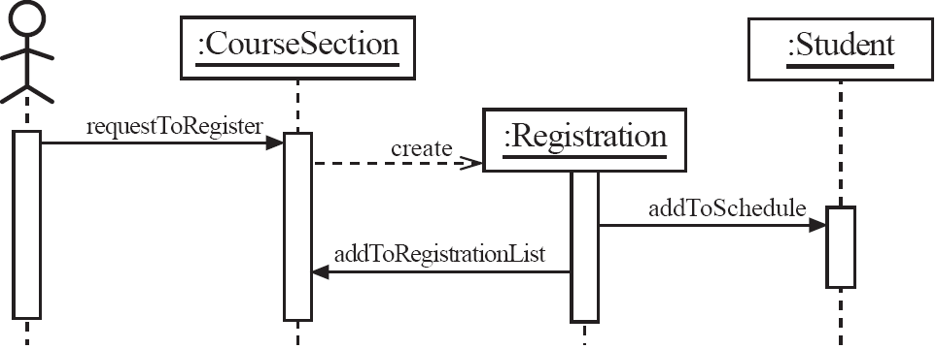
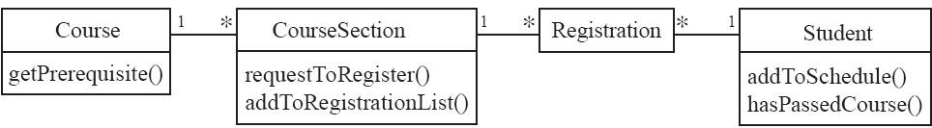
Sequence diagrams – an example
© Lethbridge/Laganière 2012
Chapter 8: Modelling Interactions and Behaviour

Slide 5
Sequence diagrams
A sequence diagram shows the sequence of messages exchanged by the set of objects performing a certain task
  The objects are arranged horizontally.
  An actor that initiates the interaction is often shown on the left.
  The vertical dimension represents time.
  A vertical line, called a lifeline, is attached to each object or actor.
  The lifeline becomes a broad box, called an activation box during the live activation period.
  A message is represented as an arrow between activation boxes of the sender and receiver.
    A message is labelled and can have an argument list and a return value.
© Lethbridge/Laganière 2012
Chapter 8: Modelling Interactions and Behaviour

Slide 6
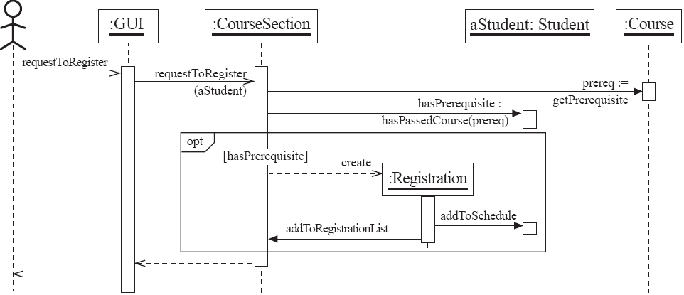
Sequence diagrams – same example, more details
© Lethbridge/Laganière 2012
Chapter 8: Modelling Interactions and Behaviour

Slide 7
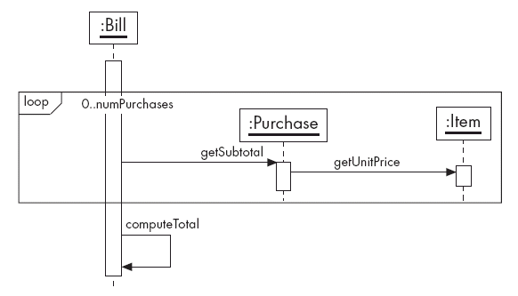
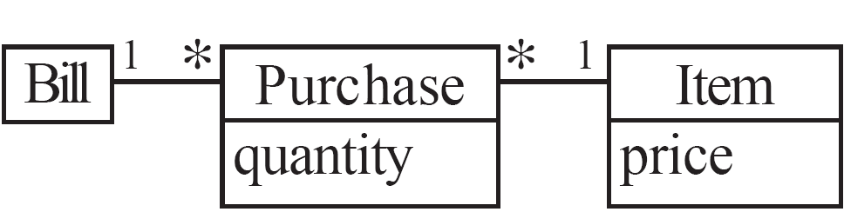
Sequence diagrams – an example with replicated messages
  An iteration over objects is indicated by an asterisk preceding the message name
© Lethbridge/Laganière 2012
Chapter 8: Modelling Interactions and Behaviour

Slide 8
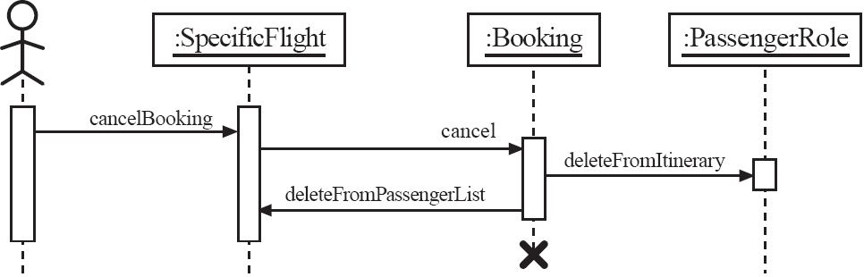
Sequence diagrams – an example with object deletion
  If an object’s life ends, this is shown with an X at the end of the lifeline
© Lethbridge/Laganière 2012
Chapter 8: Modelling Interactions and Behaviour

Slide 9
Fragments
Allow multiple sequences to be represented in compact form (may involve all participants or just a subset).
  alt, for alternatives with conditions
  opt, for optional behavior
  loop(lower bound, upper bound), for loops
  par, for concurrent behavior
  ref, for referencing other sequence diagrams

Slide 10
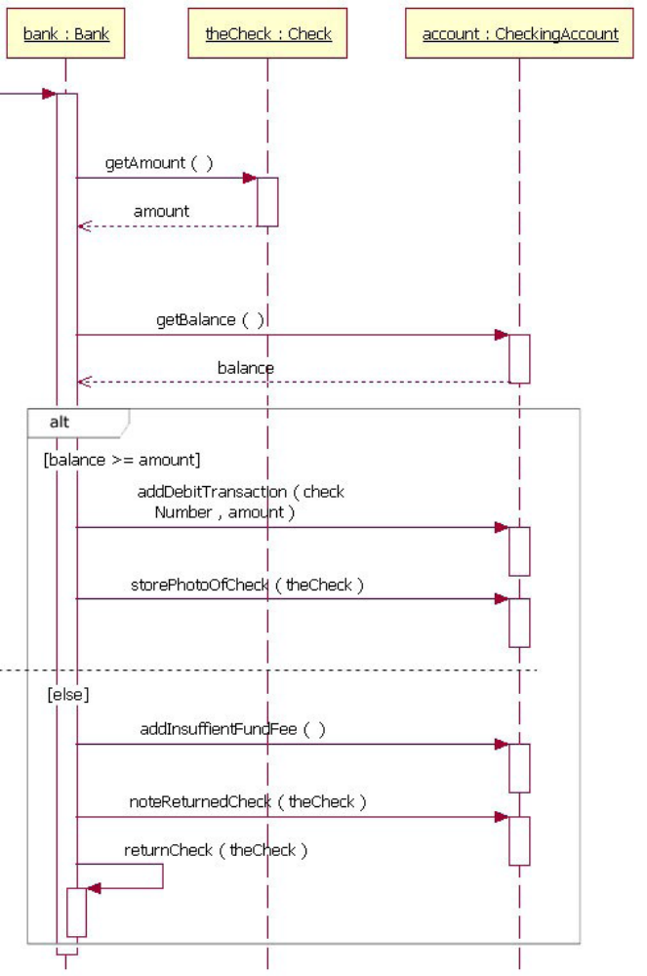
Fragments – Alternative
Alternative (operator alt)
  Multiple operands (separated by dashed lines)
  Each operand has guard condition (no condition implies true)
  One will be chosen exclusively – nondeterministically if more than one evaluates to true
  Special guard: else
    True if no other guard condition is true

Slide 11
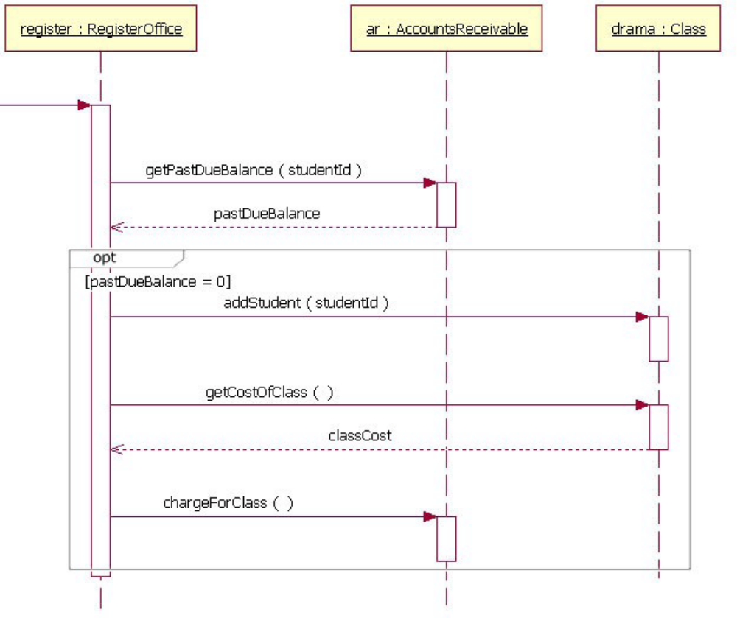
Fragments – Optional
Optional (operator opt)
  To specify a
  guarded behavior fragment with no alternative
  Special case of alt
  Equivalent to an alt
  with two operands
    The first is the same
    as the operand for
    the opt
    The second is an empty operand with
    an else guard

Slide 12
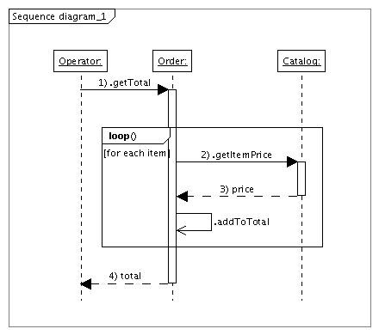
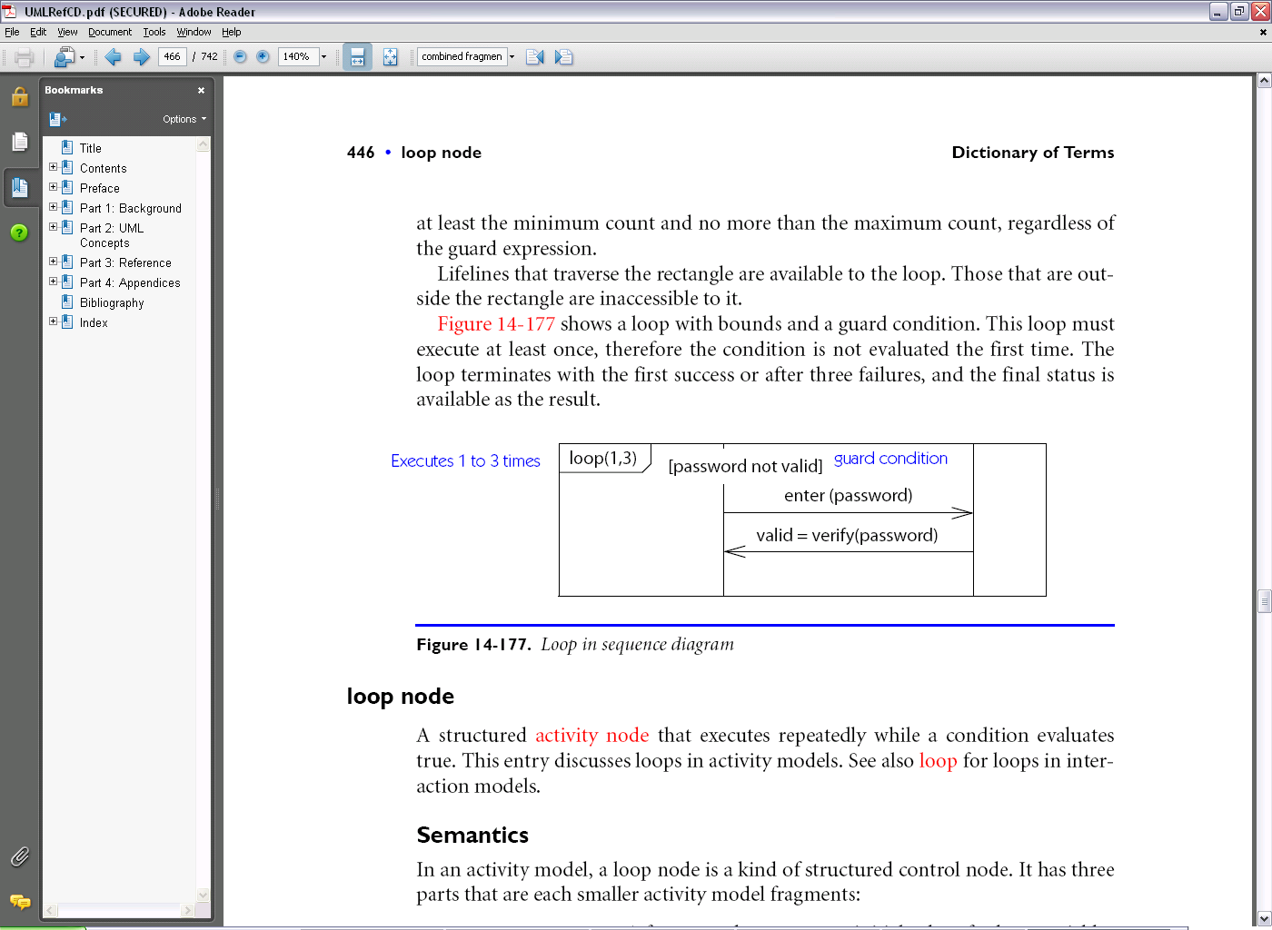
Fragments – Loop
Loop (operator loop)
  Loop fragment may execute multiple times
  At least executed the minimum count
  Up to a maximum count as long as the guard condition is true (no condition implies true)
minimum, maximum count

Slide 13
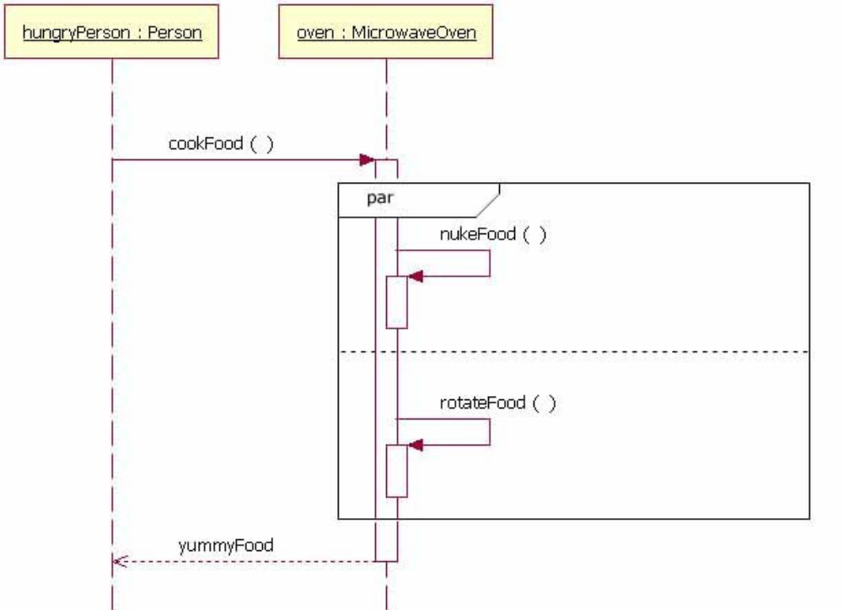
Fragments – Concurrency
Concurrency (operator par): Two or more operands that execute in parallel

Slide 14
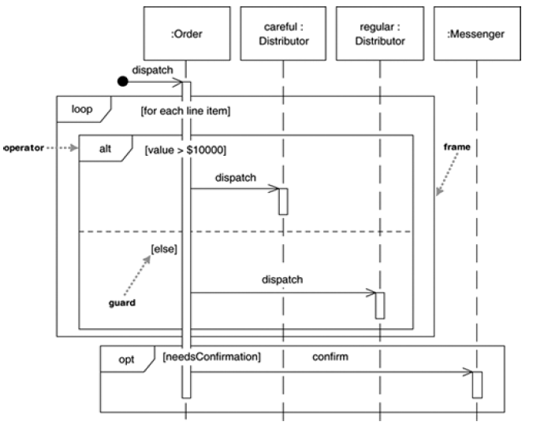
Nested Fragments

Slide 15
Top Hat Monocle Question
Interaction Diagrams
© Lethbridge/Laganière 2012
Chapter 8: Modelling Interactions and Behaviour

Slide 16
8.2 State Diagrams
A state diagram describes the behaviour of a system, some part of a system, or an individual object.
  At any given point in time, the system or object is in a certain state.
    Being in a state means that it is will behave in a specific way in response to any events that occur.
  Some events will cause the system to change state.
    In the new state, the system will behave in a different way to events.
  A state diagram is a directed graph where the nodes are states and the arcs are transitions.
© Lethbridge/Laganière 2012
Chapter 8: Modelling Interactions and Behaviour

Slide 17
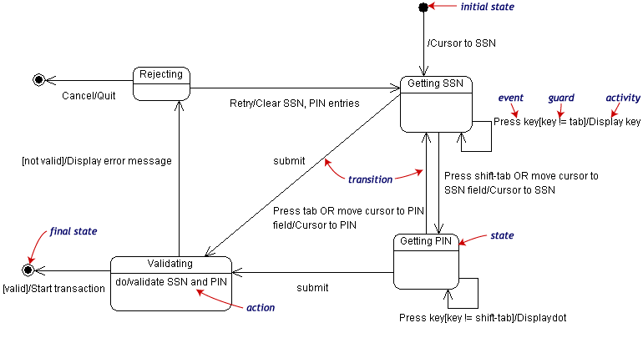
Basic Notational Elements of State Machine Diagrams
Describe the dynamic behavior of an individual object (with states and transitions)

Slide 18
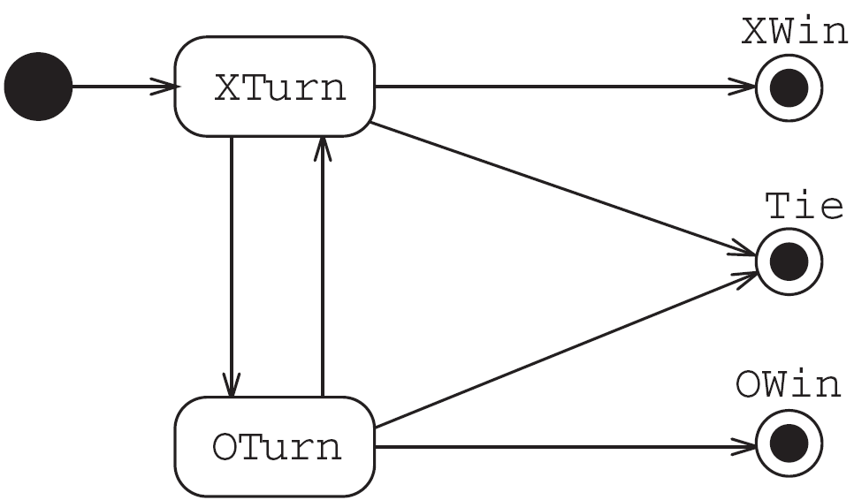
State diagrams – an example
  tic-tac-toe game (also called noughts and crosses)
© Lethbridge/Laganière 2012
Chapter 8: Modelling Interactions and Behaviour

Slide 19
States
  At any given point in time, the system is in one state.
  It will remain in this state until an event occurs that causes it to change state.
  A state is represented by a rounded rectangle containing the name of the state.
  Special states:
    A black circle represents the start state
    A circle with a ring around it represents an end state
© Lethbridge/Laganière 2012
Chapter 8: Modelling Interactions and Behaviour

Slide 20
Transitions
  A transition represents a change of state in response to an event.
    It is considered to occur instantaneously.
  The label on each transition is the event that causes the change of state.
© Lethbridge/Laganière 2012
Chapter 8: Modelling Interactions and Behaviour

Slide 21
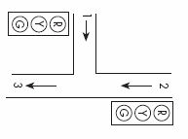
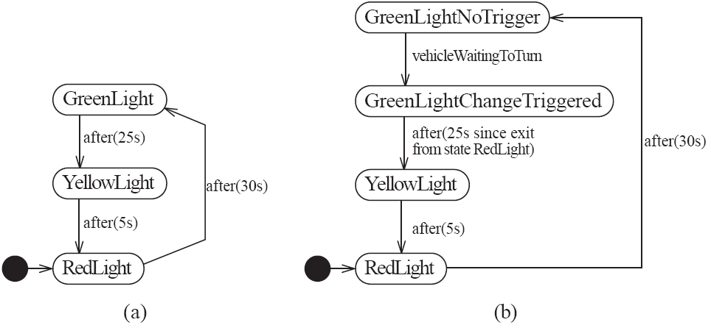
State diagrams – an example of transitions with time-outs and conditions
© Lethbridge/Laganière 2012
Chapter 8: Modelling Interactions and Behaviour

Slide 22
Top Hat Monocle Question
State Machine 1
© Lethbridge/Laganière 2012
Chapter 8: Modelling Interactions and Behaviour

Slide 23
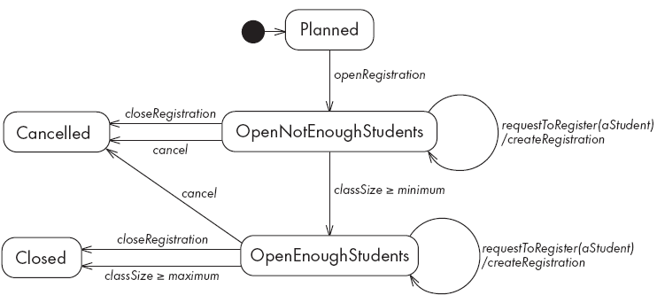
State diagrams – an example with conditional transitions
© Lethbridge/Laganière 2012
Chapter 8: Modelling Interactions and Behaviour

Slide 24
Activities in state diagrams
  An activity is something that takes place while the system is in a state.
    It takes a period of time.
    The system may take a transition out of the state in response to completion of the activity,
    Some other outgoing transition may result in:
      The interruption of the activity, and
      An early exit from the state.
© Lethbridge/Laganière 2012
Chapter 8: Modelling Interactions and Behaviour

Slide 25
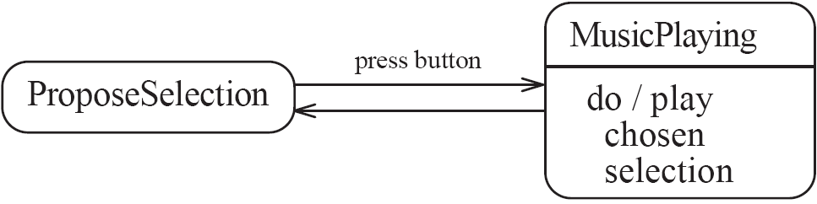
State diagram – an example with activity
© Lethbridge/Laganière 2012
Chapter 8: Modelling Interactions and Behaviour

Slide 26
Actions in state diagrams
  An action is something that takes place effectively instantaneously
    When a particular transition is taken,
    Upon entry into a particular state, or
    Upon exit from a particular state
  An action should consume no noticeable amount of time
© Lethbridge/Laganière 2012
Chapter 8: Modelling Interactions and Behaviour

Slide 27
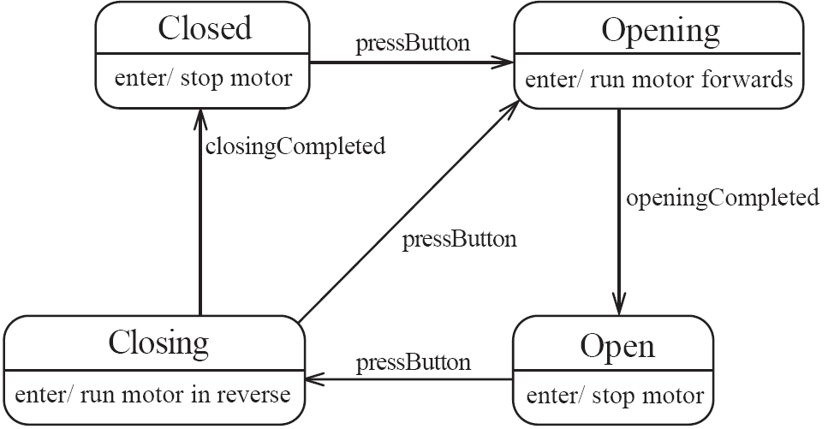
State diagram – an example with actions
© Lethbridge/Laganière 2012
Chapter 8: Modelling Interactions and Behaviour

Slide 28
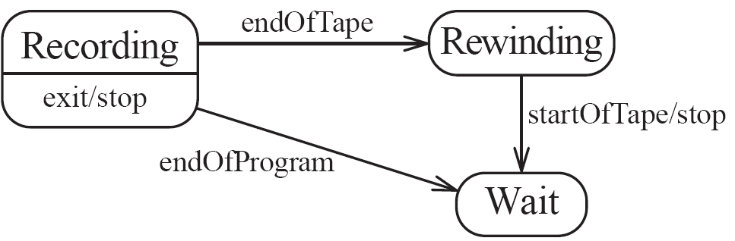
State diagrams – another example
© Lethbridge/Laganière 2012
Chapter 8: Modelling Interactions and Behaviour

Slide 29
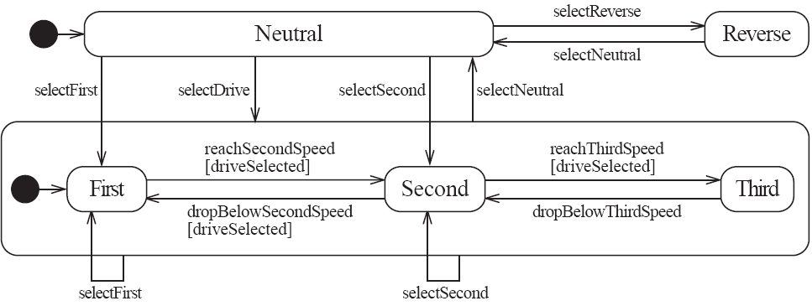
Nested substates and guard conditions
A state diagram can be nested inside a state.
  The states of the inner diagram are called substates.
© Lethbridge/Laganière 2012
Chapter 8: Modelling Interactions and Behaviour

Slide 30
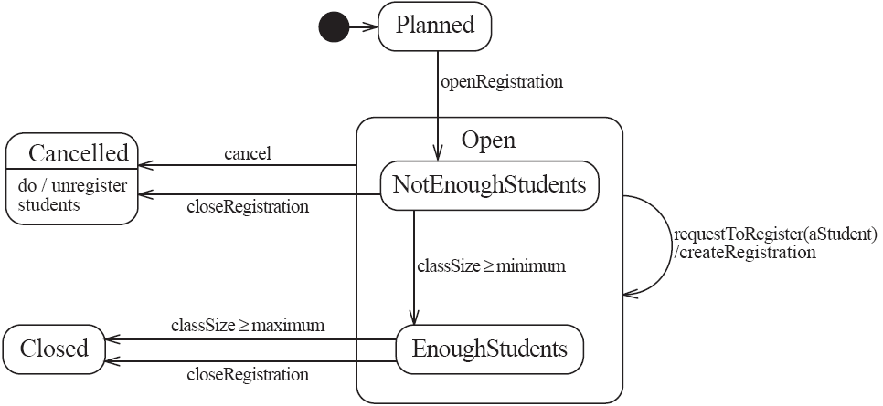
State diagram – an example with substates
© Lethbridge/Laganière 2012
Chapter 8: Modelling Interactions and Behaviour

Slide 31
Action Ordering – Composite States
S1
exit/exS1
S2
entry/enS2
/initS2
S11
exit/exS11
E/actE
S21
entry/enS21
What is the action sequence on transition E?

Slide 32
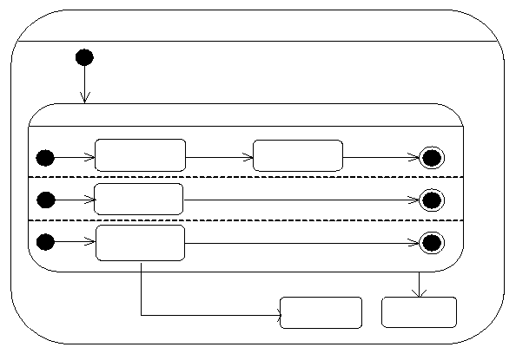
Exercise – Describe this Behaviour
CourseAttempt
Studying
Lab1
lab done
Lab2
lab done
Term Project
project done
Final Test
pass
fail
Failed
Passed

Slide 33
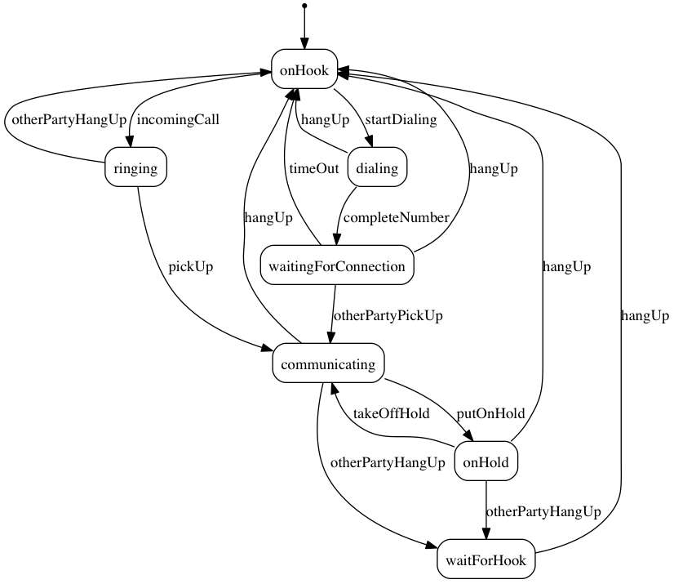
State machine for a Phone Line
© Lethbridge/Laganière 2012
Chapter 8: Modelling Interactions and Behaviour

Slide 34
Top Hat Monocle Question
Phone State Machine
© Lethbridge/Laganière 2012
Chapter 8: Modelling Interactions and Behaviour

Slide 35
Umple for the Phone Line example
class phone {
state {
onHook {
startDialing -> dialling;
incomingCall -> ringing;
}
ringing {
pickUp -> communicating;
otherPartyHangUp -> onHook;
}
communicating {
hangUp -> onHook;
otherPartyHangUp -> waitForHook;
putOnHold -> onHold;
}
onHold {
hangUp -> onHook;
otherPartyHangUp -> waitForHook;
takeOffHold -> communicating;
}
dialing {
completeNumber -> waitingForConnection;
hangUp -> onHook;
}
waitingForConnection {
otherPartyPickUp -> communicating;
hangUp -> onHook;
timeOut -> onHook;
}
waitForHook {
hangUp -> onHook;
}
}
}
© Lethbridge/Laganière 2012
Chapter 8: Modelling Interactions and Behaviour

Slide 36
8.3 Activity Diagrams
  An activity diagram is like a state diagram.
    Except most transitions are caused by internal events, such as the completion of a computation.
  An activity diagram
    Can be used to understand the flow of work that an object or component performs.
    Can also be used to visualize the interrelation and interaction between different use cases.
    Is most often associated with several classes.
  One of the strengths of activity diagrams is the representation of concurrent activities.
© Lethbridge/Laganière 2012
Chapter 8: Modelling Interactions and Behaviour

Slide 37
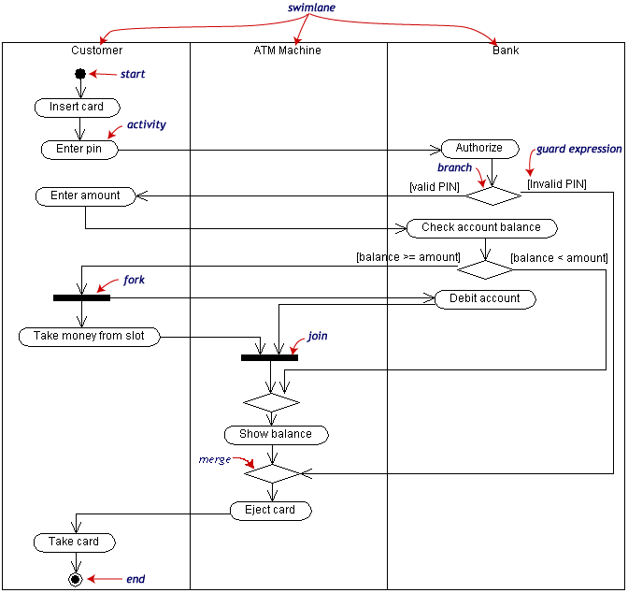
Basic Notational Elements of Activity Diagrams
Describe the dynamic behavior of a system
as a flow of activities

Slide 38
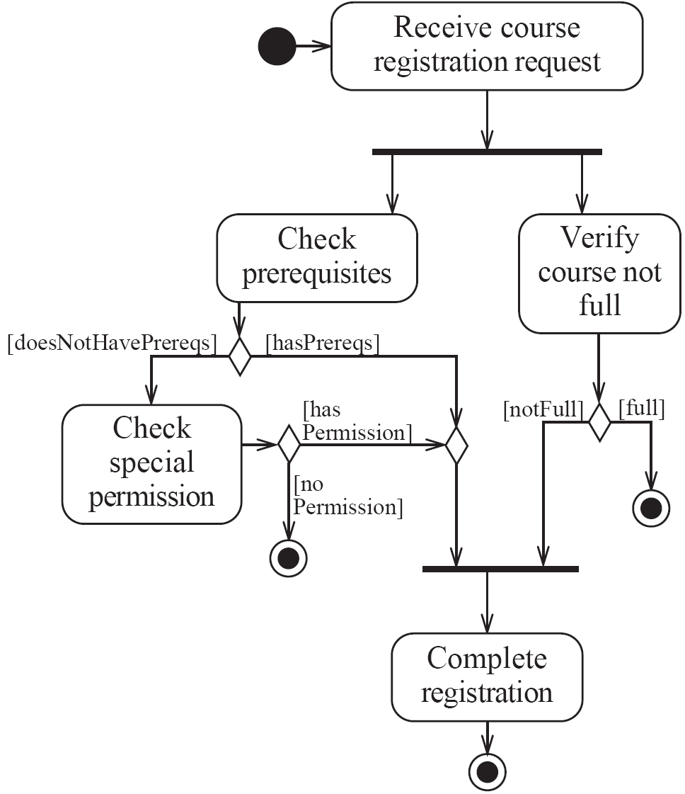
Activity diagrams – an example
© Lethbridge/Laganière 2012
Chapter 8: Modelling Interactions and Behaviour

Slide 39
Representing concurrency
  Concurrency is shown using forks, joins and rendezvous.
    A fork has one incoming transition and multiple outgoing transitions.
      The execution splits into two concurrent threads.
    A rendezvous has multiple incoming and multiple outgoing transitions.
      Once all the incoming transitions occur all the outgoing transitions may occur.
© Lethbridge/Laganière 2012
Chapter 8: Modelling Interactions and Behaviour

Slide 40
Representing concurrency
    A join has multiple incoming transitions and one outgoing transition.
      The outgoing transition will be taken when all incoming transitions have occurred.
      The incoming transitions must be triggered in separate threads.
      If one incoming transition occurs, a wait condition occurs at the join until the other transitions occur.
© Lethbridge/Laganière 2012
Chapter 8: Modelling Interactions and Behaviour

Slide 41
Swimlanes
Activity diagrams are most often associated with several classes.
  The partition of activities among the existing classes can be explicitly shown using swimlanes.
© Lethbridge/Laganière 2012
Chapter 8: Modelling Interactions and Behaviour

Slide 42
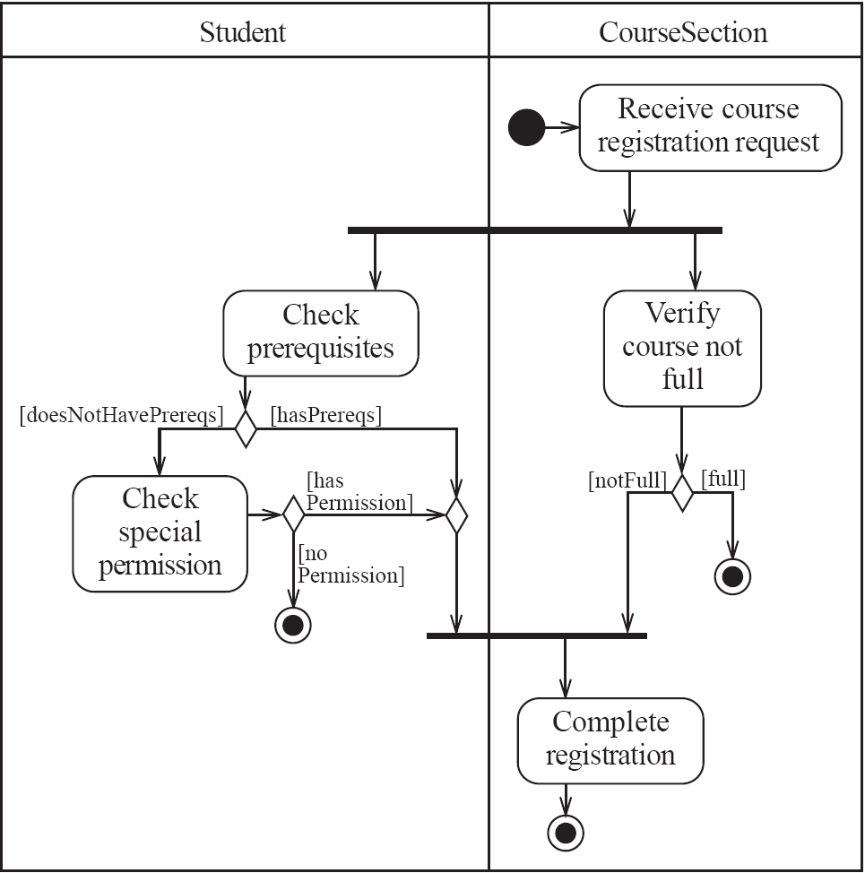
Activity diagrams – an example with swimlanes
© Lethbridge/Laganière 2012
Chapter 8: Modelling Interactions and Behaviour

Slide 43
8.4 Implementing Classes Based on Interaction and State Diagrams
  You should use these diagrams for the parts of your system that you find most complex.
    I.e. not for every class
  Interaction, activity and state diagrams help you create a correct implementation.
  This is particularly true when behaviour is distributed across several use cases.
    E.g. a state diagram is useful when different conditions cause instances to respond differently to the same event.
© Lethbridge/Laganière 2012
Chapter 8: Modelling Interactions and Behaviour

Slide 44
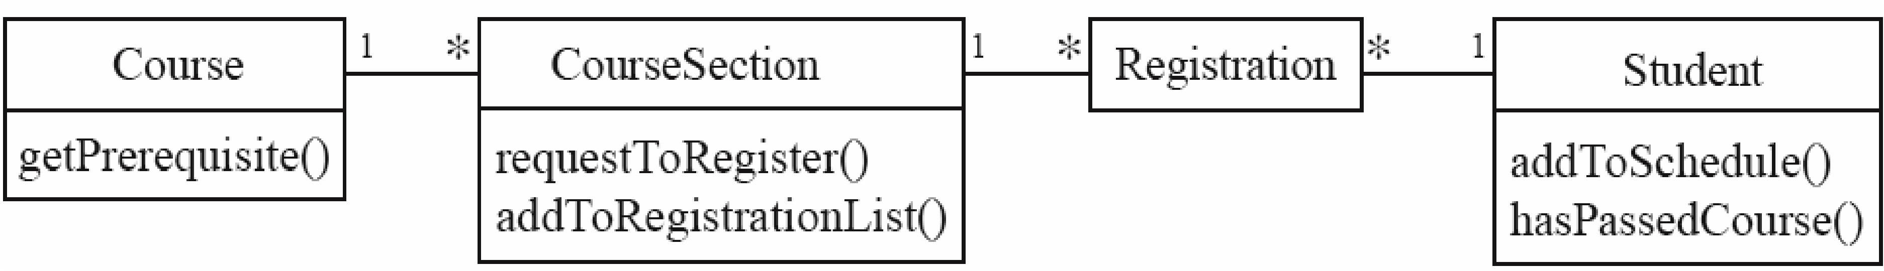
Example
© Lethbridge/Laganière 2012
Chapter 8: Modelling Interactions and Behaviour

Slide 45
Example: The CourseSection class
States:
  ‘Planned’:
    closedOrCancelled == false && open == false
  ‘Cancelled’:
    closedOrCancelled == true &&
    registrationList.size() == 0
  ‘Closed’ (course section is too full, or being taught):
    closedOrCancelled == true &&
    registrationList.size() > 0
© Lethbridge/Laganière 2012
Chapter 8: Modelling Interactions and Behaviour

Slide 46
Example: The CourseSection class
States:
  ‘Open’ (accepting registrations):
    open == true
  ‘NotEnoughStudents’ (substate of ‘Open’):
    open == true &&
    registrationList.size() < course.getMinimum()
  ‘EnoughStudents’ (substate of ‘Open’):
    open == true &&
    registrationList.size() >= course.getMinimum()
© Lethbridge/Laganière 2012
Chapter 8: Modelling Interactions and Behaviour

Slide 47
Example: The CourseSection class
public class CourseSection
{
// The many-1 abstraction-occurrence association (Figure 8.2)
private Course course;
// The 1-many association to class Registration (Figure 8.2)
private List registrationList;
// The following are present only to determine the state
// (as in Figure 8.19). The initial state is 'Planned‘
private boolean open = false;
private boolean closedOrCanceled = false;
© Lethbridge/Laganière 2012
Chapter 8: Modelling Interactions and Behaviour

Slide 48
Example: The CourseSection class
public CourseSection(Course course)
{
this.course = course;
registrationList = new LinkedList();
}
public void openRegistration()
{
if(!closedOrCanceled) // must be in 'Planned' state
{
open = true; // to 'OpenNotEnoughStudents' state
}
}
© Lethbridge/Laganière 2012
Chapter 8: Modelling Interactions and Behaviour

Slide 49
Example: The CourseSection class
public void closeRegistration()
{
// to 'Canceled' or 'Closed' state
open = false;
closedOrCanceled = true;
if (registrationList.size() < course.getMinimum())
{
unregisterStudents(); // to 'Canceled' state
}
}
public void cancel()
{
// to 'Canceled' state
open = false;
closedOrCanceled = true;
unregisterStudents();
}
© Lethbridge/Laganière 2012
Chapter 8: Modelling Interactions and Behaviour

Slide 50
Example: The CourseSection class
public void requestToRegister(Student student)
{
if (open) // must be in one of the two 'Open' states
{
// The interaction specified in the sequence diagram of Figure 8.4
Course prereq = course.getPrerequisite();
if (student.hasPassedCourse(prereq))
{
// Indirectly calls addToRegistrationList
new Registration(this, student);
}
// Check for automatic transition to 'Closed' state
if (registrationList.size() >= course.getMaximum())
{
// to 'Closed' state
open = false;
closedOrCanceled = true;
}
}
}
© Lethbridge/Laganière 2012
Chapter 8: Modelling Interactions and Behaviour

Slide 51
Example: The CourseSection class
// Private method to remove all registrations
// Activity associated with 'Canceled' state.
private void unregisterStudents()
{
Iterator it = registrationList.iterator();
while (it.hasNext())
{
Registration r = (Registration)it.next();
r.unregisterStudent();
it.remove();
}
}
// Called within this package only, by the constructor of
// Registration to ensure the link is bi-directional
void addToRegistrationList(Registration newRegistration)
{
registrationList.add(newRegistration);
}
}
© Lethbridge/Laganière 2012
Chapter 8: Modelling Interactions and Behaviour

Slide 52
8.5 Difficulties and Risks in Modelling Interactions and Behaviour
Dynamic modelling is a difficult skill
  In a large system there are a very large number of possible paths a system can take.
  It is hard to choose the classes to which to allocate each behaviour:
    Ensure that skilled developers lead the process, and ensure that all aspects of your models are properly reviewed.
    Work iteratively:
      Develop initial class diagrams, use cases, responsibilities, interaction diagrams and state diagrams;
      Then go back and verify that all of these are consistent, modifying them as necessary.
    Drawing different diagrams that capture related, but distinct, information will often highlight problems.
© Lethbridge/Laganière 2012
Chapter 8: Modelling Interactions and Behaviour

