Slide 1
Step by Step Dotnetcore API

Slide 2
Table of Contents
Target Architecture
Docker / Containers
  What is containers
  Install Docker on Local
  Hello World
Create Values API and Run Locally
  .NET Core / Visual Studio
REST API with DotnetCore
  Dotnetcore vs .NET Framework
  Setting Up PC
  Creating API
  Running in a container
  Deploying to Kubernetes
  Adding Swagger capability
  Adding End-points

Slide 3
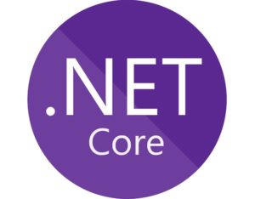
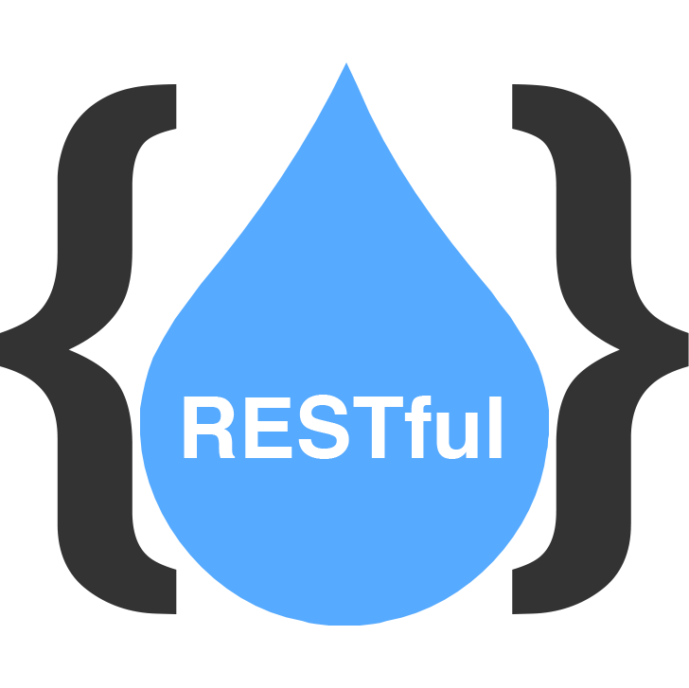
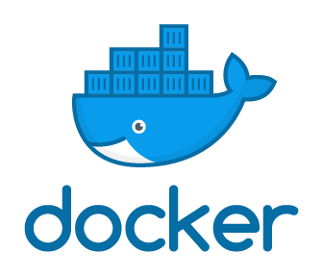
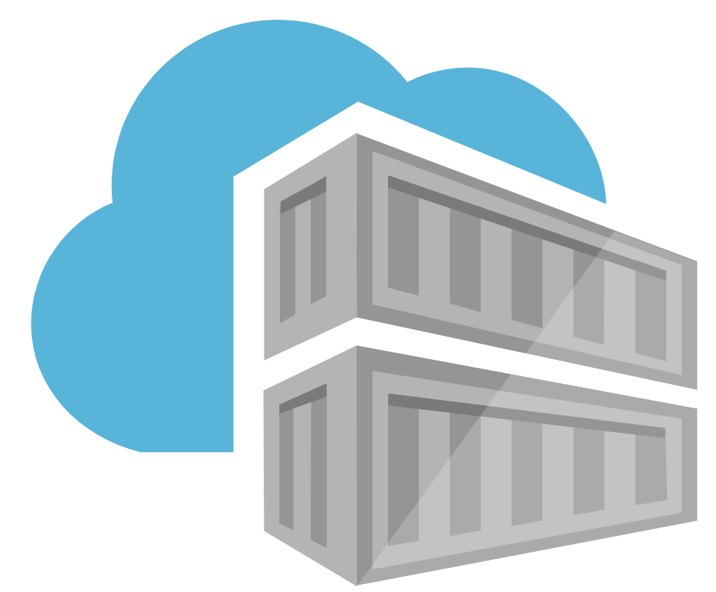
Target Architecture – What are we building
Values API
GET http://[service-ip]/api/values
List Values
Get specific value
GET http://[service-ip]/api/values/1
Tools
Visual Studio
Dotnet Core SDK
Docker CLI : To build/push docker image
Azure CLI : To connect to Azure
Kubectl : To deploy Calculator API
AKS

Slide 4
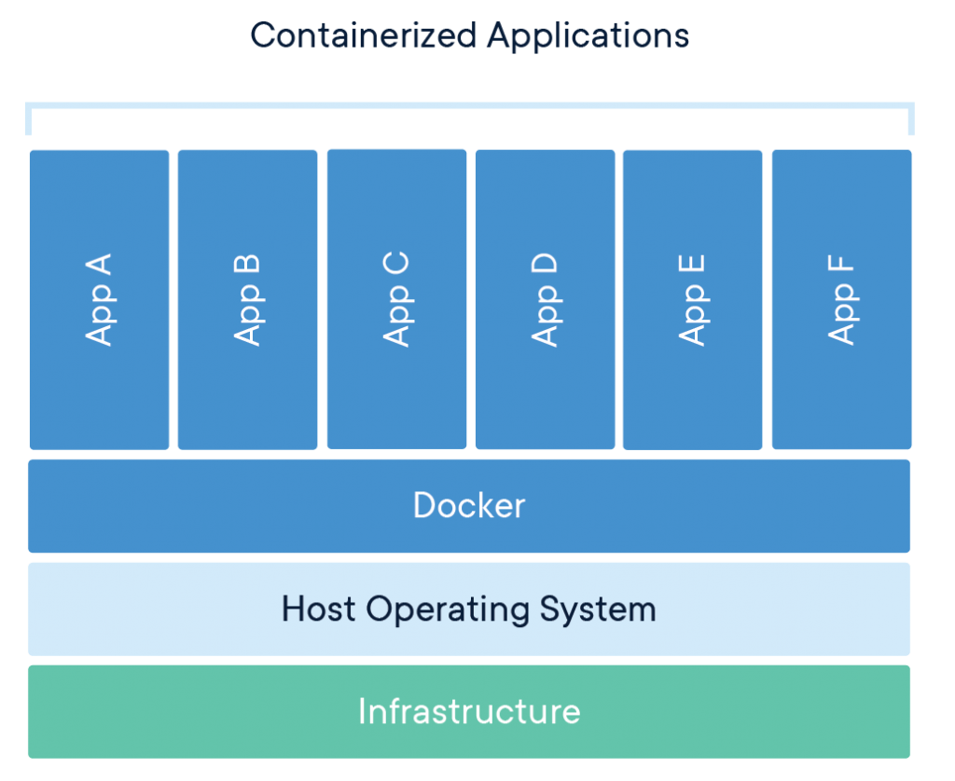
Docker - Containers
A container is a standard unit of software that packages up code and all its dependencies so the application runs quickly and reliably from one computing environment to another. A Docker container image is a lightweight, standalone, executable package of software that includes everything needed to run an application: code, runtime, system tools, system libraries and settings.
Standard – portable anywhere
Lightweight – Only required things for your app
Secure – Isolated
More info: https://www.docker.com/resources/what-container

Slide 5
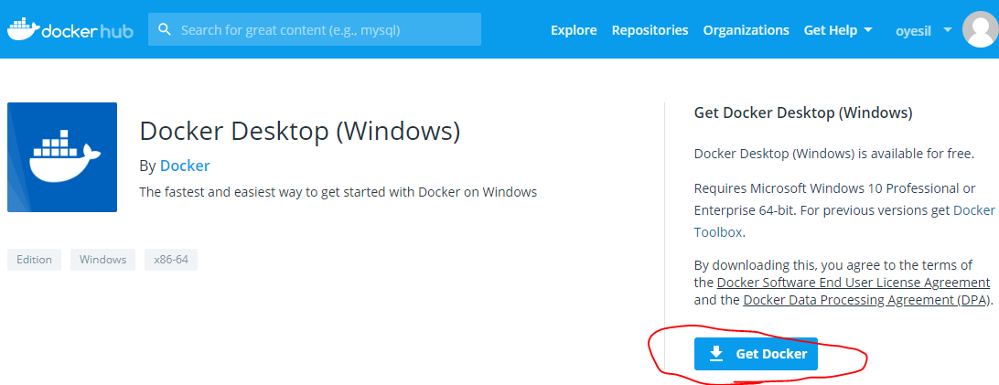
Docker - Installing Docker for Windows
Hands-on Lab
Download Docker Desktop for Windows
  Hyper-V must be installed on your PC (from Add Remove Programs)
  Register to Dockerhub
  Download and install
    https://docs.docker.com/docker-for-windows/install/
Login to Docker
  From Docker for Windows
  Or run the following command in command line/powershell
    docker login -u [your-username] -p [yourpassword]

Slide 6
Docker – Docker Hub / Hello World
Hands-on Lab
Browse Docker-hub
  Search hello-world docker image
Run hello-world from command-line
  docker run hello-world
Some docker-cli commands
  docker ps : shows running docker containers
  docker images : shows images exist in local repo
  docker search hello- : lists available images in the remote repo
  docker build : builds a new docker image from dockerfile
  docker push : pushes locally built image to remote repo

Slide 7
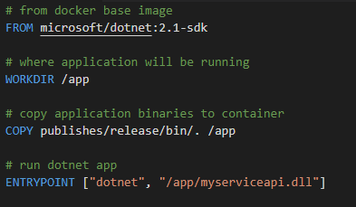
Docker – Dockerfile
Docker can build images automatically by reading the instructions from a Dockerfile.
A Dockerfile is a text document that contains all the commands a user could call on the command line to assemble an image.
Using docker build users can create an automated build that executes several command-line instructions in succession.
Sample: dockerfile

Slide 8
Docker – Azure Container Registry
Hands-on Lab
ACR – Similar to Github
  Our private repo
  Hosted in Azure – Fully managed
Login to Azure Container Registry
  docker login osrammarkhamdev.azurecr.io –u [will-be-provided] –p [will-be-provided]

Slide 9
Values API – Setup local
Hands-on Lab
If not installed
  Install Visual Studio
  Install .NET Core 2.2 SDK
  https://dotnet.microsoft.com/download
Clone git repo
https://OYesil-ext@dev.azure.com/OYesil-ext/workshops/_git/ws01-dockerize-dotnetcore
Create a branch under your name, and push that branch to remote
  git checkout –b branch [firstname].[lastname] #example: git checkout -b branch omer.Yesil
  git push –u origin [firstname].[lastname]

Slide 10
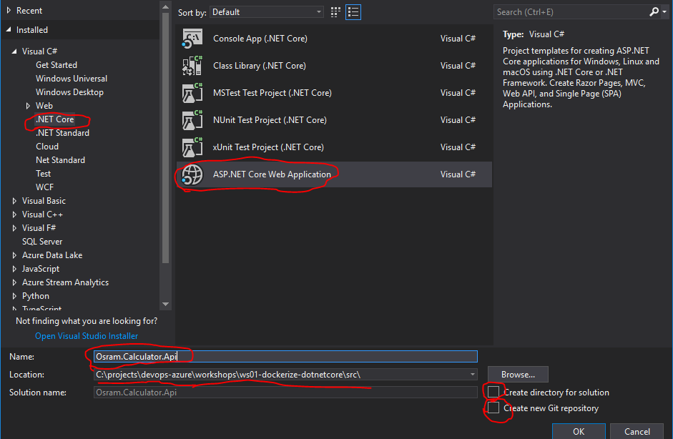
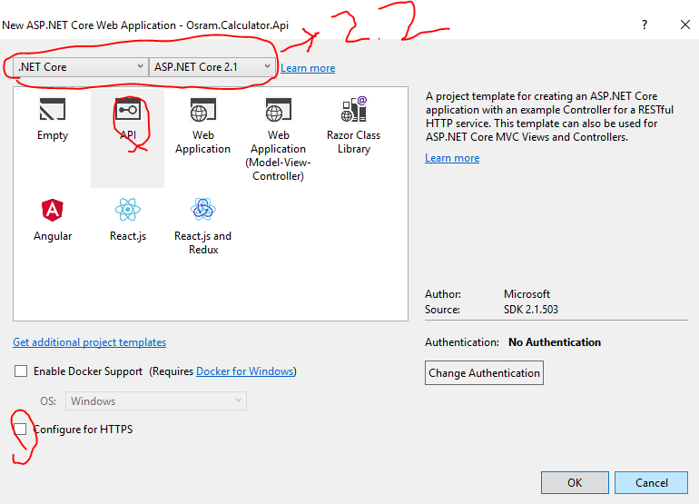
Values API – Create Values API
Hands-on Lab
From Visual Studio, select New Project from File menu, and create an “ASP.NET Core Web Application” from the templates
Run the application to test on local

Slide 11
Values API – Publish the API Runtimes
Hands-on Lab
Publish the Application. Run the dotnet cli command under ../src/Osram.Calculator.Api folder (you can also publish from Visual Studio)
  dotnet publish -c release -o publish
To test the published code run the following under the publish folder
  dotnet Osram.Values.Api.dll
  Verify : http://localhost:5000/api/values
  Now you can kill the running dotnet process (CTRL+C)

Slide 12
Values API – Dockerize
Hands-on Lab
Create a new text file named dockerfile under ../src/Osram.Calculator.Api folder, and set its’ content as below:
  FROM microsoft/dotnet:2.2-aspnetcore-runtime AS runtime
  WORKDIR /app
  COPY publish/. /app/
  ENV ASPNETCORE_URLS=http://+:5000
  ENTRYPOINT ["dotnet", "Osram.Values.Api.dll"]
Run the following command to build docker image
docker build -t osram.values.api .
  Verify : docker images

Slide 13
Values API – Run Docker Container on Local
Hands-on Lab
Run the following command to create a container from the image we created in the previous slide:
  docker run osram.values.api –p 5000:5000
  To verify, browse: http://localhost:5000/api/values
Kill the process (CTRL-C)

Slide 14
Values API – Connecting to a running Container
Hands-on Lab
Run the previous command with additional parameter (-d):
  docker run osram.values.api –p 5000:5000 -d
To see the running containers
  docker ps
Connect to the running container
  docker exec -it [containerId] /bin/bash
Now we can run any Linux bash command
To exit from the container, type ‘exit’ and Enter

Slide 15
Values API – Pushing Local Docker Image to Remote Docker Repo
Hands-on Lab
Login to docker repo (ACR)
USERNAME and PASSWORD will be provided
  docker login osrammarkhamdev.azurecr.io –u USERNAME –p PASSWORD
Tag the local docker image
  docker tag [your-docker-image-id] osrammarkhamdev.azurecr.io/workshop-values-api:yourfirstname.yourlastname
Push the image
  docker push osrammarkhamdev.azurecr.io/workshop-values-api:yourfirstname.yourlastname
Now we can run any Linux bash command
To exit from the container, type ‘exit’ and Enter

Slide 16
DEPLOYMENT

Slide 17
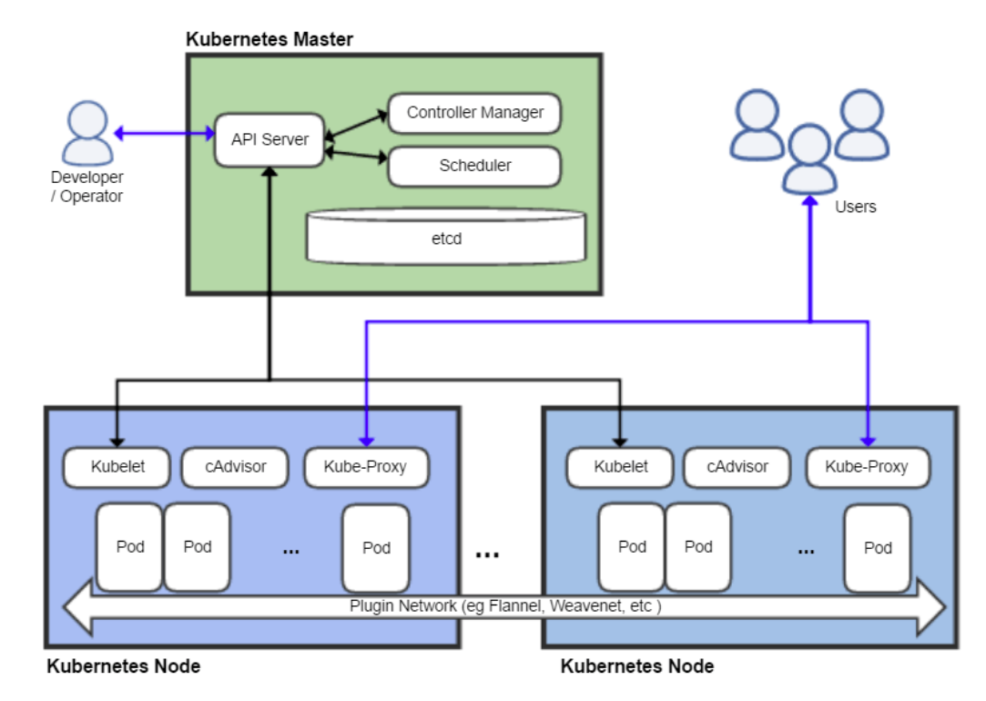
Kubernetes Cluster
A Pod can have multiple containers
Container
Container
…

Slide 18
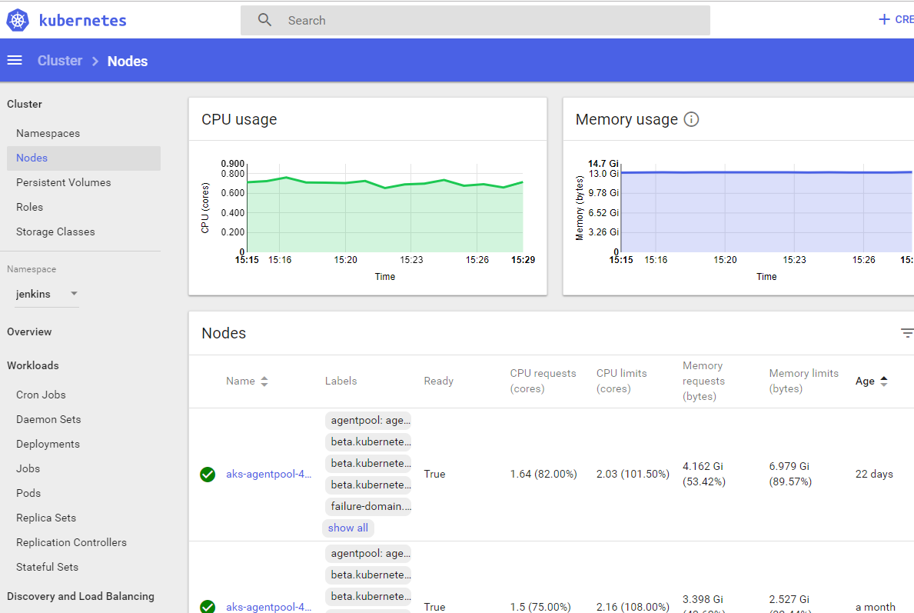
Accessing to Kubernetes
Kubernetes CLI : kubectl
https://kubernetes.io/docs/tasks/tools/install-kubectl/#install-with-powershell-from-psgallery
SAMPLE CALLS:
kubectl create –f mydeploymentfile.yml –n testnamespace
kubectl get nodes
kubectl get pods –n testname
Kubernetes Dashboard

Slide 19
Deployment Progress
Develop your app
Create a Docker Image for your App and Push it to Docker Repo
Create Kubernetes Deployment object manifests
Login to Kubernetes
Deployment YML
Service YML
Deploy to Kubernetes

Slide 20
Creating Values API Kubernetes Manifests
aspnetcore_sample microsoft/dotnet-samples:aspnetapp
microsoft/dotnet-samples:aspnetapp
microsoft/dotnet-samples:aspnetapp
sample-api-deployment.yaml
sample-api-service.yaml
---
apiVersion: apps/v1beta1
kind: Deployment
metadata:
name: YOURFIRSTNAME-YOURLASTNAME-api
namespace: workshop
spec:
replicas: 3
template:
metadata:
labels:
app: YOURFIRSTNAME-YOURLASTNAME-api
spec:
containers:
- name: YOURFIRSTNAME-YOURLASTNAME-api
image: osram.repo/fmui:bete1.0
ports:
- containerPort: 80
env:
- name: MY_TEST_ENV
value: "HELLO THERE"
imagePullSecrets:
- name: dockerhub
---
apiVersion: v1
kind: Service
metadata:
name: YOURFIRSTNAME-YOURLASTNAME-api-svc
namespace: workshop
spec:
type: LoadBalancer
selector:
app: YOURFIRSTNAME-YOURLASTNAME-api
ports:
- name: http
protocol: TCP
port: 80
targetPort: 80 #POD’s port number

Slide 21
Accessing to Kubernetes Cluster
Install and Login to Azure CLI
  Install : https://docs.microsoft.com/en-us/cli/azure/install-azure-cli-windows?view=azure-cli-latest
  Login :
  az login
Install Kubernetes CLI
  https://kubernetes.io/docs/tasks/tools/install-kubectl/#install-with-powershell-from-psgallery
  OR
  az aks install-cli
Configure kubectl for our cluster
az aks get-credentials --resource-group kubernetes-dev --name osram-markham-k8s-dev
Verify the kubectl configuration
kubectl get nodes

Slide 22
Deploying to Kubernetes
To deploy the application
kubectl create –f sample-api-deployment.yaml
To verify app deployment
kubectl get pods –n workshop
kubectl get deployments –n workshop
To deploy the service (load balancer service)
kubectl create –f sample-api-service.yaml
To verify the service deployment and get the IP address of it
kubectl get services -n workshop
Copy/paste the External IP address on Chrome(or any browser,) and browse it

Slide 23
Connecting to a POD running in Kubernetes
Similar to docker exec command, we can use kubectl exec command to connect (kind a SSH) to a running container
  Get your container name
  kubectl get pods –n workshop
  Connect to the Container
  kubectl exec –it [CONTAINERNAME] /bin/bash –n workshop

