Slide 1
Haigent
AI-Powered HR Platform
Three AI Agents | ServiceNow | Salesforce Agentforce | Claude AI
February 2026

Slide 2
What is Haigent?
● A modular HR platform powered by AI agents
● Connects enterprise systems: ServiceNow + Salesforce
● Built with Next.js 15, TypeScript, Tailwind CSS
● Three live AI agents replacing manual HR workflows

Slide 3
Architecture Overview
Claude AI (Anthropic)
ServiceNow Table API
User
Haigent (Next.js)
Salesforce Agentforce
● User → Haigent (Next.js) → Claude AI (Anthropic) for Onboarding & Benefits
● User → Haigent (Next.js) → Salesforce Agentforce for Payroll
● Claude AI → ServiceNow Table API (custom scoped app: x_1926120_employee)

Slide 4
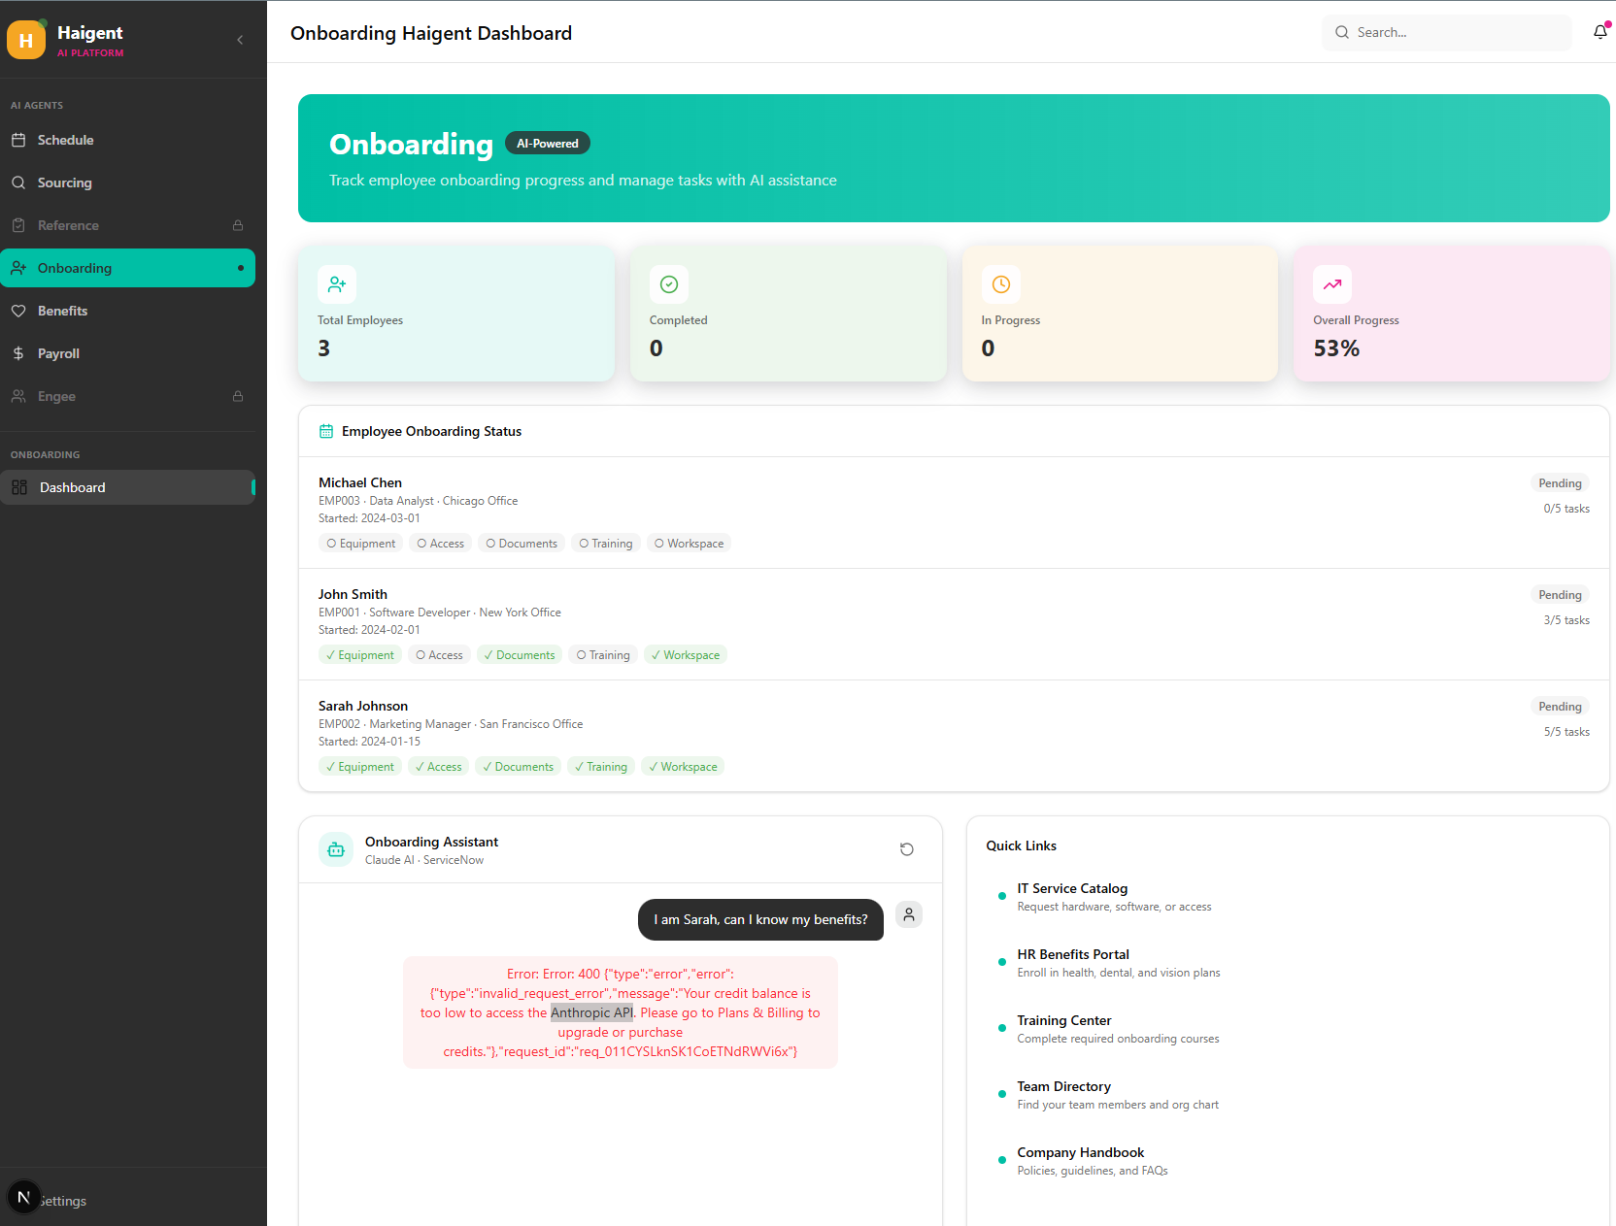
Agent 1: Onboarding Agent
Powered by Claude AI + ServiceNow
● Live dashboard of employee onboarding records from ServiceNow
● Real-time status tracking: Pending → In Progress → Completed
● AI chat with 5 tools: look up employee, update tasks, create IT tickets
● Agentic loop: Claude reasons across multiple ServiceNow API calls
● Custom ServiceNow scoped app (x_1926120_employee)

Slide 5
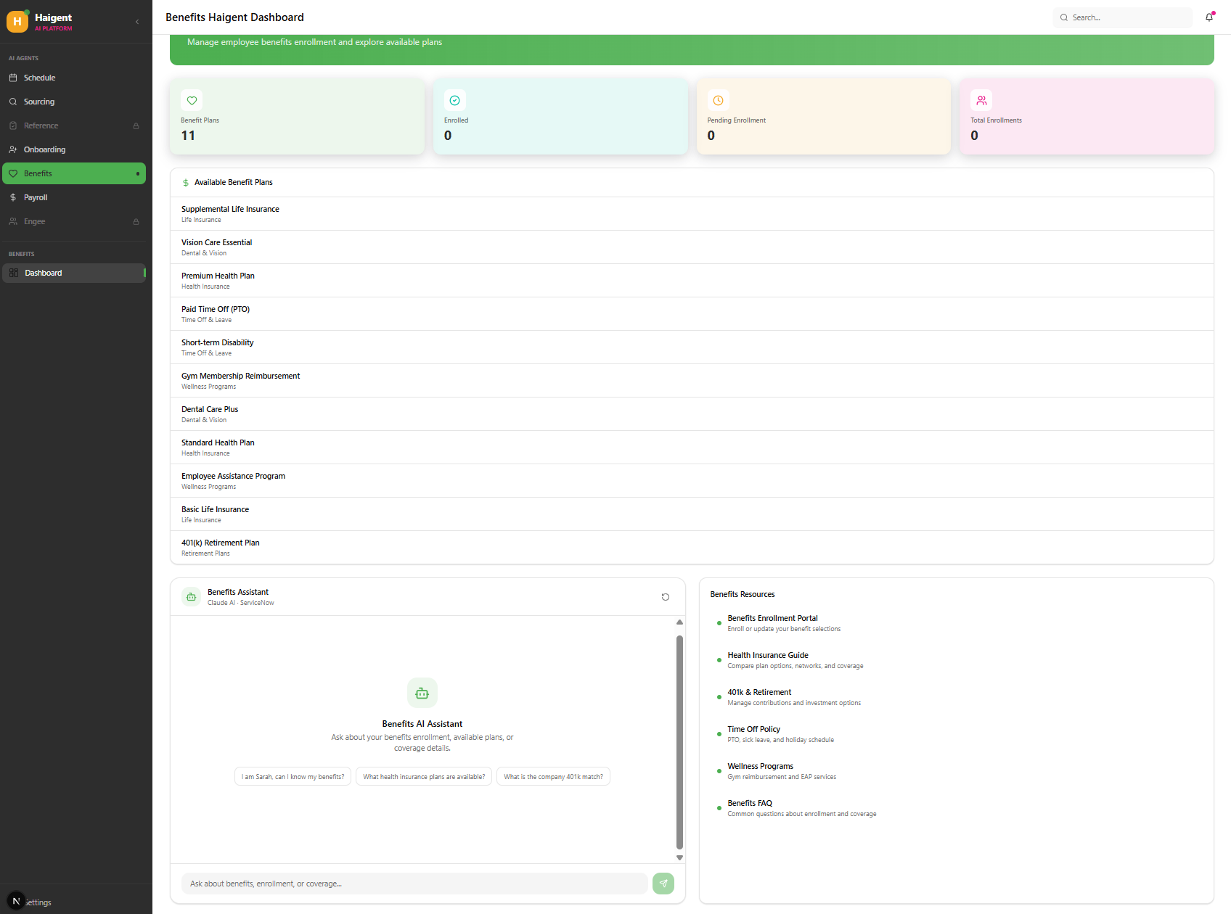
Agent 2: Benefits Agent
Powered by Claude AI + ServiceNow
● Dashboard showing all benefit plans and enrollment overview
● AI assistant answers benefit questions using live ServiceNow data
● Tools: get benefit types, check employee enrollment, enroll/update benefits
● Same ServiceNow scoped app — separate benefit_types and enrollment tables

Slide 6
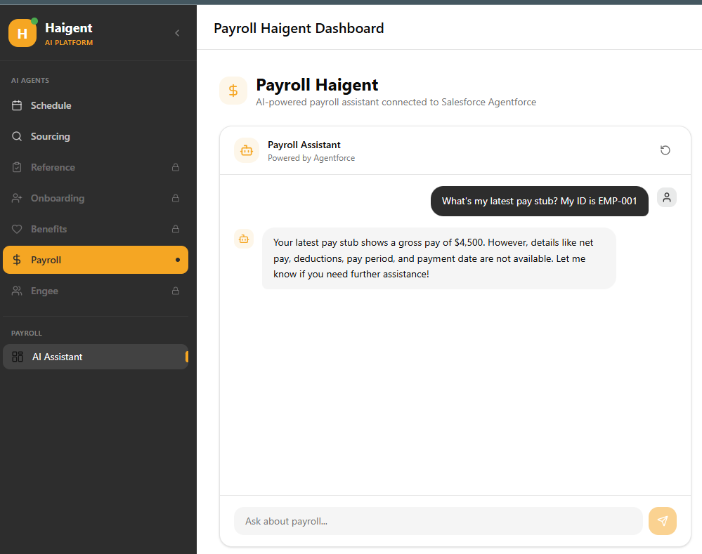
Agent 3: Payroll Agent
Powered by Salesforce Agentforce
● Connected to Salesforce's native AI agent platform (Agentforce)
● OAuth 2.0 server-to-server authentication (no user login required)
● Full session lifecycle: start session → send messages → end session
● Haigent acts as a proxy between the user and the Agentforce Agent API

Slide 7
ServiceNow Integration
● Built custom scoped app in ServiceNow Studio (IDE)
● Scope: x_1926120_employee
● 3 custom tables: onboarding, benefit_types, benefit_enrollment
● REST Table API with Basic Auth
● Required config: web services access + scoped app roles

Slide 8
How the AI Agent Works
Claude AI Tool-Use Pattern
Step 1
Step 2
Step 3
Step 4
Step 5
Step 6
User sends message
Claude decides which tool to call
Next.js executes tool → ServiceNow API call
Result returned to Claude
Claude reasons, may call more tools
Claude returns final answer (stop_reason = end_turn)
↺ Steps 2–5 repeat in an agentic loop until Claude decides the task is complete

Slide 9
Technology Stack
Frontend
AI Engine
Enterprise AI
HRIS Backend
Auth
Next.js 15 | React 19 TypeScript | Tailwind CSS shadcn/ui
Anthropic Claude (claude-sonnet-4-6)
Salesforce Agentforce Agent API
ServiceNow Table REST API Custom Scoped App
OAuth 2.0 (Salesforce) HTTP Basic Auth (ServiceNow)

Slide 10
Key Achievements
3 live AI agents connecting real enterprise systems
End-to-end ServiceNow custom app: built, deployed, and integrated
Claude AI agentic tool-use pattern for multi-step HR workflows
Salesforce Agentforce integration with session management
Modular architecture — easily extensible to new HR modules

