Slide 1

SG Fishing Guide
An analysis of environmental factors affecting fish feeding behaviour to forecast future fishing conditions for a tiered pricing system of their fishing guide services

Slide 2
Agenda
Problem Statement
Environmental factors affecting fish feeding behaviour
Analyses of the climate and environmental factors in Singapore’s context
Evaluation of Analyses
Recommendations and Matrix Scoring System
Benefits Summary
Appendix

Slide 3
Problem Statement
To explore the feasibility of a tiered pricing system for their SG Fishing Guide’s services. Instead of having a fixed price for hiring a guide each day throughout the year, the company would like to have a tiered pricing system where customers will be charged: - lower prices for days when the fishing conditions are less than ideal, and - higher prices for days with optimal fishing conditions.
This project aims to analyze the trends and patterns of environmental conditions which affect the quality of fishing and forecast the fishing conditions of future dates for the planning of their tiered pricing system.
Current State | Implications | Ideal Future State
Single pricing system throughout the year | May lose out on potential earnings during high fishing seasons Unable to optimize manpower planning | Multi-tiered pricing system Able to better plan manpower Maximize earning potential
Possible fishing conditions unknown | Customer encountering bad fishing days may not return | Multi-tiered pricing system Allows customers to manage expectations Transparency to create a loyal customer base

Slide 4


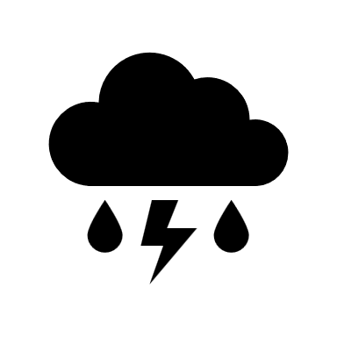
Environmental Factors affecting fish feeding behaviour
Temperature: Higher temperatures increase the water temperature, which in turn increases fishes’ metabolic rates, food consumption, swim speeds and distances
Wind Speed: Higher Wind Speeds generate more turbulence in the water, which greatly reduces the activity and feeding by ambush predators
Rainfall: One of the factors affecting water temperature, moderate to heavy rainfall levels may greatly decrease the water temperature
Source:
Stoner, Allan. (2004). Effects of environmental variables on fish feeding ecology: Implications for the performance of baited fishing gear and stock assessment. Journal of Fish Biology. 65. 1445 - 1471. 10.1111/j.0022-1112.2004.00593.x.

Slide 5
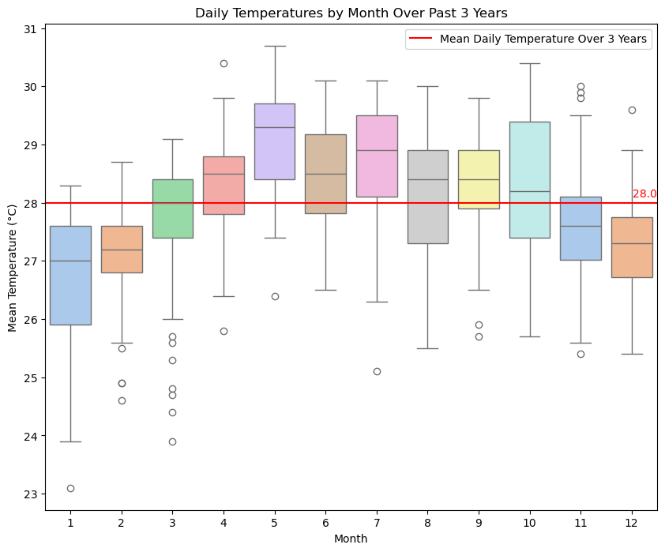
Daily Mean Temperatures by Month over 3 years
Higher Temperatures: April – October
Lower Temperatures: November – March
Several outliers where there are cooler days in January - March

Slide 6
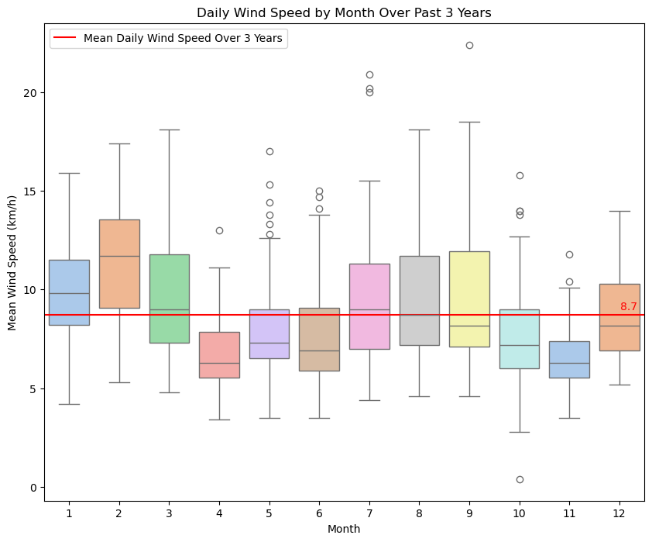
Daily Mean Wind Speed by month over 3 years
Lower wind speeds: April – June September - December
Higher wind speeds: January – March July – August
Several outliers where there are high winds in May – July and September – November

Slide 7
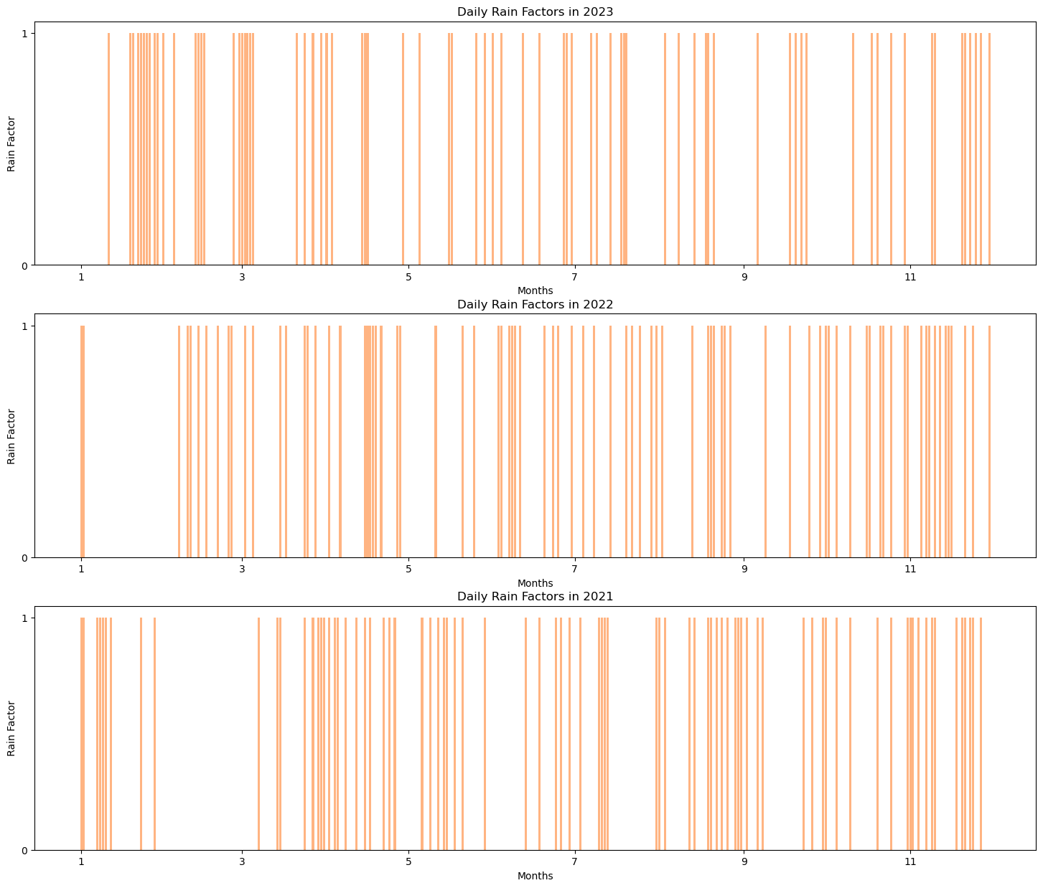
Daily Rain Factors over 3 years
Total rainfall of more than 0.25 inch (6.55mm) will warrant a Rain Factor of 1
Generally sporadic
Able to find pockets where there are periods of light or no rain which will not affect fishing conditions

Slide 8
Evaluation of Analyses
Individually, we can see some trends over the period of a year.
Temperature: Higher temperatures over the mean mainly between April – October
Wind Speed: Lower Wind Speeds below the mean in April – June and September – December
Rainfall: Sporadic throughout the year
However, collectively, to provide recommendations for the pricing system, using just visual inspection on trends may not be the best option.
Values indicating optimal fishing conditions: While there are trends where the values above or below the mean are more concentrated during certain periods, they still occur throughout the year
Business Impact: Only recommending a certain period for high-tiered pricing, and the rest of the year with low-tiered does not make business sense as it may reduce total revenue

Slide 9
Environmental Factors affecting fish feeding behaviour
Temperature: Higher temperatures increase the water temperature, which in turn increases fishes’ metabolic rates, food consumption, swim speeds and distances
Wind Speed: Higher Wind Speeds generate more turbulence in the water, which greatly reduces the activity and feeding by ambush predators
Rainfall: One of the factors affecting water temperature, moderate to heavy rainfall levels may greatly decrease the water temperature
Source:
Stoner, Allan. (2004). Effects of environmental variables on fish feeding ecology: Implications for the performance of baited fishing gear and stock assessment. Journal of Fish Biology. 65. 1445 - 1471. 10.1111/j.0022-1112.2004.00593.x.

Slide 10
How dry bulb temperature, wet bulb temperature and wind speed contribute to precipitation
Dry & Wet Bulb Temperature: Dry bulb temperatures influence water evaporation and air convection, leading to cloud formation and potential showers. Wet bulb temperatures indicate atmospheric humidity, and approaching dry bulb temperatures signal moisture buildup conducive to cloud formation and showers.
Wind Speed: Higher wind speeds allow more water evaporation into the atmosphere. With Singapore being an island nation, the wind may bring about more moisture evaporated from the ocean onto land, serving as a moisture source for precipitation when the water mass reaches its saturation point.

Slide 11
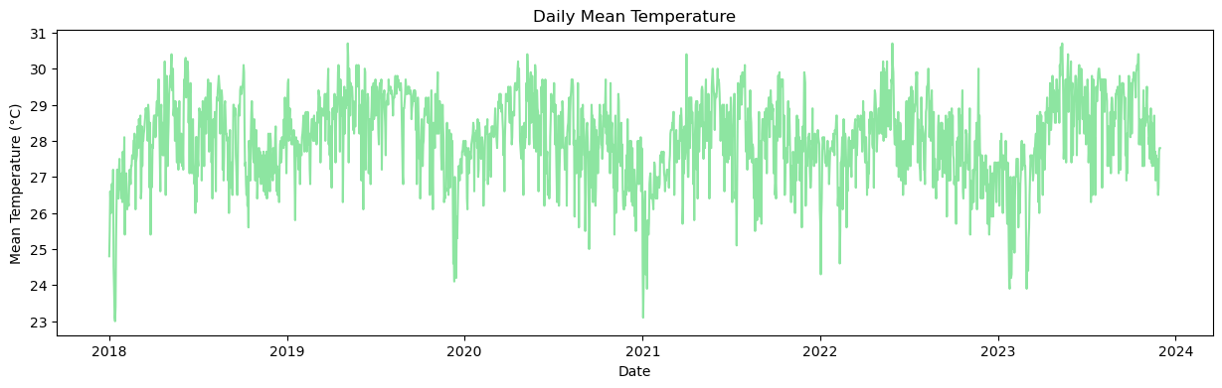
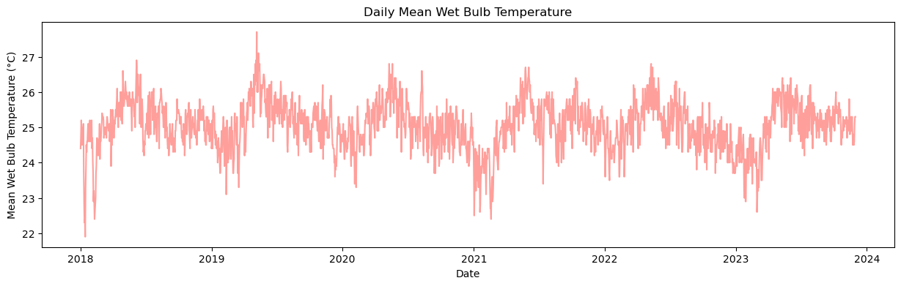
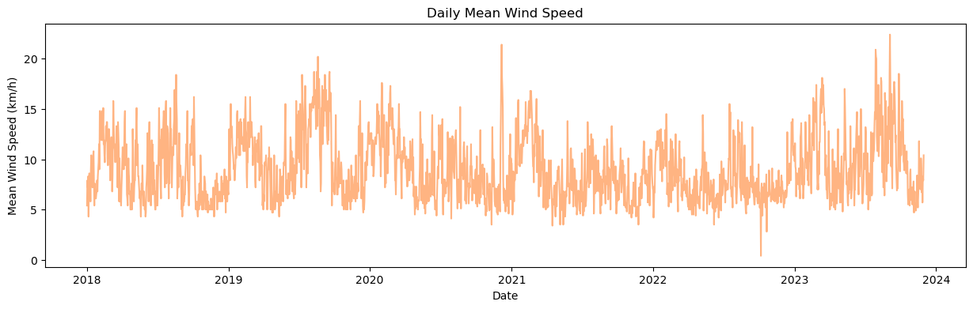
Line plots of the environmental factors
Clear patterns can be seen from the charts over 6 years
Able to forecast future data using machine learning models
With the forecast of these factors in our hands, we can then predict the chances of rainfall!

Slide 12
Matrix Scoring System & tiered pricing
Environmental Factors | Ideal Conditions |  |  | Non-Ideal Conditions
 | Property | Value | Score | Property | Value | Score
Mean Temperature (°C) | Mean over 3 years | ≥ 28 | 1 | Mean over 3 years | < 28 | 0
Mean Wind Speed (km/h) | Mean over 3 years | < 8.7 | 1 | Mean over 3 years | ≥ 8.7 | 0
Rain Factor | Boolean Value | 0 | 1 | Boolean Value | 1 | 0
Each factor to be given a score of 0 or 1, 0 being non-ideal and 1 being ideal conditions for fishing
The sum of all 3 scores will reflect the result of the conditions of fishing & pricing for the services: 0-1: Non-ideal, Low-tiered pricing 2: Moderate, Mid-tiered pricing 3: Optimal, High-tiered pricing
Date | Forecasted Mean Temperature (°C) | Forecasted Mean Wind Speed (km/h) | Rain Factor | Results
2024-05-22 | 30.67 | 7.62 | 0 | Optimal, High-tier
2024-05-23 | 30.51 | 8.54 | 0 | Optimal, High-tier
2024-05-24 | 30.42 | 10.52 | 0 | Moderate, Mid-tier
2024-05-25 | 30.51 | 8.87 | 0 | Moderate, Mid-tier
2024-05-26 | 30.58 | 8.29 | 0 | Optimal, High-tier
2024-05-27 | 30.34 | 7.87 | 0 | Optimal, High-tier
2024-05-28 | 30.46 | 8.10 | 0 | Optimal, High-tier

Slide 13




Benefits Summary
Breakthrough pricing system, first in the industry
Layer of transparency as an additional service that would help to build trust among the customers and gain customer loyalty to the brand
Manpower planning can be optimized by planning more manpower on forecasted days with optimal fishing conditions
Customer expectations can be better managed, increasing customer satisfaction and loyalty and reduce churn

Slide 14
Appendix
Process of predictions: - Check for stationarity of data of Temperature, Wet Bulb Temperature, Wind Speed and Differences in Temperature and Wet Bulb Temperature using ADF and KPSS tests: Based on p-values of both tests, all four data are stationary - Prediction of individual data using an ensemble of Facebook Prophet & XGB Regressor: Each target data converted to [ds, y] format for fitting and predicting using Prophet model Noise introduced to add variance in predictions within confidence interval XGB Regressor model used for prediction of targets with features created by Prophet Final predicted targets are the average values of Prophet’s and XGB Regressor’s predictions - Prediction of Rain Factor using XGB Classifier As Rain Factor has only 2 values, XGB Classifier was used to predict the targets Model was trained using features created by Prophet for historical data 4-fold GridSearch CV used to tune hyperparameters Model was then fed with predicted values and features created by Prophet to predict Rain Factor

