Slide 1
Senerity BDD
Lei Qi

Slide 2
Serenity BDD is a library that makes it easier to write high quality automated acceptance tests, with powerful reporting and living documentation features. It has strong support for both web testing with Selenium, and API testing using RestAssured.

Slide 3
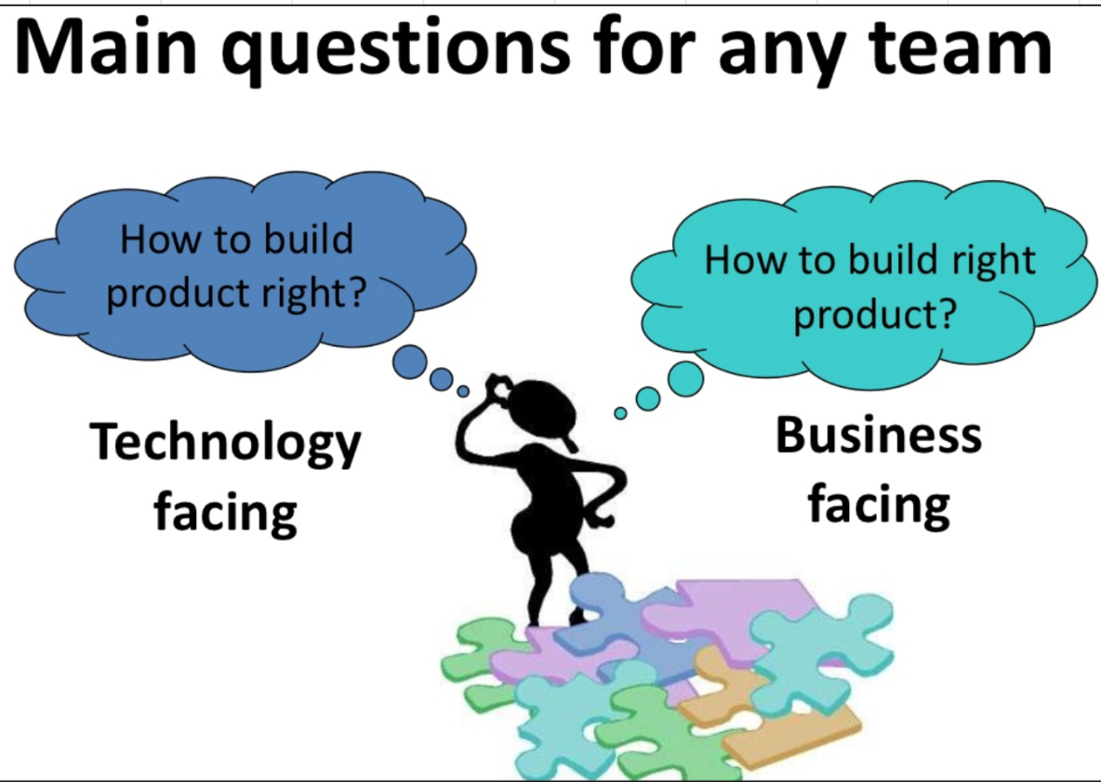

Slide 4
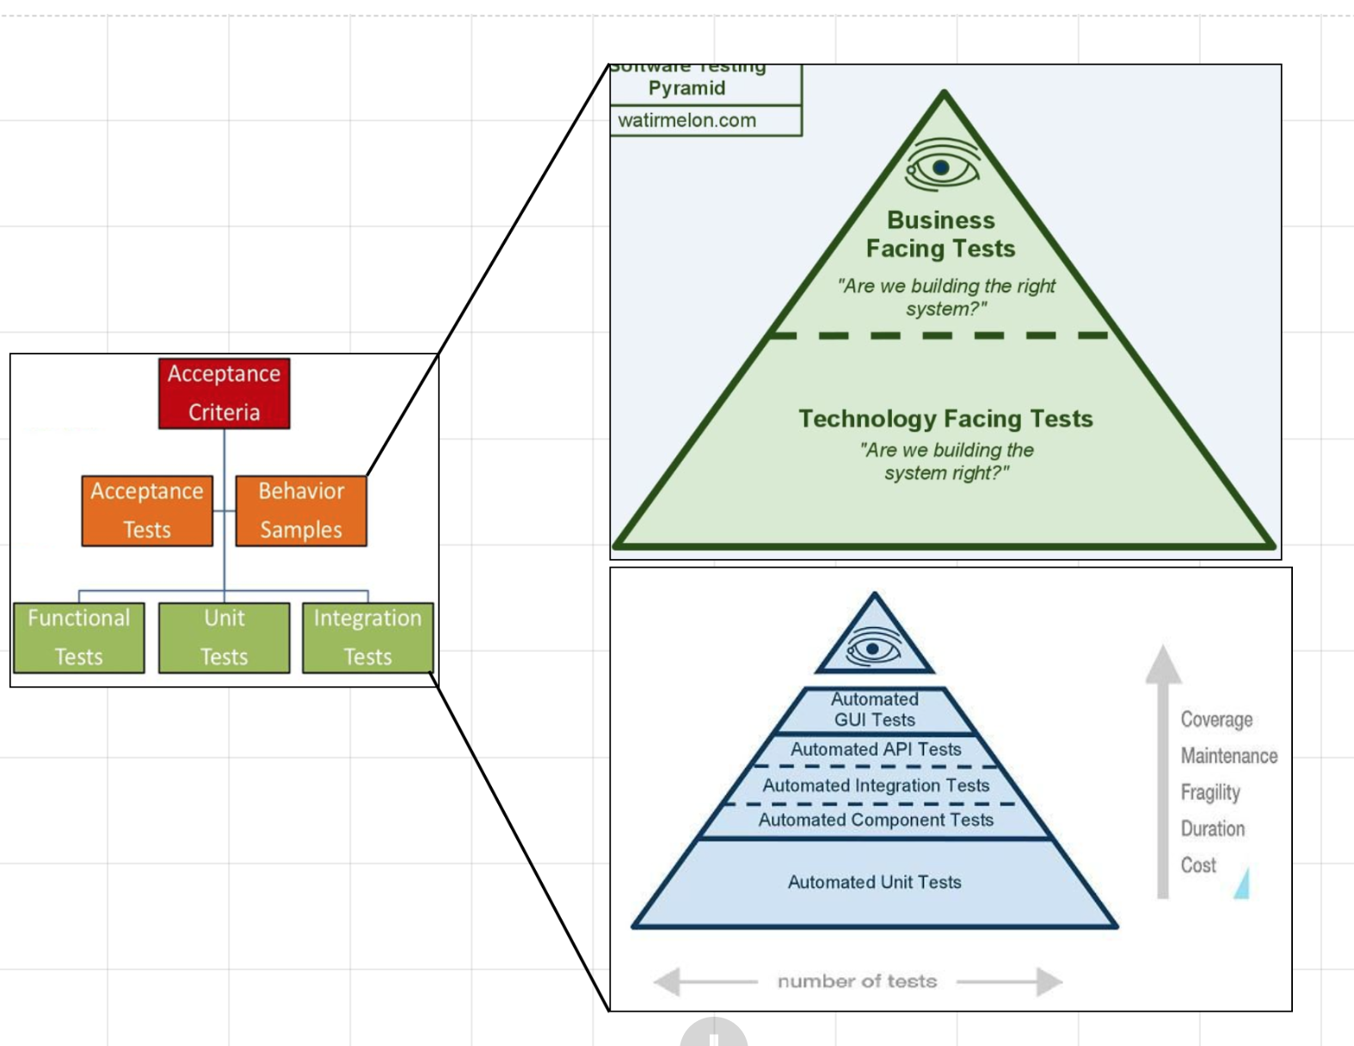

Slide 5
The challenges experienced with BDD framework
Have to code different layers of abstraction to hide the complexity behind different parts of a test.
Code required to manage page objects, web driver objects etc.
Have limited set of reports.
No linking to user story.
No way to find out what requirements are tested
Status & Progress on acceptance of Story, Epic

Slide 6
With Serenity ...
Write tests that are more flexible and easier to maintain
Produce narrative reports
Map your automated tests back to your requirements
See how much of your application is actually being tested
Keep track on project progress

Slide 7
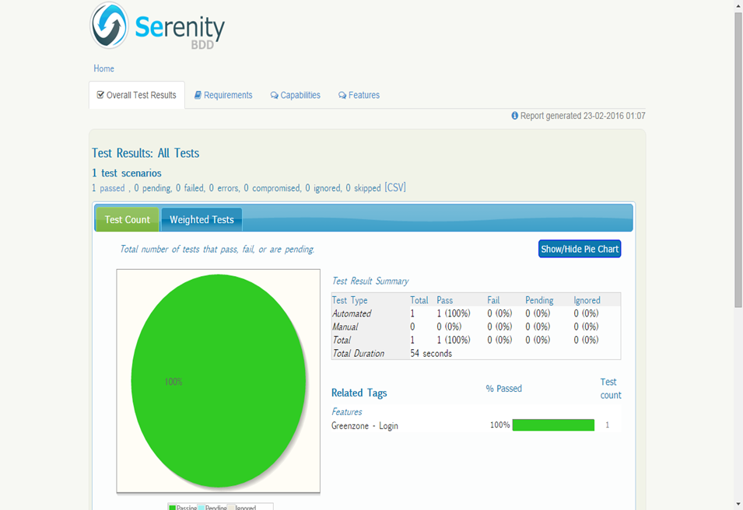

Slide 8
With webdriver and pageobject

Slide 9
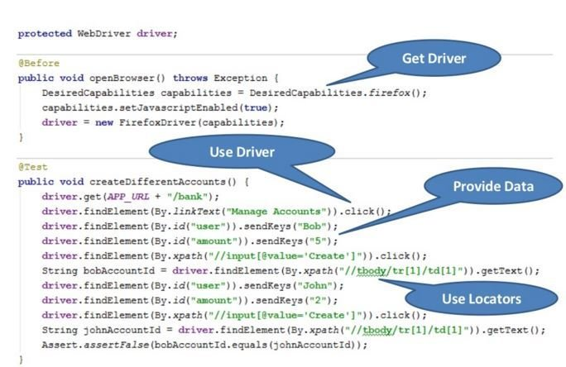

Slide 10
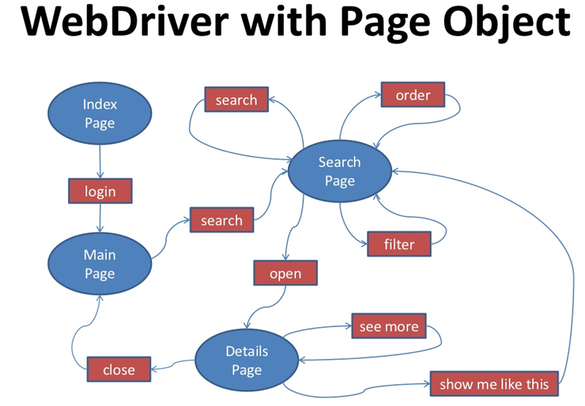

Slide 11
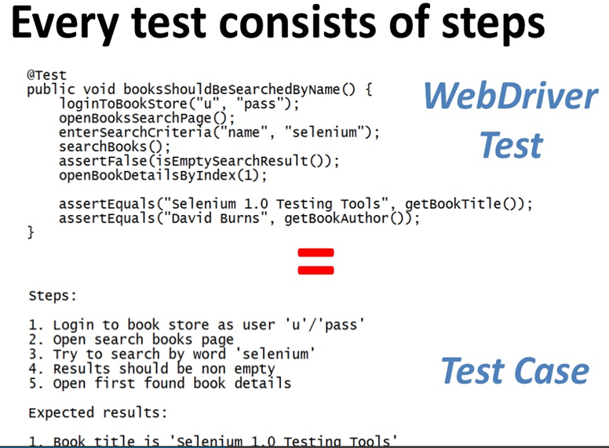

Slide 12
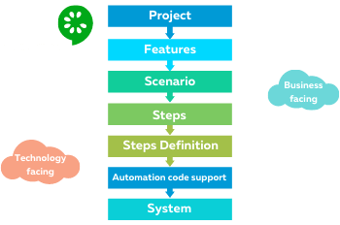

Slide 13
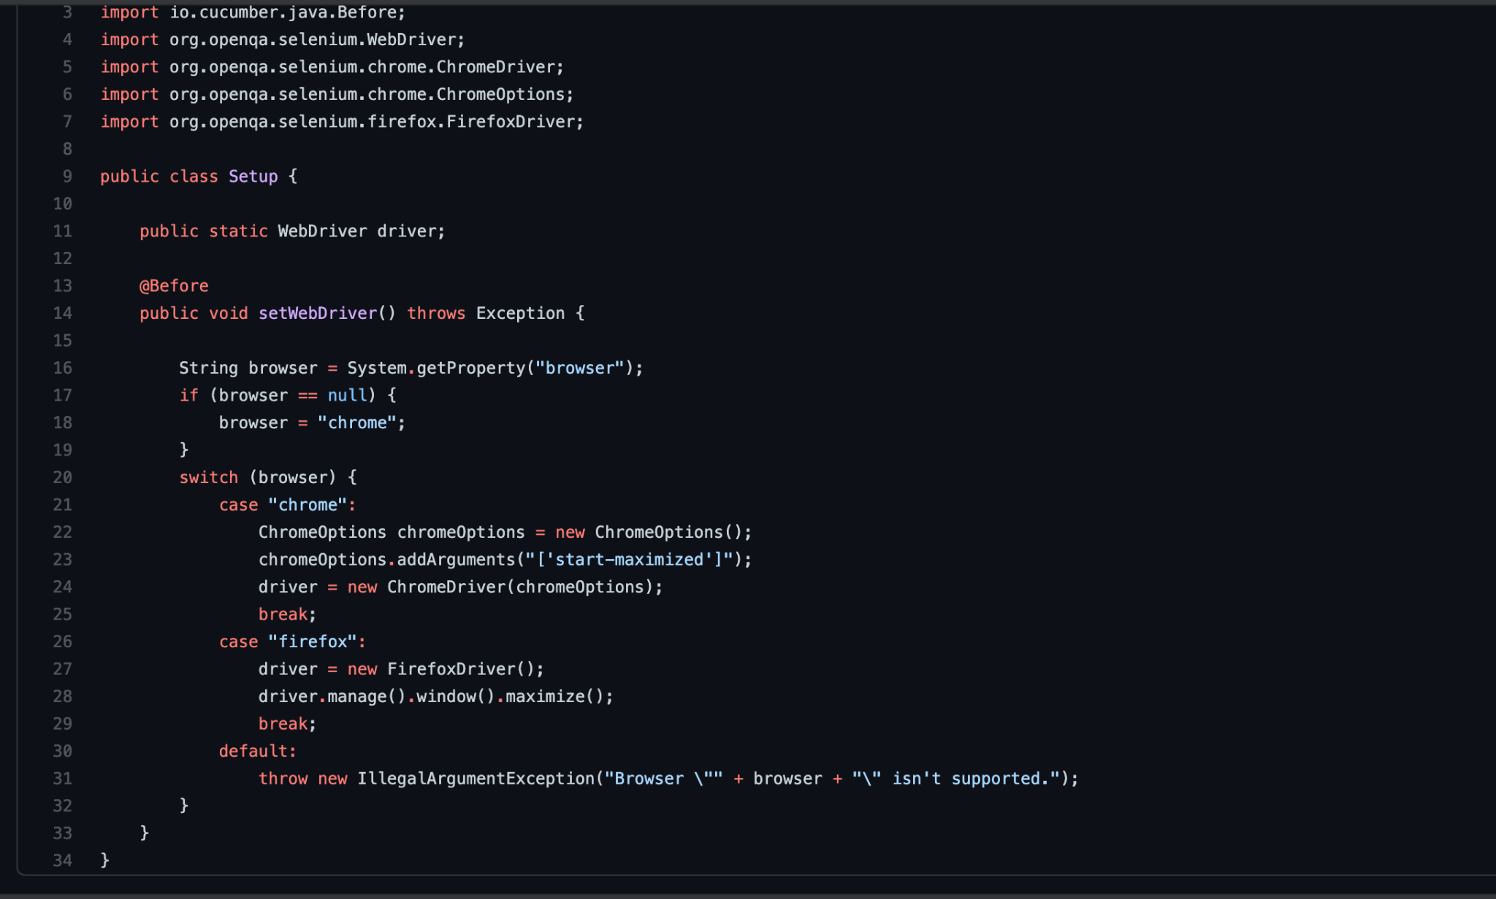

Slide 14
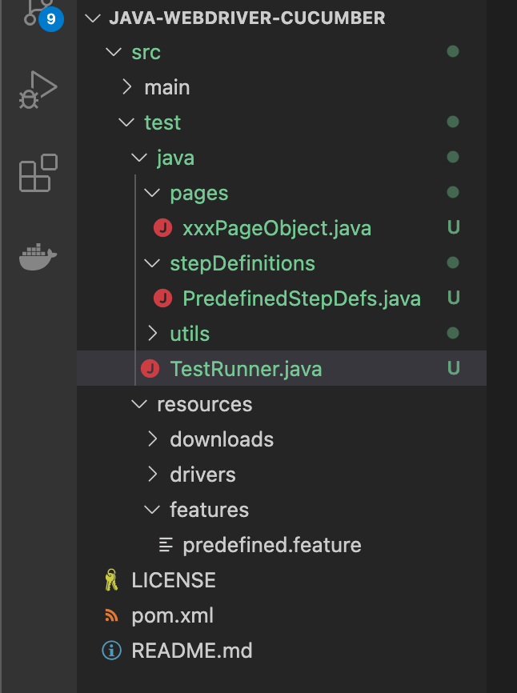

Slide 15
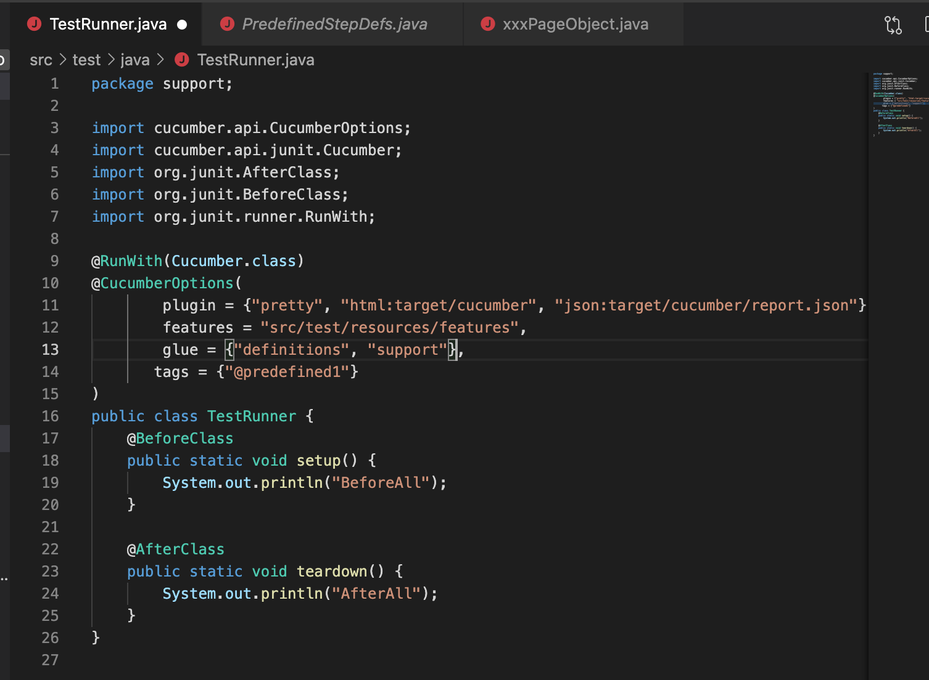

Slide 16
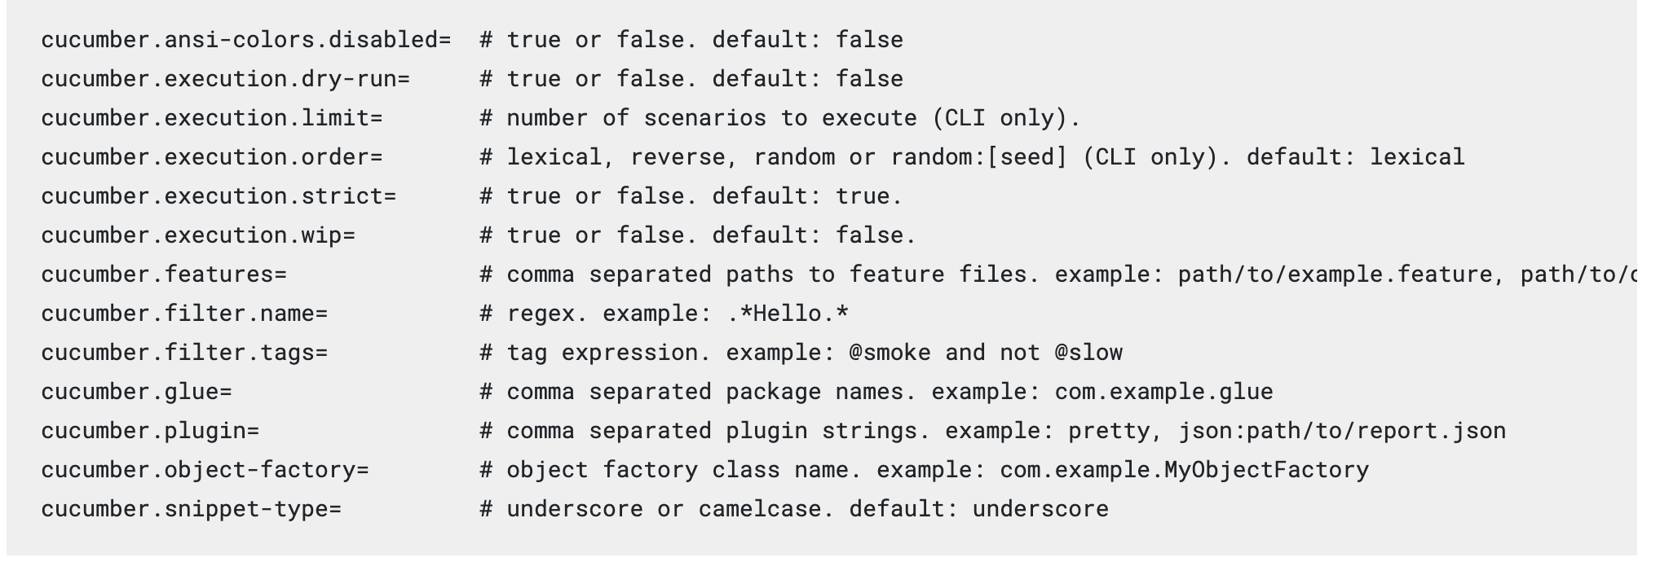
https://cucumber.io/docs/cucumber/api/#list-configuration-options

Slide 17
<dependency>
<groupId>org.seleniumhq.selenium</groupId>
<artifactId>selenium-java</artifactId>
<version>xxx</version>
</dependency>

Slide 18
Different with cucumber and webdriver

Slide 19
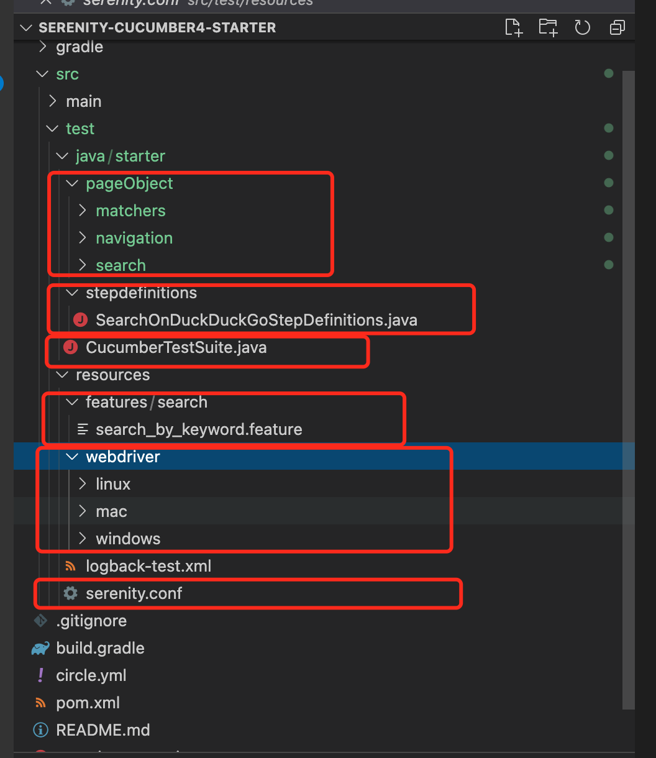

Slide 20
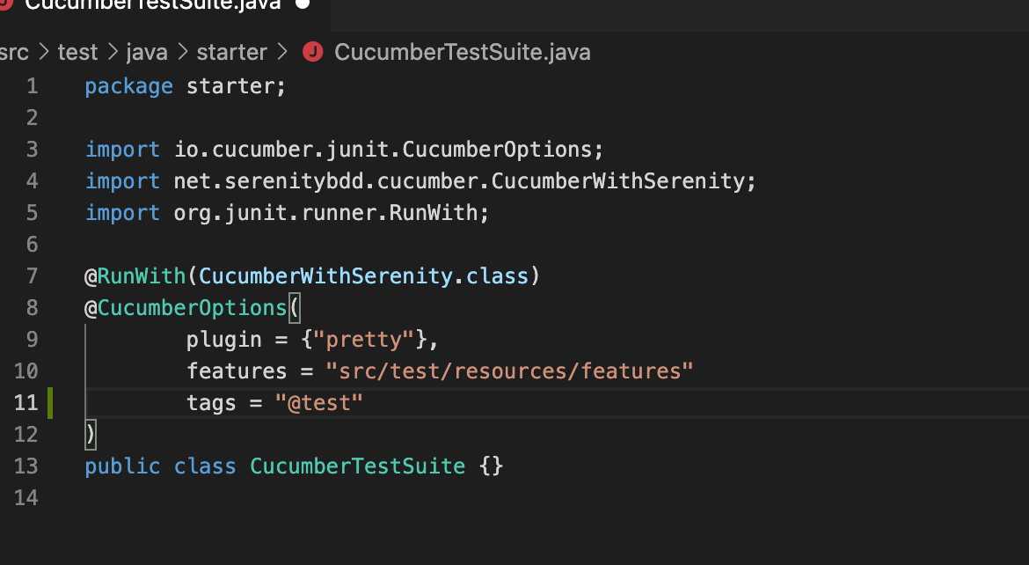

Slide 21
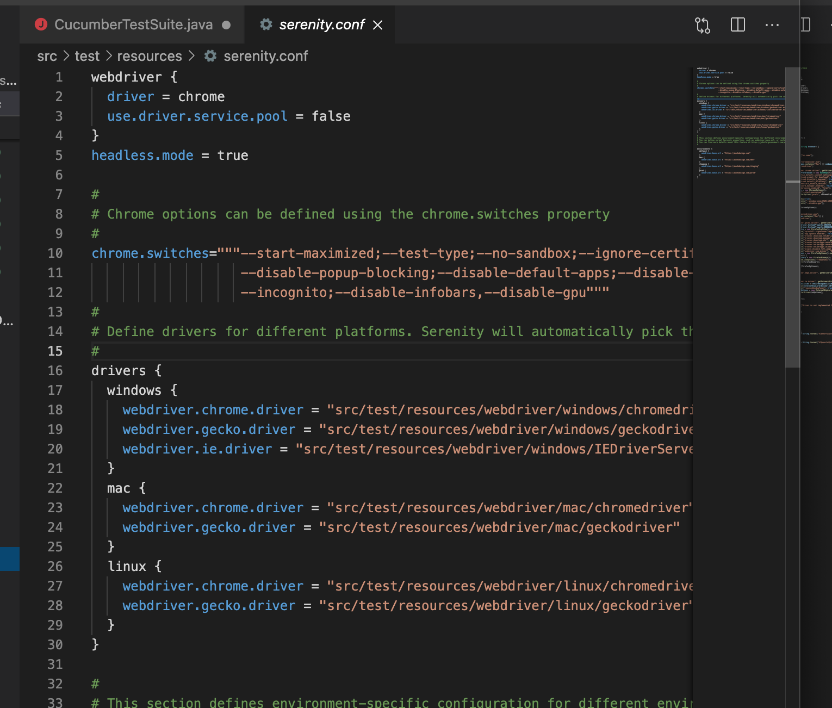

Slide 22
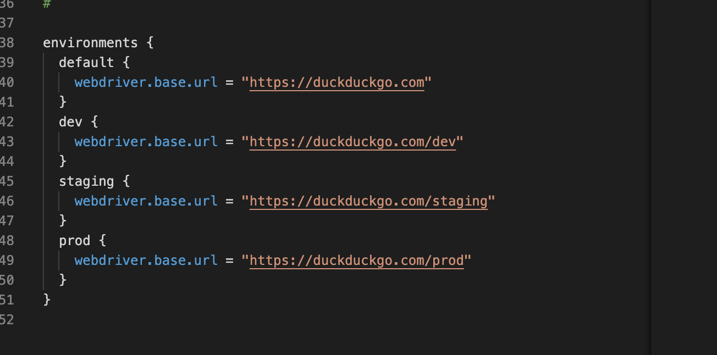

Slide 23
PageObject
Page Objects are a way of isolating the implementation details of a web page inside a class, exposing only business-focused methods related to that page.

Slide 24
@DefaultUrl("http://localhost:8080/client/list")
public class ClientList extends PageObject {
@FindBy(id="data-section");
WebElementFacade dataSection;
WebElementFacade aa =find(By.xpath("//th")).getValue();
@WhenPageOpens
public void waitUntilTitleAppears() {
element(dataSection).waitUntilVisible();
}
}

Slide 26
Checking whether elements are enabled
searchButton.isVisible() /searchButton.isCurrentlyVisible();
使用断言方式 searchButton.shouldBeVisible();

Slide 27
Checking whether elements are enabled
searchButton.isEnabled()
searchButton.shouldBeEnabled()
There are also equivalent negative methods:
searchButton.shouldNotBeVisible();
searchButton.shouldNotBeCurrentlyVisible();
searchButton.shouldNotBeEnabled()
searchButton.isPresent();
searchButton.isNotPresent();
searchButton.shouldBePresent();
searchButton.shouldNotBePresent();
button.waitUntilEnabled()
button.waitUntilDisabled()
or
field.waitUntilVisible()
button.waitUntilNotVisible()

Slide 28
Asynchronous wait
isElementVisible(By.xpath("//h2[.='A visible title']"))
shouldBeVisible(By.xpath("//h2[.='An invisible title']"));
waitForRenderedElements(By.xpath("//h2[.='A title that is not immediately visible']"));
waitFor("#popup"); //css selector
waitForRenderedElementsToBePresent(By.xpath("//h2[.='A title that is not immediately visible']"));
waitForPresenceOf("#popup"); //css

Slide 29
waitForRenderedElementsToDisappear(By.xpath("//h2[.='A title that will soon disappear']"));
waitForAbsenceOf("#popup");
waitForTextToDisappear("A visible bit of text");
waitForAnyTextToAppear("this might appear","or this", "or even this");
waitForAnyRenderedElementOf(By.id("color"), By.id("taste"), By.id("sound"));

Slide 30
Implicit Waits
https://serenity-bdd.github.io/theserenitybook/latest/serenity-system-properties.html
~/serenity.properties
Webdriver.timeouts.implicitlywait

Slide 31
Explicit Timeouts
slowLoadingField.waitUntilVisible()
waitFor(ExpectedConditions.alertIsPresent())
withTimeoutOf(5, SECONDS).waitForPresenceOf(By.cssSelector("#elements option"))
someButton.withTimeoutOf(5, SECONDS).waitUntilClickable().click()
@FindBy(name = "country", timeoutInSeconds="10")
public WebElementFacade country;

Slide 32
Executing Javascript
String result = (String) evaluateJavascript("return document.title");
evaluateJavascript("document.getElementById('firstname').focus()");

Slide 33
Matcher
assertThat(currentDateStr).matches(“”);
assertThat(currentDate).isafterOrEqualTo();
assertTant($$(XXX).get(i).getAttribute(“xxx”).isEqualTo(“xxx”));

Slide 34
