Slide 1
Jenkins
Lei Qi

Slide 2
What is CI from CI/CD?
Continuous Integration is the automation of building the code and running automate test against the build. This process may take from pushing code to a remote repository or a developer's Pull Request to the merging changes to the main branch.
Notes:
持续集成是构建代码和运行针对构建的自动化测试的自动化过程。这个过程可能从将代码推送到远程存储库或开发人员的Pull Request到合并更改到主分支。

Slide 3
What is CD from CI/CD?
Continuous Delivery is adding to the CI process an automation for getting ready a new release to deploy at any moment by clicking on a button.
Continuous Deployment is almost the same as Continuous Delivery. The no needed human intervention is the unique difference with Continuous Delivery. Once a new release pass the automated tests this will be automatically deployed to production.
Notes:
持续交付向CI流程添加了一个自动化操作，可以通过单击按钮随时准备部署新版本。
持续部署几乎与持续交付相同。不需要人工干预是连续交付的独特之处。一旦一个新版本通过了自动化测试，它将自动部署到生产环境中。

Slide 4
What is Jenkins?
Jenkins is a self-contained, open source automation server which can be used to automate all sorts of tasks related to building, testing, and delivering or deploying software.
Notes:
Jenkins是一个自包含的开源自动化服务器，可以用来自动化与构建、测试、交付或部署软件相关的所有任务。

Slide 5
What is Jenkins to me?
Jenkins is a self-contained, open source automation server which plays the middleman role between a software project, organisation or company's toolset used to automate all sorts of tasks related to building, testing, and delivering or deploying software.
Being NOT a service allows to run it on-premise, in the cloud or wherever is needed.
Notes:
Jenkins是一个自包含的开源自动化服务器，它在软件项目、组织或公司的工具集之间扮演着中间人的角色，这些工具集用于自动化与构建、测试、交付或部署软件相关的各种任务。
作为一个非服务允许运行它在内部，在云或任何需要的地方。

Slide 6
Jenkins Architect
Technically speaking Jenkins is a Java-based Web Application. Just a .war file usually executed through the built in Jetty servlet container by:
java -jar jenkins.war
This is the standalone configuration, being an only Jenkins Master, the scheduler and the builder.
Notes:
从技术上讲，Jenkins是一个基于java的Web应用程序。只是一个.war文件，通常通过构建在Jetty servlet容器中执行:
java jar jenkins.war
这是一个独立的配置，只有一个Jenkins Master，调度程序和构建器。

Slide 7
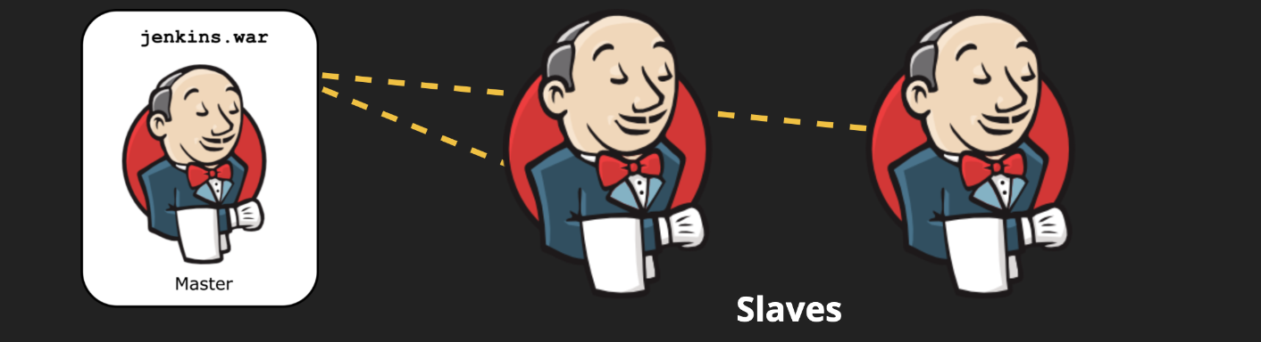
Distributed builds
Jenkins supports the master-slave mode, where the building is performed by the slaves and the master will use its resources to only handle HTTP requests and manage the build environment.
Notes:
Jenkins支持主从模式，在这种模式下，构建由从服务器执行，而主服务器将使用其资源只处理HTTP请求和管理构建环境。

Slide 8
Reduce Jenkins Master downtime on host maintenance actions
Avoid access to Jenkins Master sensitive information
Free up resources for Jenkins master

Slide 9
What is a Jenkins Slave?
Technically speaking a Jenkins slave (also called agent or node) may be any device capable of running the agent.jar file.
The Jenkins slave will have as many:
Tools, resources and connectivity as the host where is running on has.
Permissions as the user used to launch the agent (something to be aware of)
Notes:
从技术上讲，Jenkins从属设备(也称为代理或节点)可能是能够运行agent.jar文件的任何设备。
詹金斯的奴隶会有同样多的:
工具、资源和连接作为运行的主机。
用户用于启动代理的权限(需要注意的事情)

Slide 10
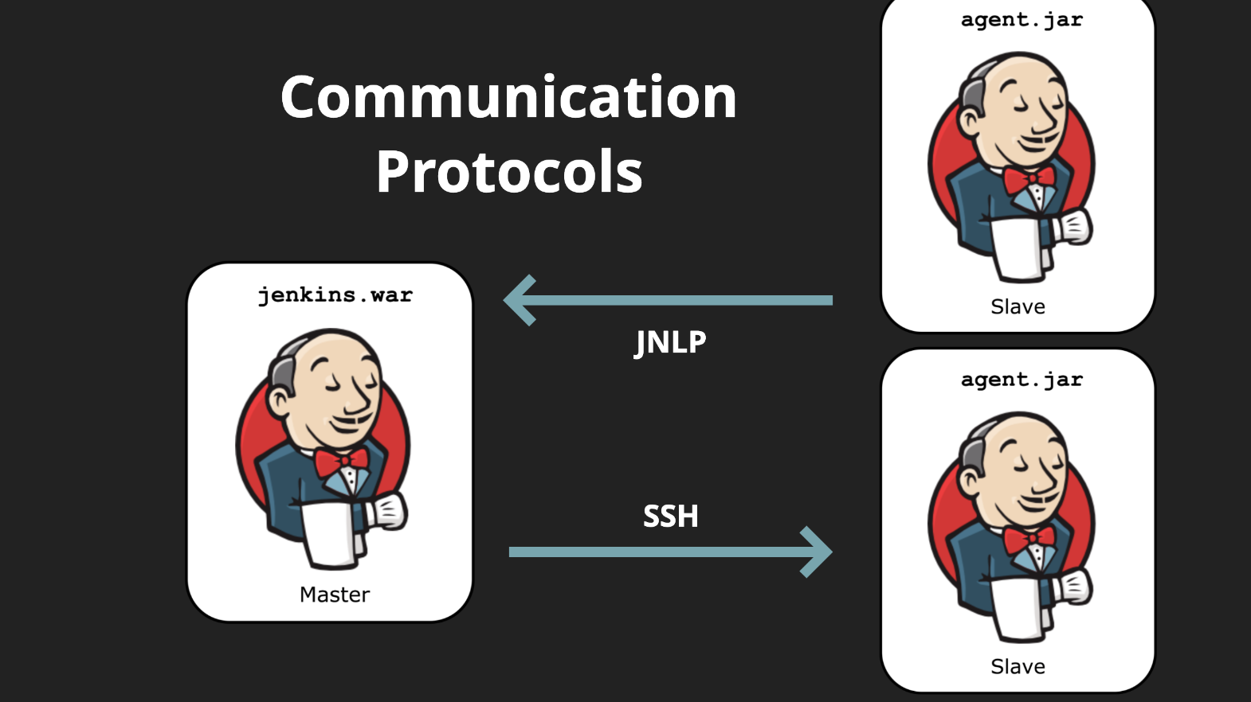

Slide 11
Support scm tools
CVS
Subversion
Git
Mercurial
Perforce
Clearcase
RTC

Slide 12
Excute
Apache Ant
Apache Maven
Arbitrary shell scripts
Windows batch commands

Slide 13
BUILDS CAN BE STARTED BY
Triggering commit in a version control system
Scheduling via a cron-like mechanism
Building when other builds have completed
Requesting a specific build URL
Manually from Jenkins web interface

Slide 14
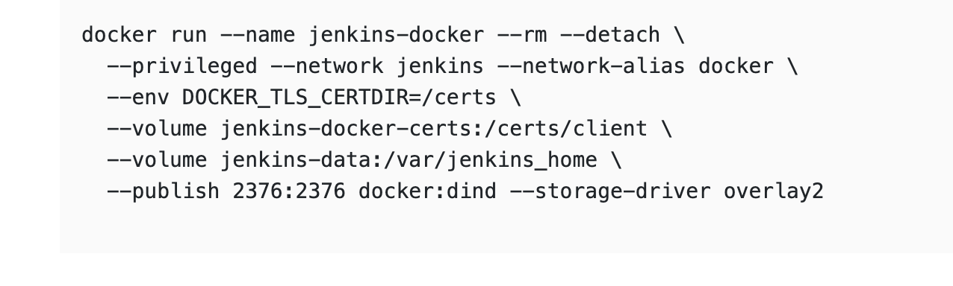
INSTALLATION
Jenkins.war
Java -jar jenkins.war…
Docker

Slide 15
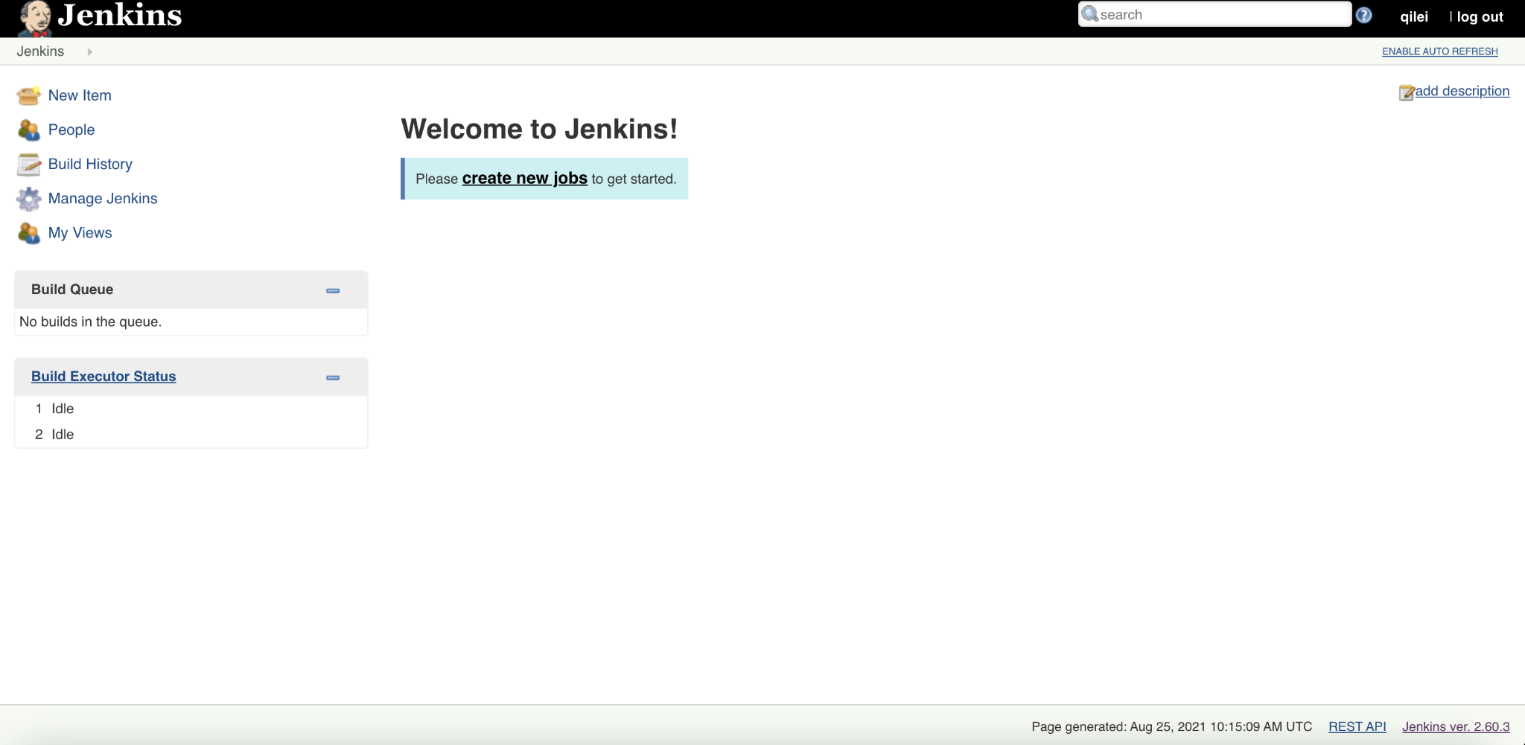

Slide 16
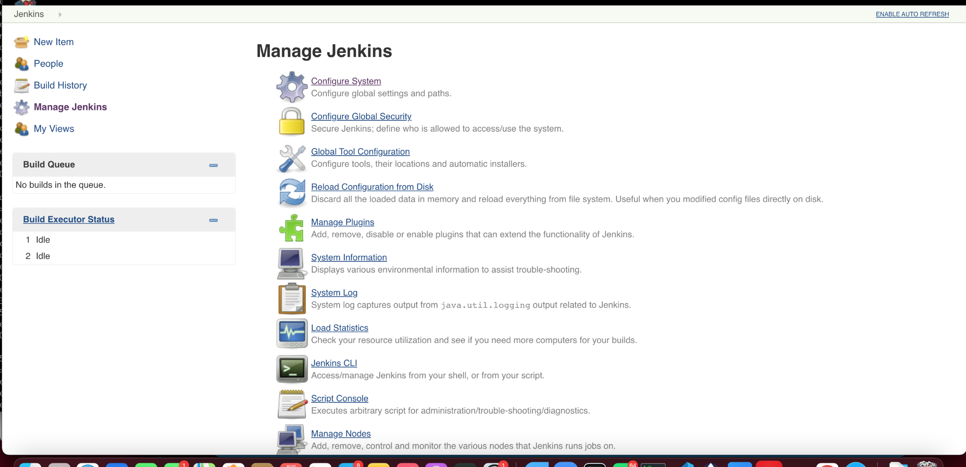

Slide 17
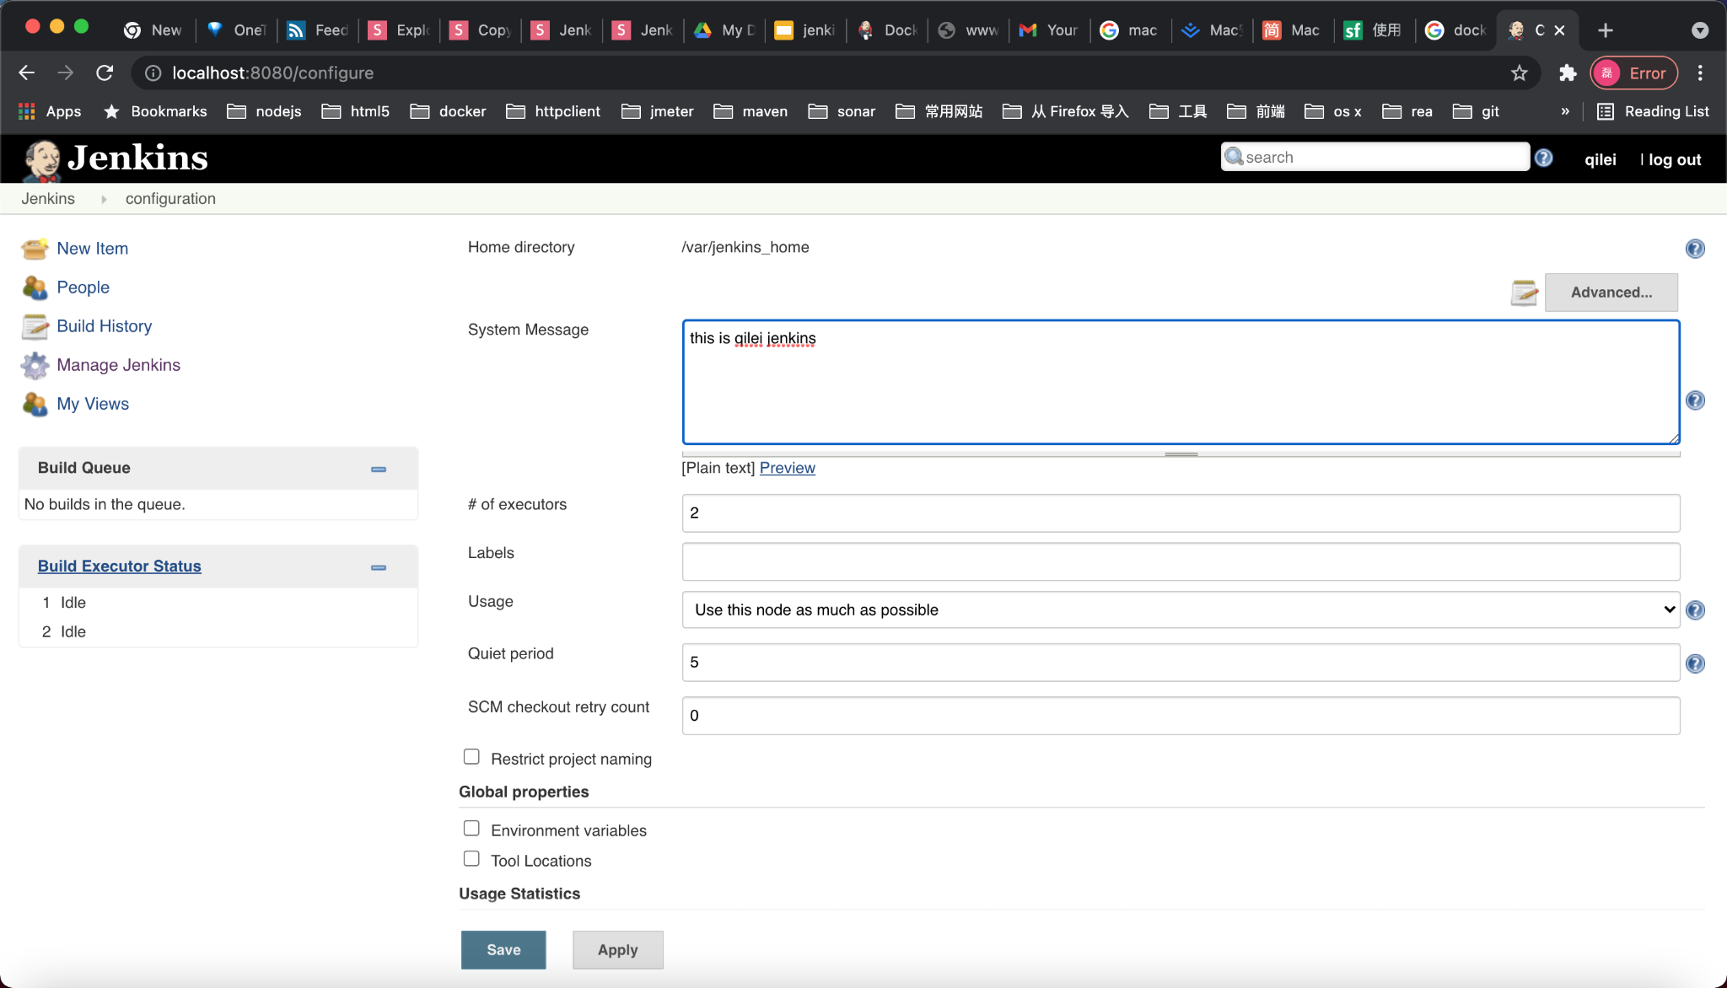

Slide 18
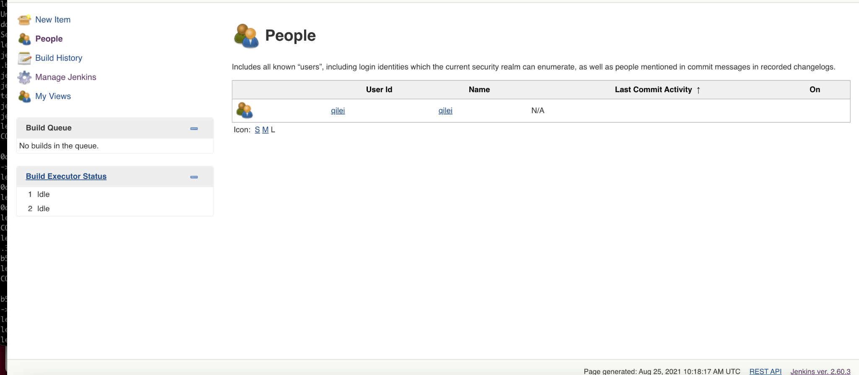

Slide 19
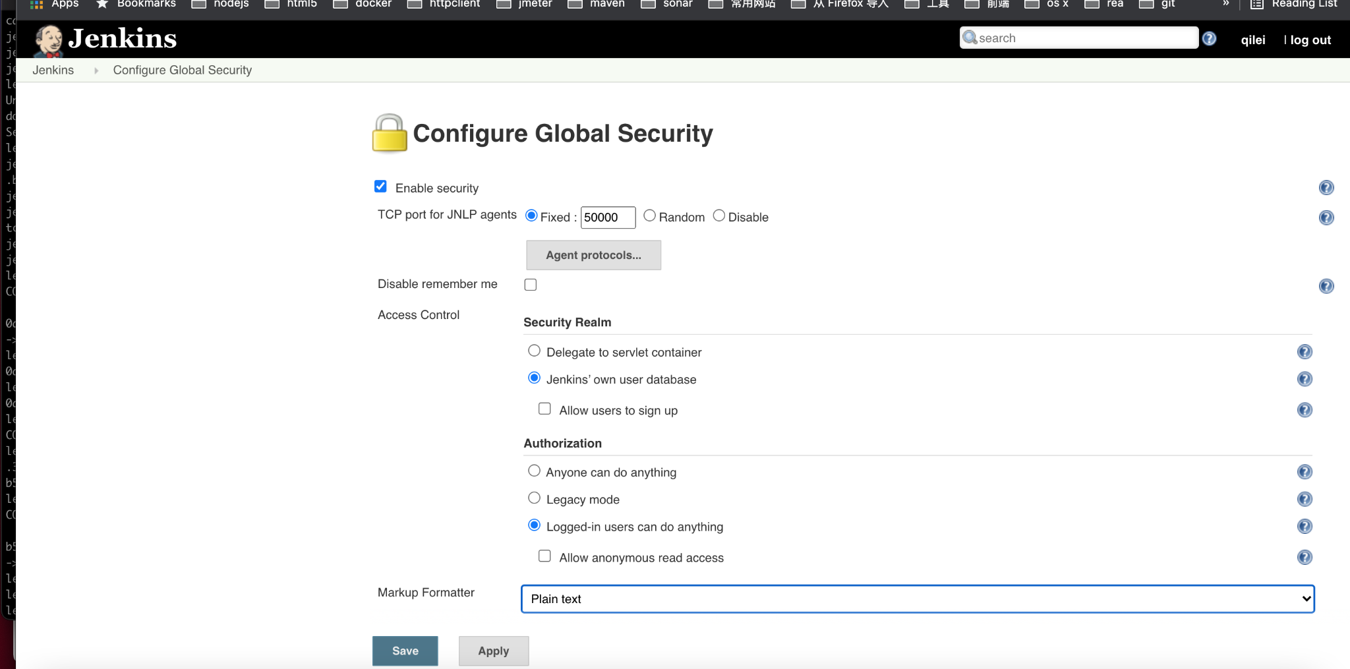

Slide 20
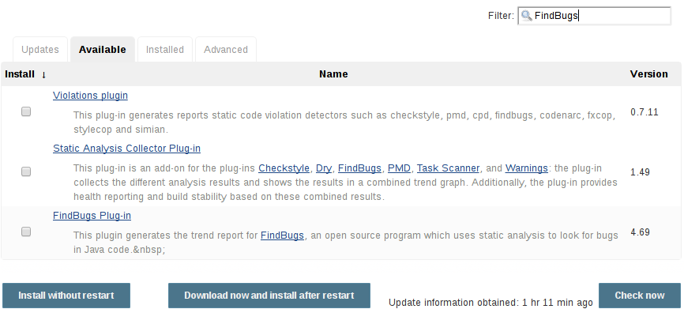

Slide 21
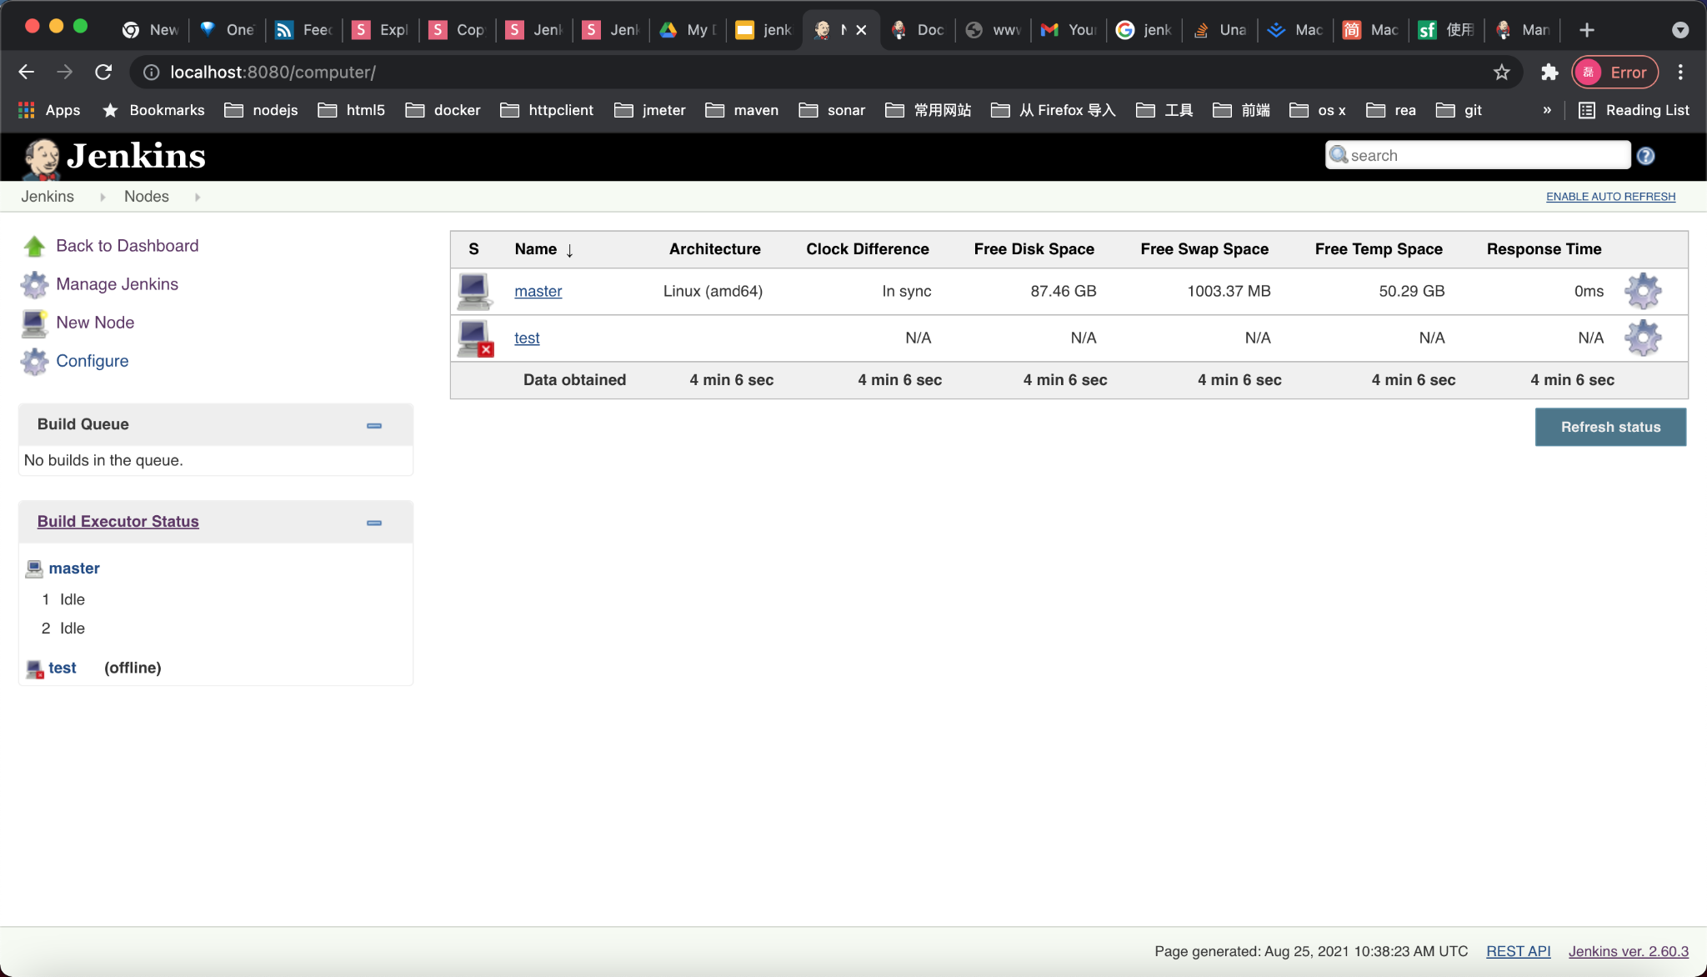

Slide 22
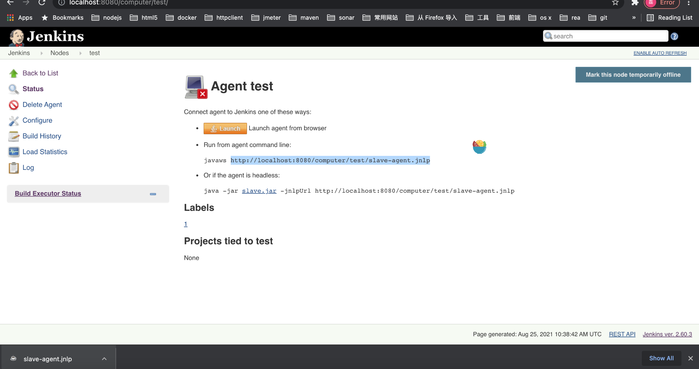

Slide 23
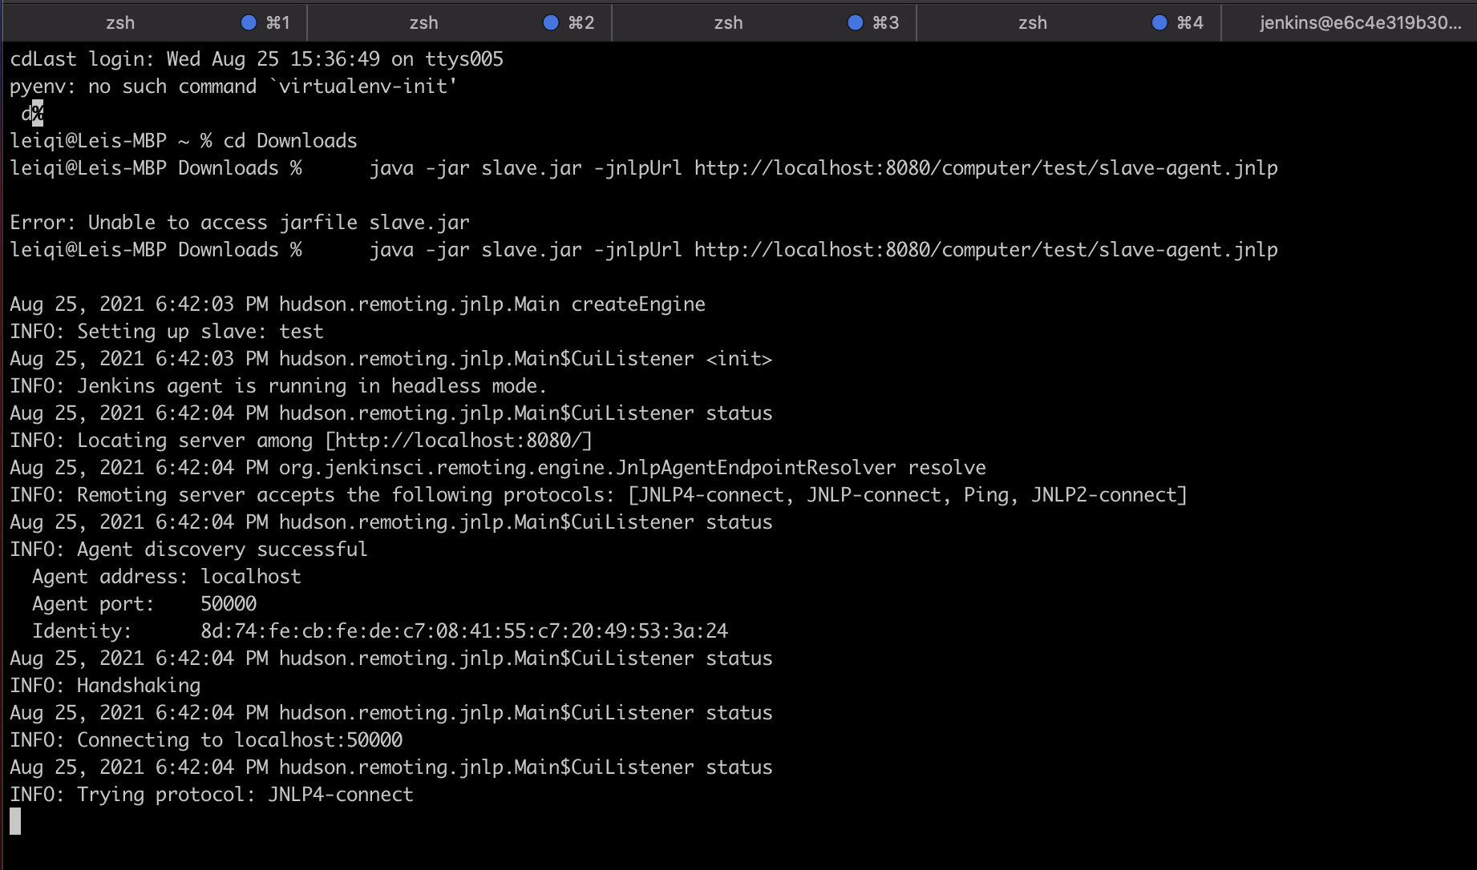
http://localhost:8080/jnlpJars/slave.jar

Slide 24
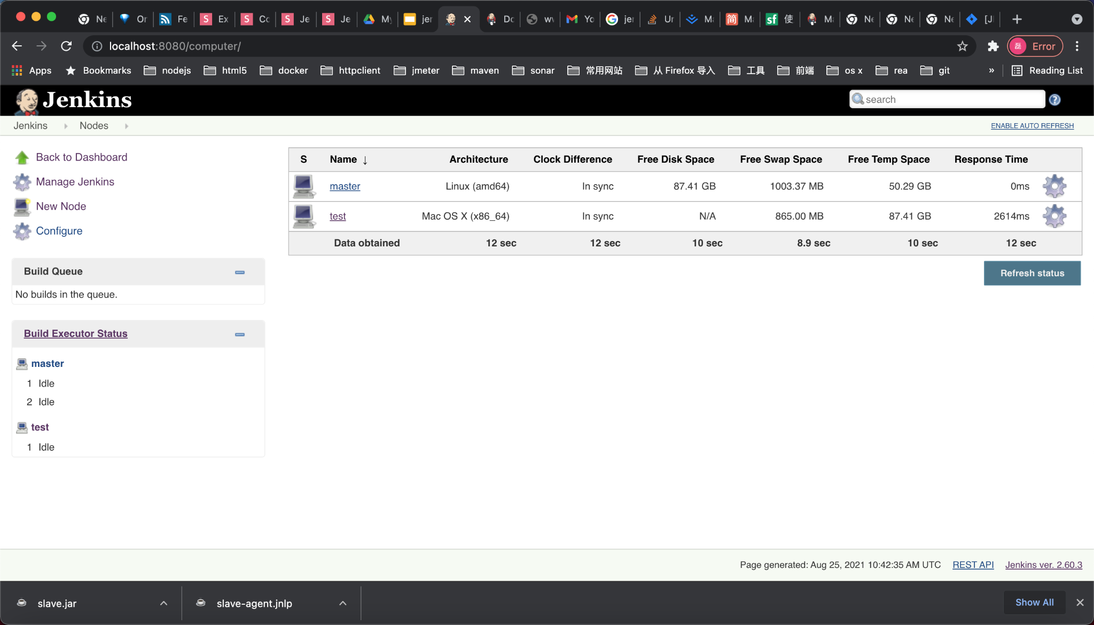

Slide 25
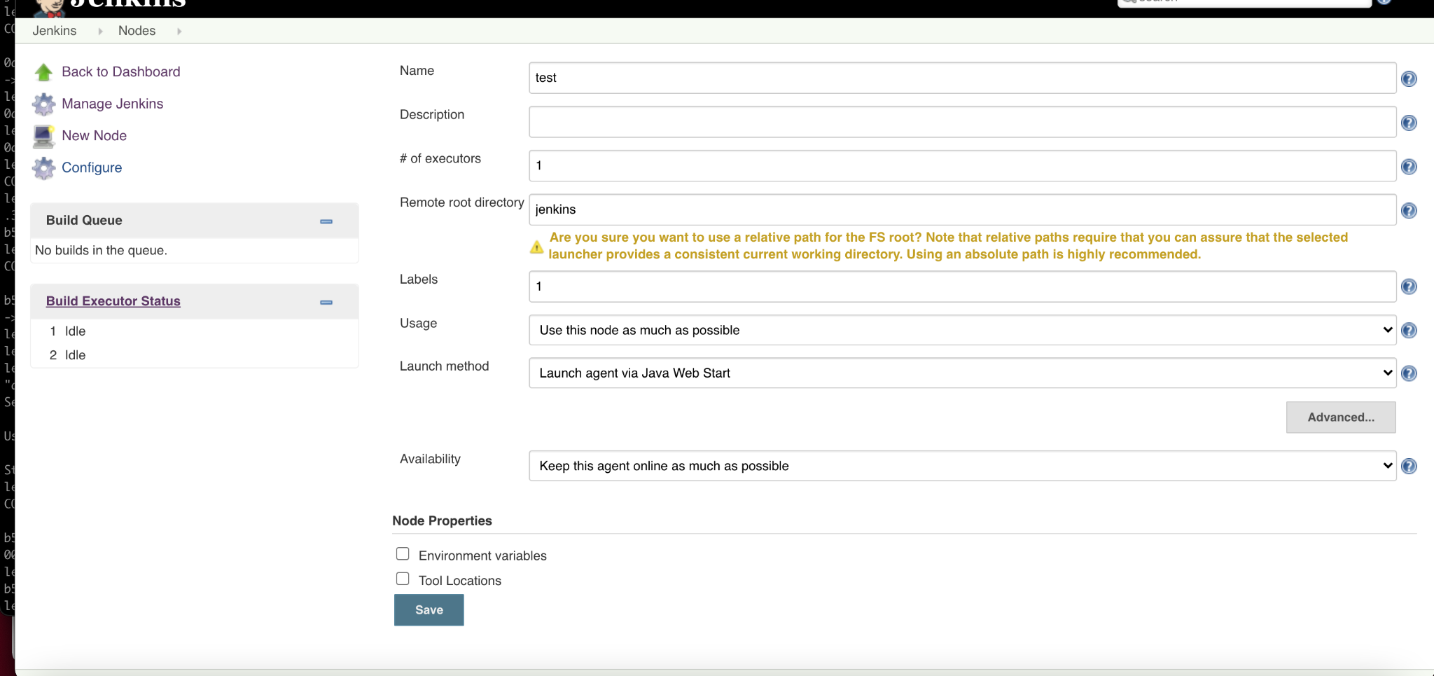

Slide 26
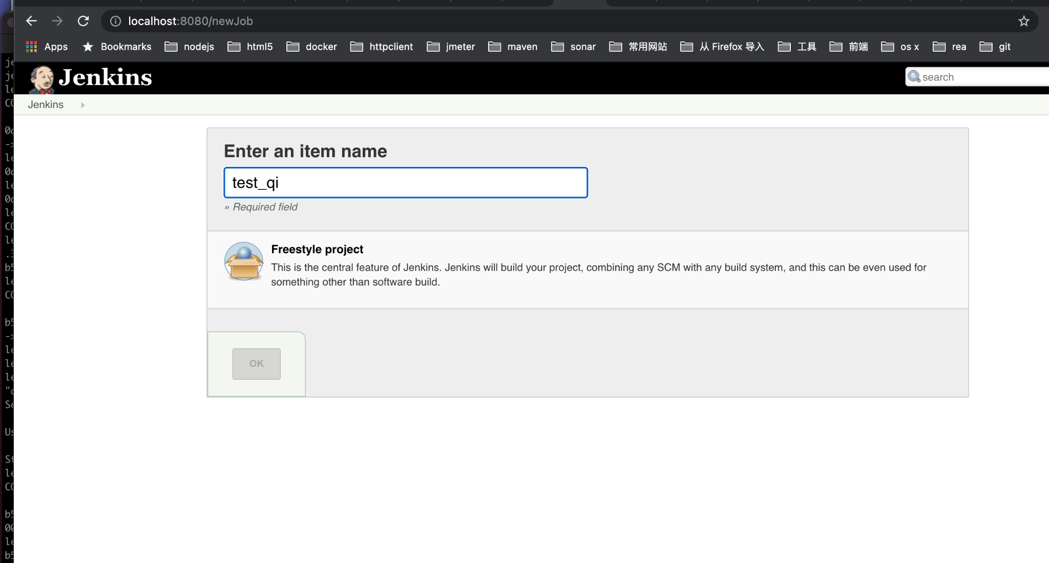

Slide 27
Quick Start Examples
Jenkinsfile (Declarative Pipeline)
pipeline {
agent { docker { image 'maven:3.3.3' } }
stages {
stage('build') {
steps {
sh 'mvn --version'
}
}
}
}

