Slide 1
Benford Law Analysis
Movie Box Office

Slide 2
Introduction
In this project, I'm going to do the Benford analysis on movies' budget, revenue, vote average(ratings), vote count. Over the past a few years, a lot of movies are accused to be misreporting their revenue so that they could attract more attention from the public. Meanwhile,lots of production companies are accused to pay for people to write positive reviews to their movies.
In the analysis, I will use 2 datasets, the movie dataset and the credit dataset. In the movie dataset, there are 4803 movies with 20 explanatory variables including title, language, released date, budget, revenue, runtime and so on. The credit dataset contains the list of crews and directors for each movie.

Slide 3
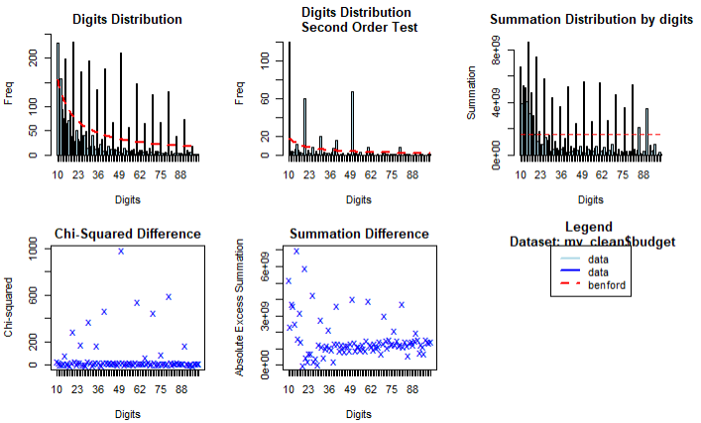
Benford Analysis on Movie Budget
Summary
In general, movie buget does not follow benford law. There are lots of suspecious values

Slide 4
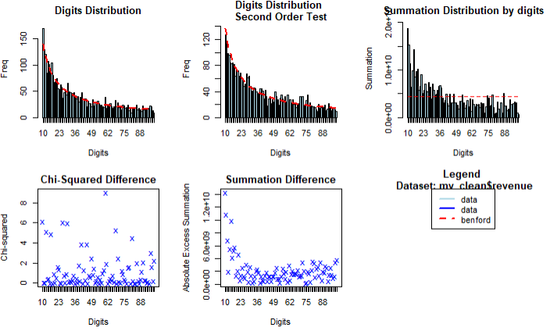
Benford Analysis on Movie Revenue
Summary
In general, movie revenue follows benford law almost perfectly. However, there is still a few suspecious value, but I think that would be normal.

Slide 5
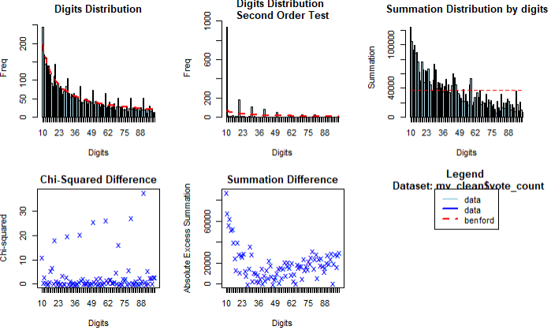
Benford Analysis on Movie Vote Count
Summary
In general, movie revenue follows benford law pretty good. However, there are some suspecious values need to be looked into.

Slide 6
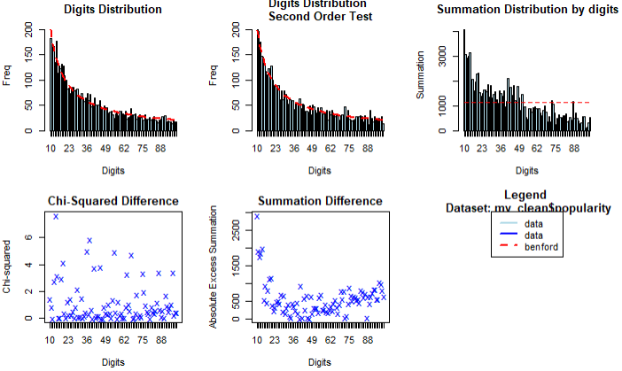
Benford Analysis on Movie Popularity
Summary
In general, the popularity follows benford law pretty good. However, there are some suspecious values need to be looked into.

Slide 7
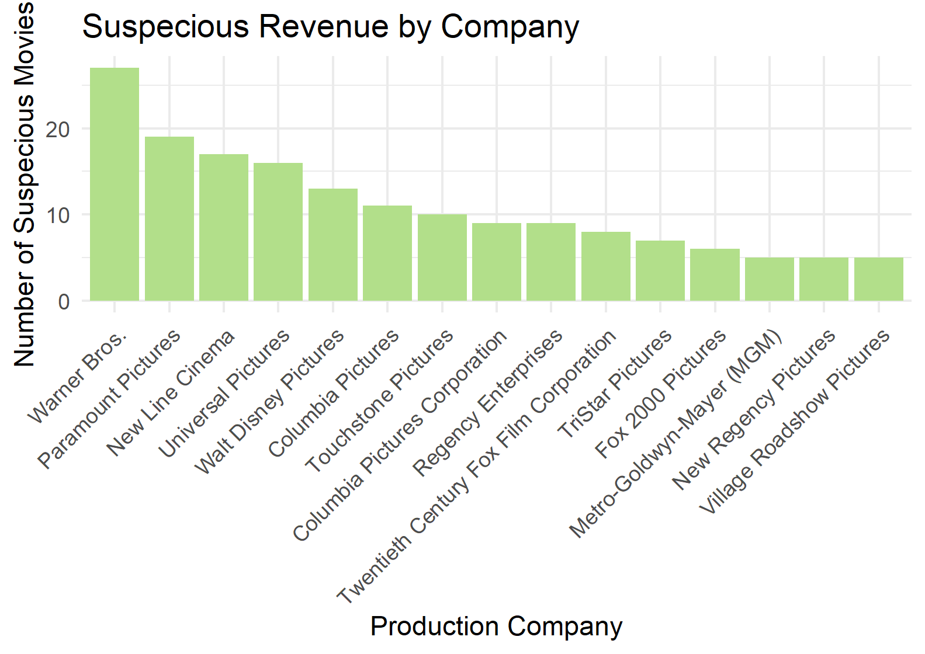
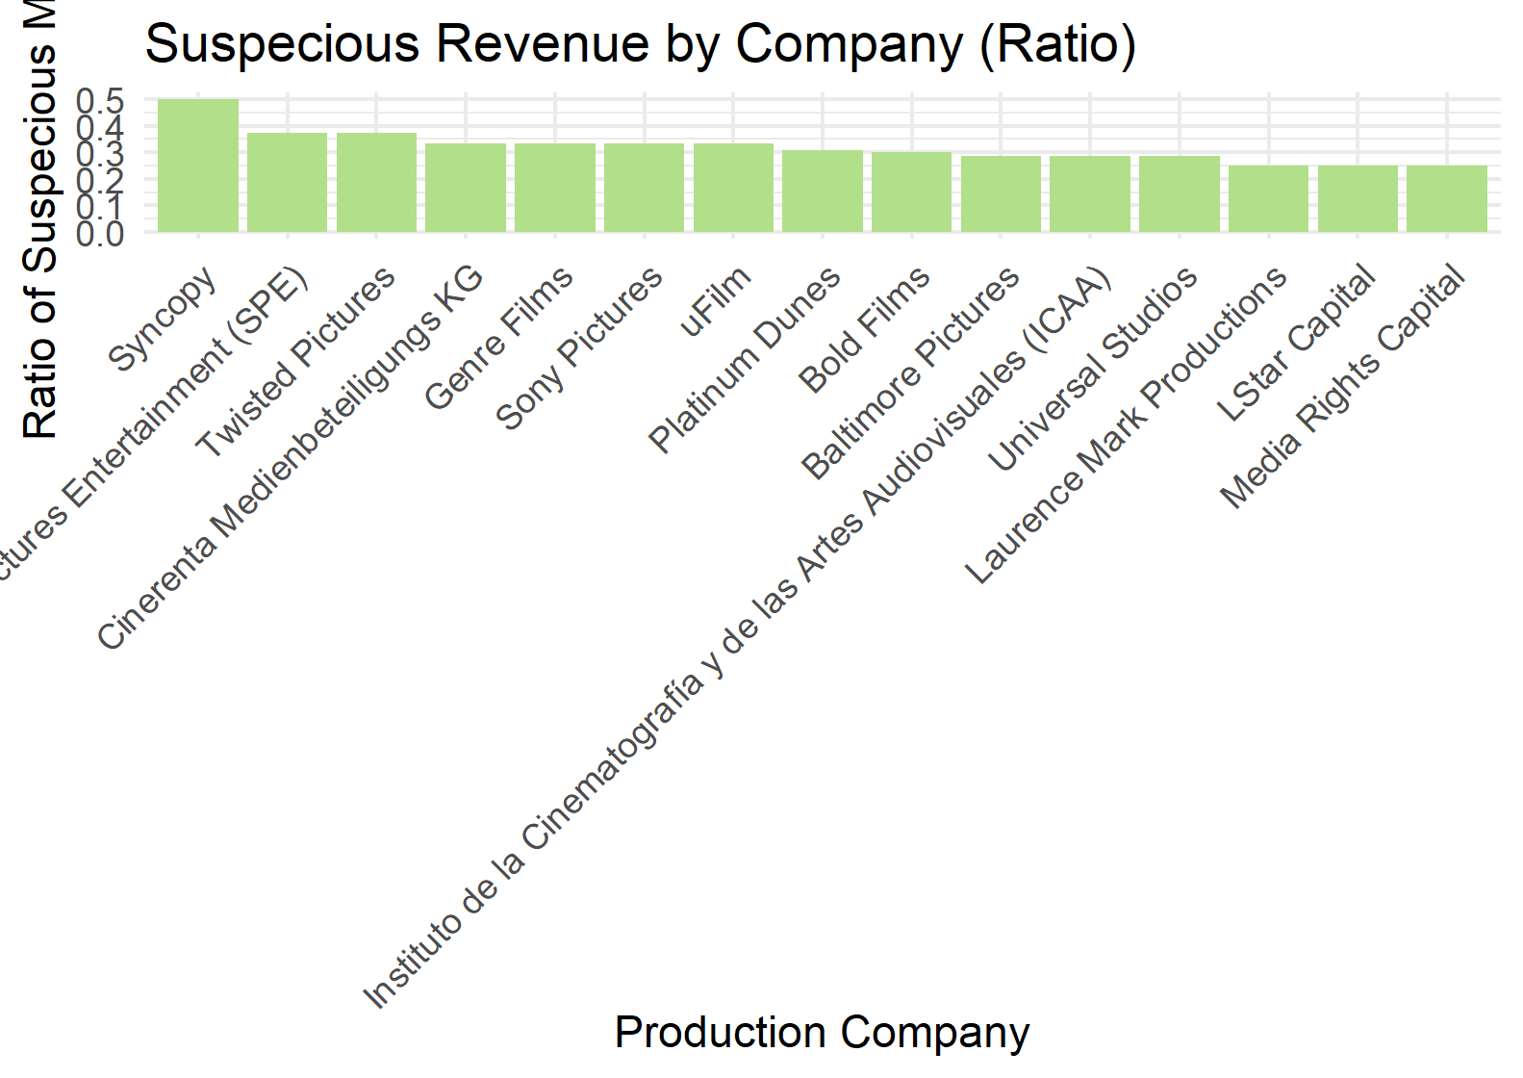
Suspecious Revenue by Company

Slide 8
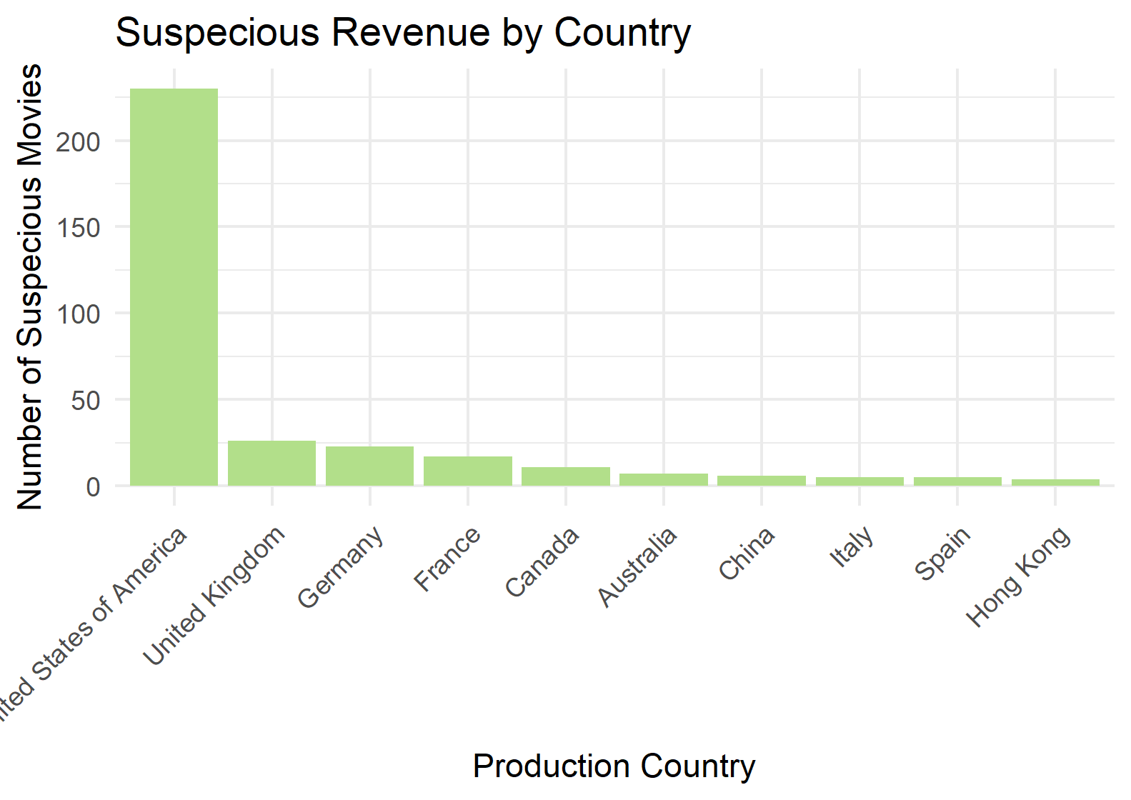
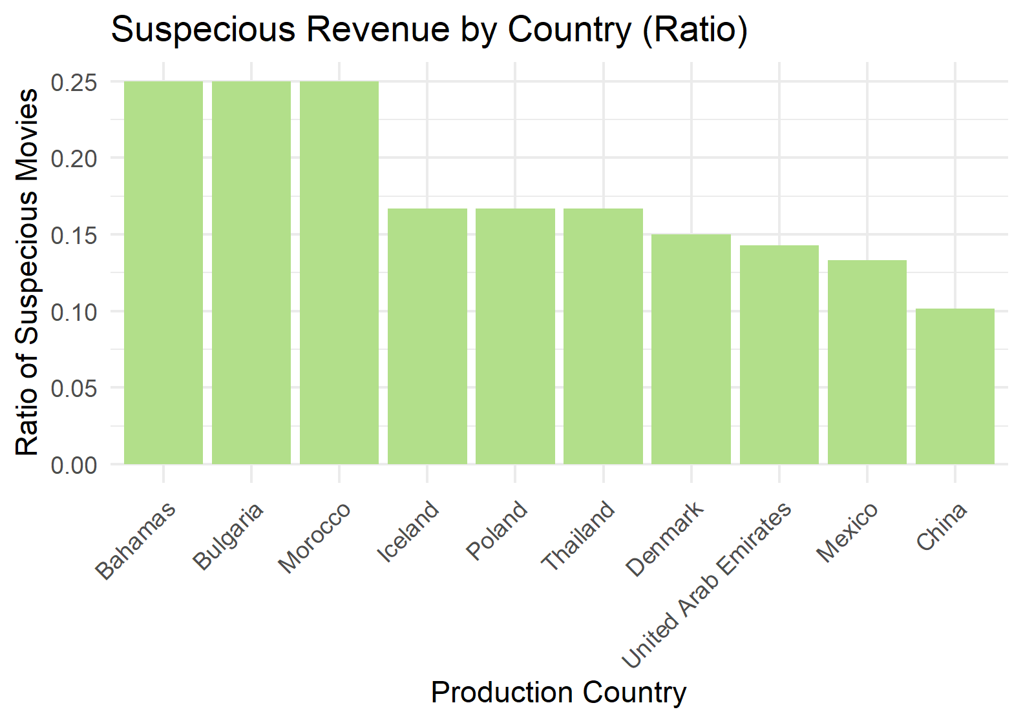
Suspecious Revenue by Country

Slide 9
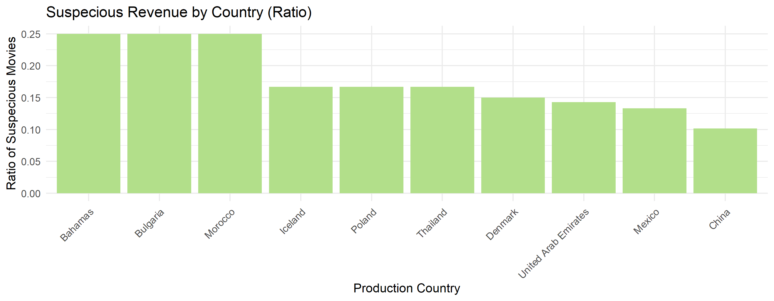
Suspecious Revenue by Director

Slide 10
Summary on Suspecious Revenue
Revenue is one of the statistics that movie production companies often misreport to attract more investors. By taking out the suspecious companies, we can see lots of bignames like Warner Bros, Paramount, New Line and so on. If we re-rank companies by the ratio of suspecious movies over total movies they made, smaller production companies showed up.
As the largest movie production contry, not quite suprisingly, the USA has the most suspecious movies in revenue. If we look at the ratio, smaller countries tend to have higher ratio of suspecious movies.
It is shocking to see Christopher Nolan on the list since he is one of my favorite directors. Again, this will not be a proof that the directors have cheated on the revenue of their movies.

