Slide 1
Advantages of a Bear Market
Yes there is a positive side to a Bear Market!
Team Members: Qixuan Zhang, Si Chen, Tingrui Huang, Chaoqun Yin

Slide 2
Investing in Stocks
1.Represents ownership in a firm
2.Earn a return in two ways
  Price of the stock rises over time
  Dividends are paid to the stockholder
3.Stockholders have claim on all assets
4. Right to vote for directors and on certain issues
5. Two types
  Common stock
    Right to vote
    Receive dividends
  Preferred stock
    Receive a fixed dividend
    Do not usually vote

Slide 3

Investing in Stocks: Sample Corporate Stock Certificate

Slide 4
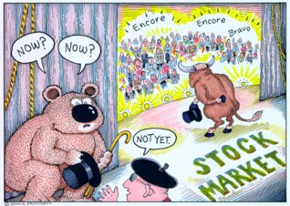
What is a Bear Market?
A decline of 15-20% of the broad market coupled with pessimistic sentiment underlying the stock market.

Slide 5
Stock Market Indexes: The Dow Jones Industrial Average
Company | Price | Change | % Change | Volume | YTD Change
MMM 3M | 197.04 | -4.06 | -0.0202 | 2525299 | -0.1628
AXP American Express | 106.49 | -1.79 | -0.0165 | 3134976 | 0.0723
AAPL Apple | 194.17 | -10.30 | -0.0504 | 50938268 | 0.1474
BA Boeing | 357.03 | -12.31 | -0.0333 | 3074152 | 0.2106
CAT Caterpillar | 125.00 | -1.91 | -0.0151 | 5867099 | -0.2068

Slide 6
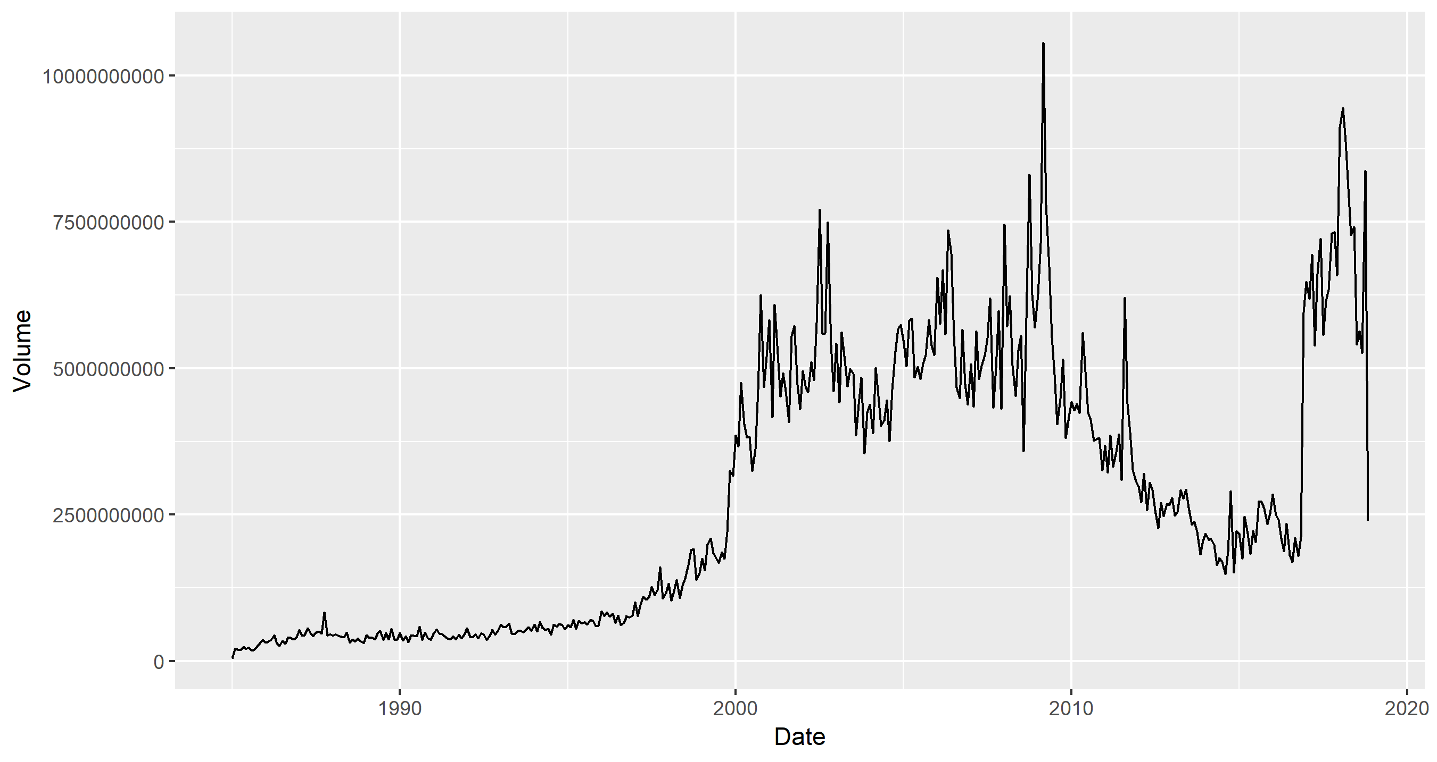
Dow Jones

Slide 7
The last Bear market
Sept. 30, 2002 Dow 7528
Jan. 5, 2004 Dow 10,568
Oct. 8, 2007 Dow 14093

Slide 8
What do I do in a Bear Market
Decide whether this is a market correction or the start of something more
Review the stocks you own
Review stocks you wanted to own but were too expensive at time of research
Check your portfolio for balance or the type of stocks you own

