Slide 1
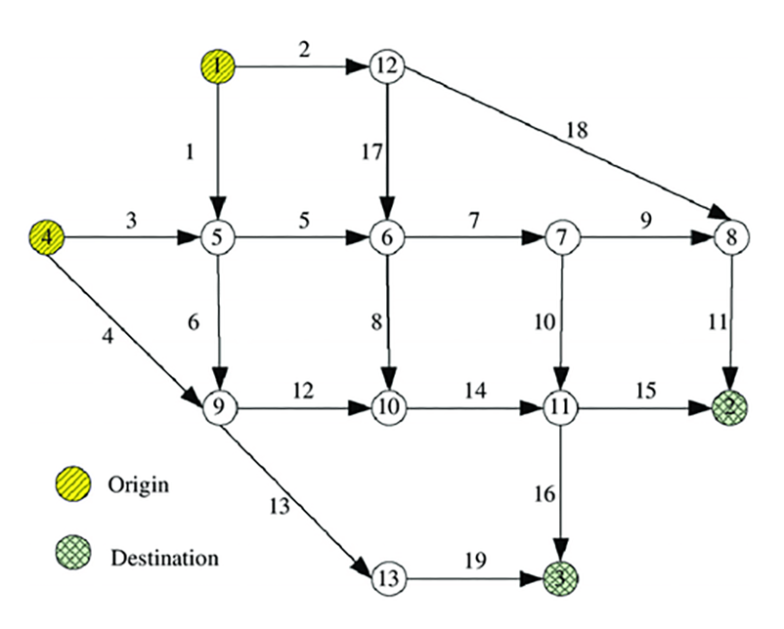
Ave_1_link_1
Apartment A
Museme
St_2_link_1
St_3_link_1
St_5_link_1
Ave_2_link_1
Ave_2_link_2
Ave_2_link_3
Food court
Ave_2_link_4
Apartment B
School
Supermarket
Amusement Park
St_1_link_1
St_2_link_2
St_3_link_2
St_4_link_1
St_5_link_2
Ave_3_link_1
Ave_3_link_2
Ave_3_link_3
Office
Hospital
Cinema
Coffe shop
St_4_link_2
St_1_link_2
Metro line 1
Ave_4_link_1
Metro line 2
Gym
Factory

Slide 2
0
11
Apartment A
Museme
3
4
5
6
7
Apartment B
School
Supermarket
Food court
Amusement Park
8
9
10
1
Hospital
Cinema
Coffe shop
Office
12
2
Gym
Factory

