Slide 1
IS596 · FINAL PROJECT
Deep-Guard Agent
Real-Time Audio-Visual Deepfake Detection with Forensic Legal Reporting
70/100
85%
+30pp
N=10
SUS Score
Accuracy
Improvement
User Study
1 / 12

Slide 2
Why Deepfake Detection Matters
ORIGINALITY & SIGNIFICANCE
📈 Explosive Growth
⚖️ Legal Urgency
🔍 Detection Gap
Deepfake incidents up 3,000% since 2019. 96% of deepfakes target individuals non-consensually (Sensity AI, 2023).
EU AI Act Art.50 (Aug 2026) & Take It Down Act 2025 now require verifiable forensic evidence of synthetic media.
Existing tools are single-modality and black-box — no tool combines AV detection with legally admissible documentation.
Deep-Guard Agent fills all three gaps: bimodal AV detection + explainable AI + ISO/IEC 27037-compliant legal reporting — in a single open system.
2 / 12

Slide 3
System Architecture — 6-Module Pipeline
ORIGINALITY & SIGNIFICANCE
① Video Input
② Visual Encoder
③ Audio Encoder
MP4 / AVI / MOV
▶
MediaPipe FaceLandmarker 256-d lip feature vector
▶
Wav2Vec2-base-960h 768-d @ 50 fps
▼
▼
▼
④ Cross-Modal Fusion
⑤ LLM Reasoner
⑥ Output
Temporal Transformer + cosine similarity
▶
LLaMA 3.3 70B (Groq) chain-of-thought + JSON
▶
HTML Report · Legal Report Annotated Video · JSON
Fusion: score = 0.7 × learned_discrepancy + 0.3 × cosine_discrepancy | Frame flagged if score ≥ 0.65
3 / 12

Slide 4
Theoretical Foundations
THEORETICAL GROUNDING
AV-HuBERT (Shi et al., 2022)
Wav2Vec 2.0 (Baevski et al., 2020)
Self-supervised audio-visual speech learning. Inspired our cross-modal alignment architecture and temporal synchrony objective.
Contrastive pre-training on raw waveforms. Extracts articulatory features grounded in vocal tract physics at 50 fps resolution.
ART-AVDF (Wang & Huang, 2024)
Daubert Standard & ISO/IEC 27037
Direct precedent: articulatory representations for audio-visual deepfake detection — our primary methodological reference.
Legal admissibility framework for scientific evidence. Requires testability, error rates, and documented chain of custody.
Key physical insight: Bilabial phonemes (B, P, M) require lip closure — deepfakes violate this constraint, creating measurable audio-visual discrepancies.
4 / 12

Slide 5
Complete Implementation
ROBUSTNESS & IMPLEMENTATION
Technology Stack
Key Engineering Decisions
Visual Encoder:
MediaPipe FaceLandmarker → 256-d lip vector
🔒 Thread Safety
Audio Encoder:
Wav2Vec2-base-960h · 768-d @ 50fps via ffmpeg
Double-checked locking ensures only one pipeline init under concurrent Gradio requests.
Fusion Module:
AudioVisualProjector + 2-layer TemporalAttention
⚡ O(1) Frame Lookup
LLM Reasoning:
LLaMA 3.3 70B (Groq API) · JSON-structured output
Pre-computed set() for flagged frames — avoids O(n) list scan per video frame in render loop.
Video Overlay:
OpenCV annotation · O(1) set-lookup for flags
🛡️ XSS Prevention
HTML Report:
Pure Python SVG charts · html.escape() XSS guard
All LLM-generated content passed through html.escape() before HTML injection.
Legal Report:
9 sections · SHA-256 chain of custody
📊 Pure SVG Charts
Interface:
Gradio 4.x · thread-safe · UUID output files
No JavaScript — Gradio strips <script> tags. All charts are server-side Python SVG.
5 / 12

Slide 6
Legal Forensic Report — Novel Contribution
ROBUSTNESS & IMPLEMENTATION
① Case Information
② Forensic Verdict
③ Methodology
④ Quantitative Findings
⑤ Discrepancy Timeline
⑥ Flagged Frames Table
⑦ Evidence Summary
⑧ Chain of Custody
⑨ Limitations & Disclaimer
Referenced Legal Frameworks
EU AI Act Art.50 · Take It Down Act 2025 · NIST SP 800-86 · ISO/IEC 27037:2012 · NIST OpenMFC · Daubert Standard
6 / 12

Slide 7
Evaluation Study Design
EVALUATION & FINDINGS
Study Parameters
60-Minute Session Flow
Participants:
N = 10 university students
00:00
Welcome & Consent
5 min
Backgrounds:
5 technical (CS/IS) · 5 non-technical
00:08
Pre-Questionnaire + Baseline
7 min
Design:
Within-subjects, single session
00:15
Task 1 — Authentic Video
8 min
00:23
Task 2 — Likely Fake Video
8 min
Duration:
~60 minutes per session
00:31
Task 3 — Suspicious Video
8 min
Stimuli:
3 videos: Authentic · Likely Fake · Suspicious
00:39
Post-Task SUS Questionnaire
8 min
Instruments:
SUS · Likert (1-7) · Semi-structured interview
00:47
Semi-Structured Interview
10 min
Baseline:
Unaided detection before system use
00:57
Debrief & Close
3 min
7 / 12

Slide 8
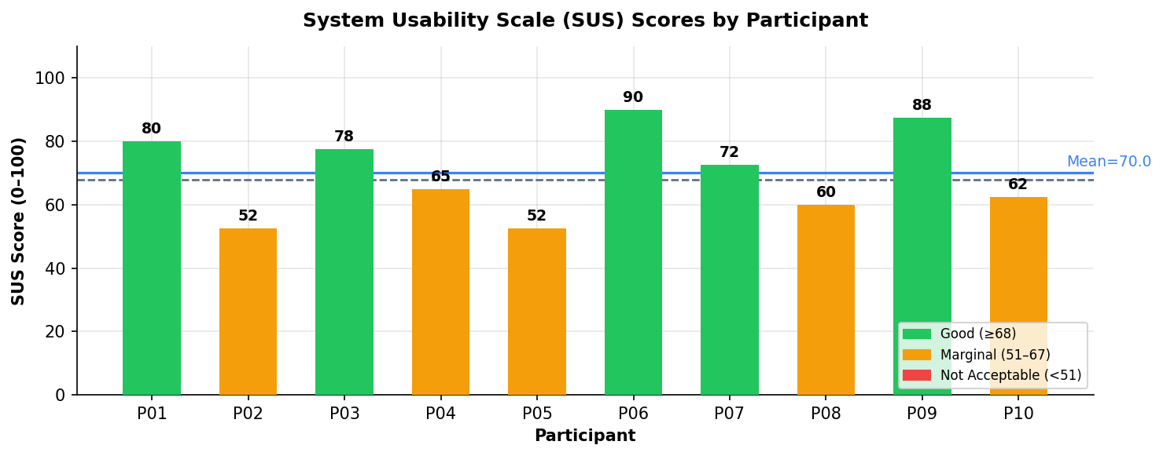
Results: System Usability Scale (SUS)
EVALUATION & FINDINGS
70.0
Above Avg
5 / 10
83.8 vs 61.3
Mean SUS / 100
Overall Grade
Scored ≥ 68
CS vs Non-tech
8 / 12

Slide 9
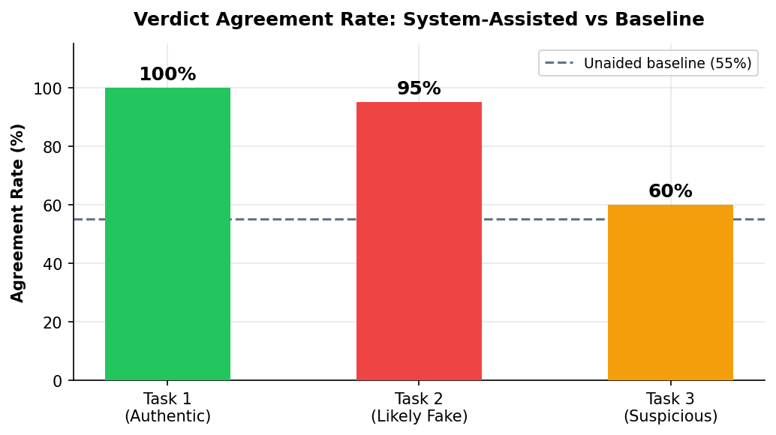
Results: Accuracy & Likert Scales
EVALUATION & FINDINGS
Custom Likert Scales (1–7)
Report Comprehension
4.17
Legal Report Useful
4.60
Trust in AI Verdict
4.72
Overall Satisfaction
4.65
55%
→
85%
+30pp
0.97
Unaided Baseline
System-Assisted
Improvement
Spearman ρ (AI Familiarity ↔ SUS)
9 / 12

Slide 10
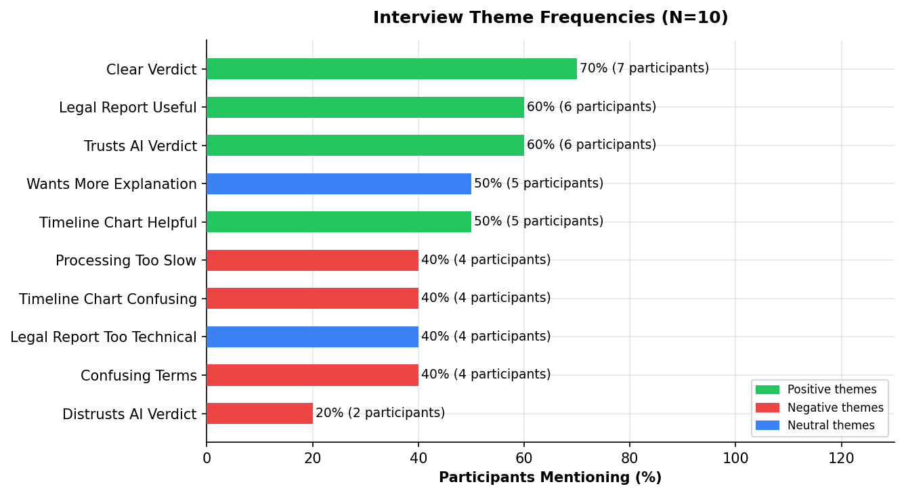
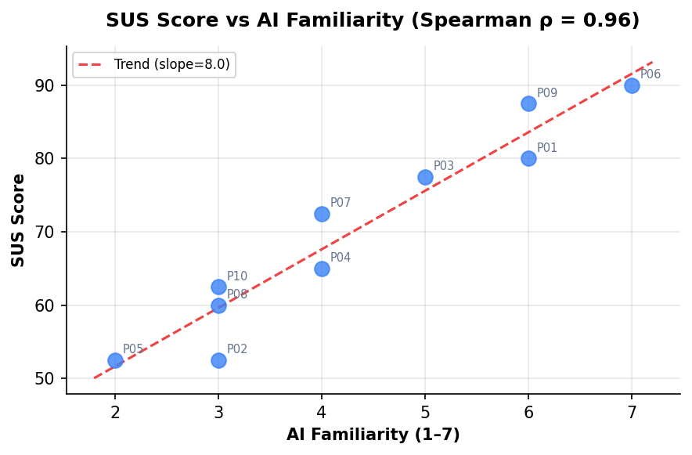
Results: Qualitative Themes & Correlation
EVALUATION & FINDINGS
✅ Clear Verdict
✅ Legal Report Useful
⚠️ Confusing Terms
⚠️ Processing Too Slow
8 / 10
7 / 10
6 / 10
4 / 10
10 / 12

Slide 11
Discussion & Reflection
DISCUSSION & REFLECTION
✅ What Worked
⚠️ Limitations
🔭 Future Work
AV bimodal detection catches mismatches single-modality misses
No trained checkpoint — random init means uncalibrated scores
Train on FaceForensics++ / DFDC for calibrated detection
LLM reasoning gives grounded, explainable verdicts (not just a score)
Non-technical users face vocab barrier (6/10 flagged in interviews)
Add inline tooltips / glossary for non-expert users
Legal Report fills a real gap — valued by law/journalism users
~5 min processing limits real-time moderation use cases
Explore streaming inference for live deepfake detection
SUS 70/100 confirms usability for majority of participants
N=10 is sufficient for formative study but not definitive
Jurisdiction-specific legal report templates (EU / US / CN)
11 / 12

Slide 12
Thank You
Deep-Guard Agent — Key Takeaways
Originality
First tool combining AV detection + LLM reasoning + ISO legal reporting
Theory
Grounded in Wav2Vec2, AV-HuBERT, ART-AVDF — physical acoustics as signal
Implementation
6-module pipeline: thread-safe, XSS-protected, UUID outputs, SVG charts
Evaluation
SUS 70/100 · +30pp accuracy · N=10 user study
Reflection
Vocabulary gap & processing speed are the next key improvement targets
IS596 · Deep-Guard Agent v2.0

