Slide 1
Group 17 Presentation
Amy Qin, Max Zou, Chi Zhang

Slide 2
Motivation
Focus on a few large US restaurant brands which serve sandwich, the brands are: Subway, Jimmy John's, Jersey Mike's Subs, Quiznos, Potbelly Sandwich Shop, Firehouse Subs
Build NLP models and give restaurants recommendation by sentiment analysis

Slide 3
Data processing
Merge "business.json" and "review.json" files by business ID
Extract each restaurant from those 6 brands and corresponding average ratings, user rating, and user reviews
Index | Address | Star | Comment
0 | 1 Brookings Dr | 2.0 | I repeated my order three times loudly and you... I assume this is the one inside the Mallinckro...

Slide 4
Statistical Methodology
Generate a sentiment score for each user review from –1 to 1
Process the comments with lemmatization to break down the comments into single words
Build "Bigram Language Model" to combine all words in pairs and pick the combination which appears many times
Calculate median of the sentiment score of reviews contain selected pairs
Pairs | Sentiment | Pairs | Sentiment
('customer','service') | 0.6285 | ('roast','beef') | 0.9314
('freaky','fast') | 0.5041 | ('meat','cheese') | 0.9246
... | ... | ... | ...
('order','wrong') | -0.54985 | ('bag','chip') | 0.6379

Slide 5
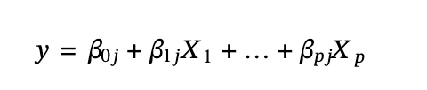
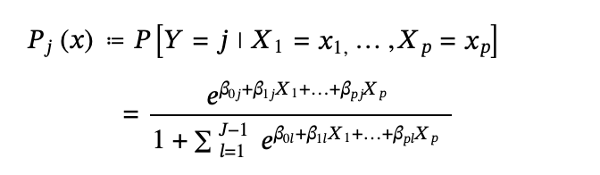
Statistical Methodology
Multilinear regression model
Multinomial logistic regression model

Slide 6
Analysis
Linear Regression Coefficients
Multilinear Regression
Features | Coefficient
bread | -1.54970724
staff | 2.1517492
beef | 2.87647606
meatball | -0.29871609
fast | 1.6430803
... | ...
steak | 2.21383941
The model accuracy is about 0.41 by a 80 –20 train-test split.

Slide 7
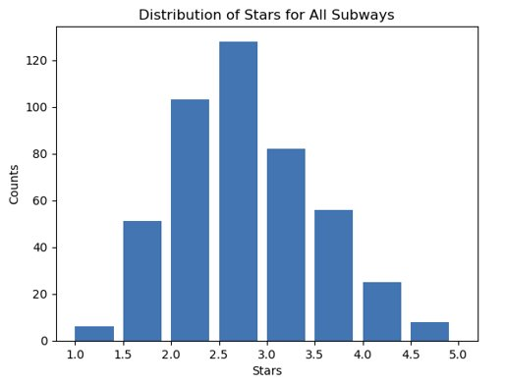
Analysis

Slide 8
Business Recommendations
Focus on improving:
Bread quality
Promote steak subs
Provide fresh ingredients
Friendly, caring service

Slide 9
Business Recommendations
Do not:
Spend too much staff training on speed of service
Develop new teriyaki or meatball menus

Slide 10
Improvements
Better data processing
Weighing observations
Combining similar words
Improve prediction accuracy

Slide 11
Thank you!

