Slide 1
Final Project Intro
AI Essentials for Business
Professor Gordon Gao, PhD

Slide 2





How It Works
You ask a question:
Four AI agents with distinct cognitive roles collaborate on it — while you steer the conversation.
Proposer
Critic
Generates creative ideas and concrete plans
Challenges assumptions, finds risks and blind spots
Researcher
Synthesizer
Gathers facts and evidence to ground the debate
Integrates viewpoints into a structured deliverable

Slide 3
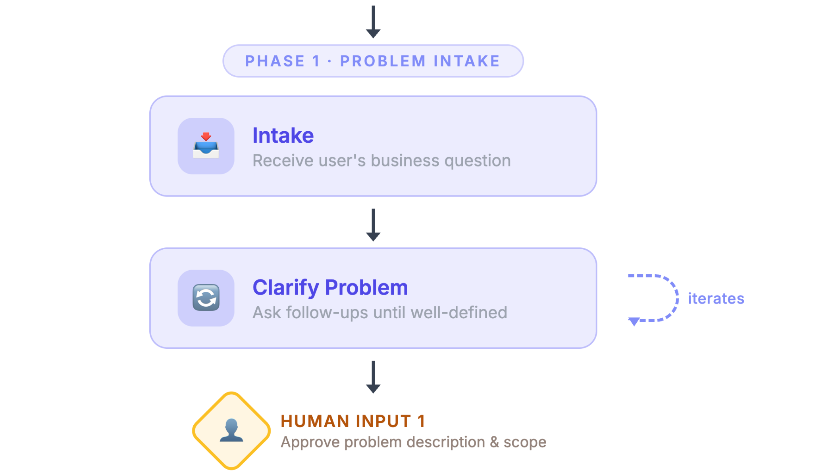
Multi-Agent Collaboration System

Slide 4
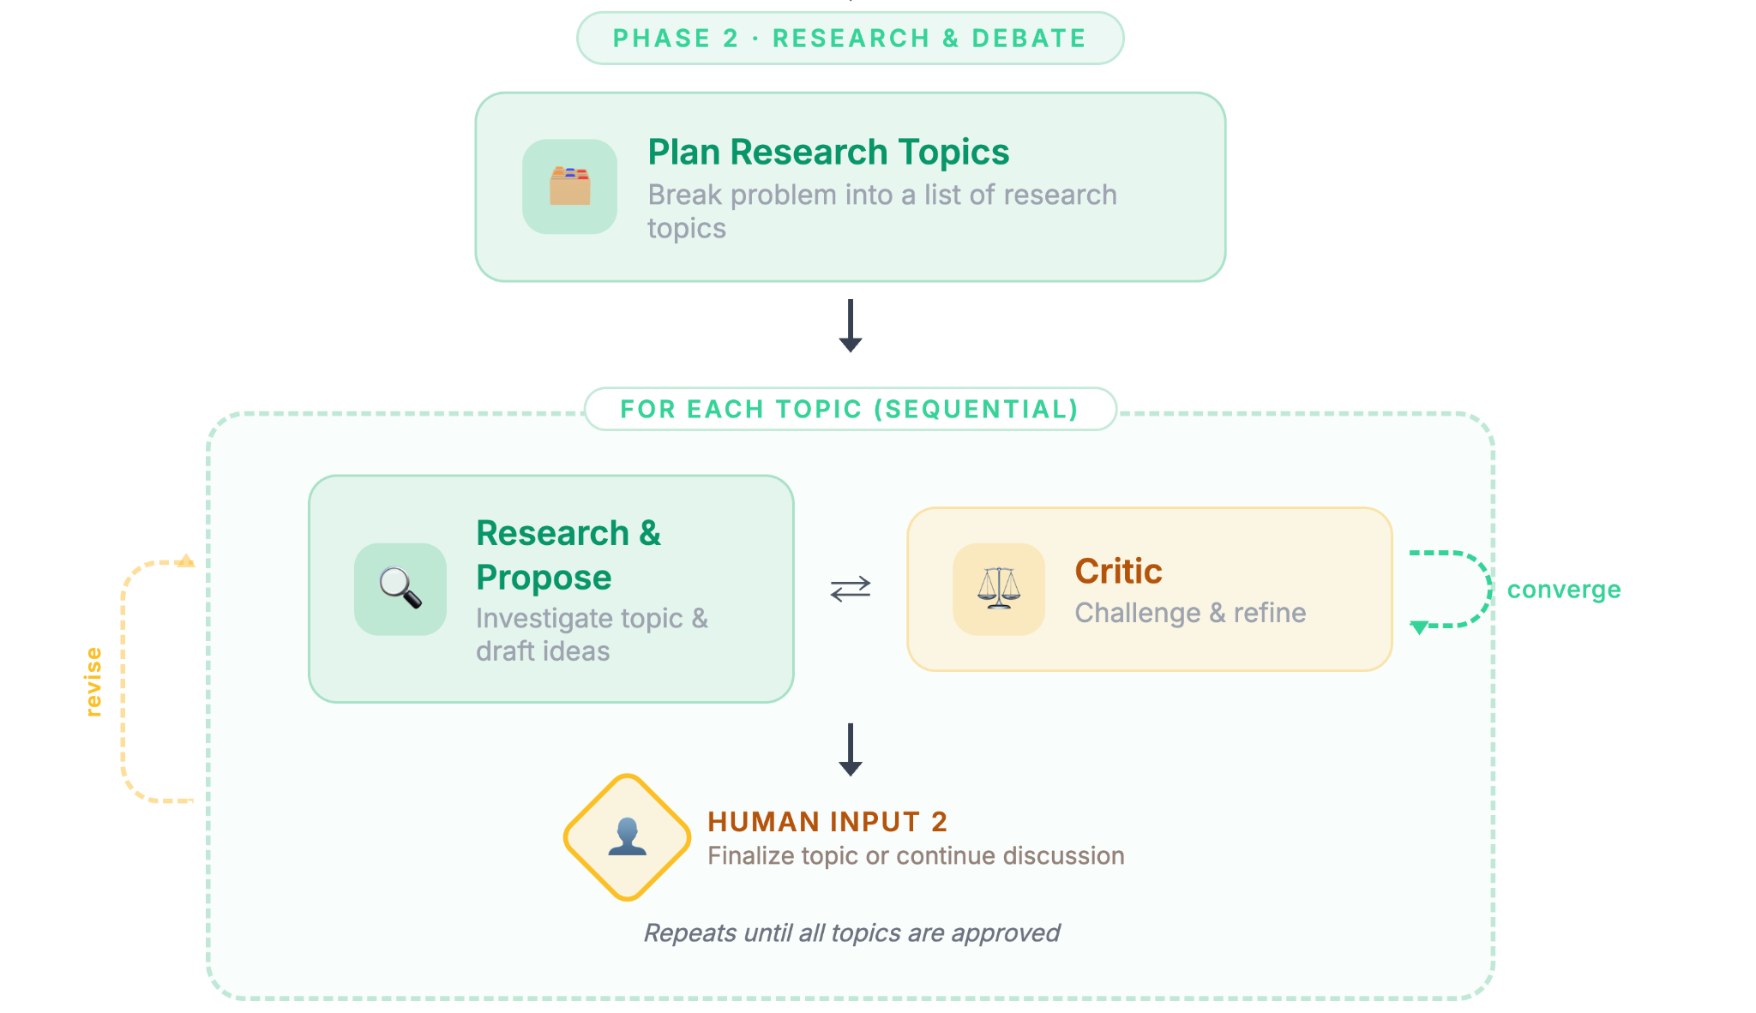
Multi-Agent Collaboration System

Slide 5
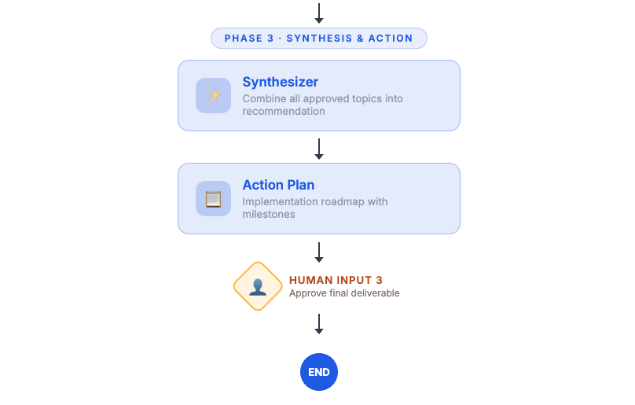
Multi-Agent Collaboration System

Slide 6



What to Observe
Model Choice
Agent Dynamics
Output Quality
How do different LLM choices (such as OpenAI, Claude and Gemini) change agent behavior?
Do agents build on each other's ideas, or just repeat themselves?
Is the final plan better than what a single agent would produce?
Does the Critic push back harder with a stronger model?
How does human intervention change direction?
What questions benefit most from multi-agent collaboration?

Slide 7

