Slide 1
Plan, Profile and Streamline Curvature:
A Simple Derivation and Applications
Scott D. Peckham
University of Colorado, Boulder
Geomorphometry 2011
Redlands, California
September 7, 2011

Slide 2
Fix the figure on Slope and Aspect.

Slide 3
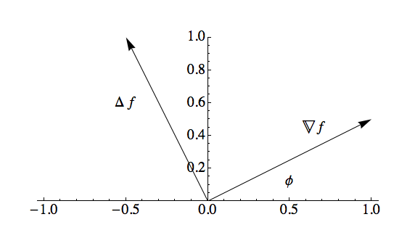



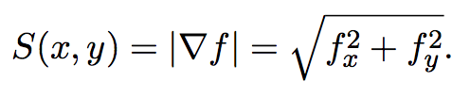
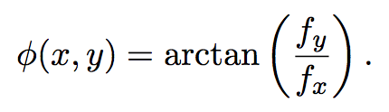
Slope and Aspect

Slide 4
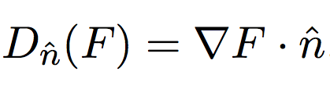

Directional Derivative
Gives the rate at which a scalar field, given by F(x,y), is changing in the direction of a (local) unit vector, n hat, such as:
The scalar field, F(x,y) can be any function of x and y, such as the slope, S(x,y), or aspect, phi(x,y).

Slide 5

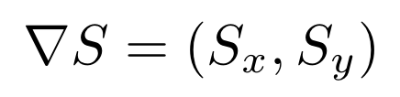
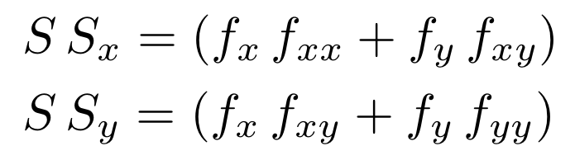

Example 1: Profile Curvature
If we compute the directional derivative with F(x,y) = S(x,y) and the norm-alized gradient of f(x,y) as n hat, we get the equation for profile curvature. That is, we get the rate at which surface slope, S(x,y) , changes as we move in the direction of grad(f), (i.e. following a streamline).
Recall:
Expressed in Cartesian coordinates we have:
The sign of this scalar field determines whether the longitudinal profile is locally concave up, flat, or concave down at any given point (x,y).

Slide 6


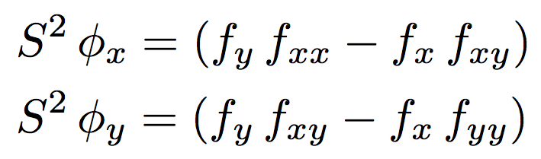

Example 2: Streamline Curvature
If we compute the directional derivative with F(x,y) = psi(x,y) and the normalized gradient of f(x,y) as n hat, we get the equation for streamline curvature. That is, we get the rate at which the flow direction (aspect) changes as we move in the direction of grad(f), (i.e. following a streamline). It is the inverse of a channel’s local radius of curvature, which measures how tightly a channel bends.
Recall:
Expressed in Cartesian coordinates we have:

Slide 7

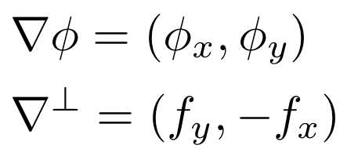

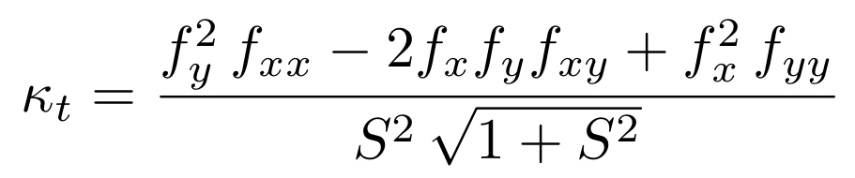
Example 3: Plan Curvature
If we compute the directional derivative with F(x,y) = phi(x,y) and the normalized perpendicular gradient of f(x,y) as n hat, we get the equation for plan curvature. This is the rate at which flow direction (aspect angle) changes as we move in the direction of grad_perp(f), (i.e. following a contour line). It is negative for channels and positive for ridges.
Recall:
Expressed in Cartesian coordinates we have:
Note: grad_perp(f) is
perpendicular and to the
right of grad(f) and to the
left of -grad(f).
Tangential curvature is a
closely-related type of
normal curvature.

Slide 8
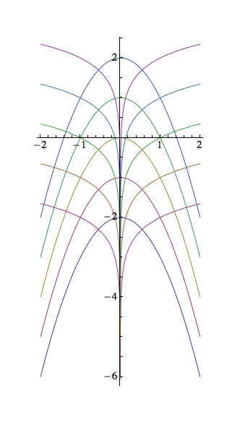
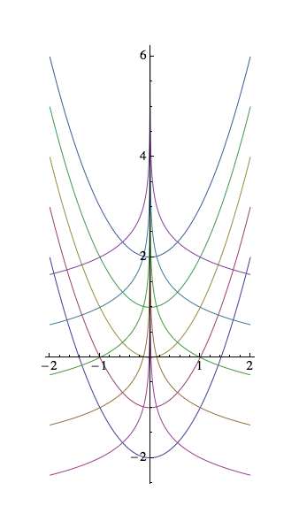

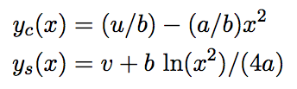
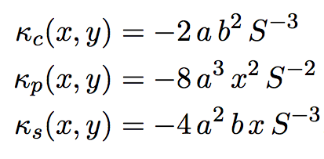
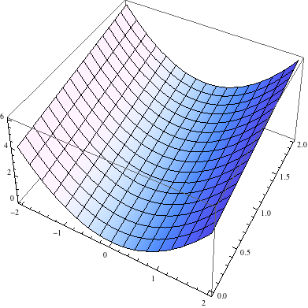
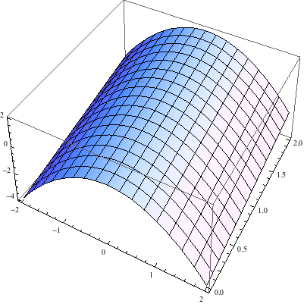
Parabolic Valley and Ridge

Slide 9
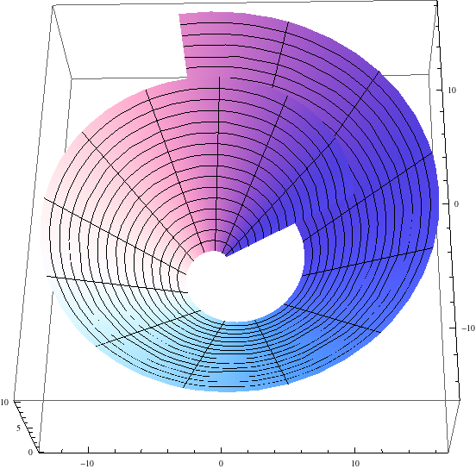
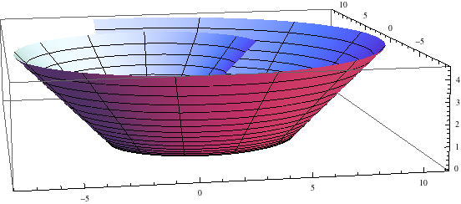

Geometric Optics Equation – Spiral Bowl
All solutions to the Equation of Geometric Optics have profile and streamline curvatures equal to zero everywhere.
Equation of Geometric Optics

Slide 10
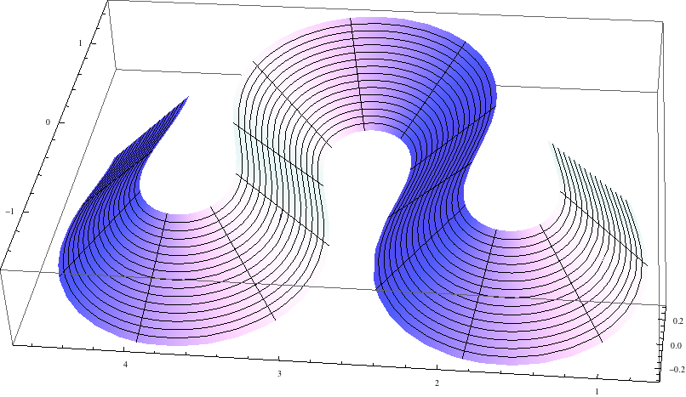
Geometric Optics Equation – Meander
Another solution to the Equation of Geometric Optics, so profile and streamline curvatures are equal to zero everywhere. Contour lines are “sine-generated” meander curves.

Slide 11
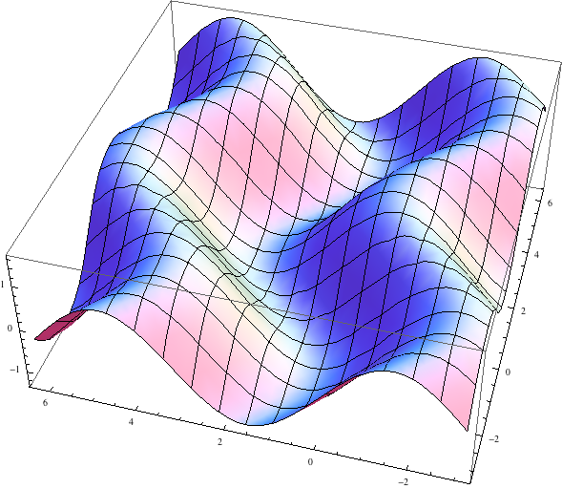
A “Sine Valley” Surface
z(x,y) = (x/10) - Sin[y – Sin(x)]

Slide 12
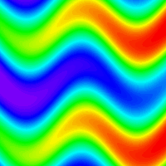
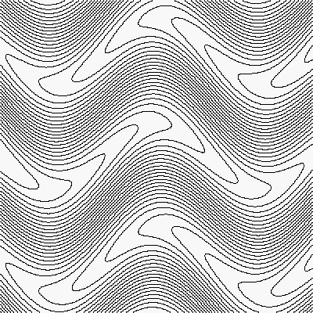
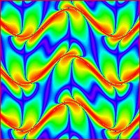
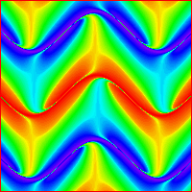
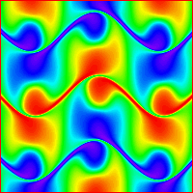
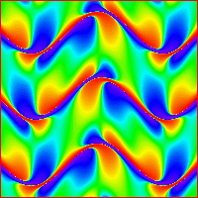
Curvatures for a “Sine Valley” Surface
elevation
contour plot
abs(streamline curvature)
plan curvature
profile curvature
streamline curvature

Slide 13
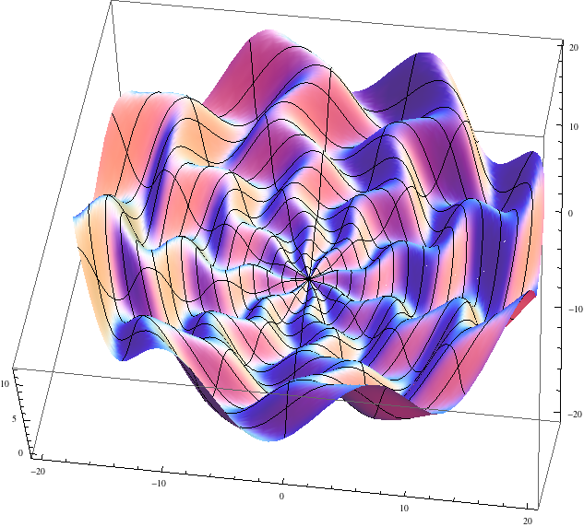
Streamline “Rose” Surface
z(r, theta) = 0.2 [ r^2/10 + r * Sin(8 theta – Sin(r)) ]

Slide 14
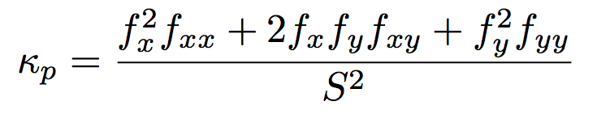
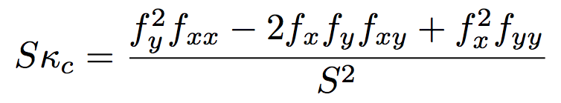
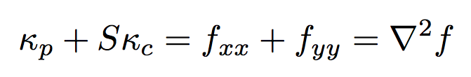
Plan and Profile Curvature and
Laplace’s Equation
Minimal Surface Equation in Cartesian Coordinates
kp + S kc (1 + S^2) = 0. S^2 << 1 => Laplace eqn.

Slide 15
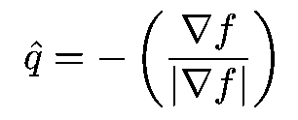




An Idealized Mathematical Model for
Steady-State Fluvial Landforms
The case where γ = -1 corresponds
to a surface such that steady flow over the surface has the same unit stream power everywhere. This seems to be the case that most closely matches available data.
When γ < 0, long profiles are always
concave up.

Slide 16
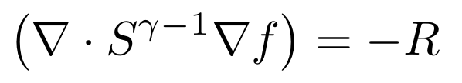
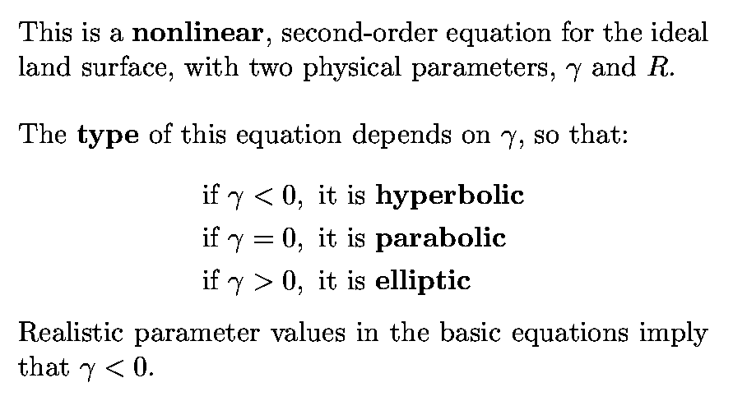
Steady-State Landscape Equation

Slide 17

Steady-State Landscape Equation
in terms of Plan and Profile Curvature
This is a powerful statement about the types of solution surfaces that are
possible because it must hold at every point on every solution to the
original, (idealized), steady-state landscape equation.
Implications of this result when γ = -1 :
Longitudinal profiles in valleys are always concave up. (k_c < 0 (valley) implies that k_p < 0.)
Narrower valleys have higher profile curvatures. For a fixed S, abs(k_p) increases linearly with abs(k_c). Valley width can be defined as proportional to the radius of curvature r_c = 1/abs(k_c).
Steeper valleys have higher profile curvatures. For a fixed k_c < 0 (valley), abs(k_p) is a rapidly increasing function of slope, S.

Slide 18
Conclusions
Plan and profile curvature are intuitive, geometric concepts that are
invaluable to the study of landforms even as we seek to understand
the physical mechanisms that give rise to these fascinating forms.
While it is quite difficult to find analytic and even numerical solutions
to nonlinear, second-order partial differential equations (PDEs), a
reformulation in terms of curvature makes it possible to understand
the types of solution surfaces that are possible and to make quite
general statements regarding their features.
Differential geometry provides powerful tools that are relevant to
both geomorphology and geomorphometry but so far they appear
to be underutilized.
Mathematica is a powerful tool for visualization and analysis.

Slide 19
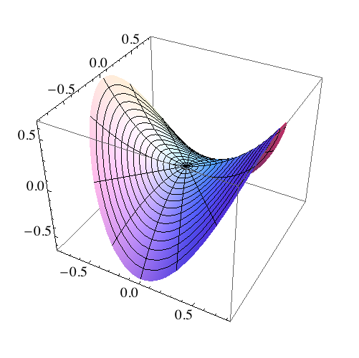
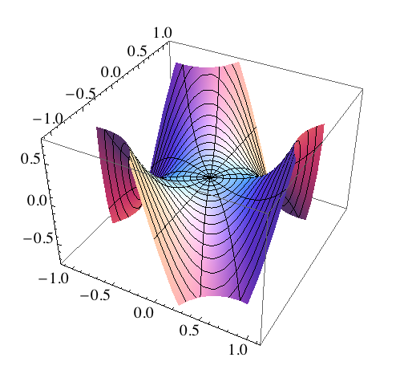
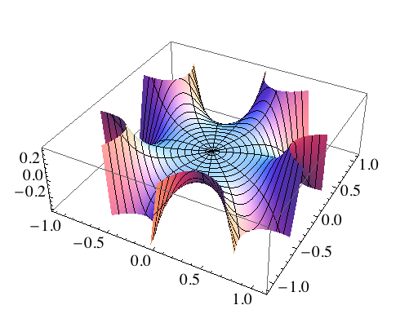
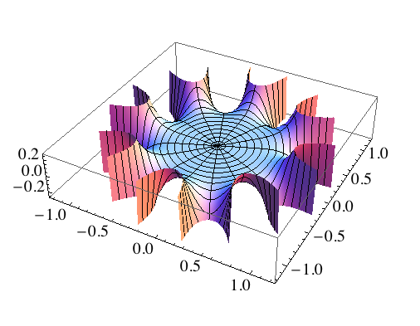
Monkey, Starfish and Octopus Saddles

Slide 21

Steady-State Landscape Equation
in terms of Plan and Profile Curvature
(when γ = -1)
This is a powerful statement about the types of solution surfaces that are
possible because it must hold at every point on every solution to the
original, (idealized), steady-state landscape equation.
Implications of this result:
(1) Can’t have channels with concave-down profiles. ( kc > 0 and kp > 0)
(2) Anywhere kc = 0 (e.g. fork), we have: kp = R S^2.
(3) Anywhere kp = 0 (e.g. linear profile, infl. pt.), we have kc = -RS < 0.
(4) Anywhere kp < 0, we have: kc < -RS.
(5) As S and kc decrease downstream, kp must also decrease.
(6) We can solve the quadratic for S and express slope as a function of
R, kc and kp. (Recall S >= 0, so discard the negative root.)

