Slide 1












$$z$$
$$\vec{r}(t_{i})$$
$$\vec{r}(t_{i−1})$$
$$O$$
$$α$$
$$t_{i−1}$$
$$t_{i}$$
$$β$$
$$t$$
$$O$$
$$y$$
$$x$$

Slide 2


$$z$$
$$\vec{F_{i}}$$
$$\vec{r}(t_{i})$$
$$\vec{r}(t_{i−1})$$
$$O$$
$$α$$
$$t_{i−1}$$
$$t_{i}$$
$$β$$
$$t$$
$$O$$
$$y$$
$$x$$

Slide 3
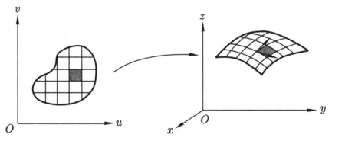


$$\vec{n}$$
$$\vec{v}$$

