Slide 1

Dynamic Spanning Trees for Connectivity Queries on Fully-dynamic Undirected Graphs
Qing Chen, Oded Lachish, Sven Helmer, Michael H. Böhlen

Slide 2

Outline
Introduction
Problem definition
$S_{d}$ and D-tree
Experiments
Conclusion

Slide 3

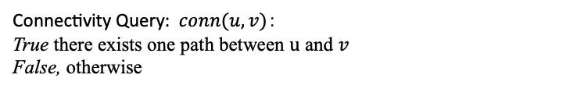
Introduction
4
Input: undirected simple dynamic graph
8
3
Connectivity Query: $conn(u, v)$：
True there exists one path between $u$ and $v$
False, otherwise
9
2
6
Example: $conn(3, 9)$ returns False
1
7
5

Slide 4

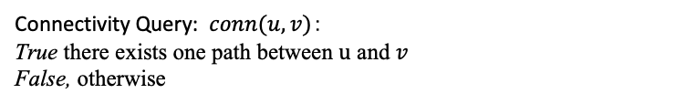
Introduction
4
Input: undirected simple dynamic graph
8
3
Connectivity Query: $conn(u, v)$：
True there exists one path between $u$ and $v$
False, otherwise
9
2
6
Example: $conn(3, 9)$ returns True
Update operations:
Insert edges
1
7
5

Slide 5
Introduction
4
Input: undirected simple dynamic graph
8
3
Connectivity Query: $conn(u, v)$：
True there exists one path between $u$ and $v$
False, otherwise
9
2
6
Update operations:
Insert edges
Delete edges
1
7
5

Slide 6

Introduction
4
Input: undirected simple dynamic graph
8
3
Connectivity Query: $conn(u, v)$：
True there exists one path between $u$ and $v$
False, otherwise
9
2
6
Example: $conn(3, 9)$ returns False
Update operations:
Insert edges
Delete edges
1
7
5

Slide 7
Introduction
4
Input: undirected simple dynamic graph
8
3
Connectivity Query: $conn(u, v)$：
True there exists one path between $u$ and $v$
False, otherwise
9
2
6
Example: $conn(3, 9)$ returns False
Update operations:
Insert edges
Delete edges
Insert isolated vertices
Delete isolated vertices
1
7
5

Slide 8
Motivation & Related work
In DB
in theoretical computer science
Solution [1] for graphs with less than 40 million edges
Real-world large graphs have billions of edges
No experimental evaluations [2]
Optimize for worst-case scenarios (HK, ET-tree)
[1] Hao Wei, Jeffrey Xu Yu, Can Lu, and Ruoming Jin. VLDBJ 2017. Reachability querying: an independent permutation labeling approach.
[2] Hanauer, K., Henzinger, M. and Schulz, C. arXiv 2021. Recent advances in fully dynamic graph algorithms.

Slide 9
Problem definition
Find an efficiently maintainable data structure (index) for fully dynamic graphs that,
on average, answers connectivity queries efficiently.
Assumptions:
efficiently maintainable: almost on the fly
Queries are uniformly distributed.
Small diameters.

Slide 10
Graphs with small diameters are more frequent
1324 real-world graphs in 24 categories at KONECT http://konect.cc/statistics/diam/

Slide 11
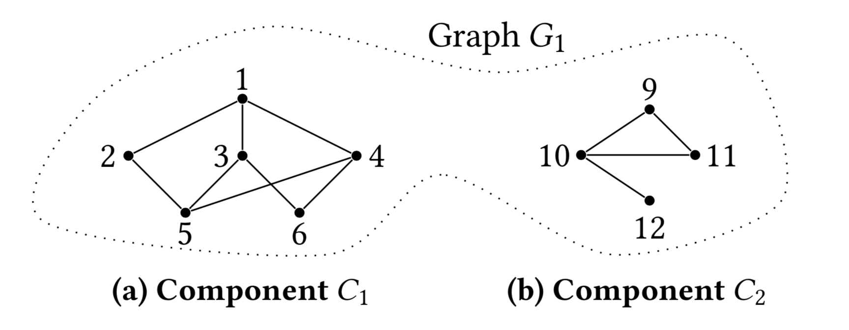

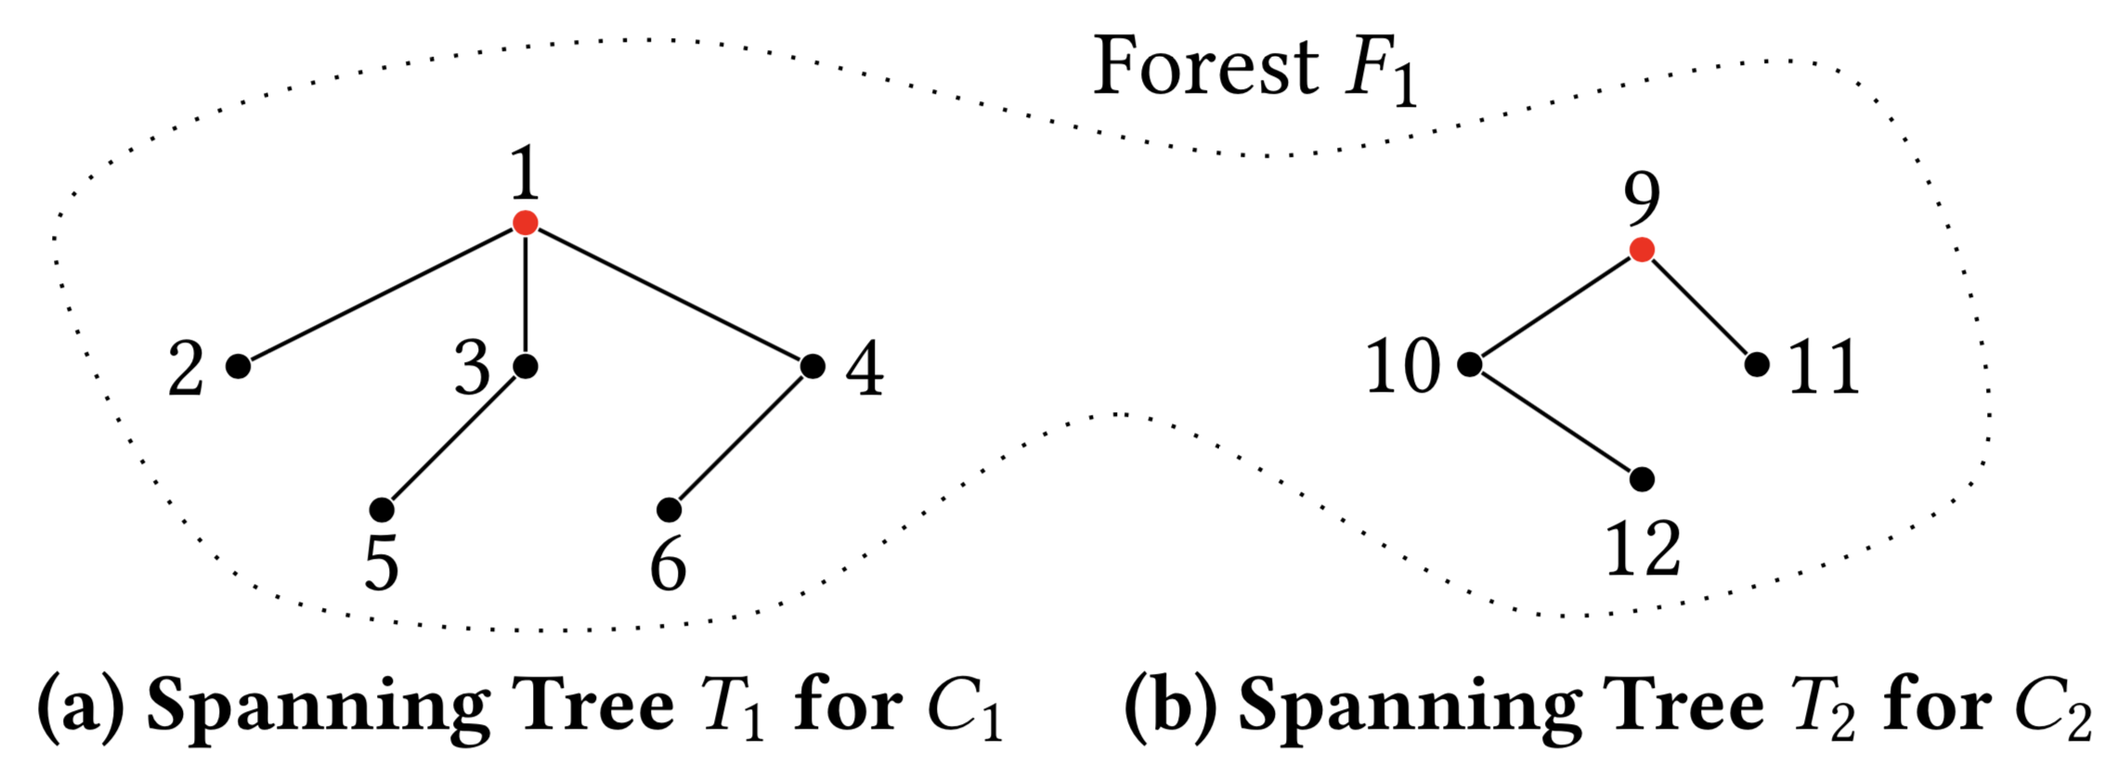

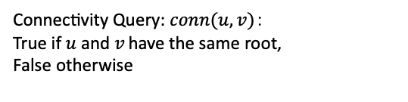
Spanning trees (forest)
Connectivity Query: $conn(u, v)$：
True if $u$and $v$have the same root,
False otherwise
Example: $conn(2, 10)$ returns False
Traversing to the root instead of the
connected component.

Slide 12

$S_{d}$: sum of distances between the root and nodes
Not all spanning trees are good
Good spanning trees are flat

Slide 13
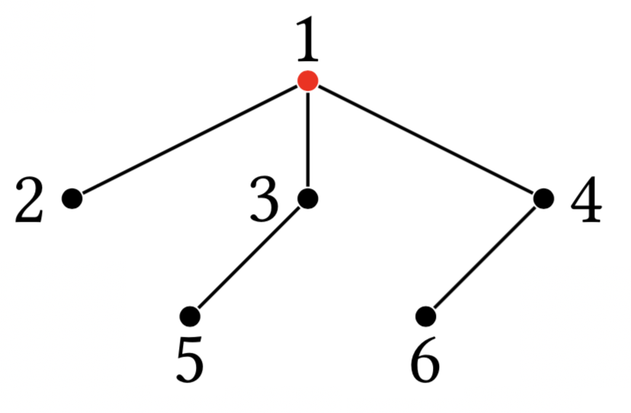
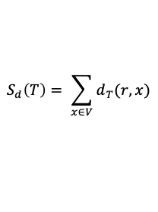


$S_{d}$: sum of distances between the root and nodes
Not all spanning trees are good
Good spanning trees are flat
Example:
For a tree$T=(V, E′)$ with the root $r$, $S_{d}$is defined as follows:
$$S_{d}\left(T\right)= \sum_{x∈V}{d_{T}(r, x)}$$
where $d_{T}(r, x)$ is the distance between a node $x$ and the root $r$ in $T$.
$S_{d}$ = 1 + 1 + 1 + 2 + 2 = 7

Slide 14
$S_{d}$: sum of distances between the root and nodes
Not all spanning trees are good
Good spanning trees are flat
Example:
For a tree$T=(V, E′)$ with the root $r$, $S_{d}$is defined as follows:
$$S_{d}\left(T\right)= \sum_{x∈V}{d_{T}(r, x)}$$
where $d_{T}(r, x)$ is the distance between a node $x$ and the root $r$ in $T$.
$S_{d}$ = 1 + 1 + 1 + 2 + 2 = 7
Small $S_{d}.$ Small average distance to the root. Fast queries.

Slide 15
Optimal average query performance
BFS gives the shortest distances
So many BFS-trees. Optimal BFS-tree (opt) has the minimum $S_{d}$.
opt has optimal average query performance.

Slide 16
Optimal average query performance
BFS gives the shortest distances
So many BFS-trees. Optimal BFS-tree (opt) has the minimum $S_{d}$.
opt has optimal average query performance.
Run BFS over all vertices per insertion and deletion to compute opt.

Slide 17

Optimal average query performance
BFS gives the shortest distances
So many BFS-trees. Optimal BFS-tree (opt) has the minimum $S_{d}$.
opt has optimal average query performance.
Run BFS over all vertices per insertion and deletion to compute opt.
On graphs with millions of vertices takes hours.

Slide 18
D-tree!
Dynamic spanning tree (D-tree) employs heuristics to maintain small $S_{d}$.

Slide 19
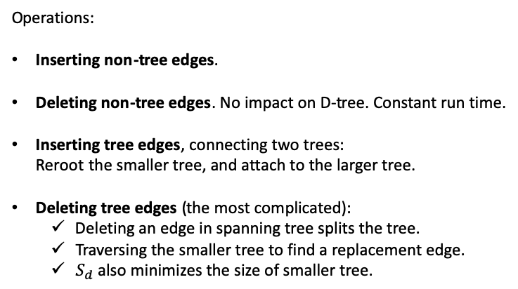
D-tree!
Dynamic spanning tree (D-tree) employs heuristics to maintain small $S_{d}$.
Operations:
Inserting non-tree edges.
Deleting non-tree edges. No impact on D-tree. Constant run time.
Inserting tree edges, connecting two trees: Reroot the smaller tree, and attach to the larger tree.
Deleting tree edges (the most complicated):
Deleting an edge in spanning tree splits the tree.
Traversing the smaller tree to find a replacement edge.
$S_{d}$ also minimizes the size of smaller tree.

Slide 20
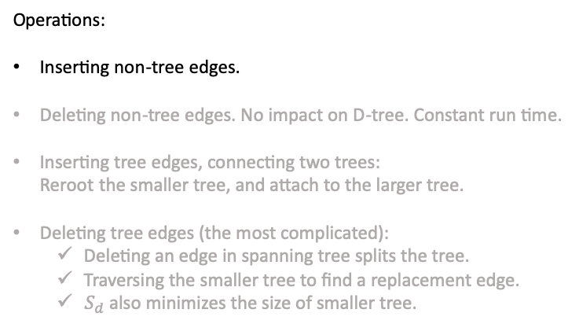
D-tree!
Dynamic spanning tree (D-tree) employs heuristics to maintain small $S_{d}$.
Operations:
Inserting non-tree edges.
Deleting non-tree edges. No impact on D-tree. Constant run time.
Inserting tree edges, connecting two trees: Reroot the smaller tree, and attach to the larger tree.
Deleting tree edges (the most complicated):
Deleting an edge in spanning tree splits the tree.
Traversing the smaller tree to find a replacement edge.
$S_{d}$ also minimizes the size of smaller tree.

Slide 21
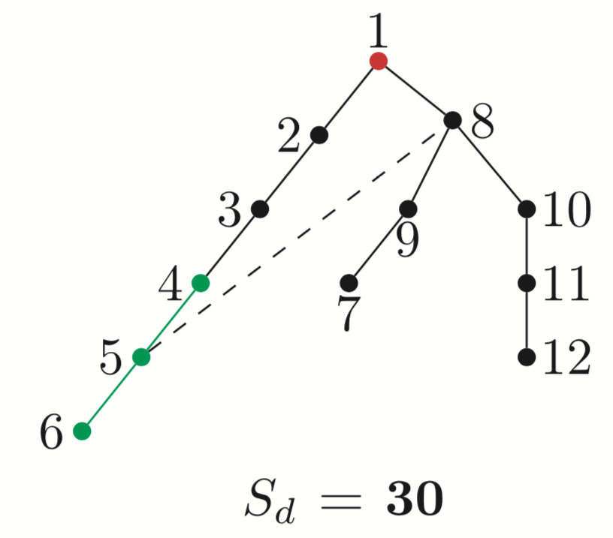
D-tree!
Example for inserting a non-tree edge (5, 8):

Slide 22
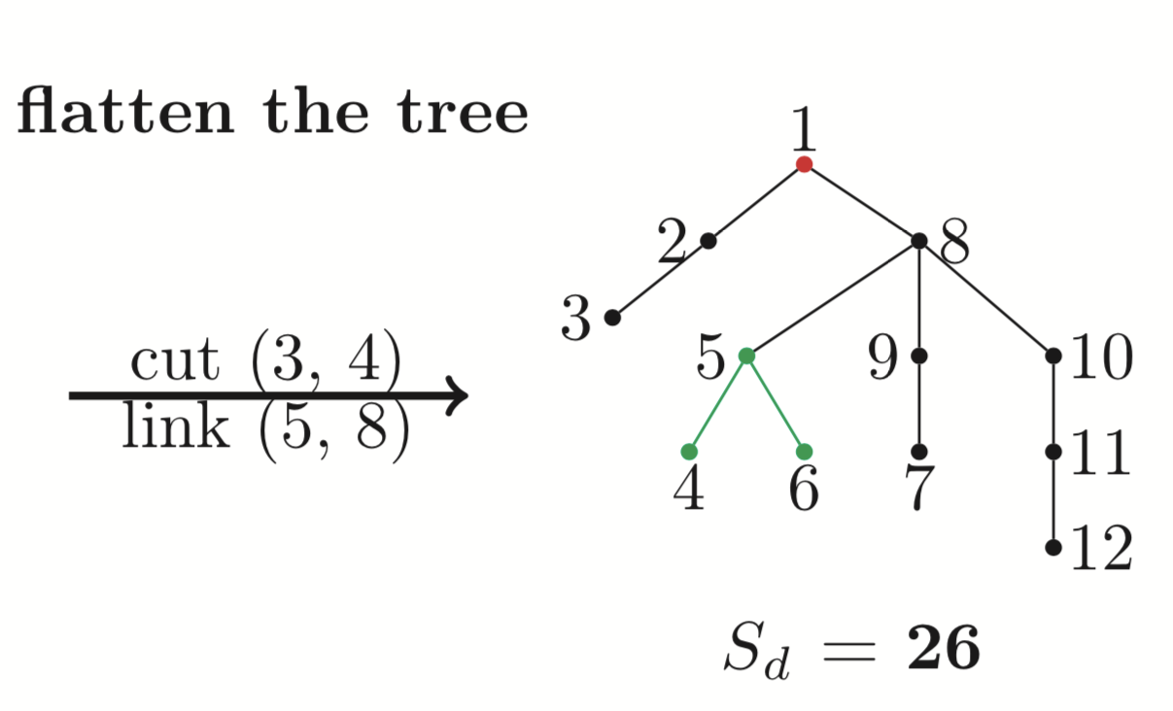
D-tree!
Example for inserting a non-tree edge (5, 8):

Slide 23
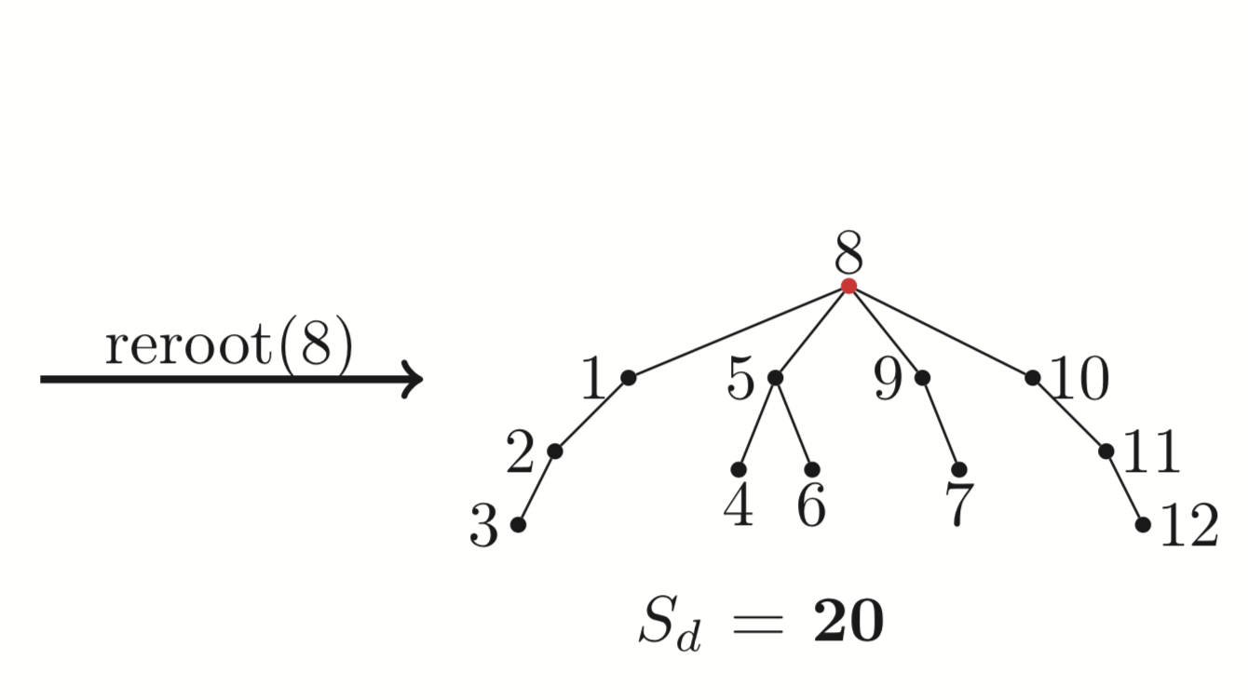
D-tree!
Example for inserting a non-tree edge (5, 8):

Slide 24
D-tree!
Example for inserting a non-tree edge (5, 8):
Best root: no children have more than half size
Only look at the size of a node
Cheap to maintain the size of a node

Slide 25
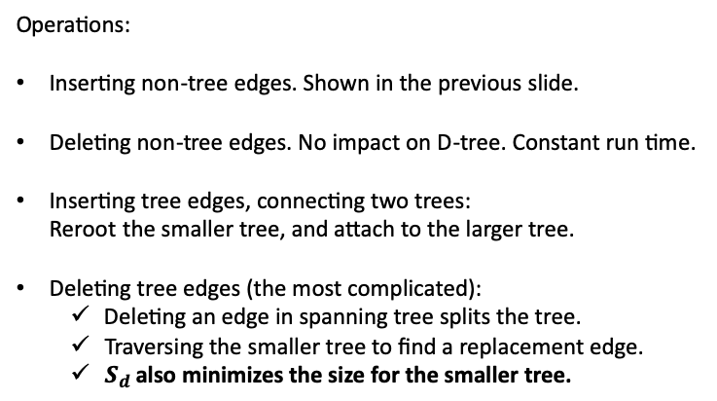
D-tree!
Dynamic spanning tree (D-tree) employs heuristics to maintain small $S_{d}$.
Operations:
Inserting non-tree edges. Shown in the previous slide.
Deleting non-tree edges. No impact on D-tree. Constant run time.
Inserting tree edges, connecting two trees: Reroot the smaller tree, and attach to the larger tree.
Deleting tree edges (the most complicated):
Deleting an edge in spanning tree splits the tree.
Traversing the smaller tree to find a replacement edge.
$S_{d}$ also minimizes the size for the smaller tree.

Slide 26
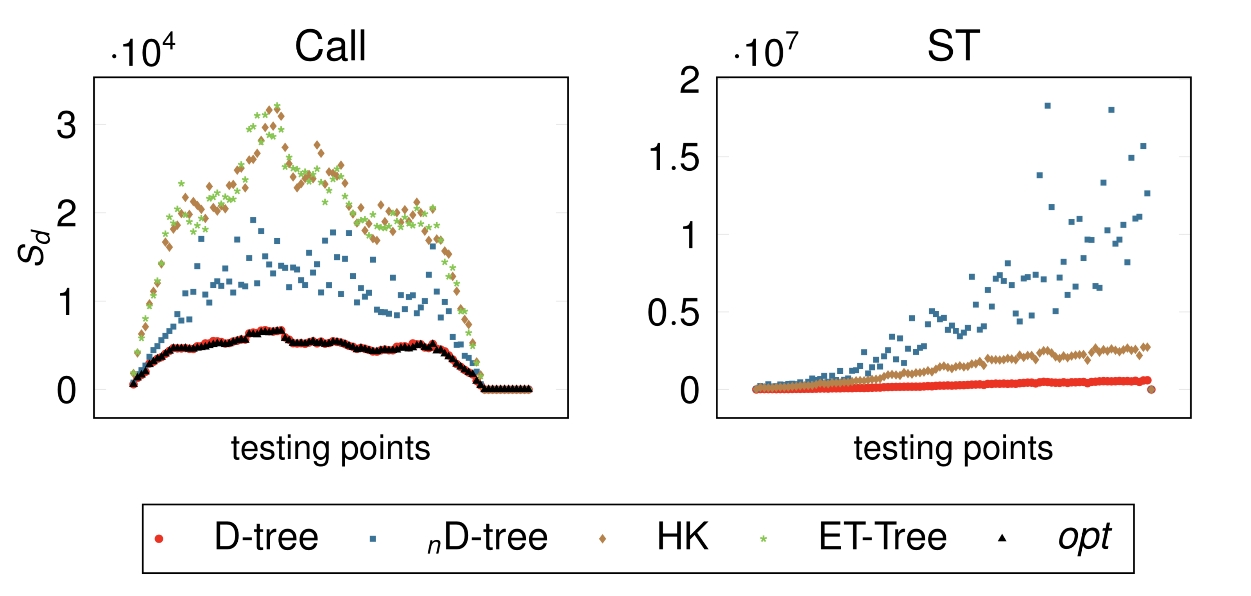

Experimental evaluation (1) : $S_{d}$ in trees
100 uniformly distributed testing points
Queries for all pairs of vertices on small graphs 50 millions random queries on large graphs
Call (phone call) and Stackoverflow (ST)
HK and ET-Tree are worst-case algorithms

Slide 27
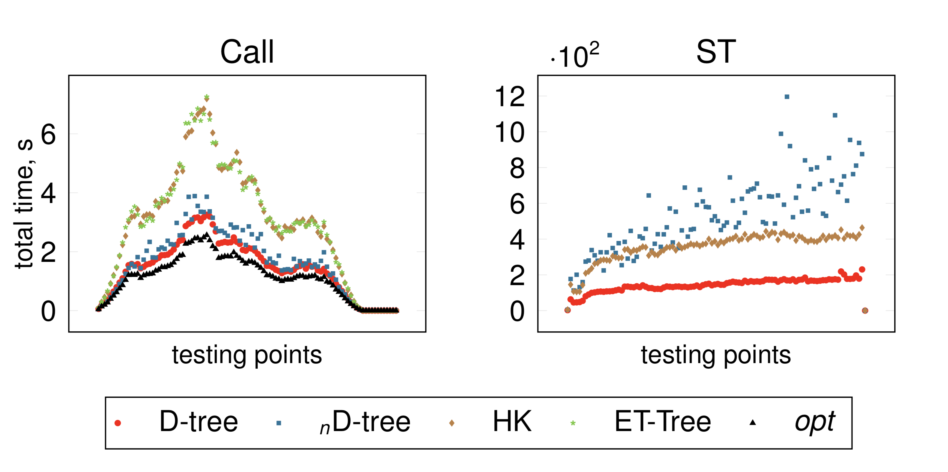
Experimental evaluation (2): Query performance
For small graphs, D-tree is close to opt.
For large graphs, D-tree is the best. ET-tree and opt do not scale to large graphs.

Slide 28
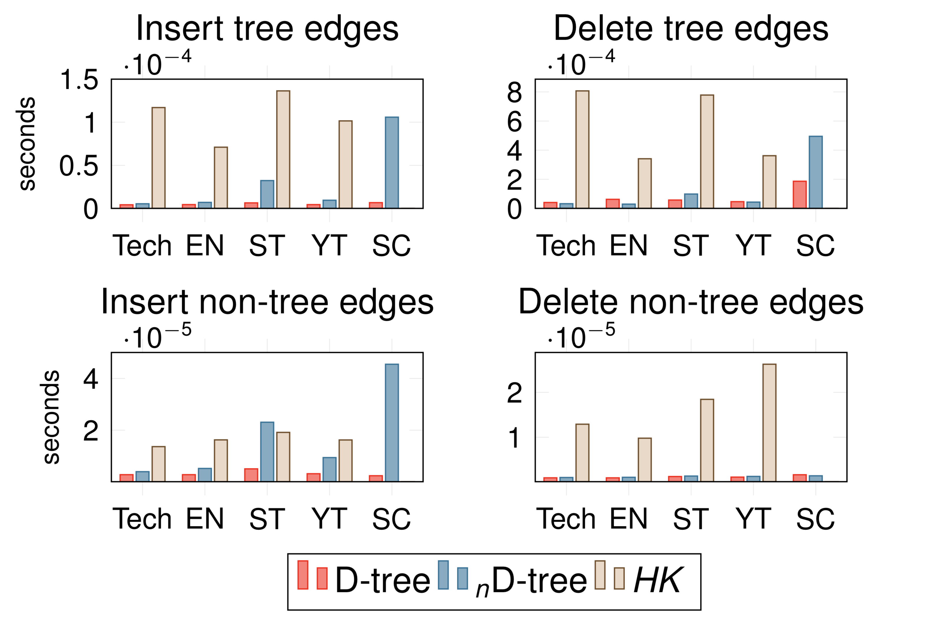
Experimental evaluation (3): Update performance (large graphs)
D-tree is up to 50x faster than HK (our implementation).
On Semantic Scholar (SC) of 8 billion edges, HK does not finish the work-loads in 14 days.

Slide 29
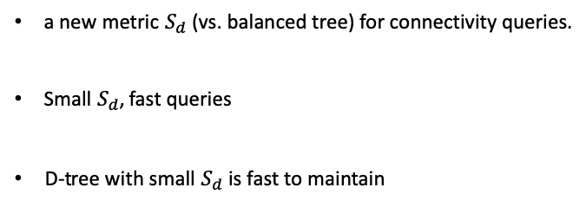
Conclusion
a new metric $S_{d}$ (vs. balanced tree) for connectivity queries.
Small $S_{d}$, fast queries
D-tree with small $S_{d}$ is fast to maintain

Slide 30
Future work
Extending D-tree for graphs with large diameters
Make D-tree work-load aware.

Slide 31
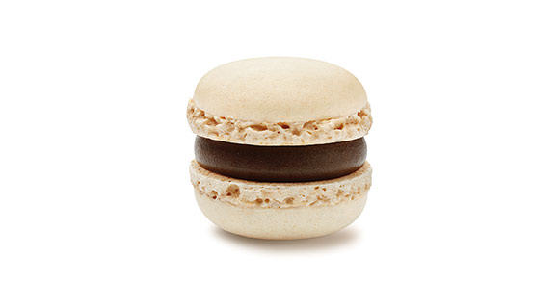
Q&A
Poster session: Wednesday
One chocolate per question

Slide 32
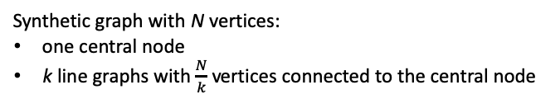
Impact of Average Length of Shortest Path
Synthetic graph with N vertices:
one central node
k line graphs with $\frac{N}{k}$ vertices connected to the central node

