Slide 1
A scalable connectivity algorithm for fully dynamic graphs
Qing Chen
University of Zürich
October 4, 2022
Joint work with Oded Lachish, Sven Helmer and Michael H. Böhlen

Slide 2

Outline
Introduction
Problem definition
Approach: $S_{d}$ and D-tree
Experiments
Conclusion
Ongoing and future work

Slide 3


Introduction
Directed edge and Undirected edge
Directed edge
Undirected edge (bi-directed)
Simple graph: at most one edge connecting two vertices.

Slide 4
Introduction
Example:
1
G1
7
2
3
4
8
9
5
6
0
Component C1
Component C2

Slide 5
Introduction
Given a connected component $C=(V^{′},E^{′})$, a spanning tree $T=(V^{′},E^{T})$,
with $E^{T}⊆E^{′}$ and ${|E}^{T}|=\left|V^{′}\right|−1$, is a rooted tree containing all vertices of $C$.
Example:
1
1
2
3
4
2
3
4
5
6
5
6
one component
spanning tree

Slide 6
Introduction
Given a connected component $C=(V^{′},E^{′})$, a spanning tree $T=(V^{′},E^{T})$,
with $E^{T}⊆E^{′}$ and ${|E}^{T}|=\left|V^{′}\right|−1$, is a rooted tree containing all vertices of $C$.
Example:
1
1
Tree edges: edges in spanning tree.
(1,2) (1,3) (1,4) (2,5) (4,6)
2
3
4
2
3
4
Non-tree edges:
edges not in spanning tree.
(3,5) (4,5) (3,6)
5
6
5
6
one component
spanning tree

Slide 7
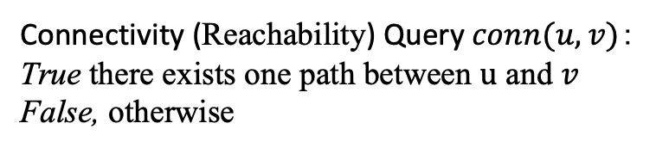

Introduction
Input: undirected simple dynamic graph
4
Connectivity (Reachability) Query $conn(u, v)$：
True there exists one path between $u$ and $v$
False, otherwise
8
3
9
Example: $conn(3, 9)$ returns False
2
6
1
7
5

Slide 8
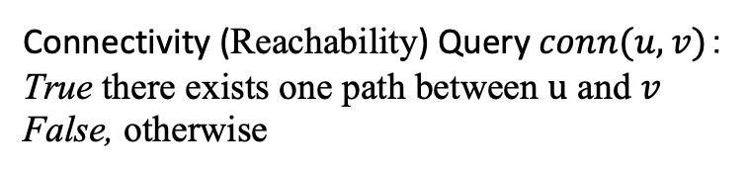

Introduction
Input: undirected simple dynamic graph
4
Connectivity (Reachability) Query $conn(u, v)$：
True there exists one path between $u$ and $v$
False, otherwise
8
3
insert edge (1, 3)
9
Example: $conn(3, 9)$ returns True
2
6
Update operations:
Insert edges
1
7
5

Slide 9
Introduction
Input: undirected simple dynamic graph
4
Connectivity (Reachability) Query $conn(u, v)$：
True there exists one path between $u$ and $v$
False, otherwise
8
3
delete edge (1, 6)
9
2
6
Update operations:
Insert edges
Delete edges
1
7
5

Slide 10
Introduction
Input: undirected simple dynamic graph
4
Connectivity (Reachability) Query $conn(u, v)$：
True there exists one path between $u$ and $v$
False, otherwise
8
3
9
Example: $conn(3, 9)$ returns True
2
6
Update operations:
Insert edges
Delete edges
1
7
5

Slide 11
Introduction
Input: undirected simple dynamic graph
4
Connectivity (Reachability) Query $conn(u, v)$：
True there exists one path between $u$ and $v$
False, otherwise
8
3
9
2
6
Update operations:
Insert edges
Delete edges
Insert isolated vertices
Delete isolated vertices
1
7
5
x
y

Slide 12
Introduction
Input: undirected simple dynamic graph
4
Connectivity (Reachability) Query $conn(u, v)$：
True there exists one path between $u$ and $v$
False, otherwise
8
3
9
2
6
Update operations:
Insert edges
Delete edges
Insert isolated vertices
Delete isolated vertices
1
7
5
x
y

Slide 13
Research Challenge
Scalable algorithm for large dynamic graphs.
U
V
millions of vertices
billions of edges

Slide 14
Motivation & Related work
In Databases research (practice)
In Theoretical Computer Science (theory)
Solution [1] for graphs with less than 40
million edges
Real-world large graphs have billions of
edges
No experimental evaluations [2]
Optimize for worst-case scenarios (HK, ET-tree)
[1] Hao Wei, Jeffrey Xu Yu, Can Lu, and Ruoming Jin. VLDBJ 2017. Reachability querying: an independent permutation labeling approach.
[2] Hanauer, K., Henzinger, M. and Schulz, C. arXiv 2021. Recent advances in fully dynamic graph algorithms.

Slide 15
Problem definition
Find an efficiently maintainable data structure (index) for fully dynamic graphs that,
on average, answers connectivity queries efficiently.
Assumptions:
Queries are uniformly distributed.
Graphs have small diameters.

Slide 16
Graphs with small diameters are more frequent
1324 real-world graphs in 24 categories at KONECT http://konect.cc/statistics/diam/

Slide 17



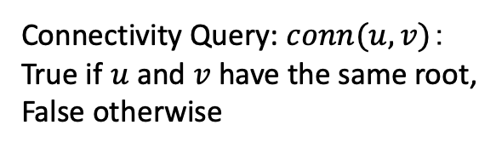




Approach: Spanning trees (forest)
1
Graph $G_{1}$
7
Connectivity Query: $conn(u, v)$：
True if $u$and $v$have the same root,
False otherwise
2
3
4
8
9
5
6
0
Component $C_{1}$
Component $C_{2}$
Example: $conn(2, 9)$ returns False
Spanning forest $F_{1}$
1
7
Traversing to the root instead of the
connected component.
2
3
4
8
9
5
6
0
Spanning tree $T_{1}$ for $C_{1}$
Spanning tree $T_{2}$ for $C_{2}$

Slide 18
Approach: Spanning trees (forest)
1
Graph $G_{1}$
7
Connectivity Query: $conn(u, v)$：
True if $u$and $v$have the same root,
False otherwise
2
3
4
8
9
5
6
0
Component $C_{1}$
Component $C_{2}$
Example: $conn(2, 9)$ returns False
Spanning forest $F_{1}$
1
7
Traversing to the root instead of the
connected component.
2
3
4
8
9
5
6
0
Answering queries is simplified.
Spanning tree $T_{1}$ for $C_{1}$
Spanning tree $T_{2}$ for $C_{2}$

Slide 19


Good spanning trees
Not all spanning trees are good
Good spanning trees are flat
1
1
2
2
3
4
2
3
4
5
1
many other trees ...
5
6
5
6
3
4
Component $C_{1}$
spanning trees for $C_{1}$
6

Slide 20
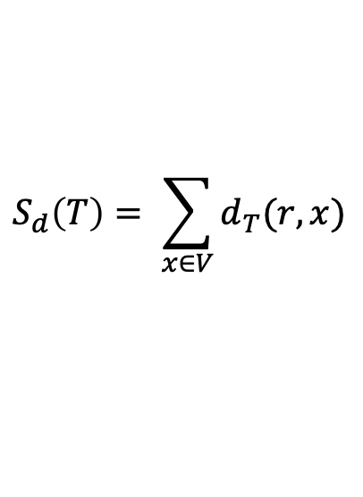


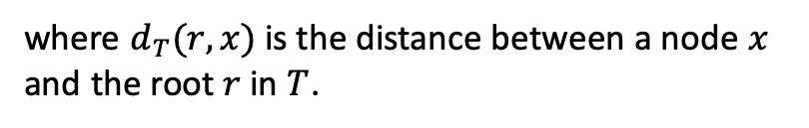

$S_{d}$: sum of distances between the root and nodes
For a tree$T=(V, E′)$ with the root $r$, $S_{d}$is defined as follows:
Example:
1
$$S_{d}\left(T\right)= \sum_{x∈V}{d_{T}(r, x)}$$
2
3
4
where $d_{T}(r, x)$ is the distance between a node $x$
and the root $r$ in $T$.
5
6
$S_{d}$ = 1 + 1 + 1 + 2 + 2 = 7

Slide 21
$S_{d}$: sum of distances between the root and nodes
For a tree$T=(V, E′)$ with the root $r$, $S_{d}$is defined as follows:
Example:
1
$$S_{d}\left(T\right)= \sum_{x∈V}{d_{T}(r, x)}$$
2
3
4
where $d_{T}(r, x)$ is the distance between a node $x$
and the root $r$ in $T$.
5
6
$S_{d}$ = 1 + 1 + 1 + 2 + 2 = 7
Small $S_{d}.$ Small average distance to the root. Fast queries.

Slide 22
Optimal average query performance on spanning trees
Breadth-first search (BFS) gives the shortest distances

Slide 23
Optimal average query performance on spanning trees
Breadth-first search (BFS) gives the shortest distances
So many BFS-trees. Optimal BFS-tree (opt) has the minimum $S_{d}$.
opt has optimal average query performance.

Slide 24
Optimal average query performance on spanning trees
Breadth-first search (BFS) gives the shortest distances
So many BFS-trees. Optimal BFS-tree (opt) has the minimum $S_{d}$.
opt has optimal average query performance.
Run BFS over all vertices per insertion and deletion to compute opt.

Slide 25

Optimal average query performance on spanning trees
Breadth-first search (BFS) gives the shortest distances
So many BFS-trees. Optimal BFS-tree (opt) has the minimum $S_{d}$.
opt has optimal average query performance.
Run BFS over all vertices per insertion and deletion to compute opt.
On graphs with millions of vertices takes hours.

Slide 26
D-tree!
Dynamic spanning tree (D-tree) employs heuristics to maintain small $S_{d}$.

Slide 27
D-tree!
Dynamic spanning tree (D-tree) employs heuristics to maintain small $S_{d}$.
Operations:
Inserting non-tree edges.
Inserting tree edges.
Deleting non-tree edges.
Deleting tree edges (the most complicated).

Slide 28


D-tree: inserting edges
Component $C′$
Spanning tree $T′$
2
5
5
2

Slide 29
D-tree: inserting edges
Component $C′$
Spanning tree $T′$
1
Insert tree edge (1, 2)
5
2
2
5
1

Slide 30


D-tree: inserting edges
Component $C′$
Spanning tree $T′$
1
5
2
2
reroot 2
2
5
5
1
more than half size
1
$S_{d}$ = 3
$S_{d}$ = 2
Size for a node v: number of vertices in the subtree rooted at v.
Example: size for 2 is 2; size for 1 is one.

Slide 31
D-tree: inserting edges
Component $C′$
Spanning tree $T′$
1
Insert tree edge (1, 4)
2
2
4
5
1
5
4

Slide 32
D-tree: inserting edges
Component $C′$
Spanning tree $T′$
1
2
2
4
5
1
5
6
4
Insert tree edge (4, 6)
6

Slide 33
D-tree: inserting edges
Component $C′$
Spanning tree $T′$
1
more than half size
2
2
4
5
1
5
6
4
Insert tree edge (4, 6)
6

Slide 34


D-tree: inserting edges
Component $C′$
Spanning tree $T′$
1
more than half size
2
1
2
4
5
1
reroot 1
2
4
5
6
4
Insert tree edge (4, 6)
5
6
6
$S_{d}$ = 7
$S_{d}$ = 6

Slide 35
D-tree: inserting edges
Component $C′$
Spanning tree $T′$
1
1
2
3
4
2
4
5
6
5
6
Insert tree edge (3, 6)
3

Slide 36


D-tree: inserting edges
Component $C′$
Spanning tree $T′$
1
1
1
2
3
4
cut(6,3)
2
4
link(1,3)
2
4
3
5
6
Short cut
[6]
5
6
5
6
Insert non-tree edge (1, 3)
[3]
3
$S_{d}$ = 9
$S_{d}$ = 7

Slide 37
D-tree: inserting edges
Component $C′$
Spanning tree $T′$
1
1
2
3
4
2
3
4
[6,5]
5
6
5
6
[3]
[3]
Insert non-tree edge (5, 3)

Slide 38
D-tree: inserting edges
Component $C′$
Spanning tree $T′$
1
1
2
3
4
2
4
3
[6,5]
5
6
5
6
[3]
[3]
a
a
Insert tree edge (a, 5)

Slide 39
D-tree: inserting edges
Component $C′$
Spanning tree $T′$
1
1
2
3
4
2
4
3
[6,5]
5
6
5
6
[3]
[3,a]
a
a
[6]
Insert non-tree edge (a, 6)

Slide 40
D-tree: inserting edges
Component $C′$
Spanning tree $T′$
1
1
2
3
4
2
4
3
[6,5]
5
6
5
6
[3]
[3,a]
a
a
[6]
Best root: no children have more than half size
Only look at the size of a node
Cheap to maintain the size of a node

Slide 41


D-tree: delete non-tree edges
1
1
2
3
4
2
4
3
[6,5]
5
6
5
6
[3]
Spanning tree $T_{1}$
[3,a]
a
a
Component $C_{1}$
[6]

Slide 42
D-tree: delete non-tree edges
1
1
2
3
4
2
4
3
[5]
5
6
5
6
[3]
Spanning tree $T_{1}$
[a]
a
a
Component $C_{1}$
[6]

Slide 43
D-tree: delete tree edges
1
1
2
3
4
2
4
3
[5]
5
6
5
6
[3]
Spanning tree $T_{1}$
[a]
a
a
Component $C_{1}$
[6]

Slide 44
D-tree: delete edges
1
1
2
3
4
2
4
3
[5]
5
6
5
6
[3]
Spanning tree $T_{1}$
[a]
a
a
Component $C_{1}$
[6]

Slide 45

D-tree: delete edges
1
1
2
3
4
2
4
3
[5]
5
6
5
6
[3]
Spanning tree $T_{1}$
[a]
a
a
Component $C_{1}$
[6]
$S_{d}$ optimizes uneven split.

Slide 46

D-tree: delete edges
1
1
2
3
4
2
4
3
5
6
5
6
a
a
Component $C_{1}$
Spanning tree $T_{1}$

Slide 47
D-tree: delete edges
1
1
2
3
4
2
4
3
5
6
5
6
a
a
Component $C_{1}$
Spanning tree $T_{1}$

Slide 48
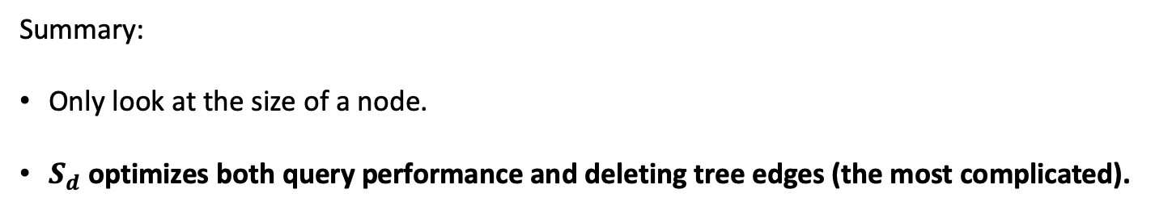
D-tree!
Dynamic spanning tree (D-tree) employs heuristics to maintain small $S_{d}$.
Summary:
Only look at the size of a node.
$S_{d}$ optimizes both query performance and deleting tree edges (the most complicated).

Slide 49
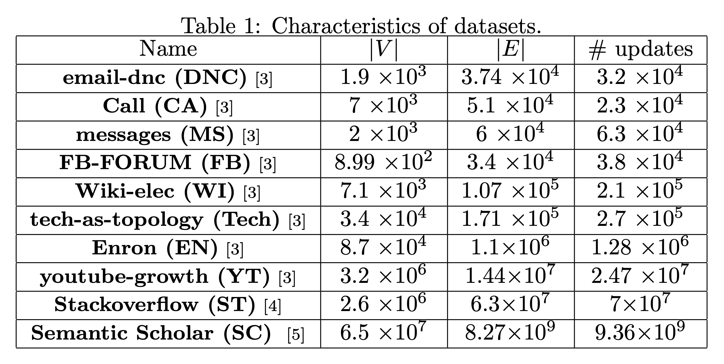
Datasets
[3] Ryan A. Rossi and Nesreen K. Ahmed. 2015. The Network Data Repository with Interactive Graph Analytics and Visualization.
In AAAI. http://networkreposit ory.com
[4] SNAP: Stack Overflow temporal network. http://snap.stanford.edu/data/sx-stackoverflow.html
[5] Waleed Ammar et al. In NAACL. https://www.semanticscholar. org/paper/09e3cf 5704bcb16e6657f6ceed70e93373a54618

Slide 50
Experimental setup
100 uniformly distributed testing points
Queries for all pairs of vertices on small graphs; 50 millions random queries on large graphs

Slide 51
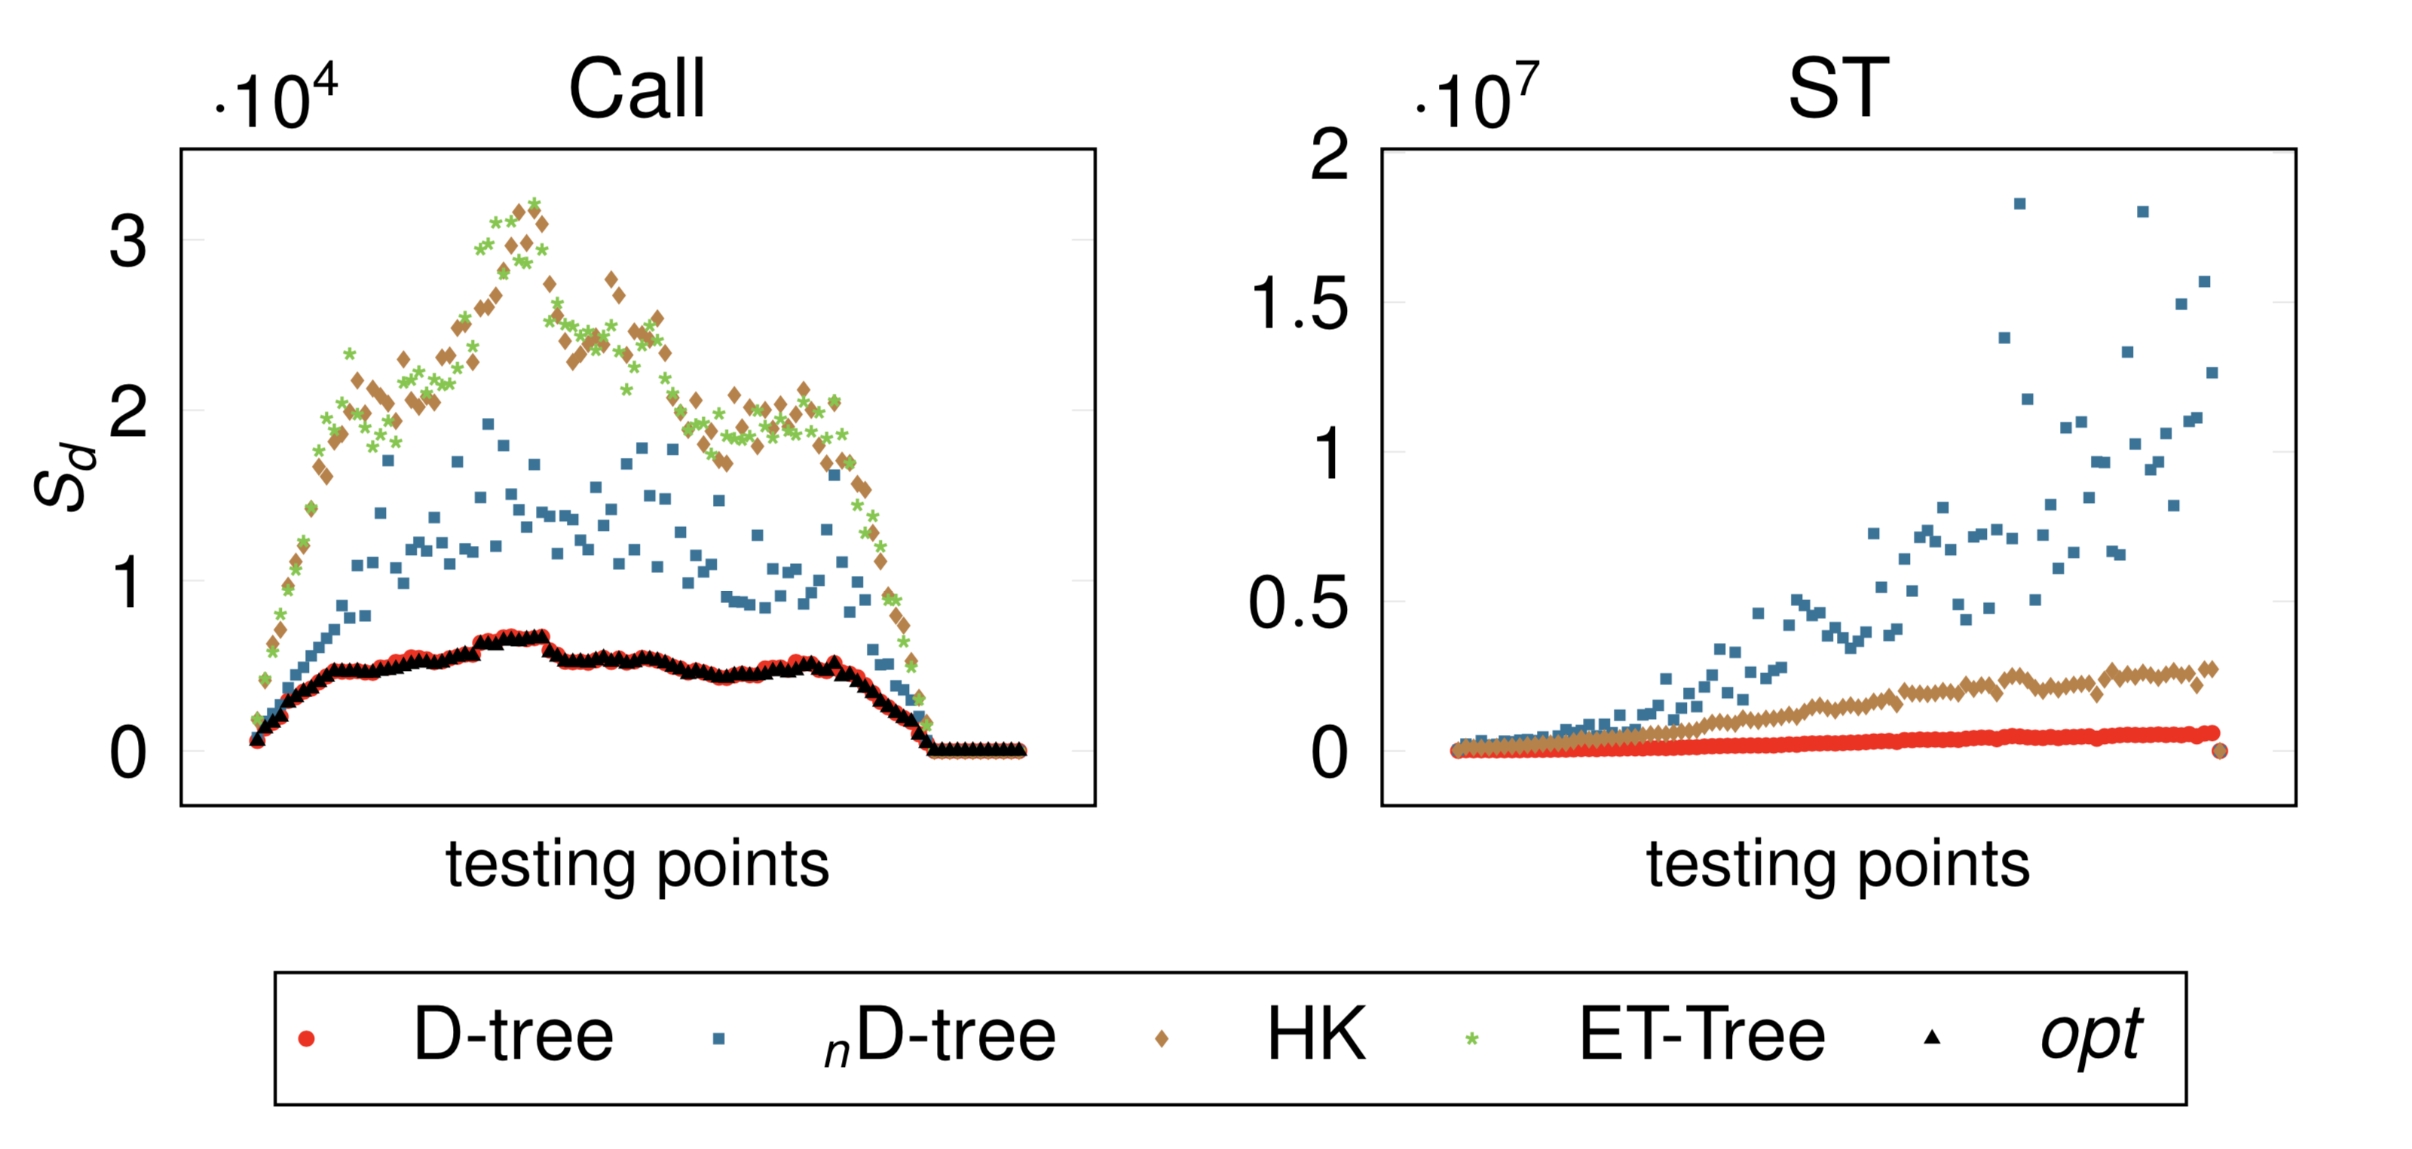

Experimental evaluation (1) : $S_{d}$ in trees
Representatives: Call (phone call) and Stackoverflow (ST)
HK and ET-Tree are algorithms with worst-case guarantees

Slide 52
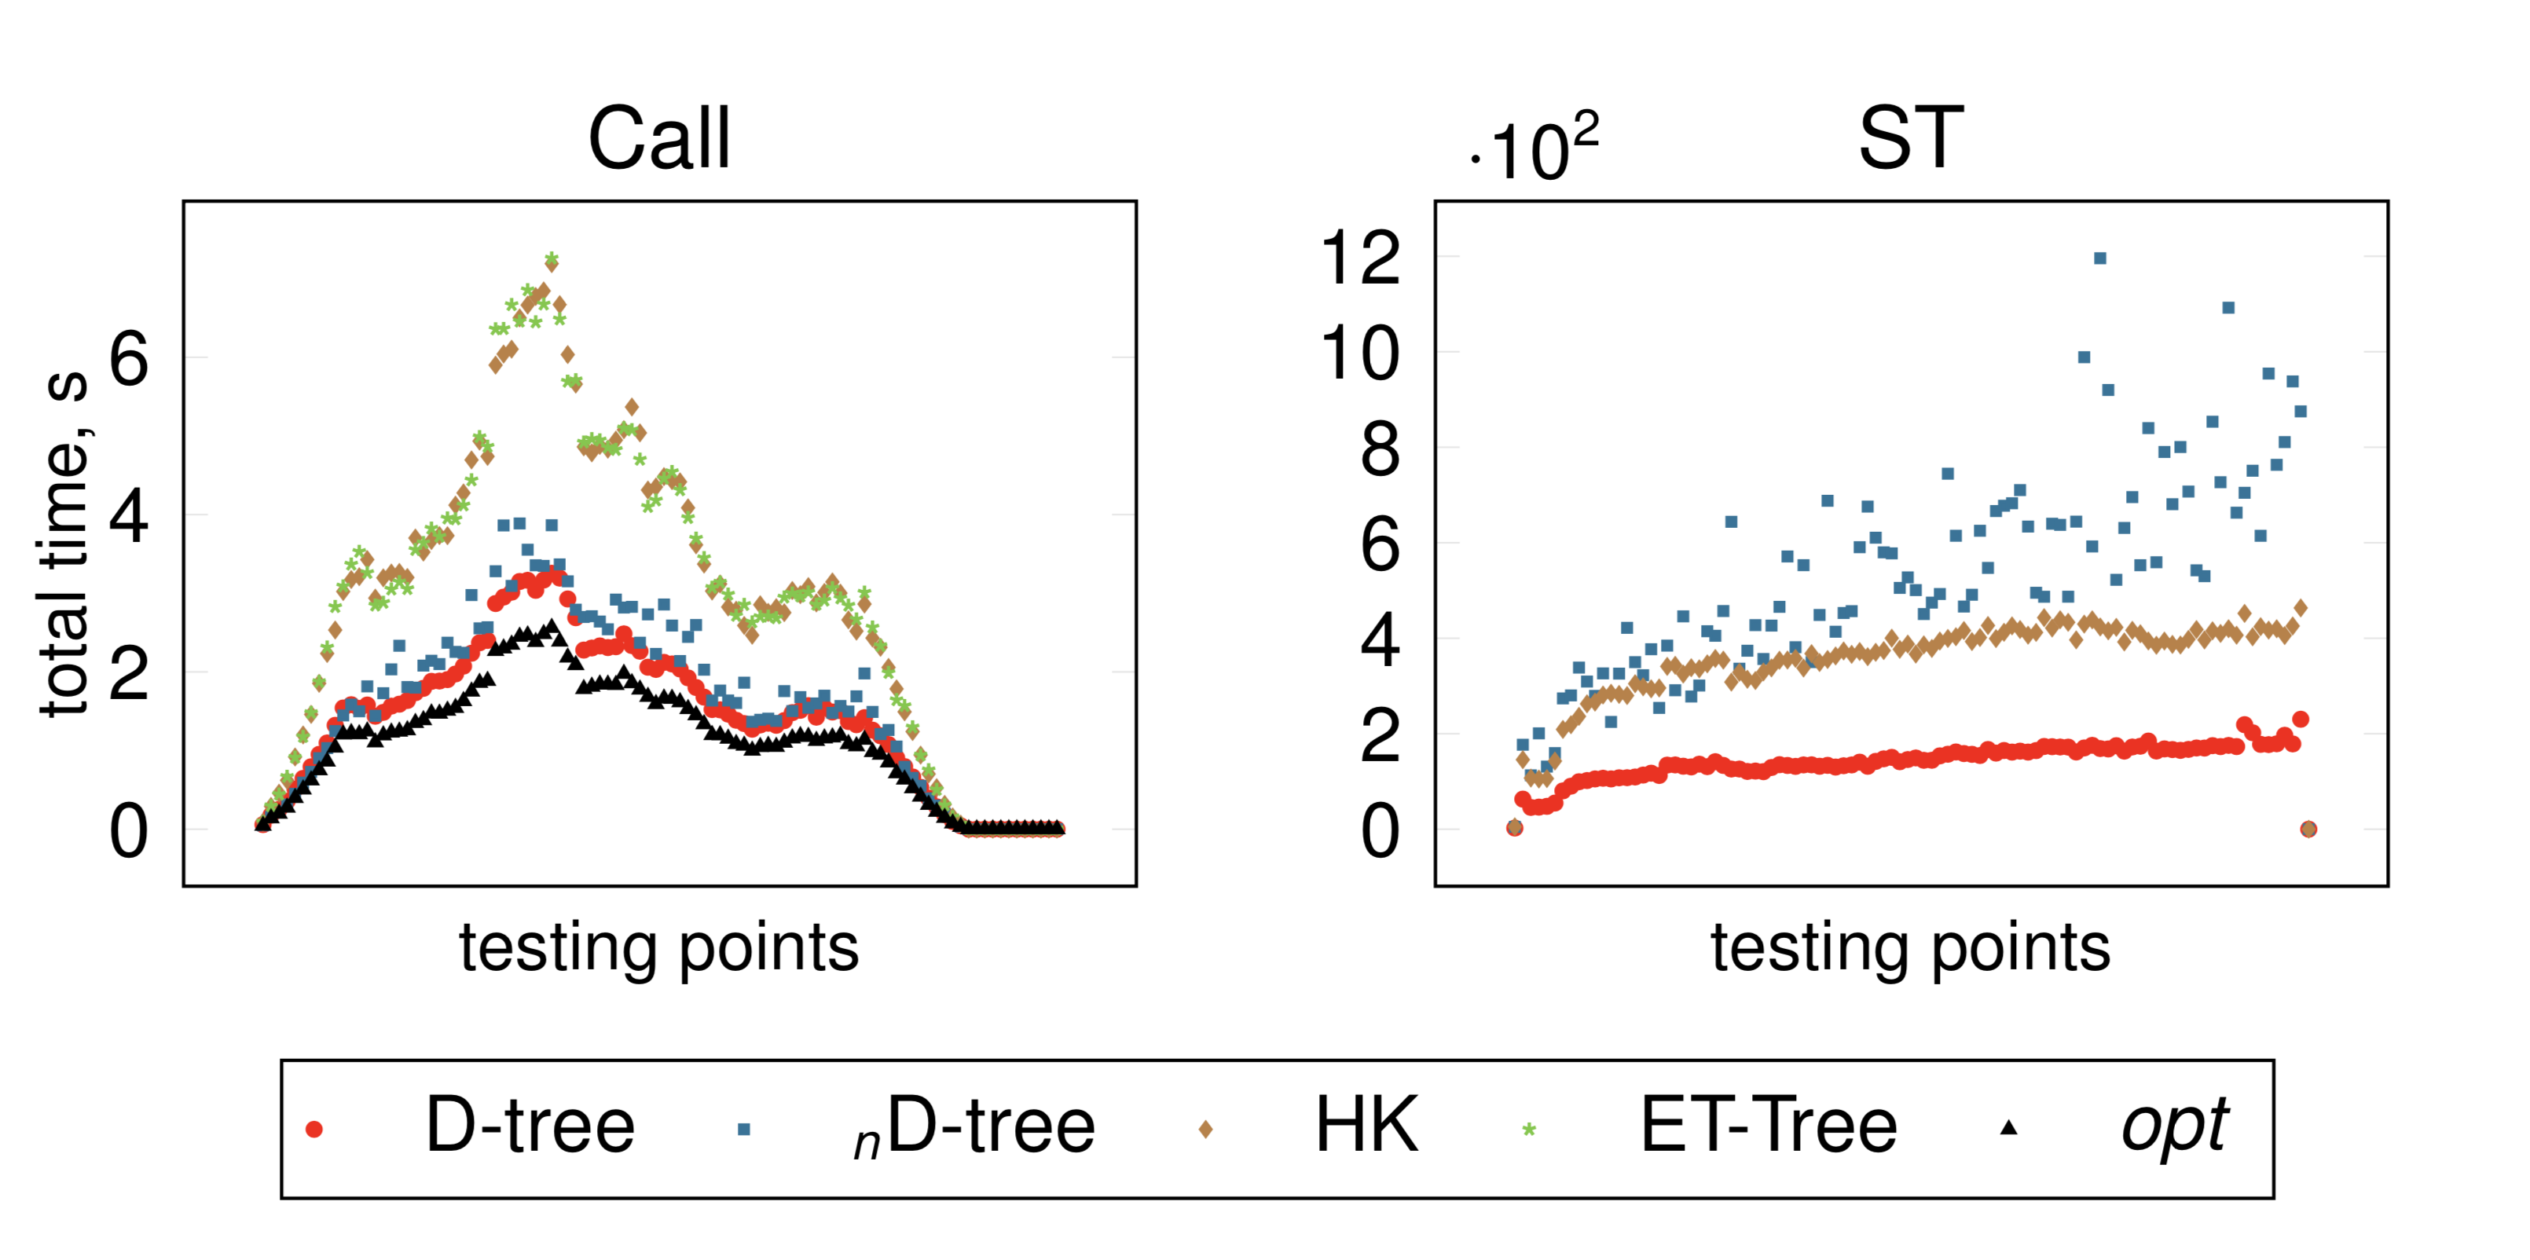
Experimental evaluation (2): Query performance
For small graphs, D-tree is close to opt.
For large graphs, D-tree is the best. ET-tree and opt do not scale to large graphs.

Slide 53
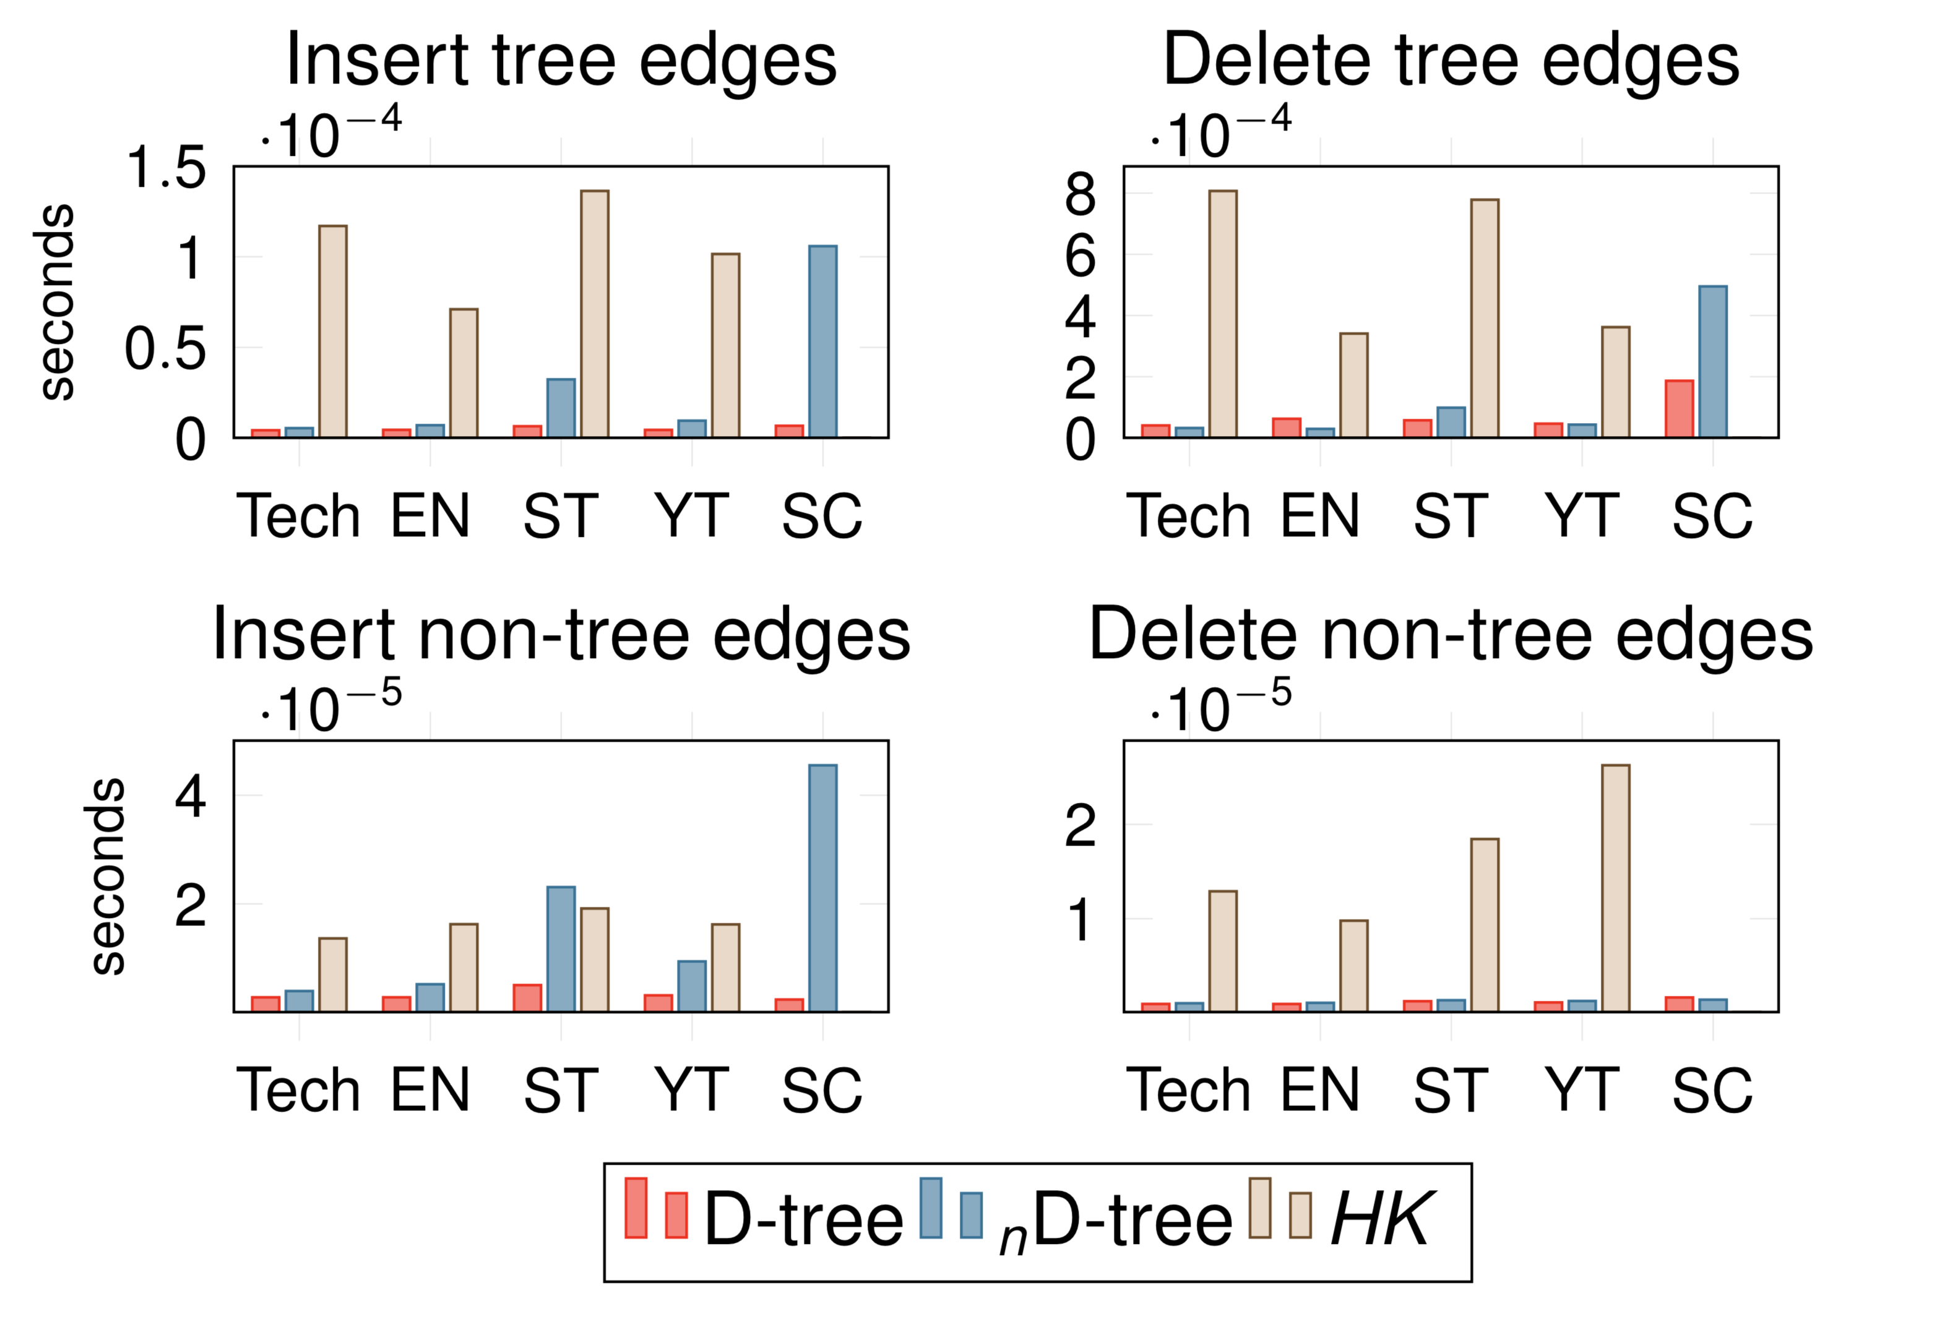
Experimental evaluation (3): Update performance (large graphs)
D-tree is up to 50x faster than HK (our implementation).
On Semantic Scholar (SC) of 8 billion edges, HK does not finish the work-loads in 14 days.

Slide 54
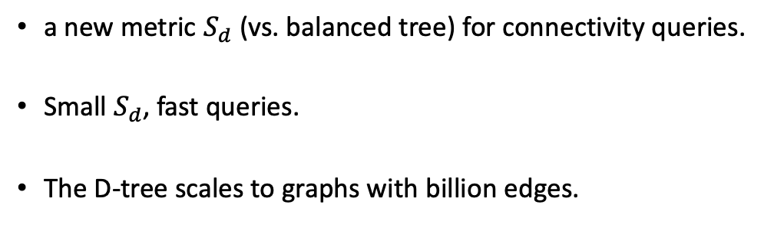
Conclusion
a new metric $S_{d}$ (vs. balanced tree) for connectivity queries.
Small $S_{d}$, fast queries.
The D-tree scales to graphs with billion edges.

Slide 55
Future work (1/2)
Make D-tree workload aware.
Optimizing average costs for connectivity queries on spanning trees is NP-complete.

Slide 56
Future work (2/2)
I plan to apply my research work to analyze source code repositories (Merkle DAGs).
I am open to related applications (Systems).

Slide 57
Q&A

Slide 58
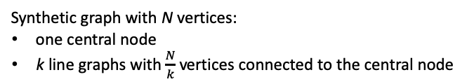
Impact of Average Length of Shortest Path
Synthetic graph with N vertices:
one central node
k line graphs with $\frac{N}{k}$ vertices connected to the central node

