Slide 1


Optimizing Strategies
PART 03
▶
Strategies for Enhancing Battery Performance and Longevity

Slide 2
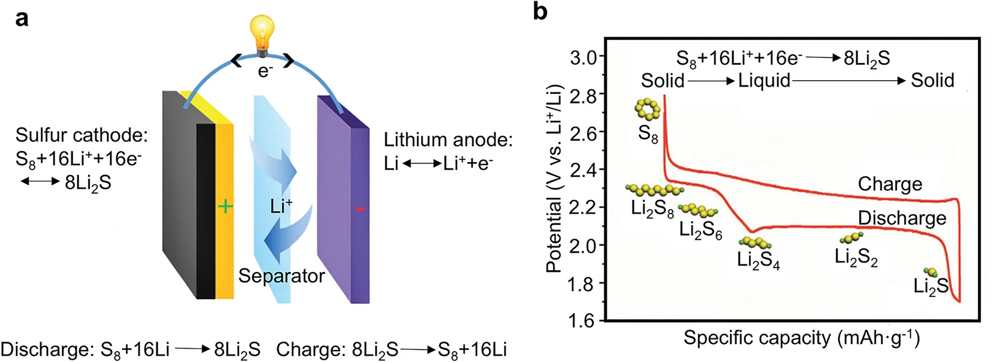
From the Perspective of Electrolyte
Dissolution-precipitation
Pros
Cons
Being operated based on solvation reactions
Novel reaction kinetics
Compatible with large sulfur particles
High E/S ratio is necessary
Serve shutting effect
Hard to achieve high loading sulfur cathode
Safety
Rare Met. 44, 1556–1576 (2025).

Slide 3
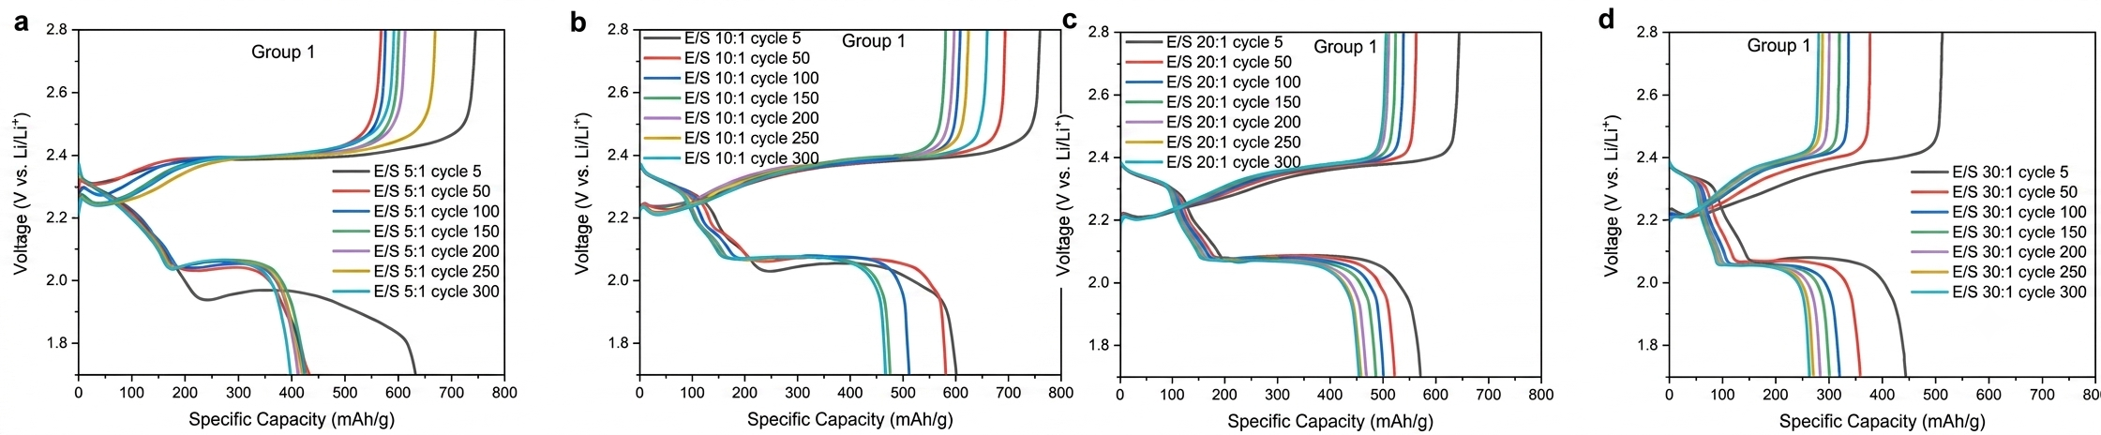
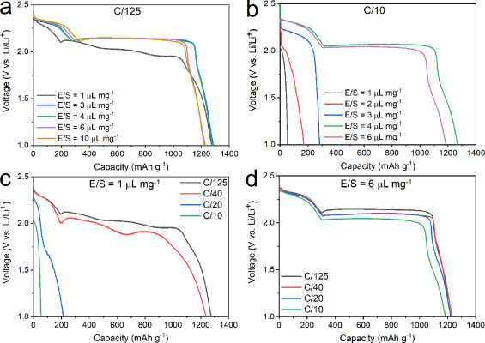
From the Perspective of Electrolyte
Nano Energy, Volume 104, Part B, 2022, 107913
Energy Storage Materials, Volume 38, 2021, 255-261
Low E/S ratio is not suitable because of the sluggish reaction kinetics

Slide 4
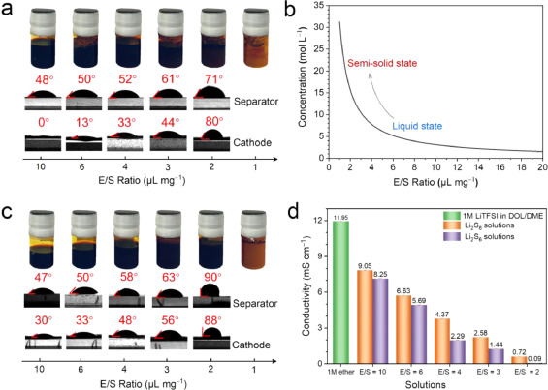
From the Perspective of Electrolyte
With the decrease of the E/S ratio, the contact angles of the solutions with both the separator and sulfur electrode increase continuously
Indicating a progressively deteriorating wettability
Migration ability of Li+ in the ether electrolyte is also reduced
Energy Storage Materials, Volume 38, 2021, 255-261

Slide 5
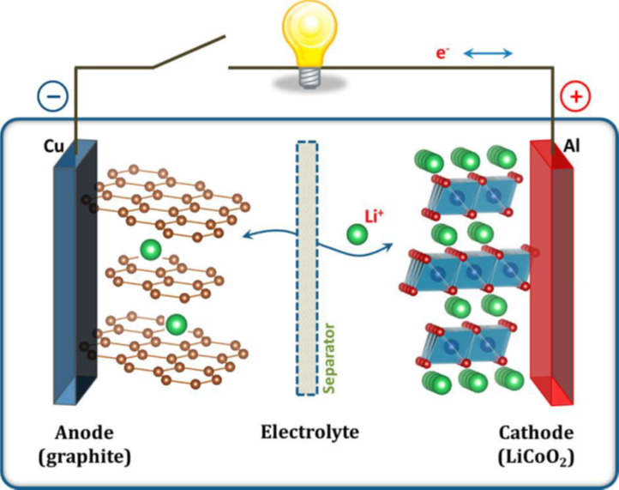
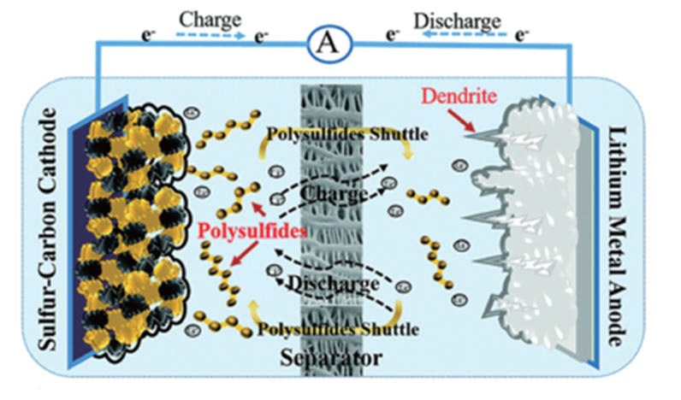


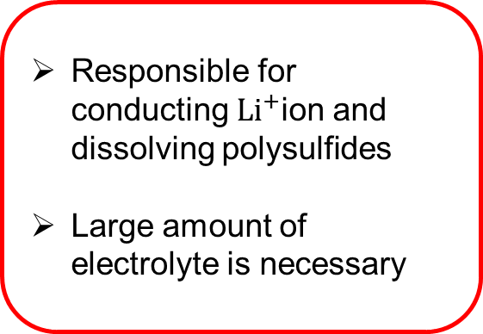
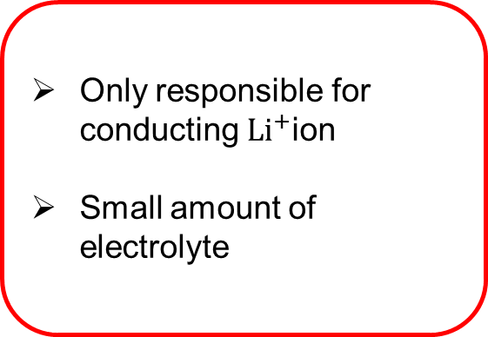
From the Perspective of Electrolyte
Only responsible for conducting ${Li}^{+}$ion
Small amount of electrolyte
What Makes Li-S Batteries distinct from other batteries
Unburden the electrolyte and let it focus on its true purpose
Boteju, T., et al., 2023
Responsible for conducting ${Li}^{+}$ion and dissolving polysulfides
Large amount of electrolyte is necessary

Slide 6
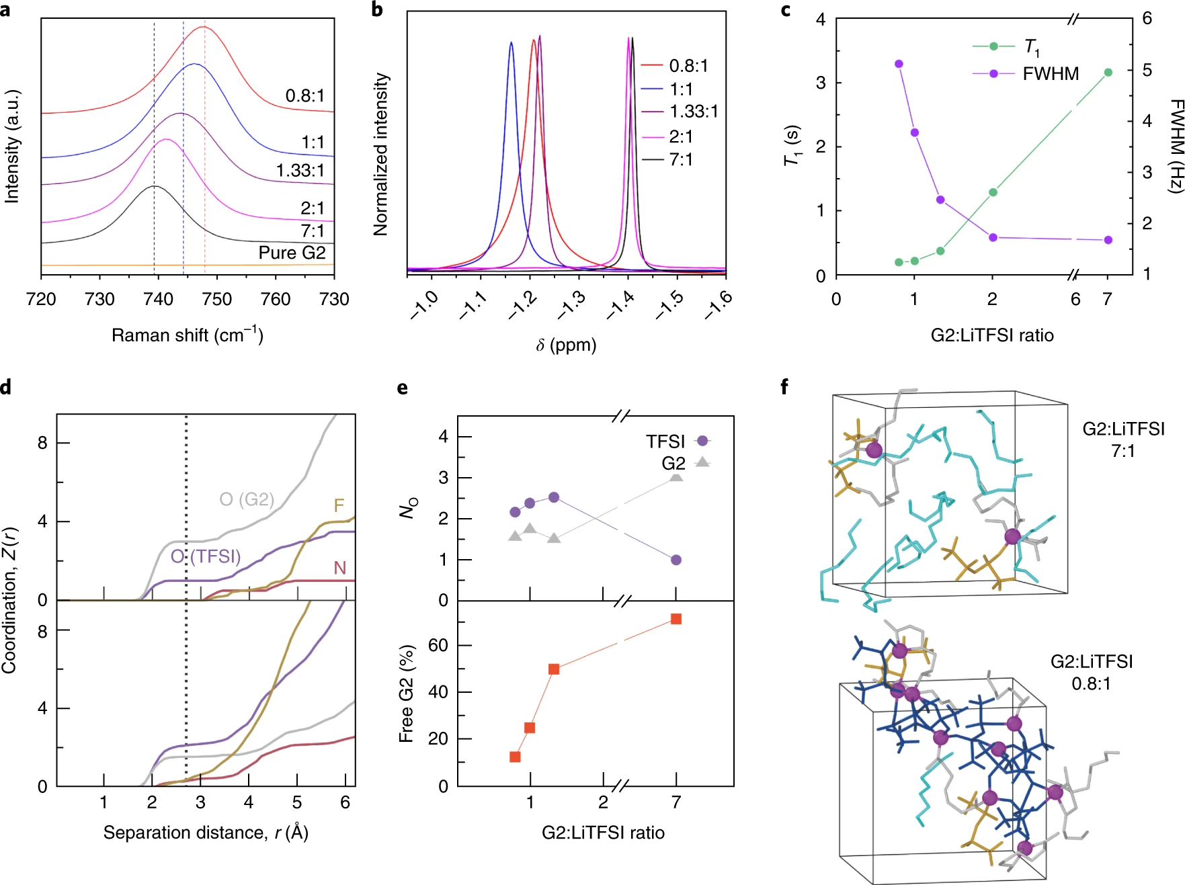

Weakly Solvating Electrolytes
To achieve a low E/S ratio cell, it is important to decouple the electrolyte volume and sulfur speciation pathway.
3D network/Aggregate
The solubility of ${Li}_{2}S_{8 }$
By reducing free solvents, the dissolution of polysulfides is suppressed to realize a quasi-solid-solid reaction.
The sulfur electrochemical reaction is decoupled from the electrolyte volume and effectively inhibits lithium metal side reactions.
Nat Energy 3, 783–791 (2018)

Slide 7
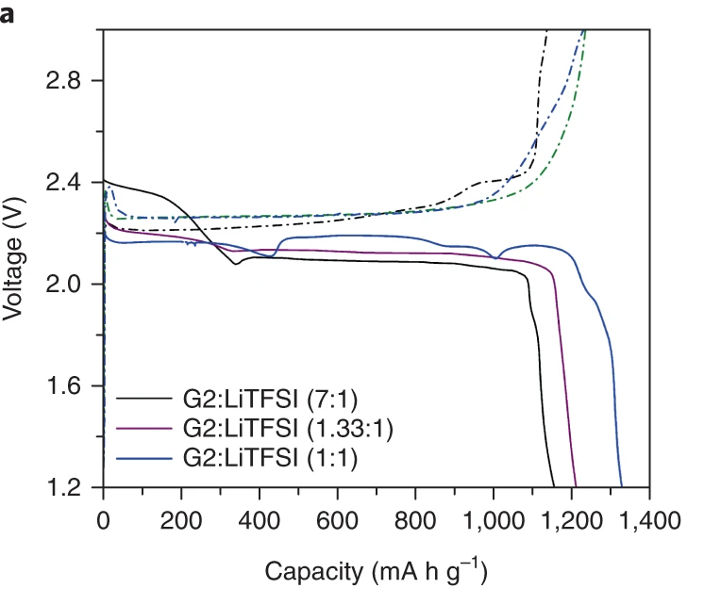
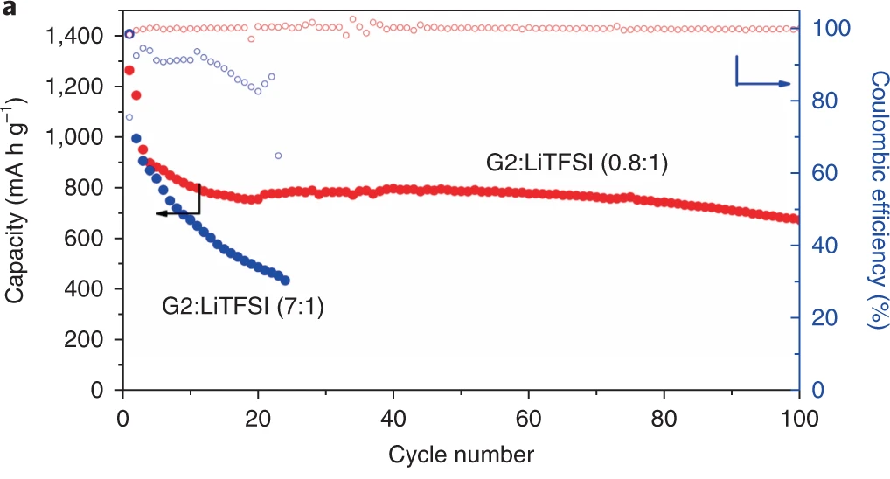
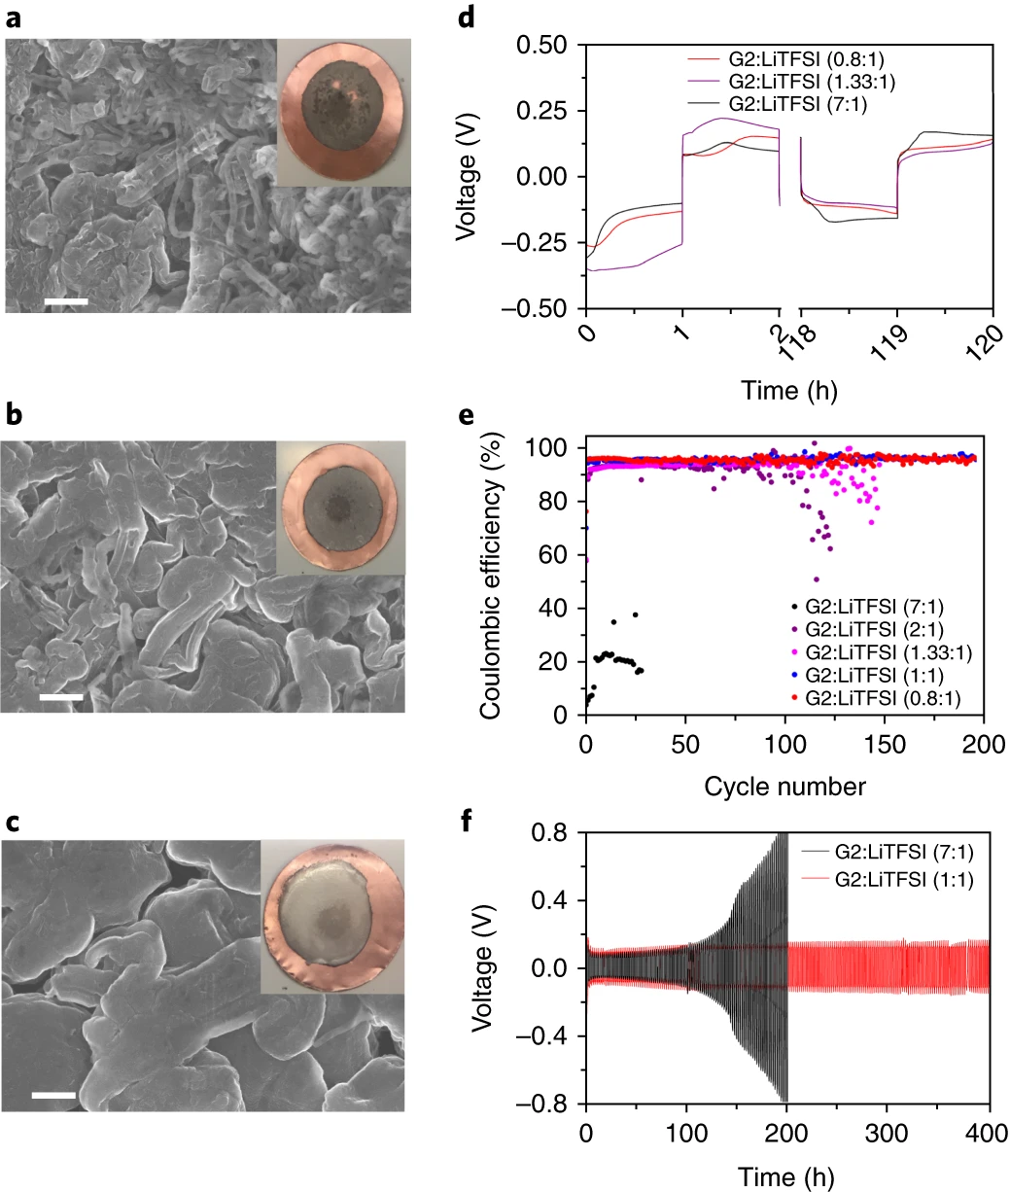
Weakly Solvating Electrolytes
Liquid state reaction is gradually converted to be qusai-solid state reaction when solvent is getting less
System with G2:LiTFSI(0.8:1) can run for 100 cycles with the CE of 100%
The issue of corrosion of lithium anode is eased
Reaction kinetics of qusai-solid state reaction is sluggish, leading to limited rate and cycle performance
Nat Energy 3, 783–791 (2018)

Slide 8
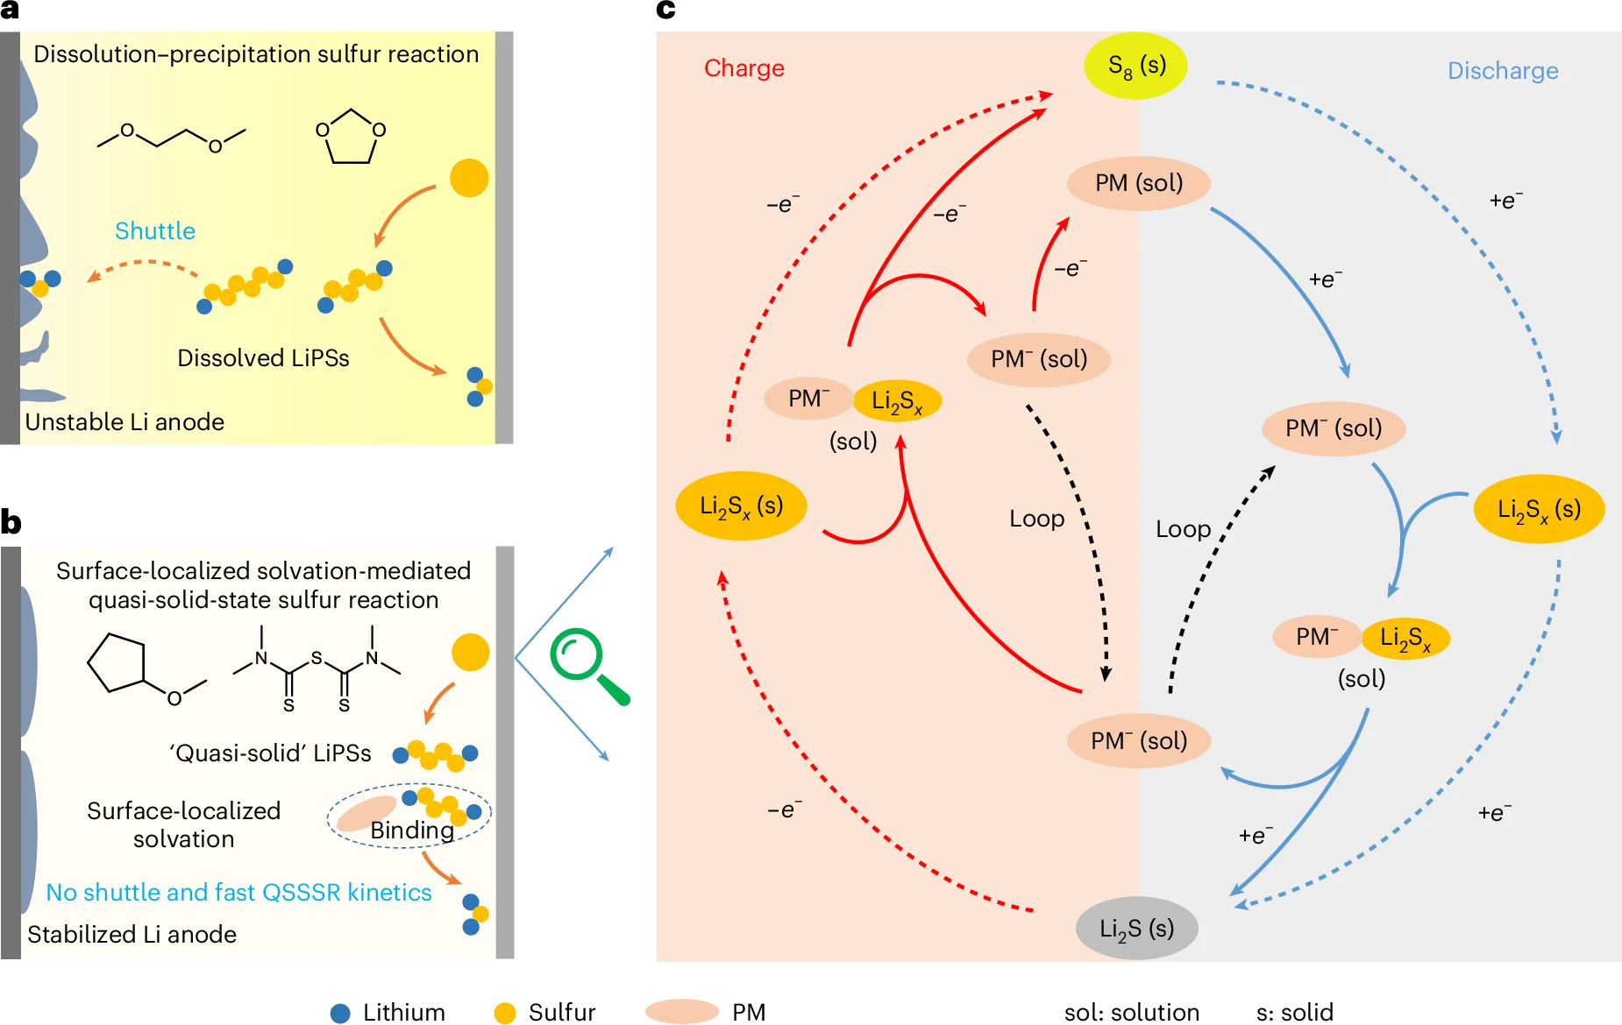
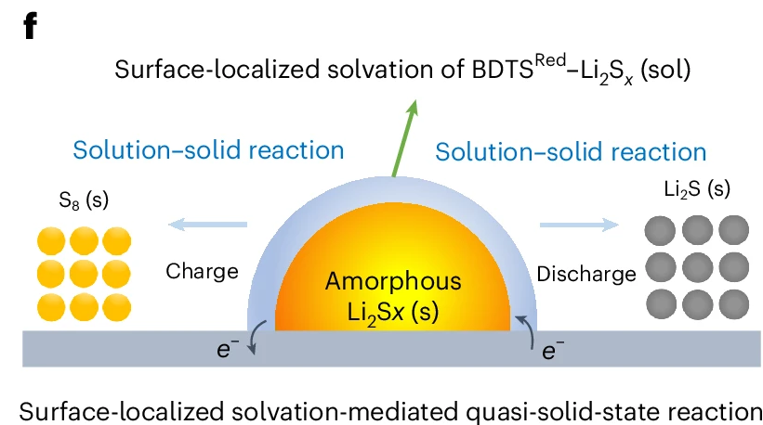
Weakly Solvating Electrolytes + Surface-Localized Liquid Phase
Baseline electrolyte configuration: Employing a sparingly-solvating electrolyte to maintain a minimally dissolving effect on lithium polysulfides
Introducing BDTS as a "phase-regulating mediator" to trigger intermolecular chelation with lithium polysulfides
Inducing slight particle dissolution to form a surface-localized liquid phase, thereby accelerating kinetics and conversion
Nat. Chem. 17, 614–623 (2025)

Slide 9
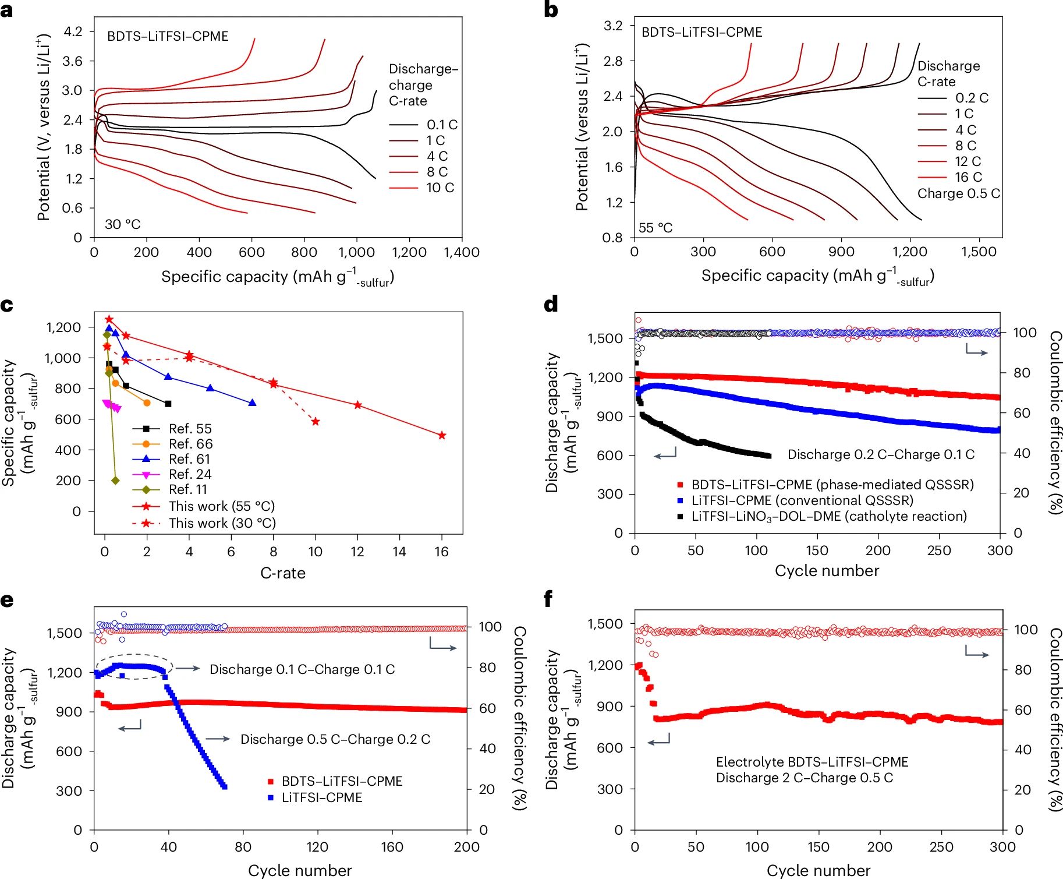
Weakly Solvating Electrolytes + Surface-Localized Liquid Phase
The Li–S cells achieve excellent kinetics showing 494 mA h $g^{−1}$-sulfur capacity at a discharge rate of 16C, and stabilized cycling under lean electrolyte (3–5 μl${ mg}^{−1}$) and high sulfur loading (3–5 mg ${cm}^{−2}$)
Nat. Chem. 17, 614–623 (2025)

