Slide 1
Conquering the Extensional Scalability Problem for Value-Flow Analysis Frameworks
Qingkai Shi, Rongxin Wu†, Gang Fan, Charles Zhang
The Hong Kong University of Science and Technology, China
†Xiamen University, China
July 10th 2020
The 42nd ACM/IEEE International Conference on Software Engineering
Notes:
Thanks very much. It is my great honor to have the opportunity to present my research.
In this talk, I will present our solution to a very important but long neglected problem, the extensional scalability problem.
That is, in face of many many software bugs, how we efficiently check them together.

Slide 2
Outline
Background
Approach
Evaluation
Summary
Notes:
This talk has four parts, the background, approach, evaluation and a brief summary.

Slide 3
A Broad Range of Software Bugs
Notes:
Although many bug detectors have been deployed and we already have many achievements, we still suffer from many many software bugs in our everyday life.
These bugs may be caused by invalid use of memory, such as double free, …
These bugs also include many taint issues, such as …

Slide 4
Value Flow Problems
Value Flow (Data Flow / Data Dependence)
Value Flow Problems
We say the value of a variable x flows to the other variable y if
y = x;
*p = x; q = p; y = *q;
An invalid value flows to some sensitive program statements
p = nullptr;
q = p; *q = 2; // null pointer dereference (CWE-476)
Notes:
We call these software bugs value flow problems
Generally, we say the value of a variable x flows to the variable y if x is assigned to y directly through an assignment or indirectly via some pointer operations.
A value flow problem means that a value improperly flows to some sensitive program statements.
here is example where a null pointer flows to a dereference statement through two variables, p and q, causing a null pointer dereference bug.

Slide 5
Value Flow Analysis
Fast SMT Solving
[Yao, et al, ISSTA 2020]
Build Precise Value-Flow Graph (Data Dependence Graph)
[Qingkai Shi, et al, PLDI 2018]
Checking Multiple Bugs
[Qingkai Shi, et al, ICSE 2020a]
Checking Bugs in Parallel
[Qingkai Shi, et al, ICSE 2020b]
p = nullptr;
q = p;
*q = 2;
p
nullptr
q
*q = 2
Notes:
So, to perform a value flow analysis to detect value flow problems, we need to build precise value-flow graph based on a precise pointer analysis.
this technique is published in PLDI 2018.
With a precise data dep graph or value flow graph, The next step is to search invalid value flows on the ddg, with the help of an SMT solver to solve path conditions and prune infeasible paths
The problem we addressed in this paper is how to efficiently check multiple bugs at the same time.
In the next talk, I will present our technique on how to improve the parallelism over existing parallel designs. We will also present out approach to fast smt solving in ISSTA this year.

Slide 6
The Extensional Scalability Problem
Static analyzer often needs to check many problems at the same time
It will be very time- and memory-consuming
Resource Leak
Taint Analysis
Double Free
Use After Free
Null Pointer Exception
…
Independent Analysis
for
Different Problems
Redundant graph traversals
and
SMT solving
Notes:
In an industrial setting, static analyzers often need to check many problems at the same time, which will be very time and memory consuming because more program states need to explore and there will be more computation redundancy.
The main problem is that the analysis logic of checking different problems are independently between each other, which leads to redundant graph traversals on the DDG and unnecessary invocations of the expensive SMT solver.

Slide 7
Basic Idea
Use the analysis results of a bug type to speed up the analysis of other bug types
Inter-Property-Aware Analysis
Use the mutual synergy to
reduce unnecessary graph traversals and SMT solving
Notes:
Our work is an inter-property-aware analysis, which uses the analysis results of checking one problem to speed up the analysis of other problems.
The basic idea is to utilize the mutual synergy among different value flow problems to reduce unnecessary graph traversals and SMT solving.

Slide 8
Mutual Synergy
and Path Contradiction
Path Overlapping
Memory-leak bugs
heap pointers → free statements
Free-global-pointer bugs
global pointers → free statements
the vertex c cannot reach any free statement
Notes:
We observe that the mutual synergy among different value flow problems are mainly in the forms of path overlapping and path contradiction.
For path overlapping, let us look at the example, where we aim to detect memory leak bugs and free global var bugs on the DDG on the right.
To detect ml, we need to search path from a heap pointer to free statements. To detect fgv bugs, we need to search path from a global variable to free statements.
Assume that we first check the memory leak bug by searching paths from the heap pointer a. during the graph traversal, we record the information that the vertex c cannot reach any free statements.
we use this information to speed up the analysis of the fgv bugs
when checking the fgv bug from the vertex b, we can directly stop at the vertex c, because we know that c cannot reach any free statement.

Slide 9
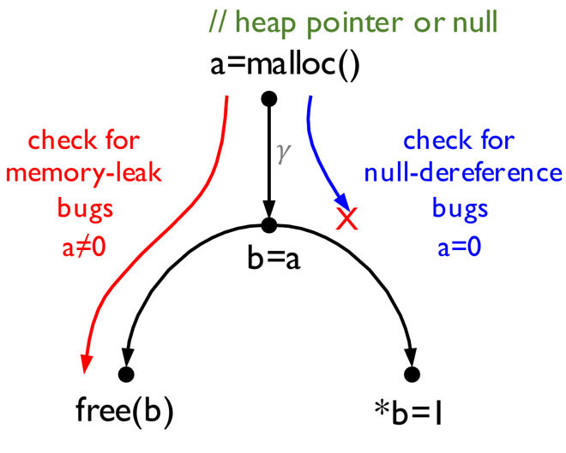
Mutual Synergy
and Path Contradiction
Path Overlapping
Memory-leak bugs
heap pointers → free statements
heap pointer condition: a ≠ 0
Null-dereference bugs
null pointers → dereference statements
null pointer condition: a = 0
𝛾 satisfiable but 𝛾∧a=0 not
=>
𝛾∧a≠0 is satisfiable
Notes:
This is an example of path contradiction, where we attempt to check ML bugs and NPD bugs. For both bugs, we need to search path from the vertex a, because a is the return value of function malloc. The function may return a heap pointer when it succeeds allocating a memory space or a null pointer when it fails.
We use the condition a!=0 to represent the heap pointer, and a=0 to represent the null pointer.
During the path traversal, we need to check whether the path condition conflicts with these bug-specific conditions.
For instance, when traverse the graph for checking the ND bug, at the vertex b, we will use a SMT solver to check whether the path condition gammar conflicts with the null condition;
Assume that the path condition gammar is SAT, but conflicts with the null pointer condition.
According to this information,
when checking ML by searching paths from the vertex a, we can directly determine the path condition gammar does not conflict with the heap pointer condition without invoking the expensive SMT solver.

Slide 10
Workflow
8 rules for
utilizing the mutual synergy
Source Vertices
Sink Vertices
Bug-Specific Conditions
Notes:
This is the work flow of our approach, the input is the specification of value flow problems to check.
Each specification mainly consists of three parts: the source vertices and the sink vertices that determine what kind of value flow paths we need to search on the data dependence graph, as well as the specific conditions each bug type needs to satisfy.
With the specifications, we make optimization plans so that the subsequent graph traversal engine can utilize the mutual synergy for sharing or pruning paths for detecting different value flow problems.

Slide 11


Evaluation
2MLoC
X 12
X 10
2KLoC
Notes:
In the evaluation,
we use 22 programs from the standard Spec benchmark suite and Github. the sizes of the programs range from a few thousand lines of code to 2 million lines of code

Slide 12
Evaluation
Comparing Catapult with existing tools by checking twenty value-flow problems
Notes:
We compare the time and memory cost of our approach, catapult, with three industrial-strength tools. Pinpoint, a value flow analyzer where catapult is built on. Clang and Infer are powered by LLVm and facebook.
due to time limit, we only discuss the results of comparing to pinpoint in this talk

Slide 13
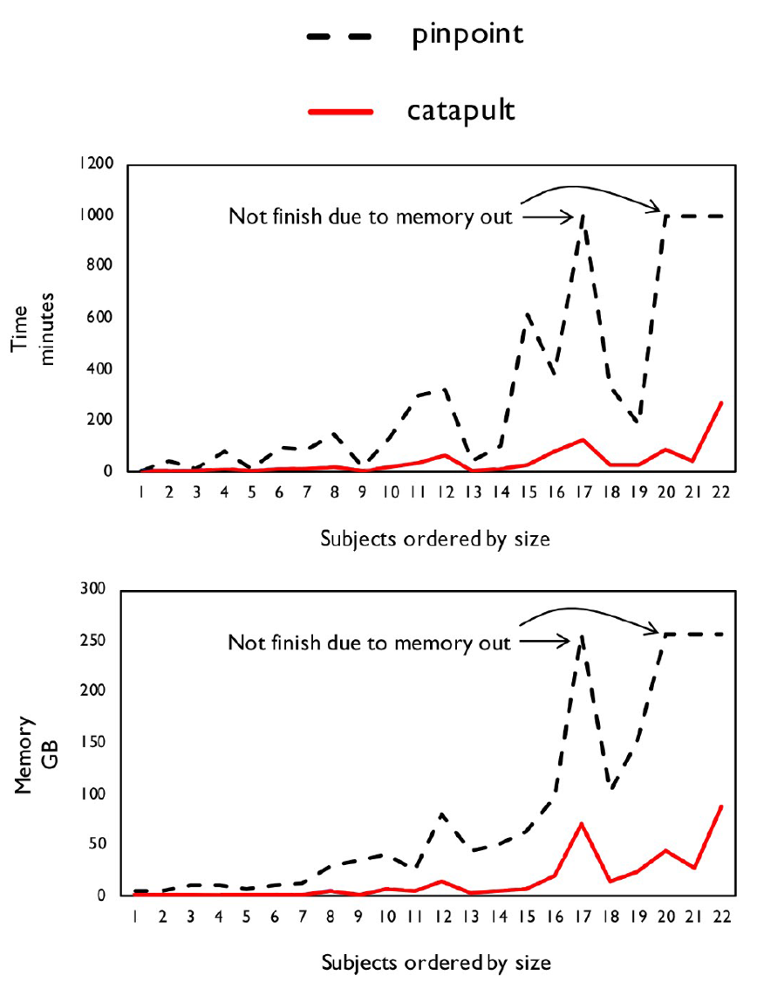
Efficiency: Time and Memory
Time reduction:
8X faster than Pinpoint
Memory reduction
1/7 memory of Pinpoint
Notes:
The figure on the left illustrate the results of comparing our new approach to Pinpoint. The x axis is the benchmark programs ordered by their sizes and the y axis is the time and memory cost. The black lines are the time and memory cost of pinpoint and the red lines are the cost of the new approach.
Compared to Pinpoint, the new approach is 8 times faster but only consumes 1/7 memory. Sometimes Pinpoint exhausts all 200GB of memory and raises an out-of-memory exception. In comparison, the new approach never exhausts the memory.

Slide 14
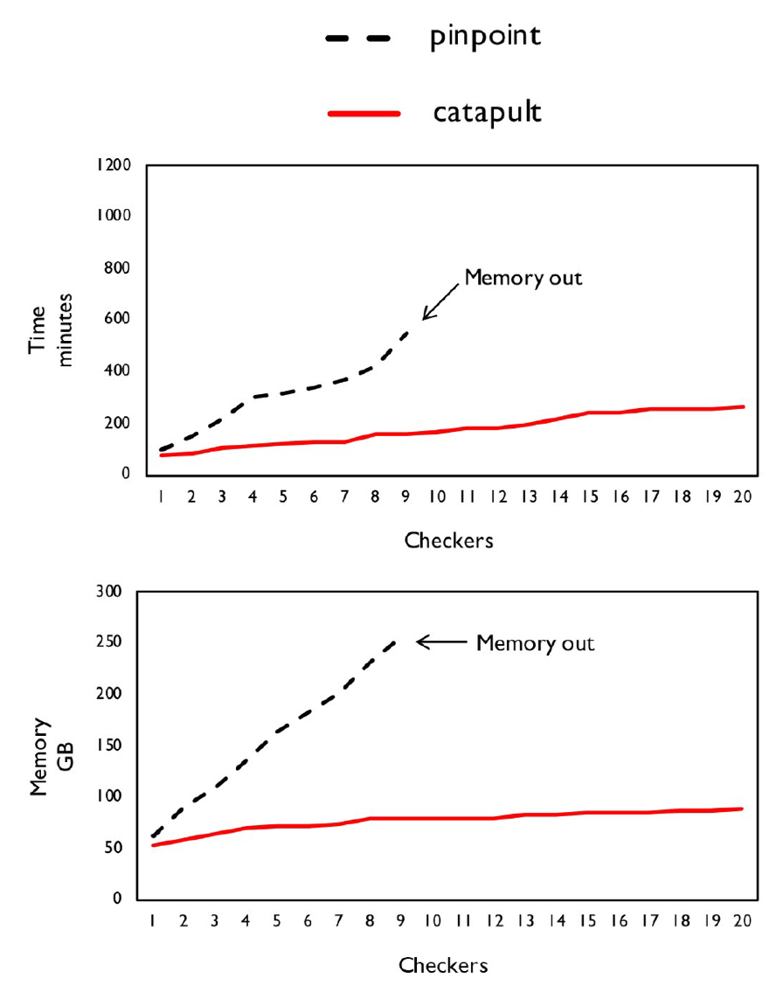
Extensional Scalability
Add the value-flow problem one by one
Time and memory grow much slower
Notes:
We also draw the growing curves of the memory and time cost against the number of value flow problems to check.
We observe that the time and memory cost grow much slower than pinpoint, so, we believe the new approach is more scalable with regard to the number of value flow problems.
30

Slide 15
Summary
Inter-Property-Aware Analysis
Using the Mutual Synergy to Prune and Share Paths
Reduce Unnecessary Graph Traversals and SMT Solving
Notes:
as a brief summary, to address the extensinoal scalability problem,
we propose an inter property aware anaysis that uses mutual synergy among different bug types to accelerate bug finding.

Slide 16
THANKS FOR YOUR TIME! Q&A

Slide 17
Comparing to Clang and Infer
Clang Static Analyzer – Symbolic Execution
Default Version – Clang (default)
Using an imprecise and range-based solver to determine path feasibility
Full Path-Sensitive Version – Clang (Z3)
Using Z3, a precise and full-featured SMT solver to determine path feasibility
Infer – Abstraction Interpretation
Notes:
We also compare catapult to clang static analyzer and infer static analyzer.
clang is based on symbolic execution, its default version uses an imprecise and range-based solver to solve path condition. we also compare to its full-pathsensitive version, where Z3 is used.

Slide 18
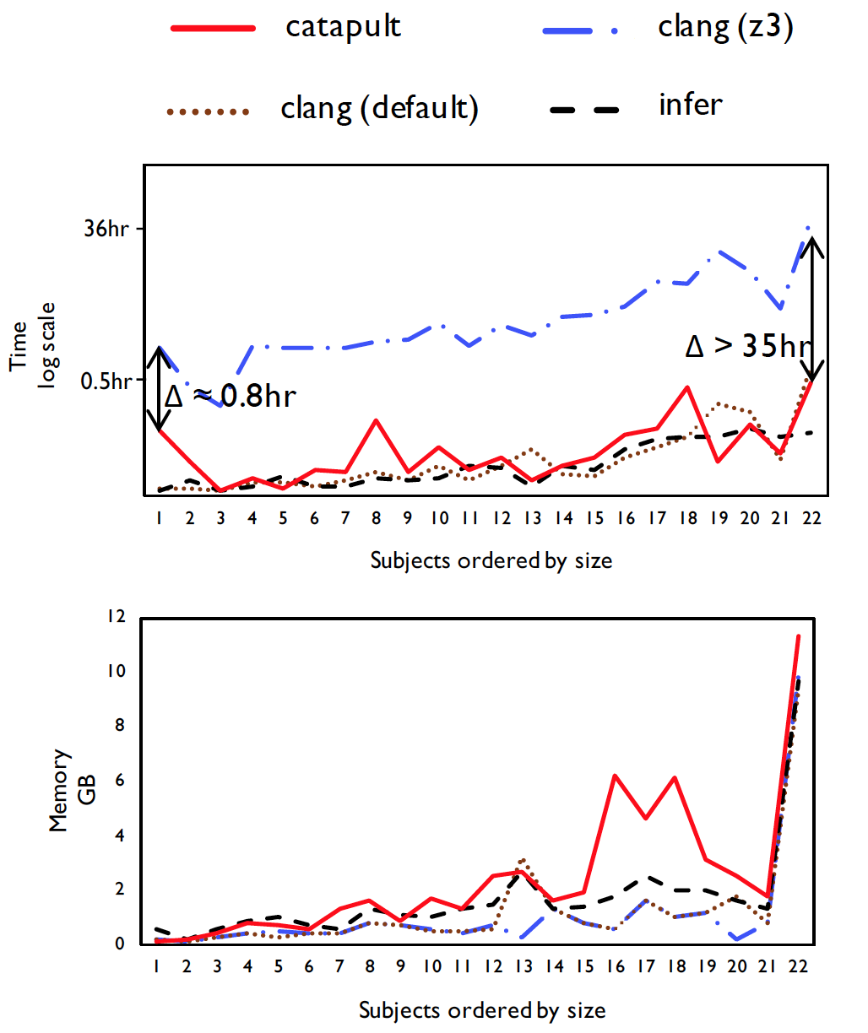
Efficiency: Time and Memory
Much Faster than Clang (Z3)
Similar Time Cost with Clang (default) / Infer
Similar Memory Cost with Clang / Infer
Effectiveness: False Positives
Catapult: 28.6%; Infer/Clang: > 60%
Notes:
We observe that, catapult is much faster than the full path-sensitive version of z3, and has similar time and memory cost with the default clang and infer static anzlyer. With similar time and memory cost, since our approach is full path sensitive, it has much higher precision than the others, reporting less than 30% false positives.

