Slide 1
Pipelining Bottom-up Data Flow Analysis
Qingkai Shi and Charles Zhang
The Hong Kong University of Science and Technology, China
July 10th 2020
The 42nd ACM/IEEE International Conference on Software Engineering
Notes:
In the second talk, I would like to introduce how we parallelize our static bug detector via a pipelining technique. The title of this paper is “pipelining bottom up data flow analysis”.

Slide 2
Outline
Background
Approach
Evaluation
Summary
Notes:
This talk also consists of four parts, the background, approach, evaluation, and a brief summary.

Slide 3

Bottom-up Analysis
Callees are analyzed before callers
Callees’ behaviors are recorded as function summaries
Callers use the summaries to analyze call sites
Easy to parallelize
Functions without calling dependence can be analyzed in parallel
Functions with calling dependence cannot be analyzed in parallel
Saturn
void f() {
…
int * a = g();
*a = 1; //safe?
int * b = h();
*b = 1; //safe?
}
Notes:
In practice, to run in parallel, conventional approaches are often implemented in a bottom up manner.
In a bottom up analysis, callees are analyzed before callers and the analysis results of a callee function are recorded as function summaries, which summarize the function hehavior.
For example, we have three functions where f calls g and h. So we firstly analyze g and h, generating function summaries by recording whether they will return invalid pointers. With these summaries, we then analyze the caller function f to check whether the invalid pointer may be improperly used.
Bottom up analysis is easy to parallelize. This is because functions without calling dep can be analyzed in parallel. so in the example, we can analyze g h at the same time and then analyze f.
31m30

Slide 4
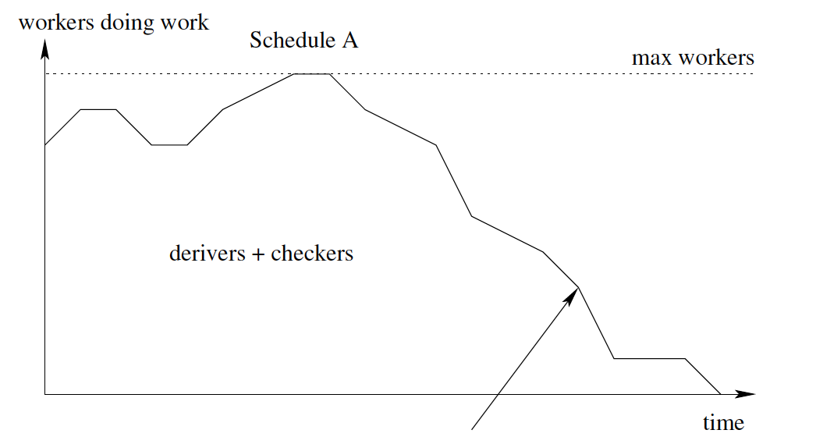
Parallelism is Limited
Any chance to increase the parallelism?
[Scott McPeak et al. FSE 2013]
Notes:
However, as pointed out by recent studies, the parallelism is limited.
As shown by the graph, the x-axis is the running time, and the y-axis is the CPU utilization rate. We can observe that the CPU utilization rate drops off at the second half of the analysis.
This is mainly because the call graph is usually a tree-like graph, the bottom-half of a call graph is usually very sparse and thus has sufficient parallelism. The top half of a call graph is usually very dense. Thus, the parallelism is limited by the calling dependence.
A nature question here is that is there any chance to improve the parallelism so that the analysis can finish earlier.

Slide 5
Basic Idea
Intuition: It is not necessary to start the analysis of a function until we get all the analysis results of its callees.
Basic Idea: Relaxing the calling dependence
The problem to solve: the partition criteria.
Notes:
Intuitively, it is not necessary to start the analysis of a function until we get all the analysis results of its callees.
Thus, our basic idea is to relax the calling dependence between functions. Ideally, we can partition the analysis task into multiple parts, so that they can be pipelined as shown by the graph.
The remaining problem to solve is how to partition the analysis of a function

Slide 6
Function Summaries
Example: tracking value flow of null pointers
Function summaries to generate for foo:
Type I: value flow starting from a parameter, e.g., p
Type II: value flow starting from a nullptr in the current function, e.g., q
Type III: value flow starting from a nullptr returned by a callee, e.g., r
void foo (int* p) {
int* q = nullptr;
…
int* r = bar();
…
}
// nullptr may be from a caller
// nullptr may be from the current function
// nullptr may be from a callee
Notes:
Before introducing the partition method, let us look at what kind of function summaries we need to generate for a value flow analysis.
Here, we use the null pointer analysis as an example.
Given a function, null pointer may come from three places, from a caller function via the function parameter, from the current function, or from callees via the function return value.
According to where a null pointer may come from, we generate three types of function summaries:
Type 1 summary is the value flow from the function parameters
Type 2 summary is the value flow from the null pointer in the current function
type 3 summary is the value flow from a null pointer returned by callee functions.

Slide 7
Function Summaries
bool y = …;
int* foo() {
int* p = bar(null₁);
return p;
}
int* bar(int* a) {
int* b = null₂;
int* c = y ? a : b;
return c;
}
null₁
bar
a
null₂
(type-1) a⤳ret c
(type-2) null₂⤳ret c
b
foo
c
(type-2) null₁⤳a⤳ret c⤳p⤳ret p
(type-3) null₂⤳ret c⤳p⤳ret p
ret c
bar
time
p
ret p
foo
Notes:
Here is an example where function foo calls the function bar. The red part is the DDG of the function bar, and the black part is DDG of the function foo.
Following a conventional bottom-up analysis, we first analyze the callee function, and generate two summaries. the type-1 summary which is the value flow from the function parameter a to the return statement. the type 2 summary, which is the value flow from a null pointer to the return statement
Second, we analyze the function foo, using the function summaries, we generate a type 2 summary, and a type 3 summary. One is the value flow from the null pointer in the current function to ret p and the other is from the null pointer in the callee function to ret p

Slide 8
Partition Criteria
Given a pair of functions: foo calls bar
All the dependences are necessary? No!
foo
Type I: Parameter → Return
foo
Type II: null in current func → Return
foo
Type III: null from callee → Return
bar
Type I: Parameter → Return
bar
Type II: null in current func → Return
bar
Type III: null from callee → Return
Notes:
In our approach, we partition the analysis task of a function into three parts, each part generates a type of function summaries.
Given a pair of functions where foo calls bar, a conventional approach conservatively assume that all the analysis tasks in the caller function depend on all analysis tasks of the callee function.
So, we need to finish all tasks in the callees and then start to analyze the callers.

Slide 9
Dependence Analysis
Given a pair of functions: foo calls bar
All the dependences are necessary? No!
foo
Type I: Parameter → Return
foo
Type II: null in current func → Return
foo
Type III: null from callee → Return
bar
Type I: Parameter → Return
bar
Type II: null in current func → Return
bar
Type III: null from callee → Return
Notes:
However, we observe that not all such deps are necessary, as the red dependence relations actually can be removed.
Thus, we have opportunities to improve the parallelism.
35min

Slide 10
Dependence Analysis
Given a pair of functions: foo calls bar
All the dependences are necessary? No!
foo
Type I: Parameter → Return
foo
Type II: null in current func → Return
foo
Type III: null from callee → Return
bar
Type I: Parameter → Return
bar
Type II: null in current func → Return
bar
Type III: null from callee → Return
Notes:
Let us look at the example.
We can observe that the type2 summary of foo depends on the summary of bar.
That is, the blue path in the figure goes through the yellow path from the function bar.
So the black dep is necessary.

Slide 11
Dependence Analysis
Given a pair of functions: foo calls bar
All the dependences are necessary? No!
foo
Type I: Parameter → Return
foo
Type II: null in current func → Return
foo
Type III: null from callee → Return
bar
Type I: Parameter → Return
bar
Type II: null in current func → Return
bar
Type III: null from callee → Return
Notes:
The blue path does not go through the type2 summary, the yellow path, of the function bar
so the red dep is not necessary and can be removed.

Slide 12
Pipeline Scheduling
Given a pair of functions: foo calls bar
foo
Type I
foo
Type II
foo
Type III
bar
Type I
bar
Type II
bar
Type III
Timeline
Notes:
After removing the red deps, we can schedule them in a pipeline manner
after generating the type 1 summary of bar, we can generate the type 1 and type2 summary of foo.
finally, we can generate the type 3 summary of foo after generating all summaries of bar

Slide 13
Function Summaries
bar
a⤳ret c
null₂⤳ret c
X
foo
bool y = …;
int* foo() {
int* p = bar(null₁);
return p;
}
int* bar(int* a) {
int* b = null₂;
int* c = y ? a : b;
return c;
}
null₁⤳a⤳ret c⤳p⤳ret p
null₂⤳ret c⤳p⤳ret p
time
a⤳ret c
null₂⤳ret c
√
null₁⤳a⤳ret c⤳p⤳ret p
null₂⤳ret c ⤳p⤳ret p
time
Notes:
Thus, for this example, our approach does not need to wait the analysis of bar to start the analysis of foo.

Slide 14
A Pipeline Parallel Strategy
We formalize the idea in IFDS/IDE framework for a wide range of problems
they can be reduced to a graph reachability problem
like our value flow analysis
Alias Sets
Problem
Secure
Information Flow
Type State
Analysis
Shape
Analysis
Specification
Inference
Notes:
In the paper, we formalize the pipeline idea in the IFDS/IDE framework for a wide range of problems, such as the alias sets problem, the problem of securing information flow and so on.
These problems have a common feature that, they can be reduced to graph reachability problems, just like our value flow analysis.
36m30in

Slide 15


Evaluation
Standard benchmarks and real-world projects
Comparing with the conventional parallel design
CPU utilization rate
Speedup
X 12
X 10 up to 2MLoC
v.s.
Notes:
As for evaluation, we use similar benchmark programs as before
and compare the pipeline method to the conventional parallel design in terms of cpu utilization rate and the speedup.

Slide 16
CPU Utilization Rate
Notes:
These figures show the cpu utilization rate for analyzing some of our benchmark programs.
The red curves are the cpu utilization rate of our pipeline approach. The blue ones are that of the conventional approach.
It is clear that our approach has higher cpu utilization rate than the conventional one and thus can finish the analysis earlier.

Slide 17
Speedup
2×-3× faster is non-trivial
12 hours → 4 – 6 hours
impractical → practical
Notes:
This figure shows the speedup against the number of threads. Different lines represent the speedup of different benchmark programs
With more threads, the benefits of our approach is more apparent, leading to 2 times to 3 times speedup. Such a speedup is not trivial, in practice, it is enough to make an originally impractical analysis practical.
For instance, originally an analysis may need 12 hours, with our approach, it may only need 4 hours to finish. This means that originally, the analysis cannot finish in a nightly building, but it can finish after adopting our approach.

Slide 18
Factors Affecting the Results
Num of Threads
Sparsity of the Call Graph
More Threads, More Effective; More Dense, More Effective!
Notes:
For the pipeline approach, there are two factors that may affect its performance.
First, we have shown that with more threads , our approach is more effective. If we only have one thread available, neither of our approach and the conventional parallel design can perform parallel analysis. So they will have similar performance.
Second, the effectiveness of our approach is also affected by the sparsity of the call graph. Recall that our pipeline approach relax calling dependence to improve the parallelism. So if a call graph is very sparse and has little call dependence, then the benefits of our approach will not that apparent.

Slide 19
Summary
Relaxing Calling Dependence to
Improve the Parallelism of Bottom-up Data Flow Analysis
Parallelizing/Pipelining Your Data Flow Analysis to
Take Advantage of Multiple Cores
Notes:
As a brief summary, our approach relaxes the calling dependence to improve the parallelism of bottom-up data flow analysis.
So, to take advantage multi cores, let us pipeline not simply parallelize your data flow analysis

Slide 20
THANKS FOR YOUR TIME! Q&A
Notes:
Thanks very much!

