Slide 1
Meeting Progress Guiding KO Differentiation Qing

Slide 2
Guiding the auto-pilot
A minimal, targeted way to make kidney-organoid differentiation more consistent
WHERE WE ARE
Stage 1 · Mesoderm induction
8 µM CHIR · 4 days
Stage 2 · Nephron specification
5% KOSR · 12 days
Only CHIR + KOSR — no other cues are added. The cells differentiate on their own (“auto-pilot”).
THE PROBLEM
Differentiation fails unpredictably — sometimes early (pluripotency exit, iPSC stage), sometimes later (kidney-lineage specification).
OUR APPROACH
Goal
Improve differentiation consistency without redesigning the protocol — make minimal, surgical changes only.
Principle
Add targeted cues at the critical decision windows to steer the auto-pilot — staying aligned with the current differentiation schematic.

Slide 3
Microdissection: a rapid test-and-readout loop
Test a change in a minimal window; keep only what moves the phenotype fast.
STEP 1 — DEFINE THE CRITICAL EVENT WINDOWS
Pluripotency exit · D0–D2
Tubular formation · D8–D10
Stage 1 · CHIR · 4 d
Stage 2 · KOSR · 12 d
D0
D2
D4
D8
D10
D16
STEP 2 — TEST ONE CHANGE PER WINDOW, READ OUT FAST
Add ONE cue
in a chosen window
Read out in 2 days
targeted phenotype only
Phenotype moved?
decision point
YES → carry forward to the full 16-day run + confirm at Day 14 endpoint QC
NO → drop it fast

Slide 4
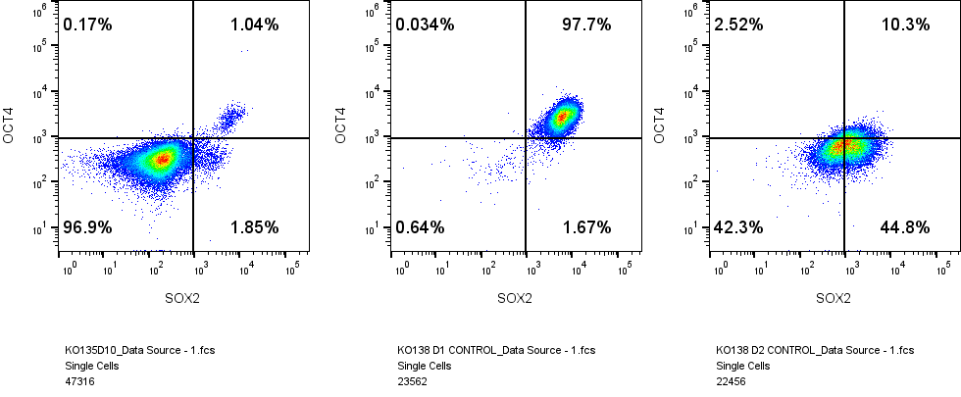
Pluripotency exit happens by Day 2 — our first target window
Day 10
(Neg control)
Day 1
Day 2
OCT4+/SOX2+ double-positive: ~98% (D1) → ~45% (D2) → ~1% (D10) · decision window: D0–D2

Slide 5


Chemical screen assay platform (3–4 day turnaround)
Day 0
Seed
Day 1
Chemical Treatment without media change
Day 2
Readout qPCR/FACS
Option 1
Seed once, treat in place
Seed 40k / well
96 U-bottom
Forced aggregate
forms by D1
Add 10 µl chemical
in situ
Harvest D2
Option 2
Re-aliquot at D1
Bulk seed
in 6-well
Collect and aliquot 200ul aggregates
Add 10 µl chemical
in situ
Harvest D2
Screen for chemicals and concentrations that accelerate downregulation of SOX2 and OCT4
Candidate cues: JNK inhibitor family, FGF2, Activin A, BMP4, Activin A / BMP4 combo, matrix

Slide 6
Plate layout: 4 cues + control per 96-well plate
DOSING SCHEME
1
2
3
4
5
6
7
8
9
10
11
12
6 concentrations × 3 replicate wells per cue
A
Small molecules (µM)
B
1 · 2 · 4 · 8 · 10 · 20
C
Proteins (ng/mL)
1 · 5 · 10 · 20 · 50 · 100
D
LEGEND
E
Chemical 1
F
Chemical 2
Chemical 3
G
Chemical 4
H
DMSO / vehicle control
Each 6-column block = one cue across 6 concentrations (low → high). The 3 rows in each block = replicates.

Slide 7
rEAD OUT-Qpcr OR facs
qPCR: wash pellets-freeze down plate -outsource for qPCR for OCT4/SOX/2 and other genes of interests
FACS: wash pellets-accmax 15 mins - combine 3 replicated of digest cells into one group- fix 30 mins -OCT4/SOX2 IC stains 30 mins- Flow
Phenotype to look for:
Faster down regulation of OCT4 by FACS
Faster down-regulation of SOX2 by FACS
Characterization of T, EOMES, MIXL1 and other pan-mesoderm early markers (KDR, PDGFR) in qPCR assays

Slide 8
Redefine the roadmap of the CURRENT STAGE 1-2 protocol

Slide 9
Defining the Stage 1–2 window: a PS → ME → IM → CM marker map
Map our CHIR→KOSR auto-pilot onto the staged kidney lineage, then place minimal cues at the right window.
Ref · Lam et al., J Am Soc Nephrol 2014
❶ + FGF2 + RA ↓
❷ + FGF9 + Activin ↓
OUR
PROTOCOL
Stage 1 · CHIR 8 µM
Stage 2 · 5% KOSR (auto-pilot)
Lam et al.
LINEAGE
PS / ME
IM
CM
Differentiated · readout
D0
D2
D4
D6
D8
D10
D12
D14
D16
Day windows are approximate — to be anchored empirically in our hands (see proposed time-course).
❶ PS / ME
Mesendoderm · ≈ D0–D2
Markers BRACHYURY(T) · MIXL1 · EOMES; OCT4/SOX2 ↓
Cue CHIR — already in protocol
❷ IM
Intermediate mesoderm · ≈ D2–D5
Markers PAX2 · LHX1 · OSR1 · PAX8
Add (new) FGF2 100 ng/mL + RA 1 µM
❸ CM
Cap mesenchyme · ≈ D5–D9
Markers SIX2 · SALL1 · WT1
Add (opt.) FGF9 100 + Activin 10 ng/mL
❹ Differentiated
Readout · D9–D16
iPODO CD249 / CD49c 50–60% @D16
iPTEC LTL⁺ ~10% — lift this
PROPOSED — DEFINE THE WINDOW, THEN ADD ONE CUE
① Anchor the windows. Time-course qPCR/FACS across D0–D6 to pinpoint the ME peak (T/MIXL1/EOMES) and IM onset (PAX2/LHX1) in our line — fixes when each window opens.
② Add one minimal cue. A short FGF2 + RA pulse in the IM window, CHIR→KOSR backbone unchanged — expect more PAX2⁺LHX1⁺ IM and a higher LTL⁺ iPTEC fraction.
③ Tune the nephron pool (opt.). FGF9 + Activin to expand SIX2⁺ cap-mesenchyme progenitors and rebalance iPODO vs iPTEC output.
Lam AQ, Freedman BS, Morizane R, Lerou PH, Valerius MT, Bonventre JV. Rapid and Efficient Differentiation of Human Pluripotent Stem Cells into Intermediate Mesoderm That Forms Tubules Expressing Kidney Proximal Tubular Markers. J Am Soc Nephrol 25:1211–1225, 2014. doi:10.1681/ASN.2013080831. Stages/markers/doses per Fig 1–5 & Methods.

Slide 10
Kidney lineage, end to end: PSC → ME → IM → MM → iPODO / iPTEC
Our two readout cell types trace back through the same developmental stages.
Spine = developmental lineage (Lam et al., JASN 2014); labels above each arrow are the inducing cues. Right = differentiated readouts in our protocol.
iPODO
induced podocyte
CD249 · CD49c
≈ 50–60% @ D16
+ CHIR
+ FGF2 + RA
+ FGF9 + Activin
PSC
ME
IM
MM
nephron differentiation
iPTEC
induced proximal tubule
LTL⁺
≈ 10% @ D16
Pluripotent stem cell
OCT4 · NANOG · SOX2
Mesendoderm
BRACHYURY · MIXL1 · EOMES
Intermediate mesoderm
PAX2 · LHX1 · OSR1 · PAX8
Cap mesenchyme
SIX2 · SALL1 · WT1
Stage 1 · CHIR 8 µM · D0–D4
Stage 2 · 5% KOSR · D4–D16 (auto-pilot — no extra cues)
Stages & markers after Lam AQ et al., Rapid and Efficient Differentiation of hPSCs into Intermediate Mesoderm that Forms Tubules Expressing Kidney Proximal Tubular Markers. J Am Soc Nephrol 25:1211–1225, 2014.

