Slide 1
Have an Elevated View for Future
How our data insights help you succeed

Slide 2
Introduction
QADG Consulting is an advanced analytics consulting company that uses data science techniques to help businesses find opportunities for growth. Currently, we are focused on foot traffic trends in New York City to identify emerging residential or commercial areas for Fitness and Health Club industry and Food Service industry.
Partners:
1. Qingling Ni - COO
2. Alexander Hughes - CMO
3. Doug Goldberg – CEO/CFO
4. Guo Lee – Chief Data Scientist

Slide 3
Executive Summary
Based on our research, location is one of the most important factors in the success of Fitness and Health Club business, and the growing Food Truck industry
Our analysis showed Long Island City neighborhood in Queens (commercial and residential), West Midwood neighborhood of Brooklyn between the H and J subway lines (residential), and Queens between the 111 St and 103-Corona St subway lines (residential) enjoyed average 25-30% of foot traffic increase over the last 2 years
We recommend Athletic Gym of NYC consider all 3 neighborhoods, especially West Midwood and Long Island City due to the demographic favorability. The estimated annual revenue increase by adding one gym for AG NYC is estimated at $400,000 assuming $100 monthly membership, and gaining 20% of market share by being first mover
We recommend Electic Food Carts focus more on the Long Island City neighborhood because of access to population during business hours. The estimated annual income by adding one truck is $500,000

Slide 4
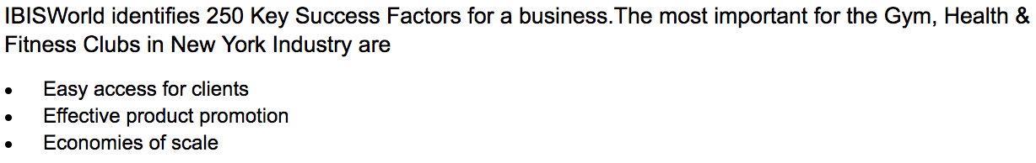
Fitness and Health Clubs are a convenience business
No. 1 success factor for fitness clubs in New York is easy access to clients
Members pay $10 to $50 more per month to go to a more conveniently located fitness gym
Source:
1. http://smallbusiness.chron.com/target-market-fitness-gyms-3354.html
2. https://www.ibisworld.com/industry/gym-health-fitness-clubs-in-new-york.html

Slide 5

Location with little competition is very important for food truck business
Identifying areas with increasing foot traffic is key, as the primary driver of success is location
Entering locations that have little competition allows your business to enjoy higher revenue, profit and market share
“Because of the food court areas located in almost all the shopping malls, the least revenue is generated by food trucks in nearby areas which consist of 12% of the total revenue. Coming after this, is the industrial and construction work sites where about 15% of the total sales take place. Other locations like event venues produce 18% of the total industry revenue. And the highest percentage of revenue is generated from random roadside locations and street corners which make up 55% of the total revenue. Random placements are the most profitable way of achieving more sales. These areas usually include residential or office-majority locations where there aren’t many restaurants nearby, which make food trucks an attraction for that place.”

Slide 6
Film & Video, Music, Publishing are most popular categories on Kickstarter
Top 3 categories accounted for 63% of the projects on Kickstarter from May 2009 to Aug 2012

Slide 7
Smaller pledges have higher chance of coming alive
Pledges less or equal to $5K had success rate of 62% vs. overall project success rate of 56%
Successful project’s median pledge amount was 20% lower than the failed ones
*Note: Data excluded 2012 data due to unconcluded projects, and also exclude projects with pledged amount above $400K

Slide 8
Conclusions and Next Steps
Based on what we know about your business, we predict by entering the market, your revenue will increase 5%, and enjoy market share increase of 10%
We can narrow down the final location choice by using your company data and detailed demographic analysis

Slide 9
Appendix

Slide 10
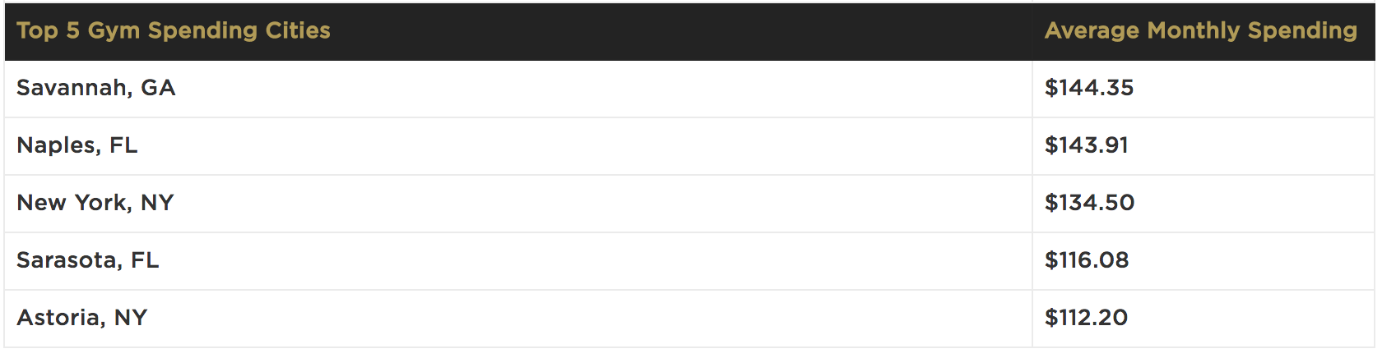
NYC Gym membership statistics
New York has a health club participation rate of 19.1 percent in 2011
Source:
1. http://www.statisticbrain.com/gym-membership-statistics/
2. http://www.huffingtonpost.com/2011/09/07/health-club-membership-by-state_n_951442.html?slideshow=true#gallery/189834/6

Slide 11
Food Truck Financial references
“ One truck owner still working his way up to profitability told us that to earn an owner a good salary, a truck would need to bring in upwards of $500,000 of revenue a year. Bobby confirmed this amount, describing $200,000 as an approximate break even point, the equivalent of “just making it into the major leagues.” Half a million per truck is doing quite well and a million dollars of revenue per year around the maximum for a single truck” – Priceconomics.com
Source:
1. https://priceonomics.com/post/45352687467/food-truck-economics

Slide 12
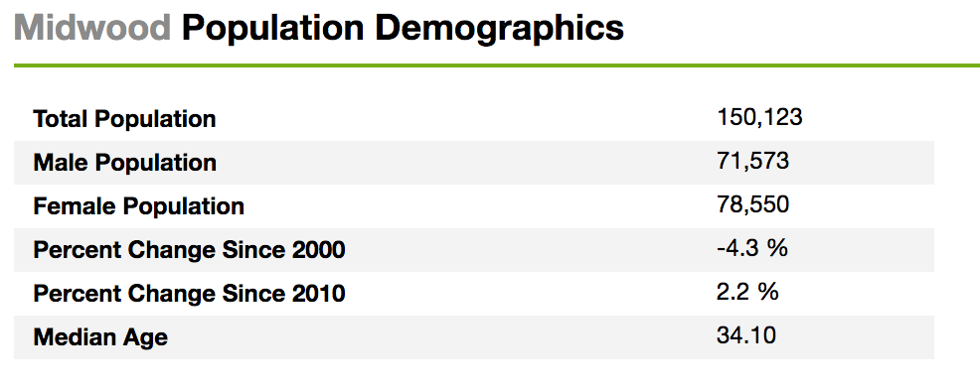
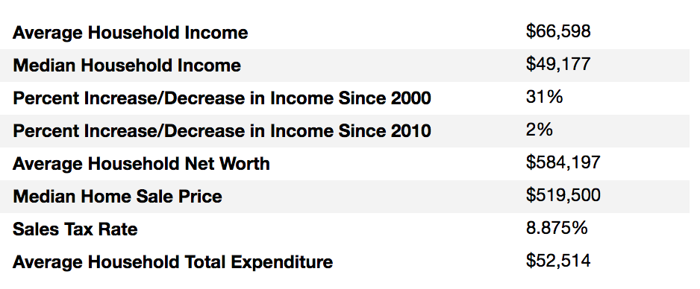
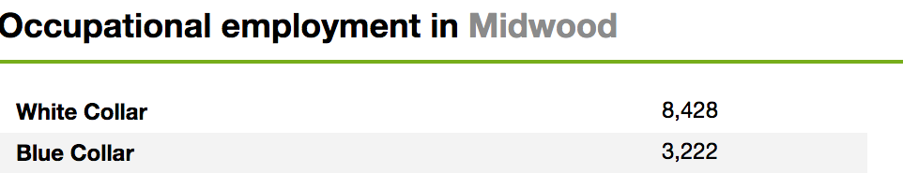
Midwood neighborhood info and statistics
“Midwood is a crazy combination of urban and suburban,” said Menachem Trietel, an agent at Weichert Realtors. Or as Alvin M. Berk, the chairman of Brooklyn Community Board 14, which includes parts of Midwood, put it: “Midwood is quiet and that’s how we like it.” The tree-lined streets of Midwood, with many single- and multifamily houses at prices that are relatively inexpensive for Brooklyn, naturally attract plenty of families – New York Times
Source: http://www.point2homes.com/US/Neighborhood/NY/Brooklyn/Midwood-Demographics.html

Slide 13
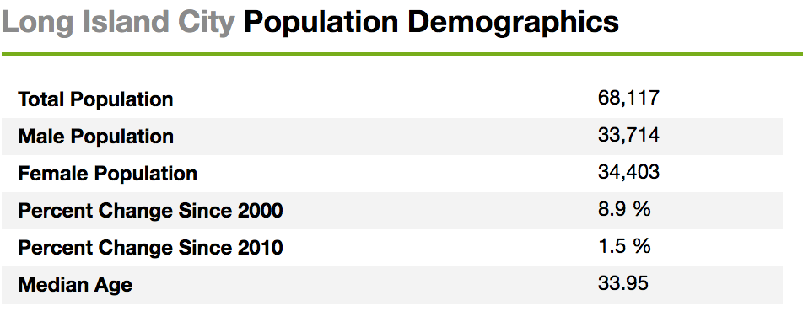
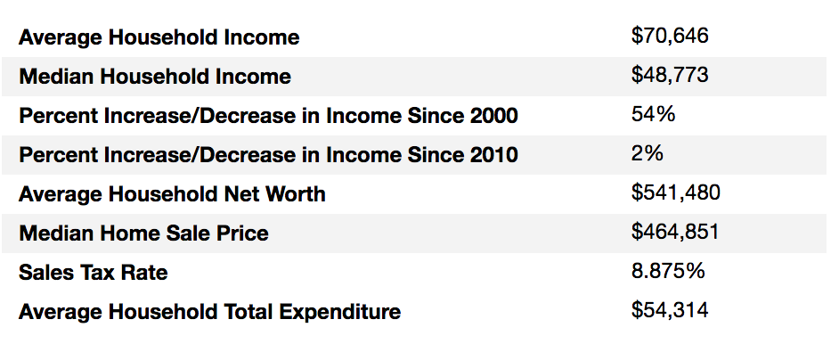
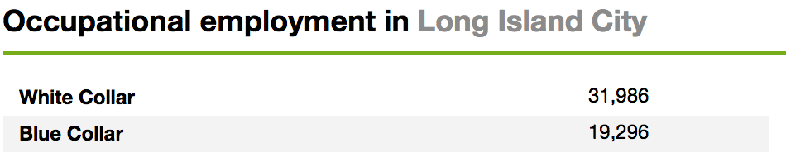
Long Island City neighborhood info and statistics
Long Island City (L.I.C.) is the westernmost residential and commercial neighborhood of the New York City borough of Queens. L.I.C. is noted for its rapid and ongoing residential growth and gentrification, its waterfront parks, and its thriving arts community.[1] L.I.C. has among the highest concentration of art galleries, art institutions, and studio space of any neighborhood in New York City. - Wikipeida
Source: http://www.point2homes.com/US/Neighborhood/NY/Queens/Long-Island-City-Demographics.html

