Slide 1
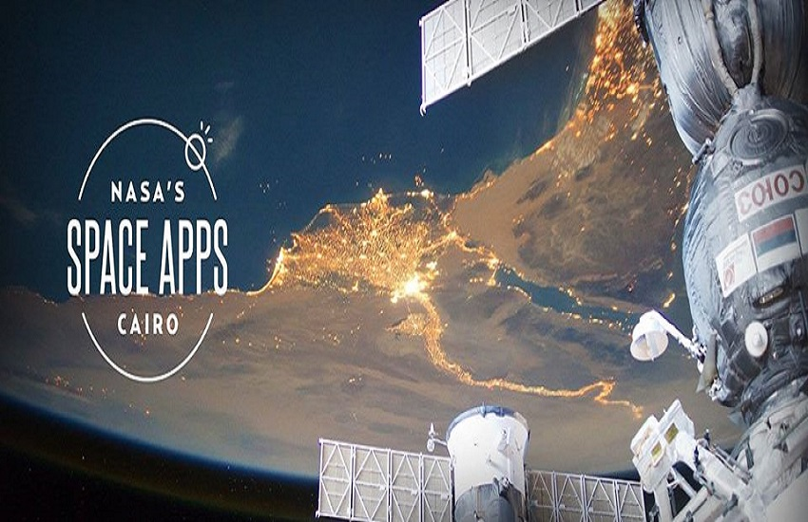

Slide 2
SpaceGloVe
Spacecraft Gesture and Voice Commanding
Team name
Qing long

Slide 3
challenge
This challenge seeks to change the way crew members and operators interact with computer systems using gestures and voice control.

Slide 4



solution
gestures
Voice
Android App
Voice & gestures detection
Internet browsing
3D Model Viewer

Slide 5
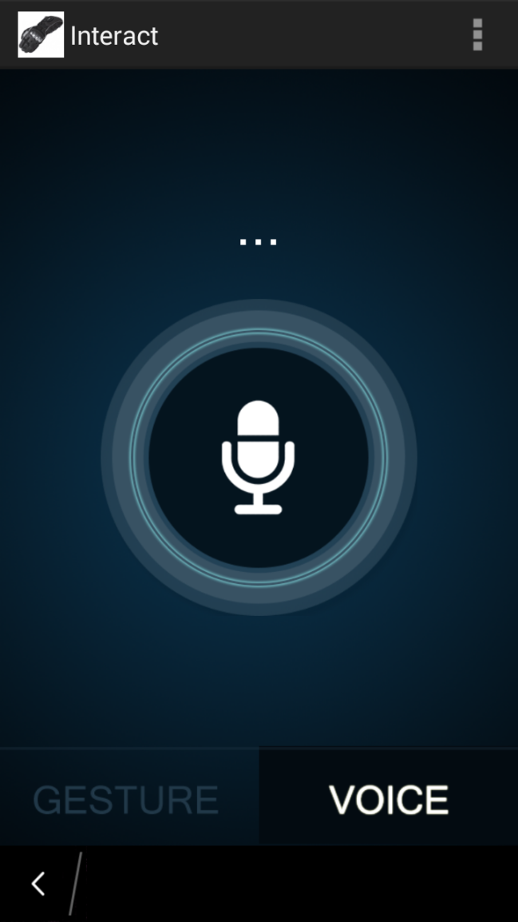
Demo

Slide 6
Thanks

