Slide 1
Using the Concept of Informative Genomic Segment to
Investigate Microbial Diversity of Metagenomics Sample
Qingpeng Zhang
Department of Computer Science and Engineering
Michigan State University
Supervisor: Dr. Titus Brown
Notes:
All, right.
So let's get started.
Good morning, everyone.
I am qingpeng zhang, a phd student from department of computer science and engineering, working with dr. titus brown. Welcome to my comprehensive exam presentation.
The topic of the project is to inverstiate the diversity
Of extremely complex metagenomic samples

Slide 2
Outline
Background
  Microbial diversity (alpha,beta) on WGS data
  Advantage – 16S -binning
The concept of IGS
  Test data sets (alpha,beta)
Working on real data sets
  GOS
  MetaHIT
  HMP(?)
Notes:
This is a overview of today's presentation.
After introducing the significance of the research and background information about metagenomics and known method of measure microbial diversity, I will show some preliminary results about the a novel method to inversitgate the microbial diversity based on an efficient k-mer counting approach
Finally proposed research will be presented, including using test data sets to prove effectiveness and the investigation to a series of extremely large metagenomic data sets generated from extremely complex microbial samples, which is soil.

Slide 3
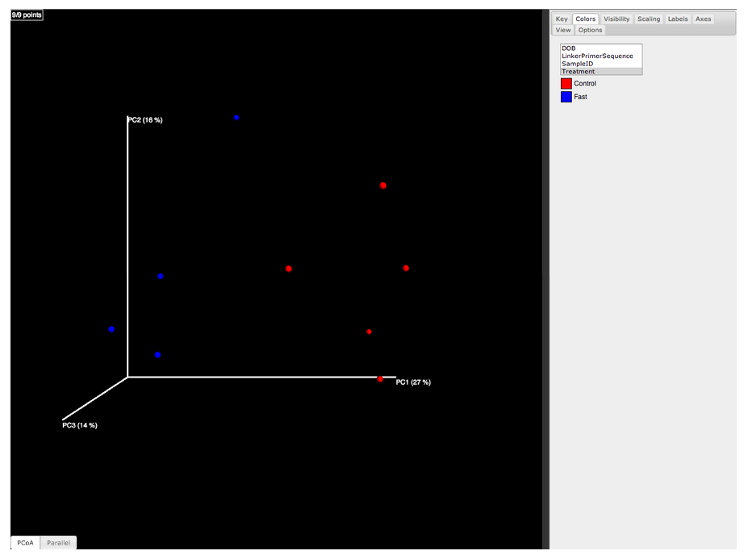
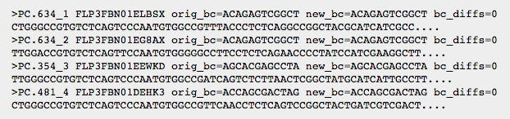
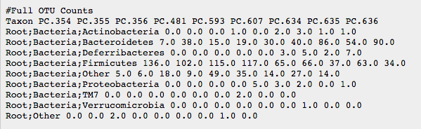
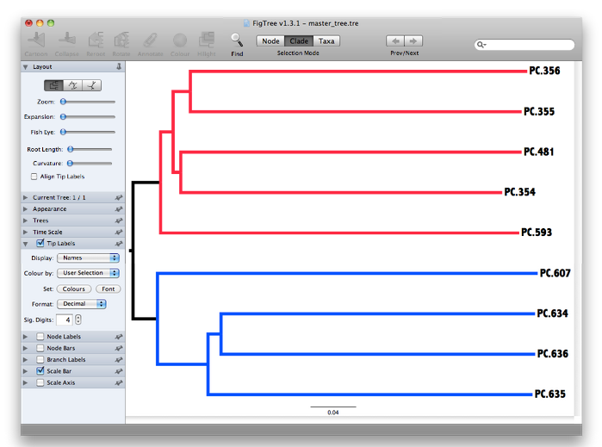
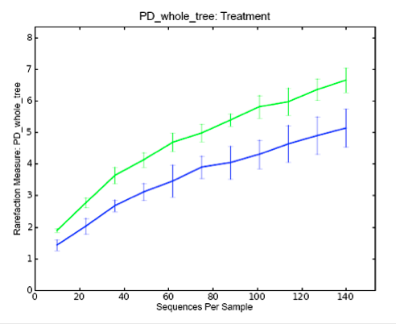
Microbial diversity

Slide 4
OTU based method
OTUs(Operational Taxonomic Units)
Binning of Metagenomic Reads into OTUs
  Composition-based approach
  Similarity-based approach
Drawbacks
  Computationally expensive
  May require reference, assembly,annotation

Slide 5
From OTUs to IGSs
IGS (informative genomic segment)
  Binning-free
  Assembly-free
  Annotation-free
  Reference-free
Based on previous work on khmer, diginorm, error correction
  Impossible without them
Efficient (Memory and Time)
  extremely large shotgun metagenomic data sets (Terabytes, etc.)
  extremely diverse microbial communities (Soil, etc.)
  Samples with largely unknown species
Notes:
Not using 16s sequences form aplicon metagenomic data set as what I described previously, for this project, we will use whoge genome shot. Meta data
To mesaure the m..
Compare...
Reason we want to use shogtun.
16s rrna methods have their problems such as sensitve to horizontal genes, genec opy in bacterium.
Also the shogun should have more information rahten than only the interested gene sequences.
Our method willb e free fre fre free,especially
Binning and refrence are very important ffor 16s . based analysis.
Our method efficient, it shoul deal with, … .
reference

Slide 6
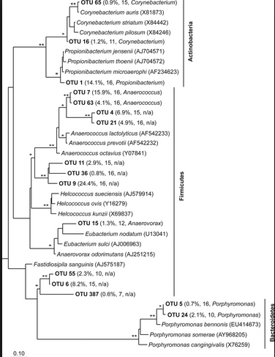
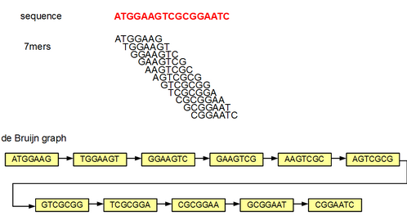
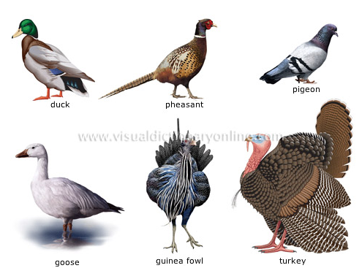
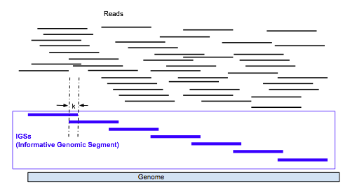
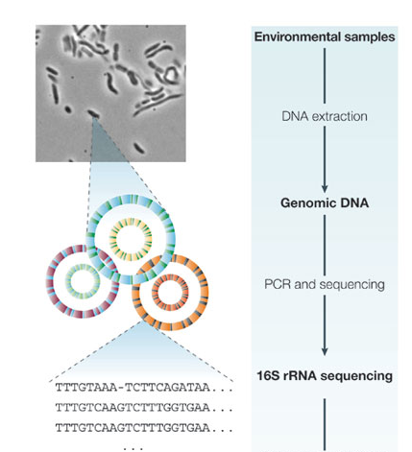
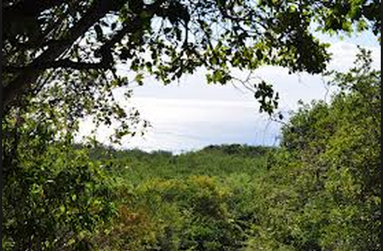
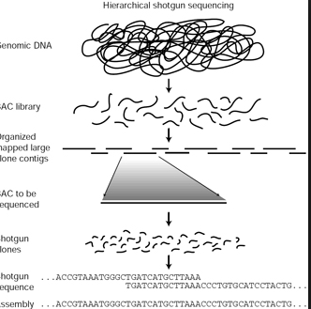
Diversity measurement based on different unit concepts
97% similarity of 16S sequences
species
Unique
k-mers
OTUs
16S rRNAs sequences
Information
Segments
(IGS)
Individuals
total k-mers in
WGS data
Whole genome
sequencing reads
Nature Reviews GeneticsÂ 6,Â 805-814, ettc.
Notes:
All right, the goal looks ambitous, but how can we acheve that?
Ok lets look a t this pic ture again.
So as I said, in microbial ecology, using 16s sequence dataset, the concept of speceis is repalce by otus.
More out, more microbial speces.
Now when we use shotgaun datas et,
We hypothethis that number of unique kmers will correlate the number of species.
If we assume difference species, fixed,
Size of microbial genomes.
Even they don't consider that, unique kmers reperent the genomic novel information a data set contains, or sample contains . Just as we can use those statisticato deal with otus like dealing with species in clasic ecology, wo can also use stats. Deal with kmer based analysis. Result, like rarefaction curve, or common elemetnes counting appraoch to compare diferent samples. We use k-mer based firstly, the problem is that we errors, will generate lost of erroous k-mers, which will influence thso staticdaf seriously. So next we starting to look at another lever, higher leve,r reads or genomic segments, we use a median k-mer counting approach to reprenst the sequencing depth of a read, which wil lalso decrase the influence of errors, which will be discussed later.

Slide 7
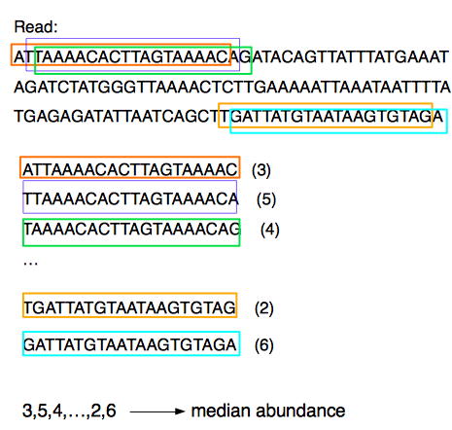
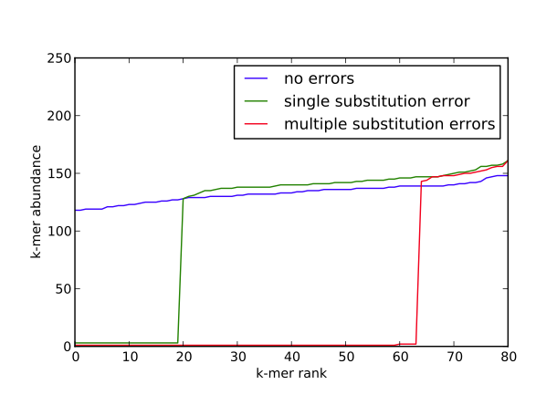
  median k-mer frequency to represent the sequencing coverage of the read
Using median k-mer frequency rather than
average k-mer frequency can decrease the influence
of sequencing error
Notes:
Next, based on k-mer counting, we devekp a mehtod to estimate the sequencing coverage of a read
If there is no error, the more time a sgemtn of dna is sequenced, the thighe abundance of k-mers from the reads would be after we count all the k-mer sin the sequencing data set, fi no erorr,
Sequencing coverage of a read ,a s segment of dna of a species precisely, estmiate by the k-mers abundanc,e
But hter eeror, one error can bgenerate a lot fo eror k-mers, decrease the abundance, of those k-mers.
But if we use median instead average,
The influence can be eliminated, if k small, leng th logner.
Only multiple erors ppere inlfunec,
Figure, we get the abundacne of k-emr sin read, and rank them , get the median , median will be the true of sequncing coverage

Slide 8
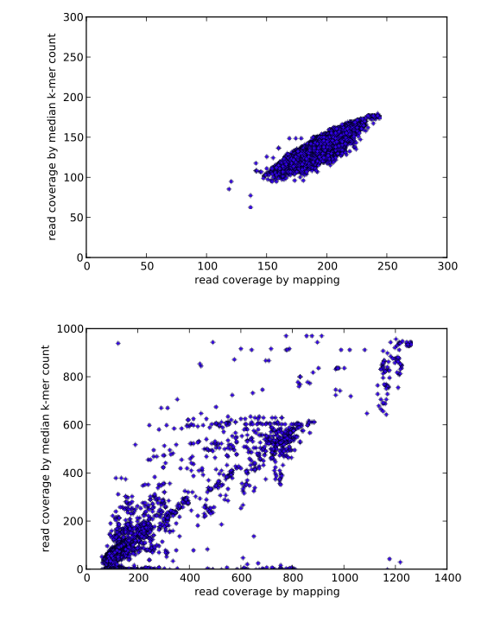
Mapping and k-mer coverage measures correlate for simulated genome data and a real E. coli data set (5m reads).
(Brown, Howe, Zhang, Pyrkosz, & Brom, 2012)
Notes:
Show the meiand coorelated the

Slide 9
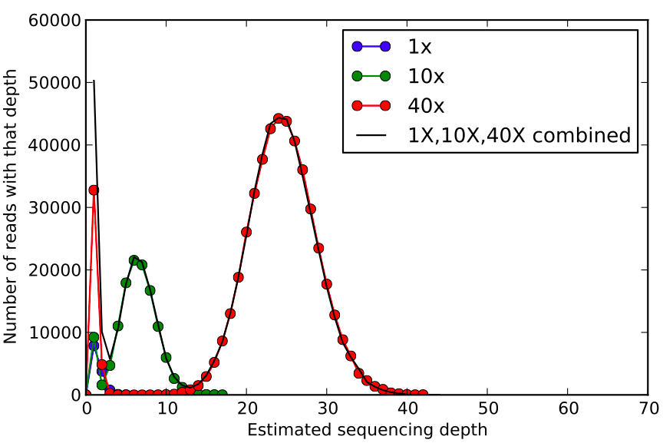
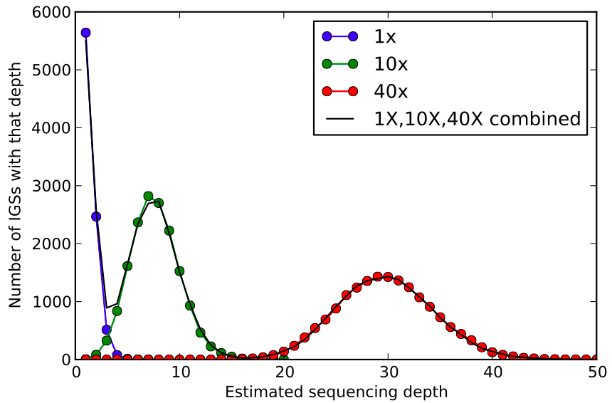
IGS(informative genomic segment) can represent the novel information of a genome
iGS
It there are Y reads with a sequencing depth of X. In other word, for each of those Y reads, there are X-1 other reads that cover the same DNA segment in a genome that single read originates. So we can estimate that there are Y/X distinct DNA segments with reads coverage as X. We term these distinct DNA segments in species genome as IGS(informative genomic segment).
Notes:
Next we used the method of using median kmer ferquence ot estimat read sequencing coverage to introduce a new concept , hcih I called informative genomic segement.
How was the concept developed.
It there are Y reads with a sequencing depth of X. In other word, for each of those Y reads, there are X-1 other reads that cover the same DNA segment in a genome that single read originates. So we can estimate that there are Y/X distinct DNA segments with reads coverage as X. We term these distinct DNA segments in species genome as IGS(informative genomic segment).

Slide 10
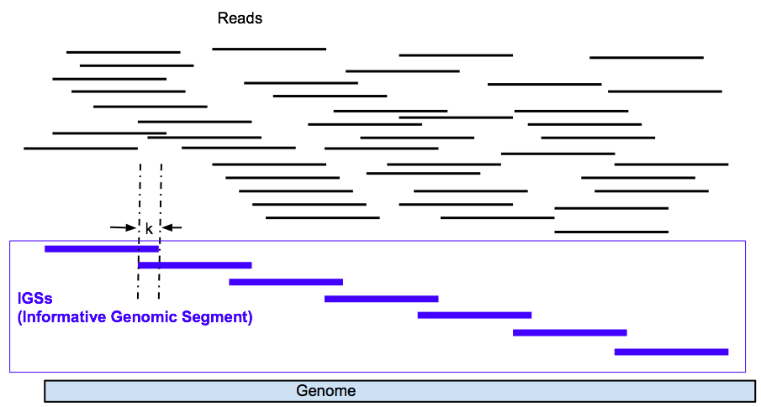
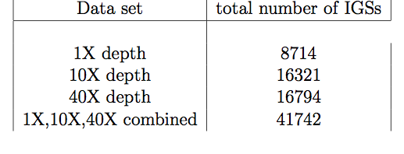
Borrowing statistical methods from OTU based diversity analysis, (rarefaction curve, estimators, etc.)
N =G/(L-k+1)
1000000/(80-22+1)

Slide 11
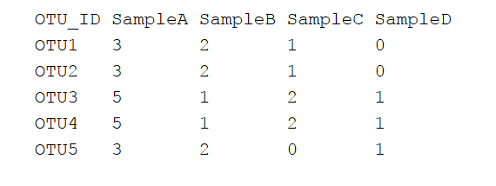
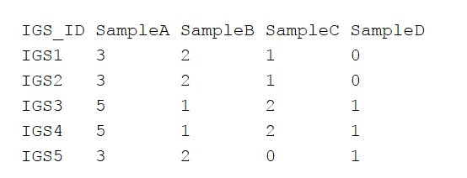

IGSs abundance across samples
We can get the coverage of a read from a sample A dataset in another sample B dataset. We can still use the median k-mer count to represent the coverage
if a read R from sample A with a coverage C_A in sample A has a coverage as C_B in sample B, that means that segment of genome in sample A from which read R derive also exists in sample B. That genomic segment has a coverage as C_A in sample A and has a coverage as C_B in sample B.
6 reads in sample A, C_A = 3, C_B =2
  2 IGSs with coverage as 3 in sampleA
  The same 2 IGSs with coverage as2 in sampleB
  There must be ~4 reads in sampleB with C_A = 3, C_B =2

Slide 12
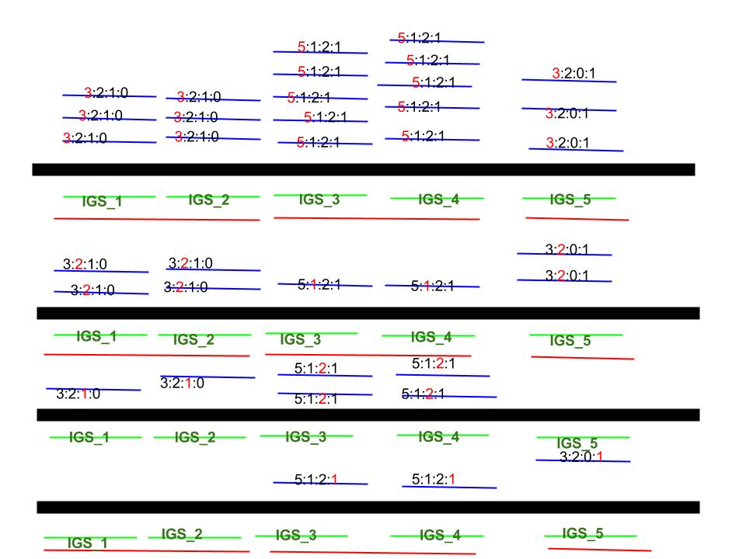

black: overall information in the genomes of
all species in a sample
blue: reads, with the coverage spectrum across
samples
green: IGSs
red: potential genomes of separate species

Slide 13
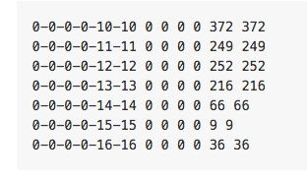
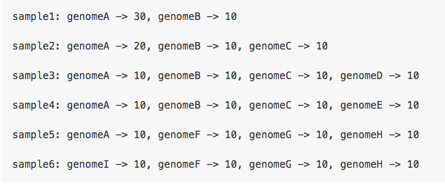
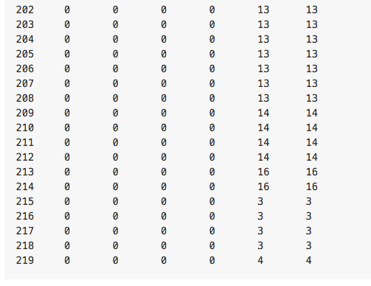
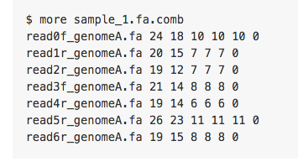
Simulated data sets

Slide 14
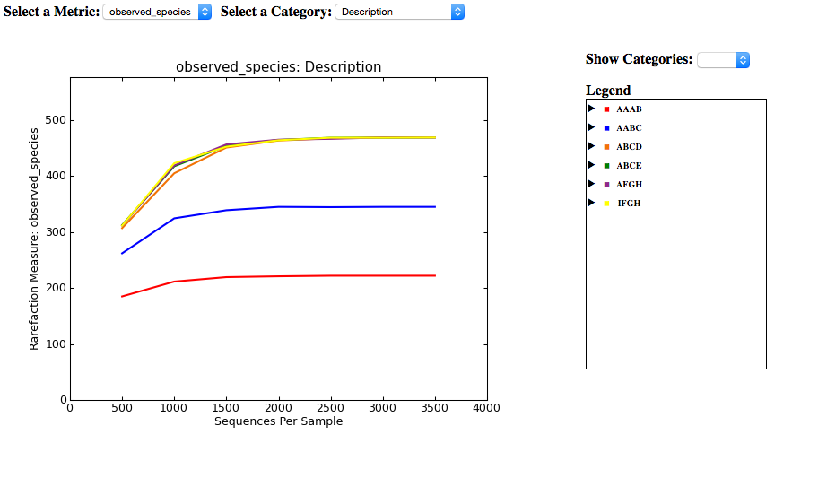
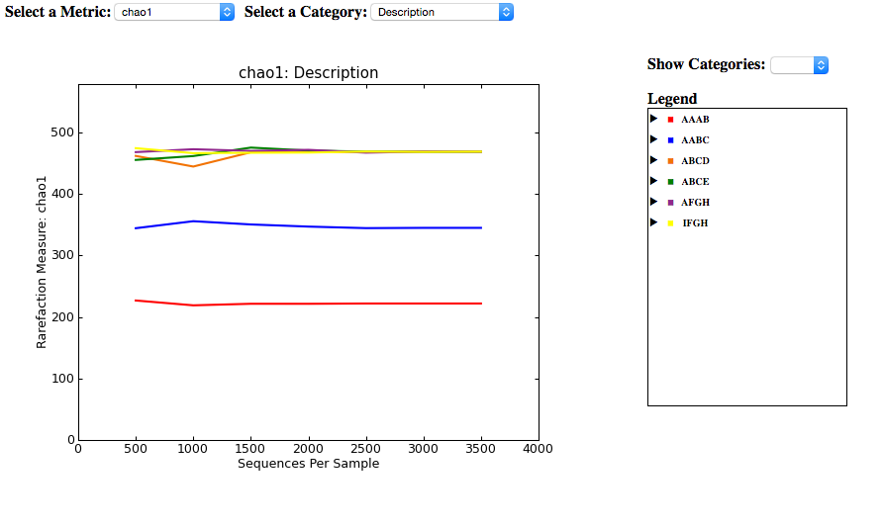
Alpha diversity(richness)

Slide 15
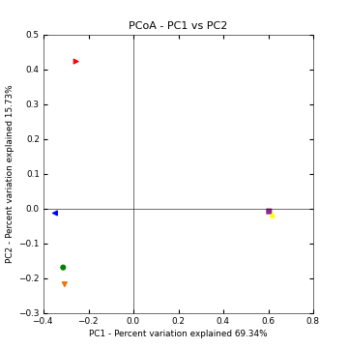
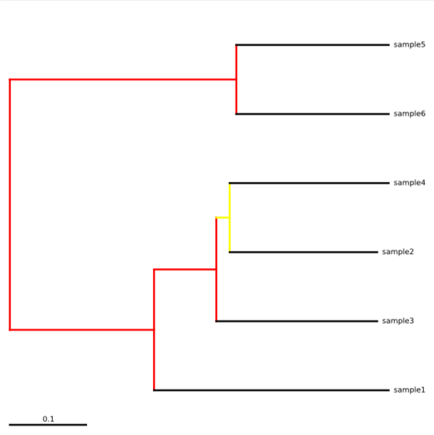
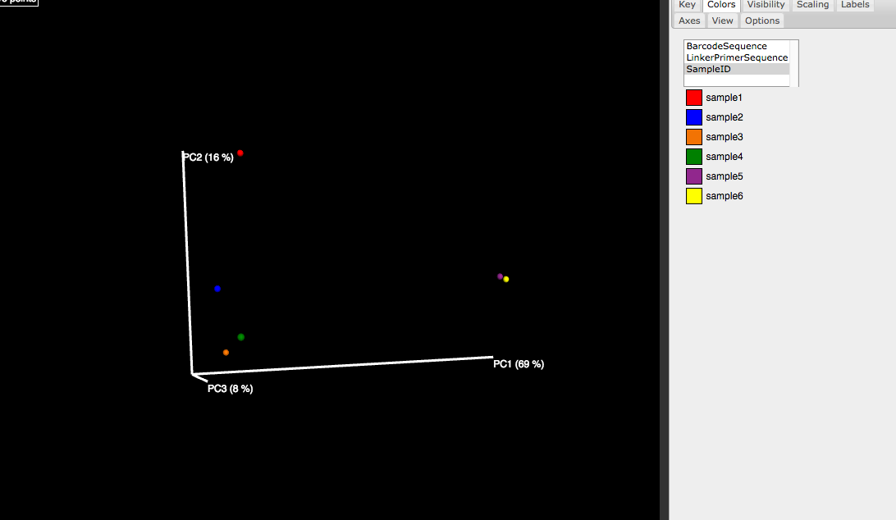
Beta diversity

Slide 16
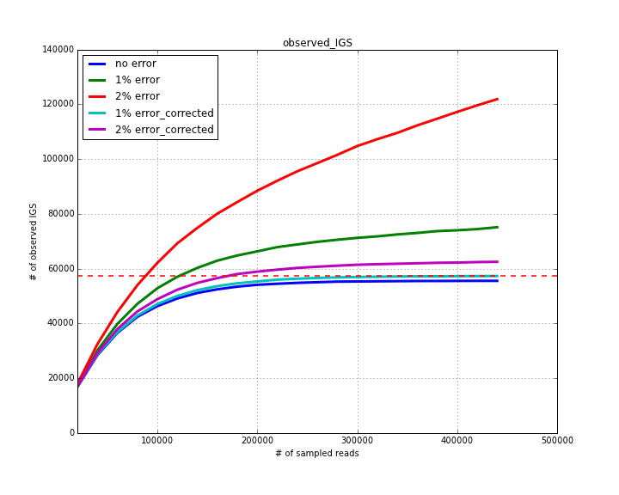
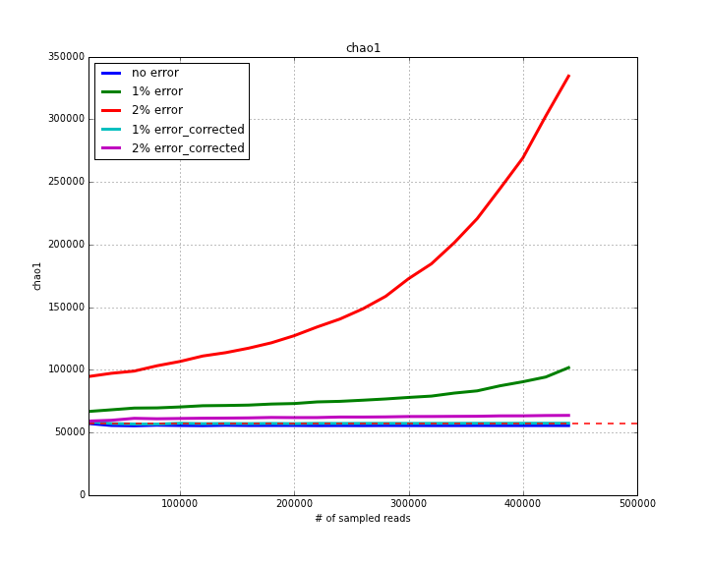
Dealing with the error

Slide 17
Computing challenge
An efficient kmer counting tool – khmer
Filter short reads (>=60bp for 20-mer)
Use optimal hash tables to reduce computing time
  Error correction – 0.1 false positive rate
  Counting coverage – 0.3 false positive rate

Slide 18
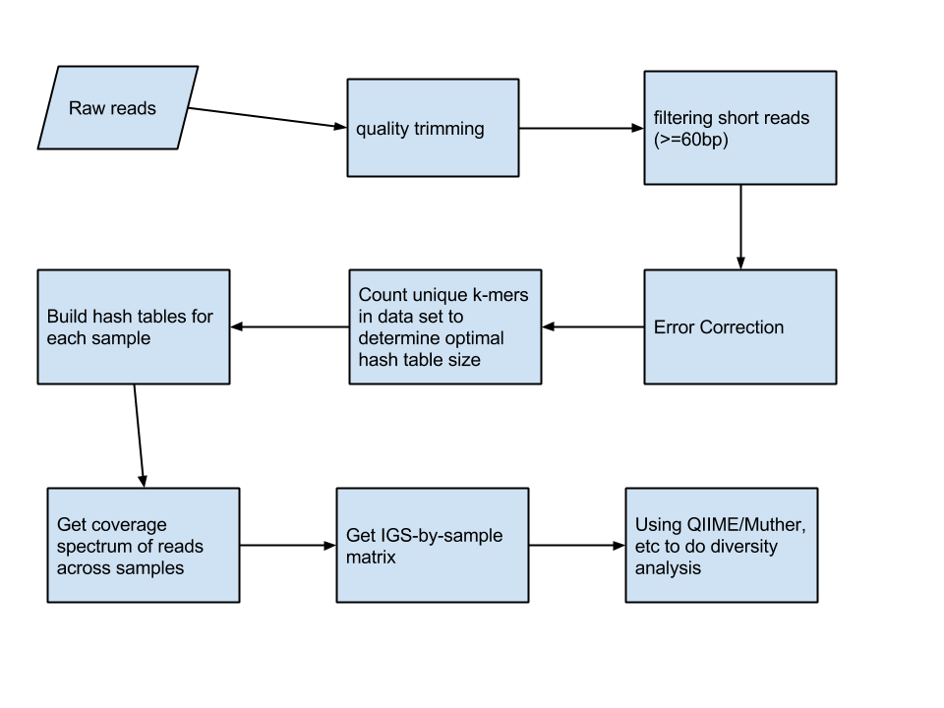
IGS-based analysis pipeline

Slide 19
Real data sets
GOS (GOS data sets: Sorcerer II Global Ocean Sampling Expedition)
MetaHIT
More to come

Slide 20
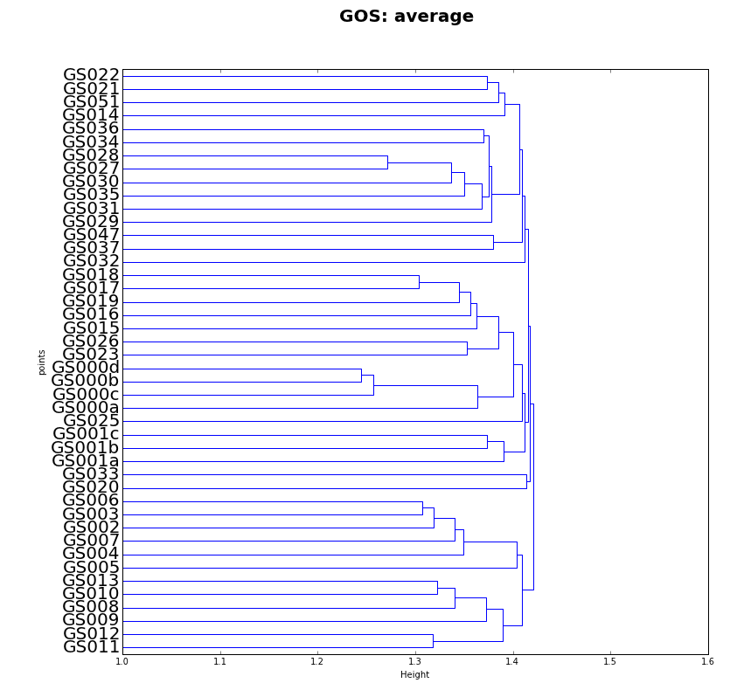
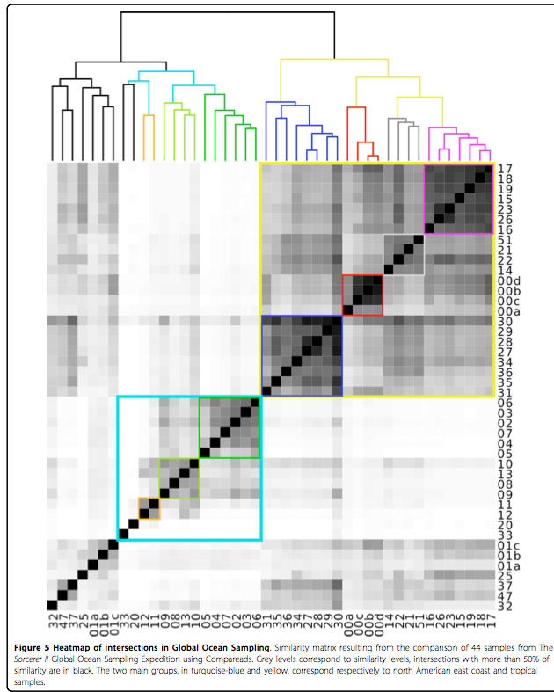
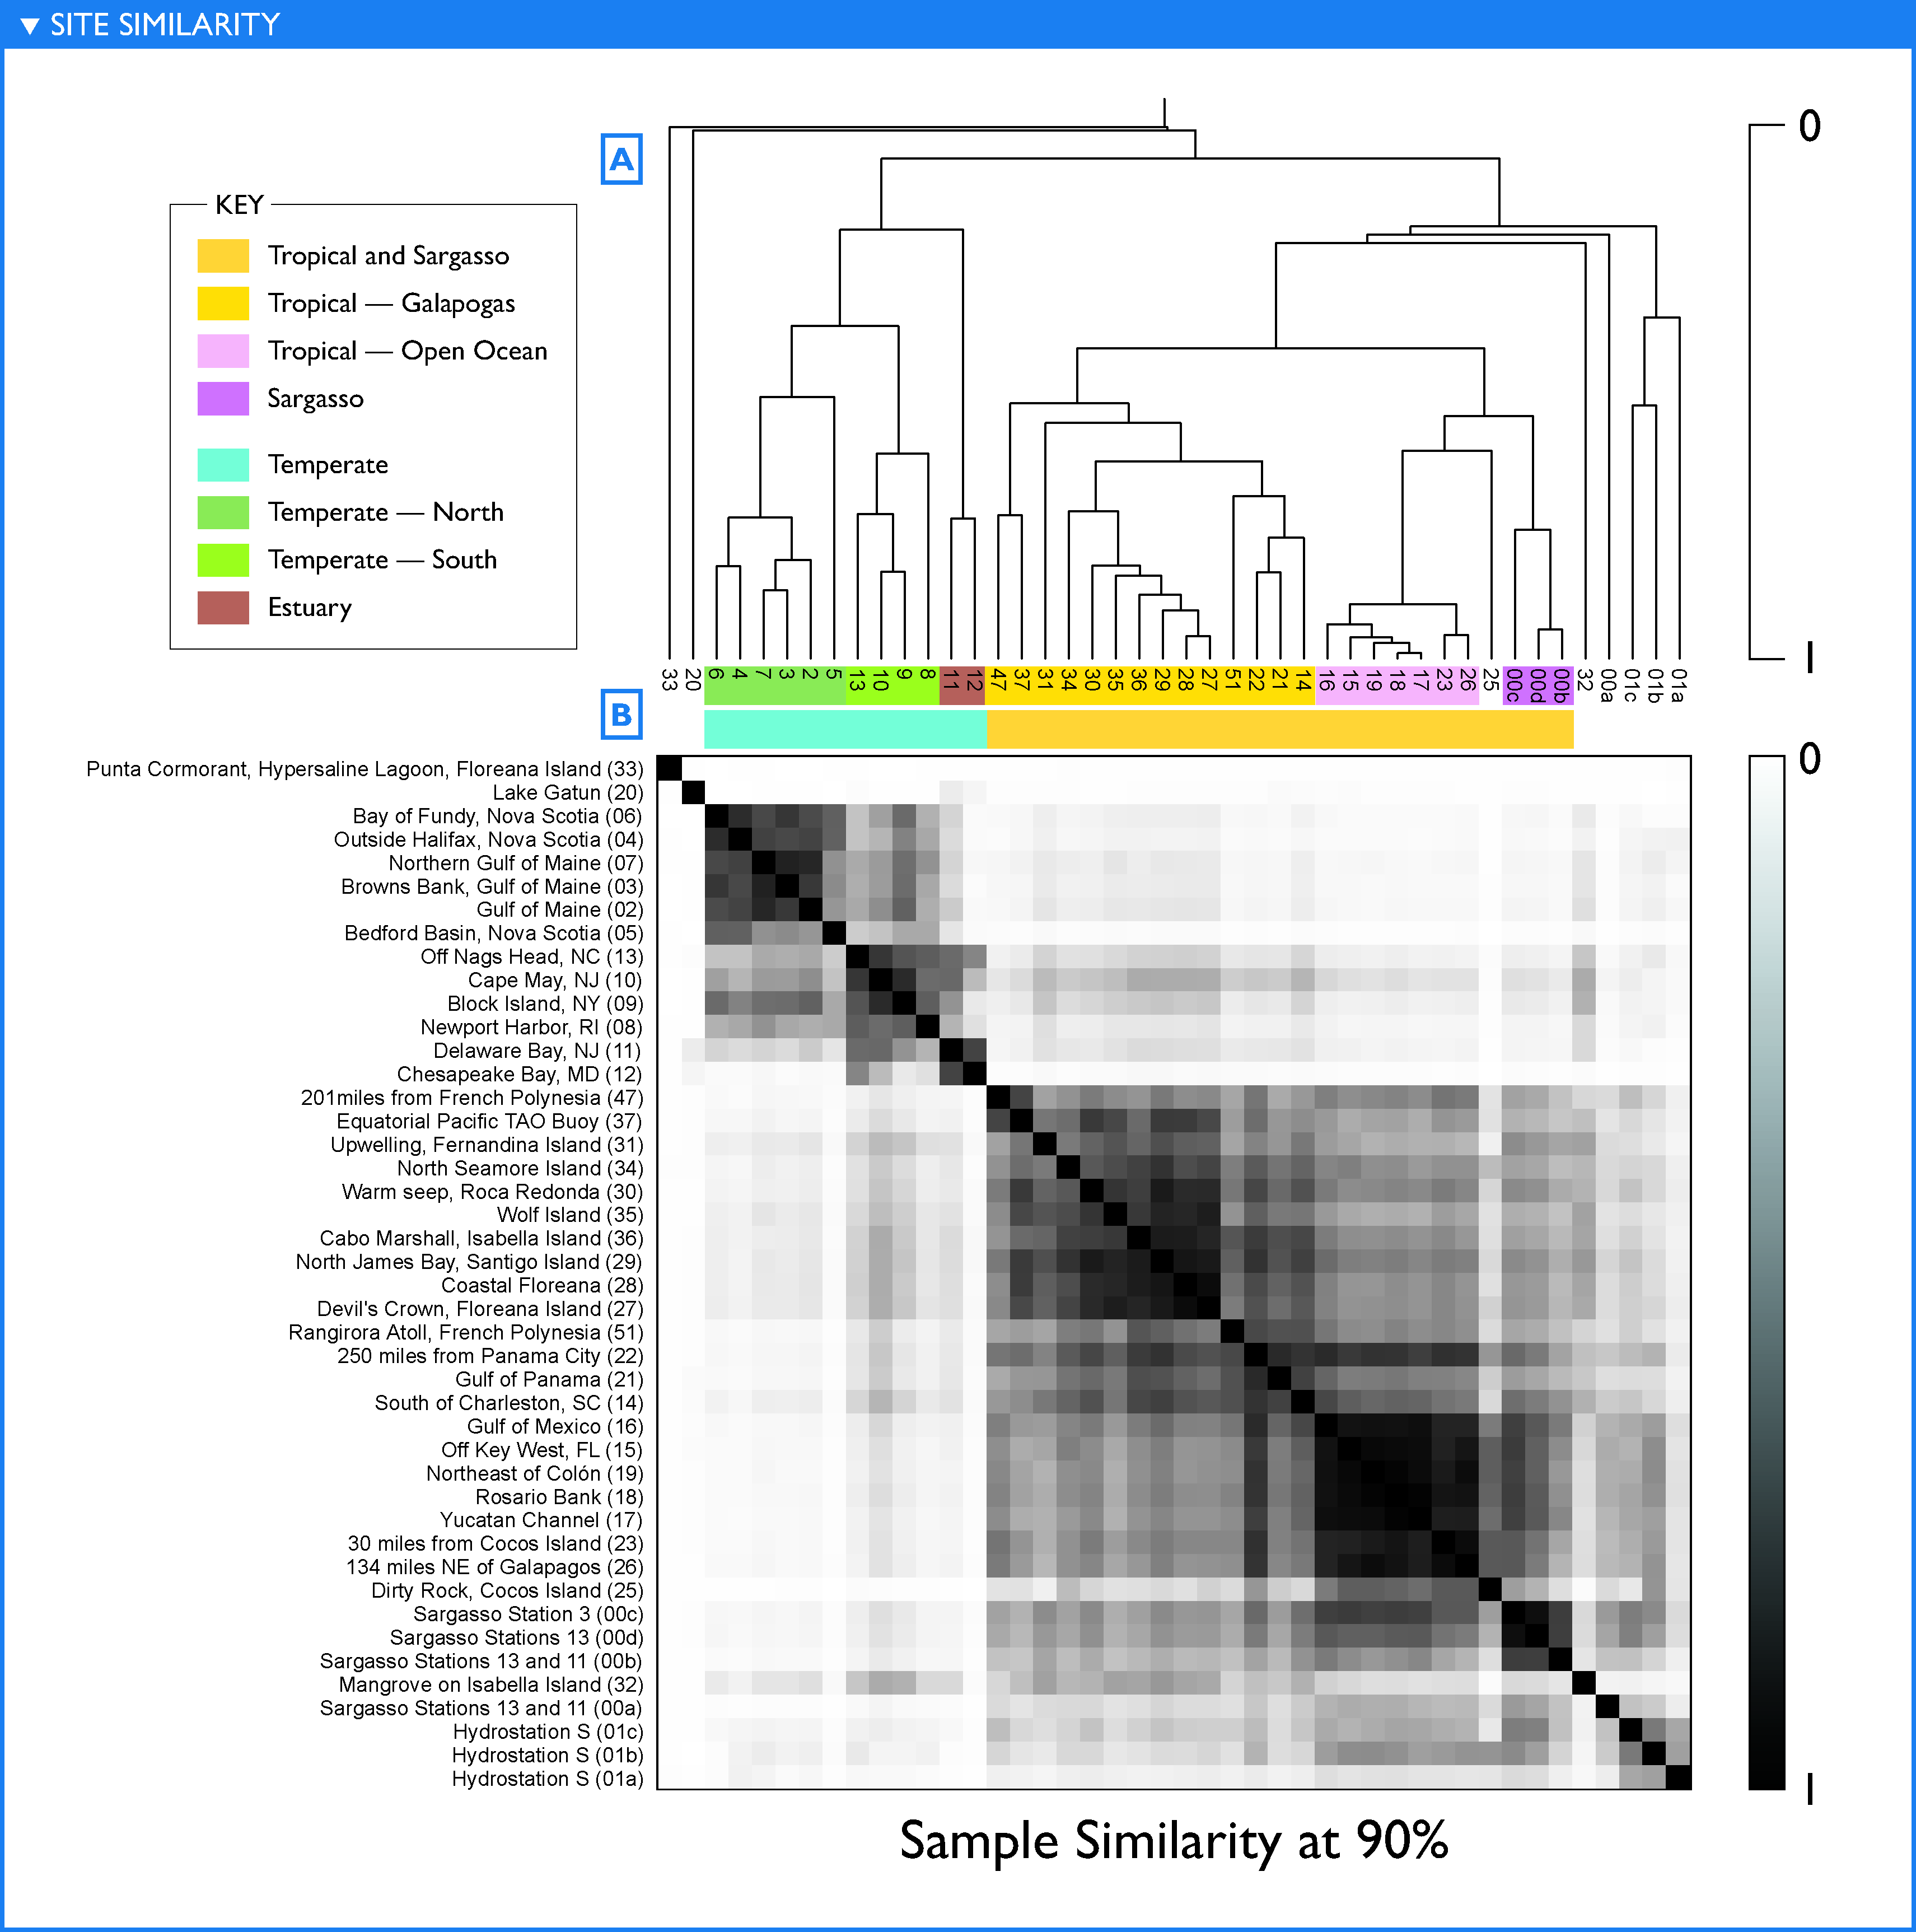
GOS
Beta diversity
Notes:
Better figure, should be like the other two figures
And after error correction!

Slide 21
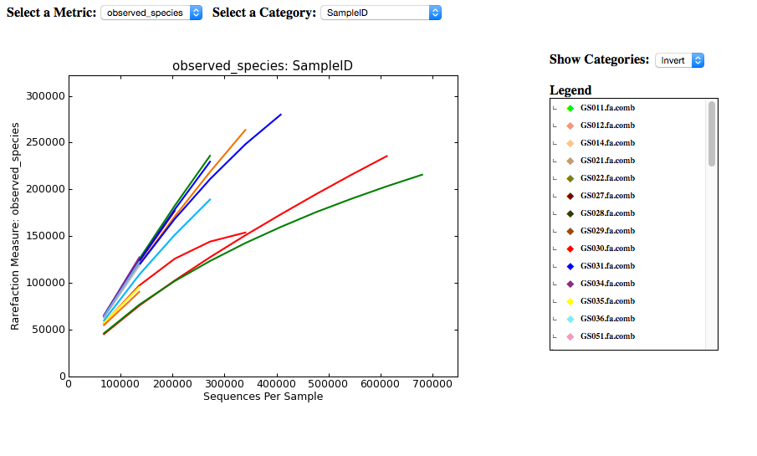
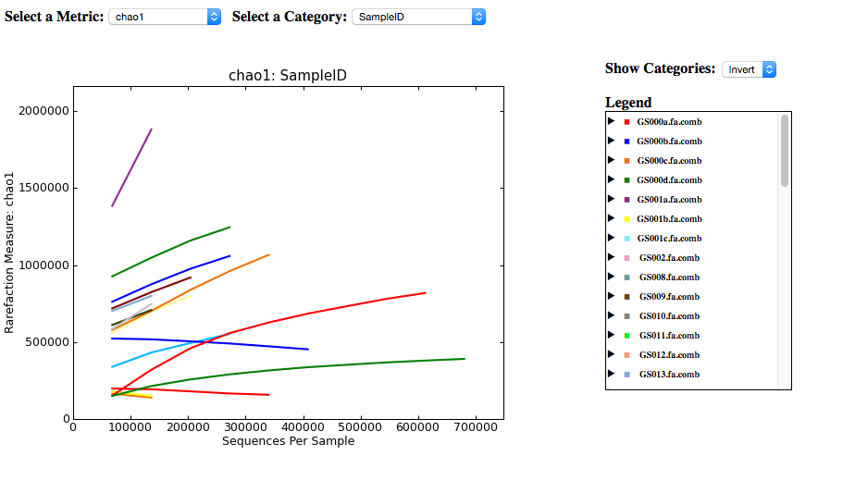

Slide 22
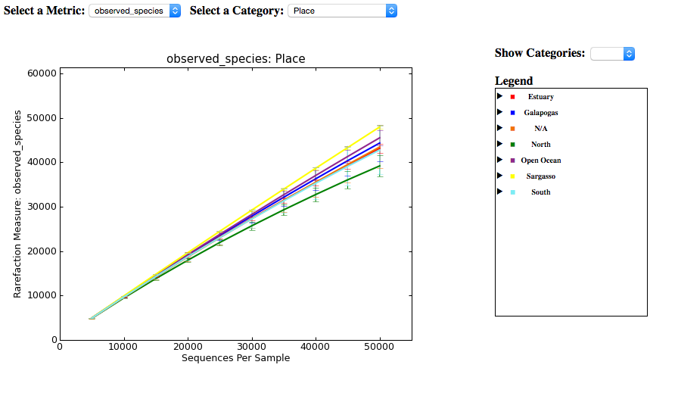
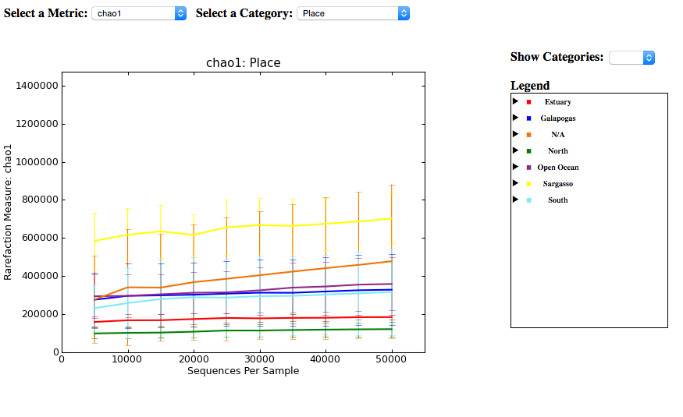

Slide 23
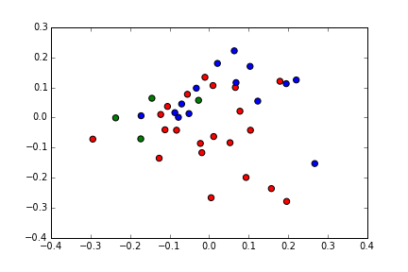
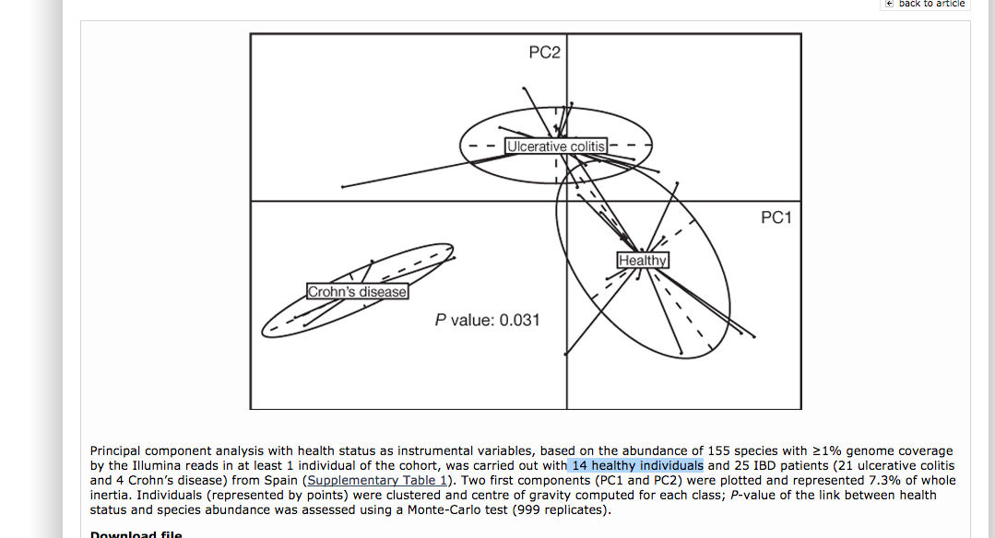
MetaHIT data
P-value = 0.045

Slide 24
What's next
More real data sets
  HMP(Human microbiom project)
  Ballast water virus (collaboration with Dr. Joan Rose)
  GPGC (The Great Prairie Grand Challenge)
Expand application beyond diversity analysis
  Reads binning/classification
  Genome size estimation/sequencing effort evaluation
  Relate IGSs to function/species
  co-assembly
Refine pipeline, optimize performance
  Adjust IGS resolution
  Influence of read size
  Choose statistical models that fit IGS best

