Slide 1
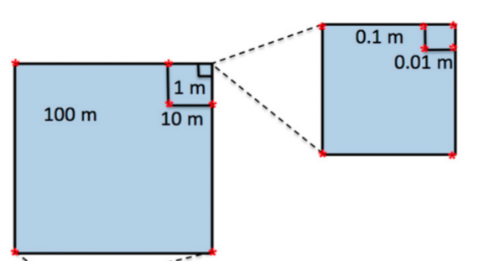
ARMO (Amazon Rain Forest Microbial Observatory) project
Blue: Prairie
Red: Forest
Samples can be separated by different treatments using IGS method.
Notes:
Amazon rain forest is very important for global ecosystem and microbial communities play key roles in the nutrient cycling. The goal of this study is to understand the effect of agriculture practice (conversion of forest to pasture) on microbial community.

Slide 2
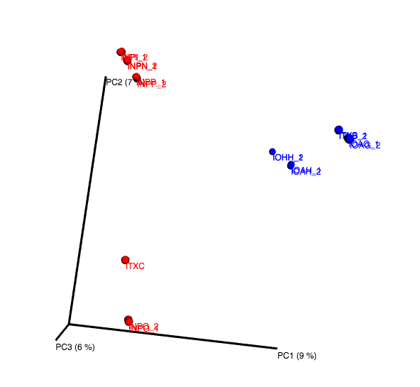
Samples can be separated by different treatments using IGS method.
Blue: Prairie
Red: Forest

Slide 3
Samples can be clustered by different treatments and distances using IGS method.
0.1m
0.01m
10m
100m
0.1m
0.01m
1m
10m

Slide 4
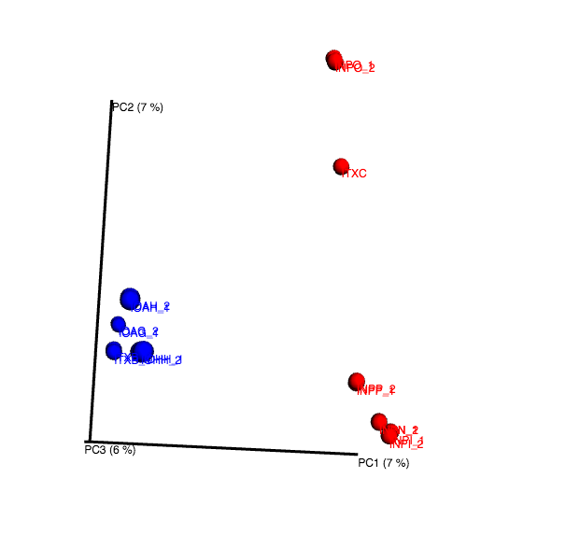
Using subsamples can get decent result of beta diversity.

Slide 5
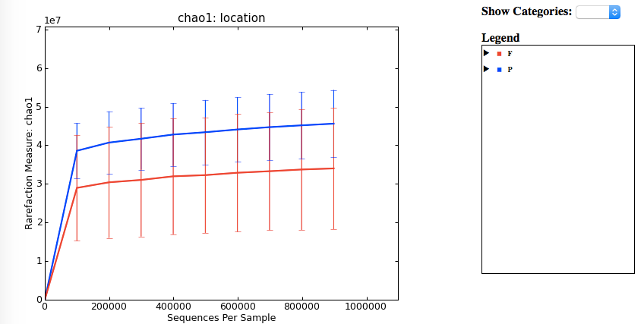
Alpha diversity analysis shows samples from prairie area have higher richness than forest area.
Notes:
Our results show that bacterial community composition was significantly altered by the forest-to-pasture conversion.

