Slide 1


Learning Mixture of Gaussians in High Dimensions
Qingqing Huang
Laboratory for Information & Decision Systems
2015

Slide 2
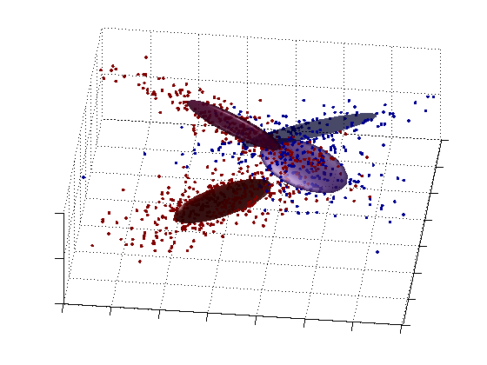
Motivation
Input: multi-dimensional data points
Assumption: mixture of Gaussian distributions
Goal: learn weights, means, covariance matrices
Widely used model in machine learning
Notes:
Infinitely countable table

Slide 3
Problem statement
-dimensional -component
Parameters: weights , means , covariance matrices
MoG sample generation
Can we learn the parameters with poly algorithm for every MoG ?
Notes:
Infinitely countable table

Slide 4
Problem statement
-dimensional -component
Parameters: weights , means , covariance matrices
MoG sample generation
Can we learn the parameters to accuracy ε in poly time using poly samples
for every MoG instance ?
Notes:
Infinitely countable table

Slide 5

Problem statement
-dimensional -component
Parameters: weights , means , covariance matrices
MoG sample generation
Can we learn the parameters with poly algorithm for every MoG ?
No!
“Exponential dependence in k is unavoidable in general.” [Moitra&Valiant]
Notes:
W_i also super script
x~ mc N (mu, sigma)

Slide 6
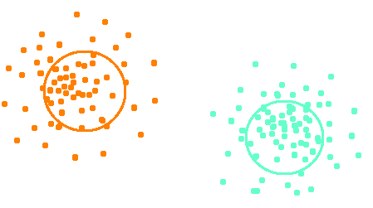
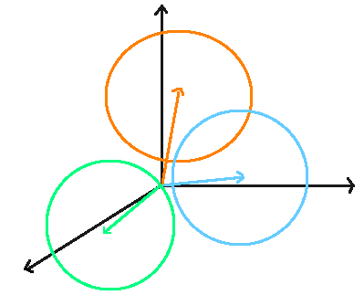
Prior works
General case
Moment matching method [Moitra&Valiant] [Belkin&Sinha]
Additional assumptions
Non-overlapping clusters
Pair wise clustering [Dasgupta]…[Vempala&Wang]
Spherical, n>k, independent mean vectors
Lower order moments tensor decomposition [Hsu&Kakade]
Density estimation [Chan et al]
1-dim Higher dim
Notes:
Pace up

Slide 7

Main result
Can we learn the parameters with poly algorithm for most MoGs?
Yes! worst cases are not everywhere
Notes:
Infinitely countable table

Slide 8
Smoothed analysis Escape from the worst cases
Given an arbitrary instance
Nature perturbs the parameters with a small amount (ρ) of noise
Goal: Given samples from smoothed MoG, learn the smoothed parameters with negligible failure probability over nature’s perturbation
[Spielman&Teng]
With high probability over nature’s perturbation, an arbitrary instance
- escapes from the degenerate cases
- becomes a sufficiently well conditioned instance
Notes:
Infinitely countable table

Slide 9
Smoothed analysis Escape from the worst cases
Given an arbitrary instance
Nature perturbs the parameters with a small amount (ρ) of noise
Goal: Given samples from smoothed MoG, learn the smoothed parameters with negligible failure probability over nature’s perturbation
[Spielman&Teng]
With high probability over nature’s perturbation, an arbitrary instance
- escapes from the degenerate cases
- becomes a sufficiently well conditioned instance
Notes:
Infinitely countable table

Slide 10
Smoothed analysis Escape from the worst cases
Given an arbitrary instance
Nature perturbs the parameters with a small amount (ρ) of noise
Goal: Given samples from smoothed MoG, learn the smoothed parameters with negligible failure probability over nature’s perturbation
[Spielman&Teng]
Hope：With high probability over nature’s perturbation, an arbitrary instance
- escapes from the degenerate cases
- becomes a sufficiently well conditioned instance
Notes:
Infinitely countable table

Slide 11
Main theorem
Our algorithm learns the MoG parameters up to accuracy ε
For high enough dimension
With high probability under smoothed analysis
Fully polynomial time and sample complexity
Notes:
Infinitely countable table

Slide 12
Algorithmic ideas
Method of moments
Match the first 6-th order moments
Decomposing moments tensor (not low rank, but structured)
Why high dimension helps us to learn?
Enough moment matching constraints for identifiability
#parameters #6-th moments
Enough randomness in nature’s perturbation model for well-condition
Notes:
Infinitely countable table

Slide 13
Algorithmic ideas
Method of moments
Match the first 6-th order moments
Decomposing moments tensor
Why “high dimension & smooth” help us to learn?
Enough number of moment matching constraints for identifiability
#parameters #6-th moments
Enough randomness in nature’s perturbation model for well-condition
[Rudelson&Vershynin]
Notes:
Remind notation n, k

Slide 14
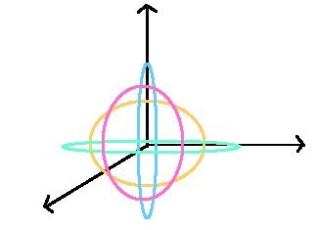
Learn 0-mean MoG
Why 0-mean?
Clean moment structure
Notation
-dimensional -component smoothed MoG
Given empirical moments tensor
Learn parameters: weights , covariance matrices
Notes:
Infinitely countable table

Slide 15
Learn spherical MoG, spectral method review
Construct a low rank tensor from the moments tensor
[Hsu&Kakade]
Low rank tensor decomposition, ‘s are independent
Notes:
Definition of M2 and M3 E xx
X = mu i， i~w_i

Slide 16
Learn spherical MoG, spectral method review
Construct a low rank tensor from the moments tensor
Low rank matrix
Low rank tensor
Low rank tensor decomposition, ‘s are independent
Notes:
Infinitely countable table

Slide 17

Learn 0-mean general covariance MoG
Notes:
X ~ N(0, Sigma)
Vectorized bullet point

Slide 18

Moments structure of 0-mean MoG
Isserlis’ theorem for 4-th moments
Have empirical moments
Want low rank matrix!
Notes:
M4, E[x_1 x_2 …] =
It has more symmetry
Have only M4, flip back to previous slide

Slide 19
Moments structure of 0-mean MoG
Isserlis’ theorem for 6-th moments
Have empirical moments
Want low rank tensor!
Notes:
M4, E[x_1 x_2 …] =
It has more symmetry
Have only M4, flip back to previous slide

Slide 20
Unfold Moments Tensor M₄ M₆
Estimate from data
Structured linear projection
Desired low rank tensor!
Recover low rank tensors from their linear projections
Looks like matrix sensing, but standard method does not apply
Notes:
Infinitely countable table

Slide 21
Exploit low rank property of X₄ X₆ to unfold M₄ M₆
Underdetermined linear eqn’s
Given the k-dim span of , change variable
Unique solution!
Find by examine the structure of
1-d columns of M₄ are related to columns of
2-d slices of M₄ are related to
Notes:
Infinitely countable table

Slide 22
Exploit low rank property of X₄ X₆ to unfold M₄ M₆
Underdetermined linear eqn’s
Given the k-dim span of , change variable
Unique solution!
Find by examine the structure of
1-d columns of M₄ are related to columns of
2-d slices of M₄ are related to
Notes:
Infinitely countable table

Slide 23
Algorithm outline. Learn 0-mean MoG
Step 1. Find the span of
Step 2. Use the span to change variable and
unfold the M₄ M₆ to get unfolded moments X₄ X₆
Step 3. Low rank tensor decomposition to recover
Each step involves basic matrix operations
( poly time and poly stable ! )
Notes:
Infinitely countable table

Slide 24
Sketch of proofs
Deterministic conditions for correctness and stability of each step
Step 1. Find the span of
Rank factorization of matrices constructed with M₄
Randomness from ρ-perturbation to guarantee the factors are full rank.
Step 2. Unfold M₄, M₆ to get X₄, X₆
Solving over-determined linear system
Randomness from ρ-perturbation to guarantee the coefficient matrix is full rank.
Step 3. Tensor decomposition of X₄, X₆
Randomness from ρ-perturbation to guarantee tensor factors are well-conditioned
Notes:
Infinitely countable table

Slide 25
Algorithm outline. Learn General MoG
Step 1. Find the span of and span of projected to
Step 2. In the subspace find use our 0-mean algorithm
Step 3. Find the using
Step 4. Find the full covariance matrices
Notes:
Infinitely countable table

Slide 26
Algorithm outline. Learn General MoG
Step 1. Find the span of and span of projected to
Step 2. In the subspace find use our 0-mean algorithm
Step 3. Find the using
Step 4. Find the full covariance matrices
Notes:
Infinitely countable table

Slide 27
Take away messages
Provide a fully poly algorithm under smoothed analysis
(avoid worst case complexity exponential in k)
Can potentially relax by using higher order moments?
Other “hard problems” in learning?
Thank you! Question?
Notes:
Infinitely countable table

