Slide 1
Dynamic Network Volatility
2
6
3
1
7
4
8
5
Qingqing Huang (MIT)
collaborated with Ye Yuan (Cambridge University)
Jorge Gonçalves (Cambridge University) Munther Dahleh (MIT)
Informs October 9, 2014
Notes:
In the interest of time
I will skip all the derivation and proof details
Should emphasize that studying the graph / network robustness should really consider dynamics that’s going on in the network system
Instead of focusing on the static inter connections of the nodes

Slide 2

Motivation
Opinion network
2
6
Do people like it?
3
1
7
4
8
5
Notes:
People’s opinion try to converge, but suffer from noise, noise can be personal bias, or comes from the different information acess
Should survey those people whose opinions are less biased, and less sensitive to the noise in the environment,
This survey result will be closer to the true population average, with a smaller estimator variance

Slide 3
Motivation
Opinion network
2
6
Do people like it?
3
1
7
4
8
5
Notes:
People’s opinion try to converge, but suffer from noise, noise can be personal bias, or comes from the different information acess
Should survey those people whose opinions are less biased, and less sensitive to the noise in the environment,
This survey result will be closer to the true population average, with a smaller estimator variance

Slide 4
Motivation
Opinion network
Which consumers to survey?
2
6
Do people like it?
3
1
7
4
8
5
Notes:
People’s opinion try to converge, but suffer from noise, noise can be personal bias, or comes from the different information acess
Read different news, see different advertisements
Should survey those people whose opinions are less biased, and less sensitive to the noise in the environment,
This survey result will be closer to the true population average, with a smaller estimator variance

Slide 5

motivation
Economic input-output network
Cobb-Douglas production
2
6
3
1
7
4
8
5
Notes:
Idiosynchratic shocks in each sector
Affect each other through production cost and input output network structure.
We want to identify the sectors which local shock have the most siginificant impact to the entire network.

Slide 6
motivation
Economic input-output network
Which sectors are more volatile?
Which sectors amplify local shocks the most?
Cobb-Douglas production
2
6
3
1
7
4
8
5
Notes:
Idiosynchratic shocks in each sector
Affect each other through production cost and input output network structure.
We want to identify the sectors which local shock have the most siginificant impact to the entire network.
Factor productivity

Slide 7
motivation
Noisy sensor fusion
Which nodes to measure?
Which communication links are critical?
2
6
3
1
7
4
8
5
Notes:
Engineers are interested in the network design problems
With limited resources, which communication link to improve, in the most efficient way → volatility reduction the most.
State: the up to date estimation
Critical, in the sense that improving the quality of this link, will lead to a significant reduction of variance of the measurement

Slide 8
Questions
How to measure volatility?
Which networks are more volatile?
Which nodes are more robust?
Which links are critical?
2
6
3
1
7
4
8
5
Notes:
What we have in common for the three motivational examples, is that
Receive noise from the environment, and noise affect the nodes state evoluation, propagate through out the network via node interaction
We want to measure the volatility, in the sense that we want to quantify how the network structure can amplify and propargate the noise input to the state fluctuation of the nodes in the system.
Critical, in the sense that, improving these links a little bit will lead to a large amount of reduction of the network volatility.
Critical in terms of determining the network volatility
In the rest of the presentation, I will present our initial analysis which attempt to address these four questions.
Talk about the variance intuition here
V iid : how much the i.i.d. local shocks get amplified into state fluctuation of all the nodes in the network
v iid _k: how the i.i.d affect a particular node in the network
also, it (happen) equals to the contribution to the global volatility of that particular node.
Also explain,
What we want to capture with the measure of link criticality, most effective volatility reduction
network
Input: white noise can be uncorrelated / correlated across different nodes.
Output: state fluctuation at each node, also random processes
Want to measure: the network amplification from noise to state fluctuation, how it depends on network connection, and position of nodes in the network.

Slide 9

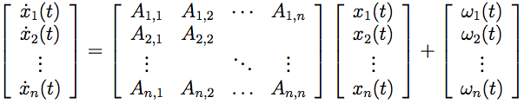
setup
Stable A
State
(random process)
Network
Noise
(random process)
State fluctuation ⬅ Noise
Notes:
We start with a simple set up
We consider a network of n nodes, and denote
We denote the state of a node k by small x_k, and putting the state of all nodes in a vector x(t)
Then we study the first order linear dynamics of the state variables, here, the state evolution of node k is affected by his noise input w_k(t), which is a random process, as well as affected through his interation with other nodes, which interaction is described by the matrix A
And the volatility we are interested in is the amplifcation from the noise random process input to the state fluctuation
We acknowledge the limitations of the first order linear model,
Sheds light on analysis
Also, even for complicated non-linear network system, it is meaningful to analyze the deviation of its state trajectory under some small perturbations, and approximate the dynamics under small perturbation by the first order linear time invariant system.
Contrast, say we are not considering the cascading dynamics (transient ) we are stationary

Slide 10

setup
Stable A
Measure volatility using H2 norm
Variance amplification
Threshold
Notes:
In particular, we measure this amplification using system H2 norm.
The H2 norm has 2 interpretations, and we will explain how each of them is related to the notion of “amplification”.
First, when the input noise w is a white stationary random process, x state will also be a random process, and H2 norm equals the ratio between the output state variance and the variance of the white input noise
So in this way, H2 norm captures the variance amplification in the average sense
Secondly, when the input noise is any signal that has finite L2 norm, in other words, finite energy
H2 norm equals the maximum amplitude of the state fluctuation, that is the L infinity norm of the output sequence
In this way, H2 norm can also capture the the worst case amplitude amplification.

Slide 11
setup
Stable A
How to compute H2 norm
State
covariance matrix
Noise
covariance matrix
Notes:
So how do we compute the H2 norm?
We can compute it using the first

Slide 12
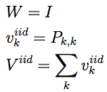
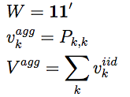
setup
Stable A
How to compute H2 norm
I.I.D noise:
Aggregate noise:
Notes:
In particular, we shall look at two cases
Come from the same source and are perfectly correlated

Slide 13
setup
Stable A
How to compute H2 norm
State
covariance matrix
Noise
covariance matrix
I.I.D noise:
Aggregate noise:
Notes:
We make use of the first interpretation to compute

Slide 14
setup
Stable A
How to compute H2 norm
State
covariance matrix
Noise
covariance matrix
I.I.D noise:
Nodal Volatility
Network Volatility
Aggregate noise:
Nodal Volatility
Network Volatility
Notes:
Where to add the definition of H2 norm
From dyn sys
Very naturally, we have the volatility definition based on H2 norm

Slide 15





How to measure volatility?
New volatility measures
A new measure for link criticality
Notes:
Talk about the variance intuition here
V iid : how much the i.i.d. local shocks get amplified into state fluctuation of all the nodes in the network
v iid _k: how the i.i.d affect a particular node in the network
also, it (happen) equals to the contribution to the global volatility of that particular node.
Also explain,
What we want to capture with the measure of link criticality, most effective volatility reduction
network
Input: white noise can be uncorrelated / correlated across different nodes.
Output: state fluctuation at each node, also random processes
Want to measure: the network amplification from noise to state fluctuation, how it depends on network connection, and position of nodes in the network.

Slide 16

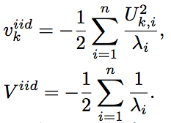
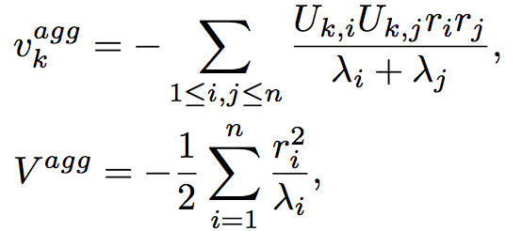

Spectral properties
Stable, symmetric A
I.I.D noise
Nodal
volatility
Network
volatility
Aggregate noise
Notes:
Highlight on the intuition
Eigenvalues Lambda smaller, the less stable the system, the higher the volatility
Connection with lambda 2, consensus dynamics, graph partition
Compared to I.I.D shock, aggregate shock how different eigenvalues and their eigenvectors are aligned
Edges that connecting two nodes which have high absolute weight on the less stable eigenvalues
We can construct two networks that have different
Two interpretations for i.i.d shock, all others receive iid shock, my state fluctuation
And only I have a local shock, the network volatility induced

Slide 17

Spectral properties
Stable, symmetric A
I.I.D noise
Nodal
volatility
Network
volatility
Aggregate noise
Link criticality
of
Notes:
Highlight on the intuition
Eigenvalues Lambda smaller, the less stable the system, the higher the volatility
Compared to I.I.D shock, aggregate shock how different eigenvalues and their eigenvectors are aligned
Edges that connecting two nodes which have high absolute weight on the less stable eigenvalues
We can construct two networks that have different
Two interpretations for i.i.d shock, all others receive iid shock, my state fluctuation
And only I have a local shock, the network volatility induced
Mention that for non-symmetric A, we have lower and upper bounds of similar forms

Slide 18
Graph-based properties I
If the linear dynamics is first-order noisy consensus
Network
Linear Dynamics
Graph
Laplacian Matrix
2
6
3
1
7
4
8
5
Notes:
Why do we need to care about how the volatility measures depend on A
It guides the network design problem.
With this mapping between the linear dynamics of the network system, and the graph Laplacian, we are able to study the relationship between the graph degree based properties and our volatility measures.
Natural interpretation of A by algebraic graph properties, edges have positive weight, and connected gives that lambda_2 >0, lambda_1 = 0, we project onto the orthogonal subspace, but omit the technical details
Interprete the approximation results, impliacations on the graph
Mension laplacian based consensus can capture the system dynamics in our motivational examples
Viid
Connectivity (\lambda_2)
Modularity
Degree distribution
Mean degree
Edge criticality
The nodes they are connecting
Edge betweenness

Slide 19
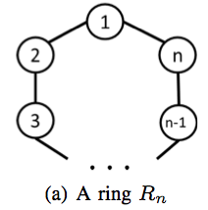
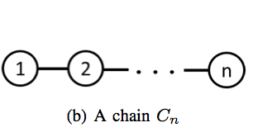
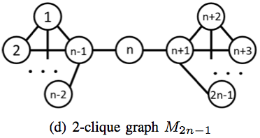
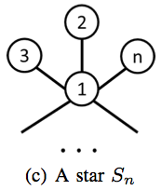
Fundamental graphs
Notes:
Connectivity-- For ring and chain, average per node vol, blows up to infinity, while for star and 2-clique, converges to 1 and ½
Non-monotonic to degree of the node –
Critical edge: intuitively increases the “graph connectivity” the most
Comment that there is no conflict with the approximation result, we have that it is not monotonic

Slide 20




Fundamental graphs
Notes:
Connectivity-- For ring and chain, average per node vol, blows up to infinity, while for star and 2-clique, converges to 1 and ½
Non-monotonic to degree of the node –
Critical edge: intuitively increases the “graph connectivity” the most
Comment that there is no conflict with the approximation result, we have that it is not monotonic

Slide 21
Fundamental graphs
Critical links
Notes:
Connectivity-- For ring and chain, average per node vol, blows up to infinity, while for star and 2-clique, converges to 1 and ½
Non-monotonic to degree of the node –
Critical edge: intuitively increases the “graph connectivity” the most
Comment that there is no conflict with the approximation result, we have that it is not monotonic
One comment is that, the per-node volatility will increase to infinity, because they are too loosely connected
The other comment is that,

Slide 22


For network system with first order linear dynamics
A has small stability margin
≠ degree, criticality
≠ betweenness
Which types of networks are more volatile?
Which nodes are more robust?
Which links are critical?
Notes:
Talk about the variance intuition here
V iid : how much the i.i.d. local shocks get amplified into state fluctuation of all the nodes in the network
v iid _k: how the i.i.d affect a particular node in the network
also, it (happen) equals to the contribution to the global volatility of that particular node.
We still wanna see, how it depends on the graph properties, at least for certain classes
Also explain,
What we want to capture with the measure of link criticality, most effective volatility reduction
network
Input: white noise can be uncorrelated / correlated across different nodes.
Output: state fluctuation at each node, also random processes
Want to measure: the network amplification from noise to state fluctuation, how it depends on network connection, and position of nodes in the network.

Slide 23



Graph-based properties II
If the linear dynamics is first-order consensus
Degree based approximations of volatility measures
Network
Linear Dynamics
Graph
Laplacian Matrix
Notes:
Why do we need to care about how the volatility measures depend on A
It guides the network design problem.
Need to comment on why we focus on consensus dynamics
Interprete the approximation results, impliacations on the graph
Mension laplacian based consensus can capture the system dynamics in our motivational examples

Slide 24
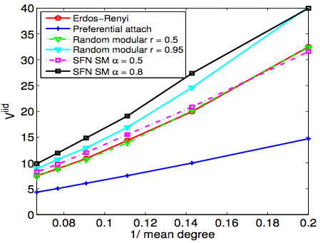
Random networks
VS 1/ (mean degree)
VS
Mean degree
Graph modularity
Degree distribution
(power law)

Slide 25


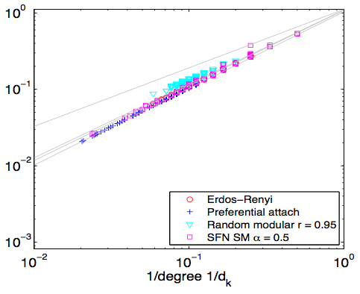
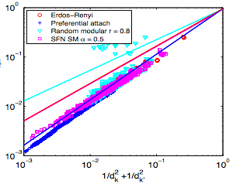
Random networks
VS
VS
Notes:
Provide reasonably accurate approximations, but we also notice that it’s not monotonic relationship,
and the vertical spread highly depends on the type of random network

Slide 26
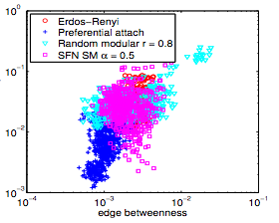
Random networks
VS betweenness
Notes:
Edge criticality and edge betweeness, defined using shortest path.
In log scale

Slide 27
For first order consensus dynamics
≈ Heterogeneous degree distribution,
≈ high modularity,
≈ loosely connected
≈ Hubs
≈ Information centrality,
≈ betweenness
Which types of networks are more volatile?
Which nodes are more robust?
Which links are critical?
Notes:
Talk about the variance intuition here
V iid : how much the i.i.d. local shocks get amplified into state fluctuation of all the nodes in the network
v iid _k: how the i.i.d affect a particular node in the network
also, it (happen) equals to the contribution to the global volatility of that particular node.
Also explain,
What we want to capture with the measure of link criticality, most effective volatility reduction
network
Input: white noise can be uncorrelated / correlated across different nodes.
Output: state fluctuation at each node, also random processes
Want to measure: the network amplification from noise to state fluctuation, how it depends on network connection, and position of nodes in the network.

Slide 28
conclusion
Graph based “centrality measures” do not lead to meaningful implications for real dynamics over networks.
One should examine the real dynamics to measure network robustness / volatility, link criticality.
For linear dynamics over networks, we propose volatility measures which can offer guidance to network design.
For consensus dynamics, we establish the relations between the proposed measures and other graph based properties.
Notes:
Centrality measures

Slide 29

Thank you

