Slide 1
Nonnegative matrix/tensor decomposition
Greedy algorithm for large scale
LIDS student conference 2015
Qingqing Huang
Joint work with Tong Zhang at Baidu

Slide 2
Nonnegative matrix factorization
Problem
Non-convex, NP-hard

Slide 3
Nonnegative matrix factorization
Problem
Non-convex, NP-hard
Regularization for sparsity…

Slide 4
Nonnegative matrix factorization
Problem
Applications (why not PCA, Eckart-Young)
Image compression
Sound source separation
Spectral clustering
Topic model learning
Hidden markov model learning
Non-convex, NP-hard
Regularization for sparsity…
Nonnegative signals, probabilities, network

Slide 5
Nonnegative matrix factorization
Problem
Applications (why not PCA, Eckart-Young)
Image compression
Sound source separation
Spectral clustering
Topic model learning
Hidden markov model learning
Non-convex, NP-hard
Regularization for sparsity…
Nonnegative signals, probabilities, network

Slide 6
Nonnegative tensor factorization
Problem
Tensor product: multi-linear, homogeneous

Slide 7
Nonnegative tensor factorization
Problem
Tensor product: multi-linear, homogeneous
A hard problem even without the positive constraint
Applications (natural multi-dimensional data, image, video, moments)

Slide 8
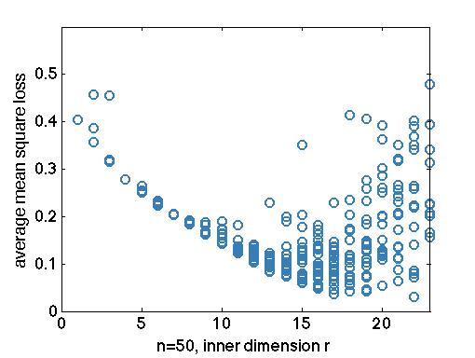
Literature
Alternating optimization method high variance especially for large scale problem can we solve it in a more controlled way?

Slide 9
Literature
Alternating optimization method high variance especially for large scale problem can we solve it in a more controlled way?
Recent theoretical work on exact recovery under assumptions can we still solve it in a agnostic way?

Slide 10
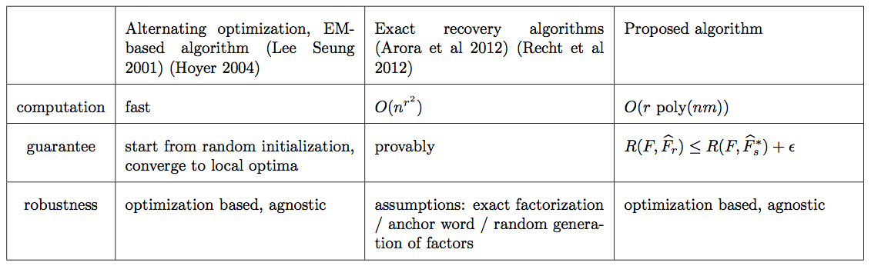
Literature
…..

Slide 11
Literature
…..

Slide 12
Literature
…..

Slide 13
Literature
…..

Slide 14
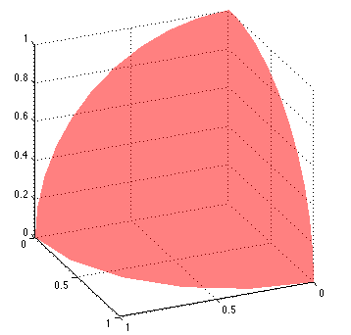
Algorithm
Observation: positive weighted sum of rank-one matrices/tensors supported over the sphere in the positive orthant

Slide 15
Algorithm
Observation: positive weighted sum of rank-one matrices/tensors supported over the sphere in the positive orthant
Eckart-Young fails… but can we still find one at a time?
Greedy feature selection (Frank-Wolfe) incremental, greedy, first order method

Slide 16
Incremental algorithm
At t-th round: start from a rank (t-1) find a rank t NMF

Slide 17
Incremental algorithm
At t-th round: start from a rank (t-1) find a rank t NMF
Step 1. Greedy feature selection
Maximizing the decreasing rate of loss function at

Slide 18
Incremental algorithm
At t-th round: start from a rank (t-1) find a rank t NMF
Step 1. Greedy feature selection
Maximizing the decreasing rate of loss function at
Step 2. Weight update (not on )

Slide 19
Incremental algorithm
At t-th round: start from a rank (t-1) find a rank t NMF
Step 1. Greedy feature selection
Maximizing the decreasing rate of loss function at
Step 2. Weight update (not on )

Slide 20
Guarantee
Notes:
Assumption on loss function, smoothness

Slide 21
Guarantee
One round improvement
Notes:
Assumption on loss function, smoothness

Slide 22
Guarantee
One round improvement
After t rounds
Notes:
Assumption on loss function, smoothness

Slide 23
Guarantee
One round improvement
After t rounds
So far, break the original problem into a sequence of “simpler” problems:
Can we solve the “simpler” problems efficiently?
Notes:
Assumption on loss function, smoothness

Slide 24
Rank one problem (matrix)
Greedy feature selection step
Asymmetric case can be reduced to symmetric case

Slide 25
Rank one problem (matrix)
Greedy feature selection step
SDP relaxation for quadratic program
Asymmetric case can be reduced to symmetric case

Slide 26
Rank one problem (matrix)
Greedy feature selection step
SDP relaxation for quadratic program
Asymmetric case can be reduced to symmetric case

Slide 27
Rank one problem (matrix)
Greedy feature selection step
SDP relaxation for quadratic program
What if SDP solution is not rank one?
Rank reduction, other relaxation form to enforce rank constraint
Asymmetric case can be reduced to symmetric case

Slide 28
Rank one problem (tensor)
Greedy feature selection step
General polynomial optimization over (multi) positive spheres
Asymmetric case can be reduced to symmetric case

Slide 29
Rank one problem (tensor)
Greedy feature selection step
General polynomial optimization over (multi) positive spheres
Reduce to a QP (auxiliary variables of monomials)
Asymmetric case can be reduced to symmetric case

Slide 30
Rank one problem (tensor)
Greedy feature selection step
General polynomial optimization over (multi) positive spheres
Reduce to a QP (auxiliary variables of monomials)
Adopt SDP relaxation monomials of degree d
Asymmetric case can be reduced to symmetric case

Slide 31
Summary before numerical examples
Two step sequential algorithm
Heuristic post processing: prune least important features
Use it in complementary to alternating optimization methods

Slide 32
Summary before numerical examples
Two step sequential algorithm
Heuristic post processing: prune least important features
Use it in complementary to alternating optimization methods
Message
Tradeoff computation with guaranteed accuracy
A class of “Hard” ML problems, non-convex due to latent structure look for efficient algorithm -- more assumptions, or approximate solution
Open problems
Understand SDP relaxation, variations of relaxation to enforce rank constraint
Large scale SDP numerical
Proof for guarantee on Greedy + ALS

Slide 33
Summary before numerical examples
Two step sequential algorithm
Heuristic post processing: prune least important features
Use it in complementary to alternating optimization methods
Message
Tradeoff computation with guaranteed accuracy
A class of “Hard” ML problems, non-convex due to latent structure look for efficient algorithm -- more assumptions, or approximate solution
Open problems
Understand SDP relaxation, variations of relaxation to enforce rank constraint
Large scale SDP numerical
Proof for guarantee on Greedy + ALS

Slide 34
Numerical example
Symmetric matrix, n = 60

Slide 35
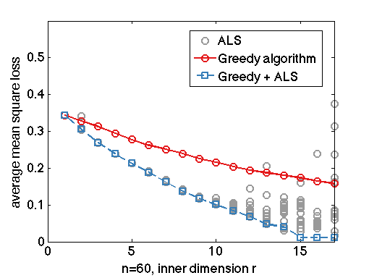
Numerical example
Symmetric matrix, n = 60
Use sequential algorithm for initial point of alternating improvement
Greedy selection + weight update
One time ALS improvement

Slide 36
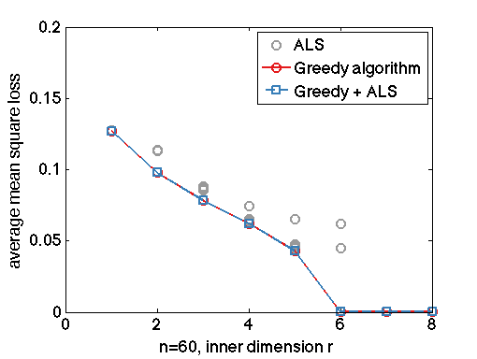
Numerical example
Symmetric matrix, n = 60
Use sequential algorithm for initial point of alternating improvement
Sequential algorithm is exact if the matrix is orthogonally decomposable
Greedy selection + weight update
One time ALS improvement

Slide 37
Numerical example
Asymmetric matrix, n = m = 30

Slide 38
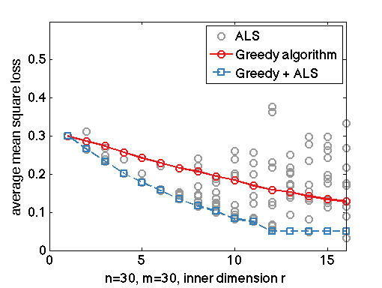
Numerical example
Asymmetric matrix, n = m = 30
Greedy selection + weight update
One ALS improvement

Slide 39
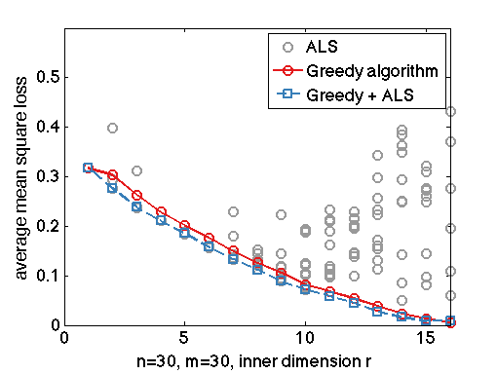
Numerical example
Asymmetric matrix, n = m = 30
Greedy selection + weight update
One ALS improvement
Greedy selection + weight update + ALS
One ALS improvement

Slide 40
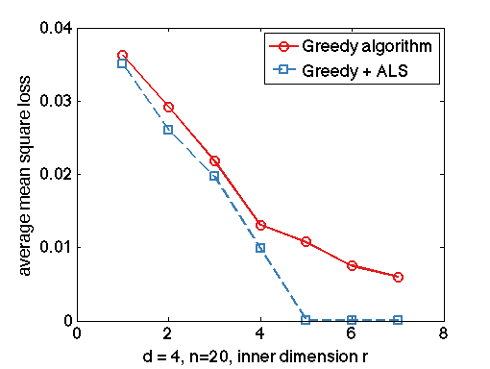
Numerical example
4-th order symmetric tensor n = 20, true rank r* = 5

Slide 41
Thank you
LIDS student conference 2015

