Slide 1
Linux programming environment -- tools
Ivan Chen
Engineer
2012-11-07

Slide 2
Agenda
Demo
Editor : vi + ctags
Build : make
Debugger : gdb
Version control : git

Slide 3
Demo
Say hello to Linux programming environment.
Notes:
CISCO AXP

Slide 4

Terminal – set up
~/.profile
Notes:
In OSGi module compose of one or more bundles;
Bundle is a normal jar file,the difference is its Manifest.mf file,OSGi add some specical header info property to declarative bundle,such as:
bundle-version,export-package,import-package

Slide 5
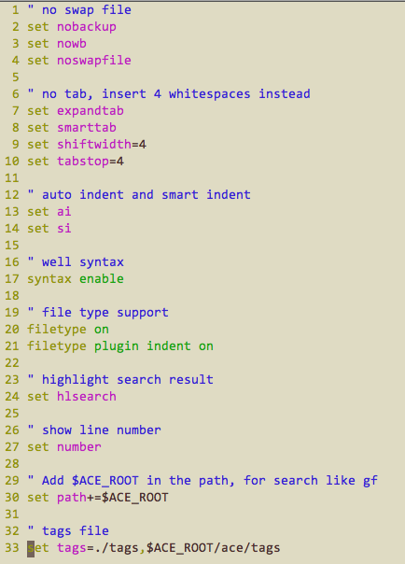
Vi – set up
~/.vimrc
Notes:
In OSGi module compose of one or more bundles;
Bundle is a normal jar file,the difference is its Manifest.mf file,OSGi add some specical header info property to declarative bundle,such as:
bundle-version,export-package,import-package

Slide 6
Editor
Vi -- the editor
Ctags -- support for symbol search like go to definition

Slide 7
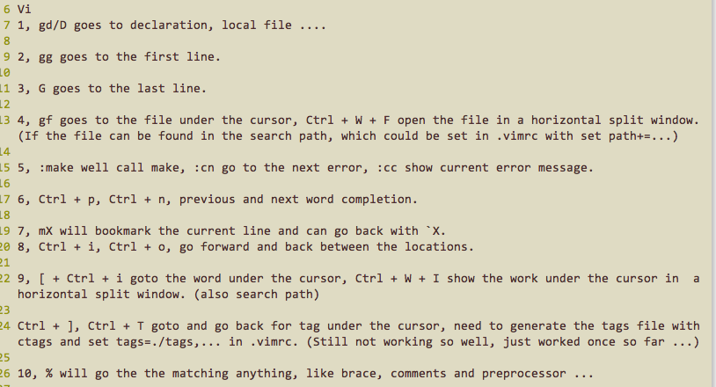
Vi + Ctags usages

Slide 8
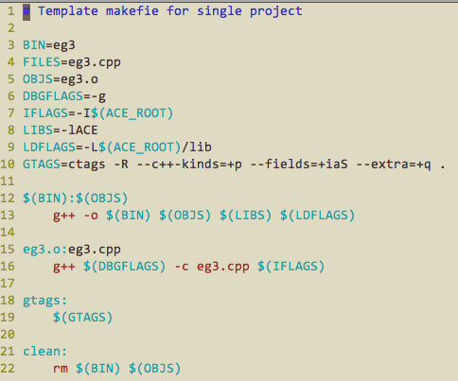
Make
Notes:
Component that provide no service;
when all need OSGi services(exclued optional service) are usable,the component will be actived;
Component that provide services;
when all need OSGi services(exclued optional service) are usable;
other component call this OSGi service implemention.

Slide 9
gdb
Demo – say hello to gdb.

Slide 10
git
Demo -- say hello to git.
Free git server, github.com.
My git : https://github.com/ivanchenhz/IvanChenGit.git

