Slide 1
Pivot Desk
MBA recruiting with evidence.
Application preparation with a final human say.
Qingyuan Zhang
AI Foundations for Managers · October 25, 2026
Working local prototype · Publication and a timed real-user trial remain pending
Notes:
Local companion to the required nine-slide reveal.js deck. Prepared October 25, 2026. Source: report.html and output/harness.md. No personal resume contents in this deck. Publication remains on hold.

Slide 2
A career pivot creates repeated work
Choose the right roles
Prepare the same facts
West Coast healthcare and technology.
Exclude investment-banking roles.
Check degree timing and real experience.
Work history, education and languages.
Review once and reuse.
Keep legal acceptance and submission manual.
The applicant described this problem directly; the project does not invent hours saved.
Notes:
Source: the project owner’s recorded request in AI_prompts.md. No quantified human time saving has been measured.

Slide 3
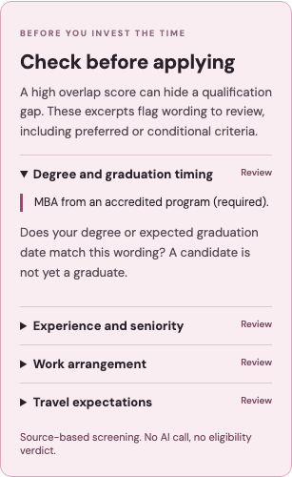
The proposed contribution
Trace the decision
Reviewed resume facts
Exact employer quotations
Explicit gaps beside the overlap score
A controlled review-before-fill step
Simplify already offers autofill; Teal already offers tracking. Superiority has not been proven.
Notes:
Comparison sources: https://help.simplify.jobs/en/help/articles/1749022-install-and-set-up-copilot and https://www.tealhq.com/tools/job-tracker . Reviewed October 25, 2026. Source checks: output/evidence/readiness_benchmark.json. Screenshot: output/screenshots/application-checks.png.

Slide 4
Two bounded specialists
Resume reader
Human review
Evidence analyst
Text → typed facts
Exact source excerpts
No action tools
→
Correct facts
Confirm the profile
Choose a role
→
Two read-only tools
Fact-to-source links
Gaps and questions
Search, scoring, saving and form filling use ordinary code. No autonomous submission or email.
Notes:
Source: backend/agent.py, backend/models.py and both backend/prompts/*.md files. Reader output is a draft; human confirmation occurs before the selected-role analyst. The analyst must call get_candidate_evidence and get_job_evidence. Model gpt-6-astra. The course-key restriction is disclosed on slide 9.

Slide 5
A real role, an honest gap
Actual assessment, excerpt
93 / 100 overlap
“Year-only employment dates suggest roughly five years of analytical experience; exact qualifying tenure remains uncertain.”
Research and financial modeling support the pivot.
Still check:
MBA completion
Exact experience months
On-site work and travel
The complete response is in the report.
Fictional applicant, real posting and real AI run. The assessment challenged the score.
Notes:
Source: output/evidence/live_runs.json. Fictional Avery Morgan profile and real Heartflow Manager, Corporate Strategy — MBA Grad, Summer 2027 posting, https://job-boards.greenhouse.io/heartflowinc/jobs/6218422004 . Source snapshot checked October 25, 2026; availability may change. Score is overlap, not probability.

Slide 6
Costs and a rejected shortcut
Mode | Input / output tokens | Est. USD
Full source | 3,225 / 892 | $0.07685
Truncated source | 2,774 / 904 | $0.07294
Identical-result cache | 0 / 0 | $0
5.09% cheaper lost a later requirement.
Full text stays the default.
Assumed monthly model cost: $1.30/user; $130 at 100 users; $13,010 at 10,000. Hosting excluded.
Notes:
Source: output/evidence/live_runs.json and cost_comparison.json. One controlled comparison. Public standard Astra rates: $10/M input, $1/M cached input, $50/M output, checked October 25, 2026, https://developers.openai.com/api/docs/models/gpt-6-astra . Not the provider invoice. Monthly assumption: two resume extractions plus sixteen paid reviews, 20% repeated-result cache hits among twenty requested reviews.

Slide 7
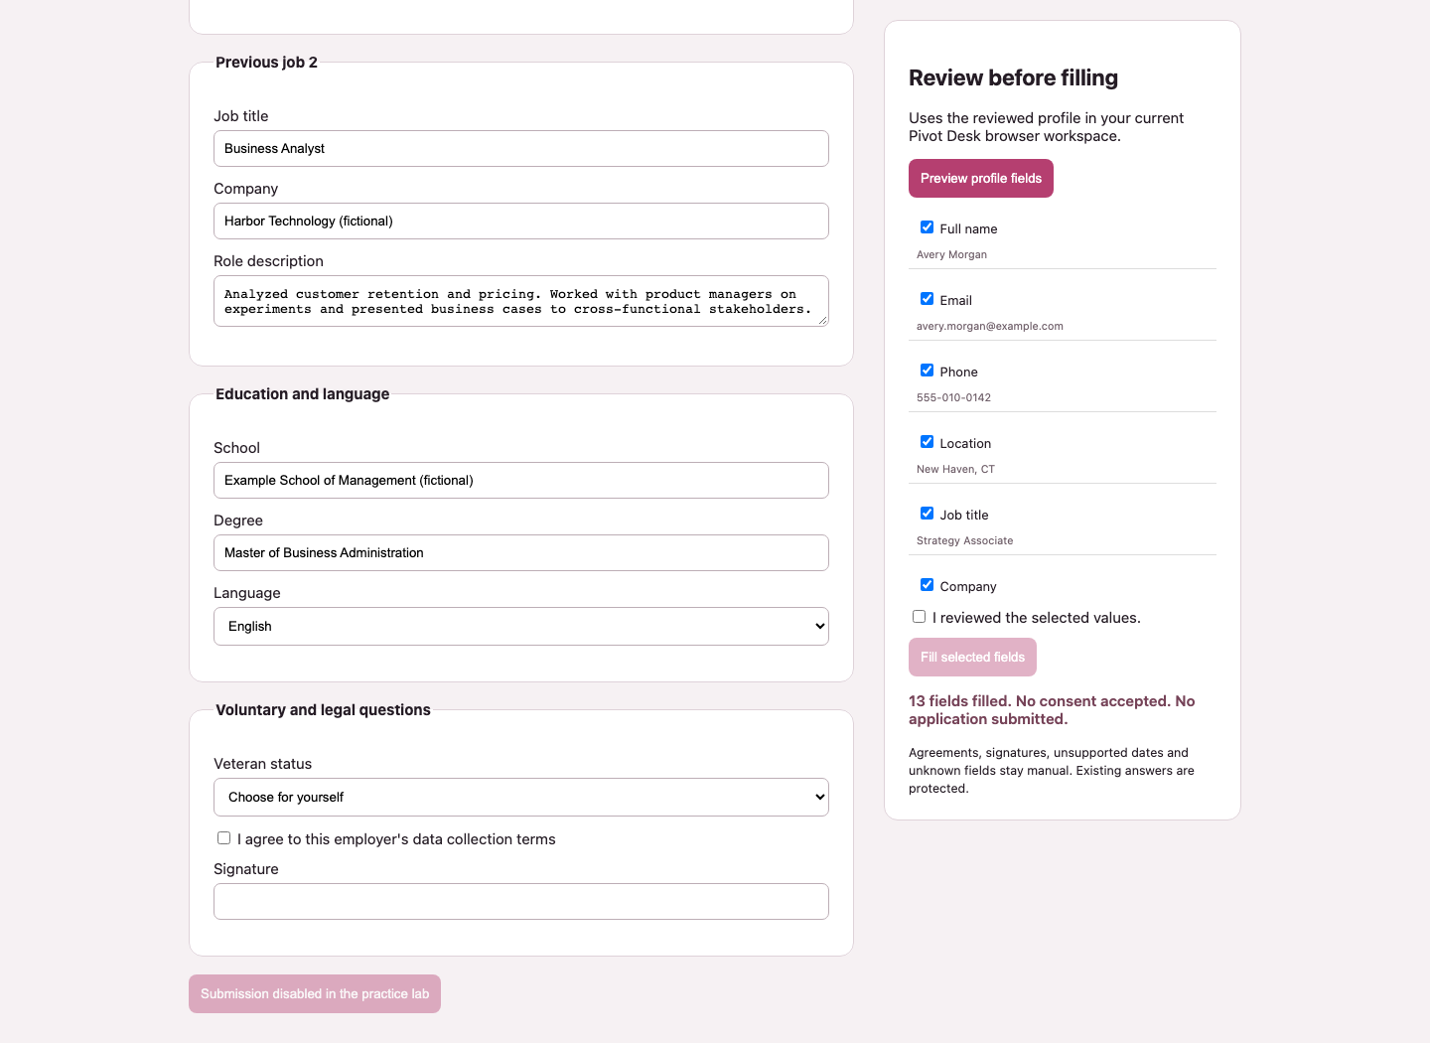
Review is a real boundary
13 fields filled
Fictional demo: contact, work history, education and language.
0 agreements accepted
No signature.
No application submitted.
Unknown dates, legal-name questions, sensitive answers and unsupported controls stay manual.
Notes:
Sources: output/evidence/browser_checks.json, form_regression.json, injection_attempt_1.json and injection_test.json. The image shows the fictional demo, not the owner’s resume. One completed injection case passed; the first provider failure remains inconclusive.

Slide 8
A real resume exposed a defect
Fictional regression | Before | After
Correct language entries | 1 of 3 | 3 of 3
Legal-name question | Display name filled | Left manual
12 supported fields filled in the private local practice test.
No resume text sent to a model or employer.
No claim of a human time saving or live Workday completion.
The repeated-entry fixture preserved 17 fields; the raw resume and personal screenshots stay private.
Notes:
Sources: output/evidence/private_resume_local_check.json and form_multilingual_comparison.json. Assistant-operated local PDF parsing, manual transcription and checking of 12 facts; no AI extraction call on this document. Four same-employer positions, three schools and three languages were tested in private. Public evidence is aggregate, and the before/after fixture is fictional. Baseline 29acc13.

Slide 9
The next evidence to earn
01 Observe a real applicant and measure the task.
02 Verify one permitted employer form before submission.
03 Improve matching with labeled near-miss roles.
04 Confirm the allowed account; publish reviewed source.
Local materials are prepared. Nothing is published.
Astra is user-selected; the brief permits only Luna on the course key. Account permission remains open.
Notes:
Sources: docs/user_trial.md, output/submission_checklist.md, README.md and the supplied course brief. A timed human trial, authenticated Workday form validation and publication remain uncompleted. The user requested Astra with Portkey; the course brief allows only Luna on its course key, or another model on a personal paid account. Do not imply that disclosure alone makes the configuration compliant.

